Slide 1
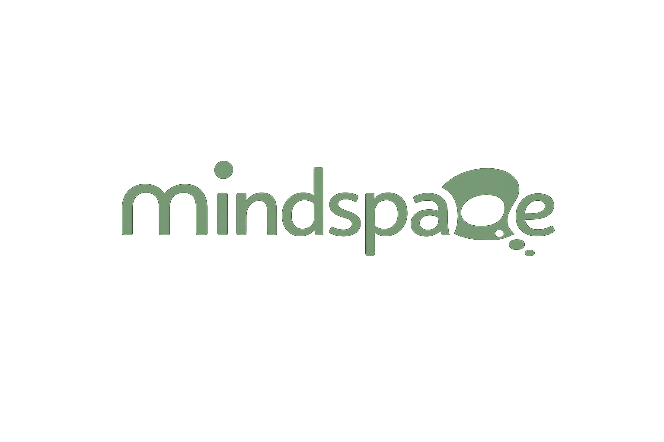

🤖
My Voice
Summer Camp 2026
AI Explorers Academy
Discovering Artificial Intelligence
🌟 No Coding Required • Just Explore & Have Fun! 🌟
1
2
3
4
5
6
Intro
to AI
How AI
Learns
AI Finds
Patterns
AI Makes
Pred.
AI in
Daily Life
Fun
Project! 🎮

Slide 2

🗺️ Your AI Journey
6 exciting stops along the way!
🤔
📚
🔍
🔮
📱
🎮
Intro to AI
How AI Learns
AI Finds Patterns
AI Makes Predictions
AI in Daily Life
Fun Project
What is AI?
Training & examples
Spotting the repeat
Smart guesses!
AI is everywhere!
Play & celebrate!
1
2
3
4
5
6
🚀 Ready? Let's explore AI together!

Slide 3
2
📚
Phase 2
How AI Learns
Training, examples, and practice!

Slide 4
📚 How Does AI Learn?
AI learns by seeing LOTS and LOTS of examples!
The more examples it sees, the smarter it gets 🧠
👀
AI learns by seeing LOTS of examples
📈
More examples = Smarter AI!
🏋️
This process is called 'Training'
🔄
It practices over and over — millions of times!
🔗 Video Link: https://youtu.be/zXxuxJvRddU?si=MRuhE4kXOtpoV6A4

Slide 5
❓ Quick Question!
What is the process of teaching AI called?
Sleeping 💤
A
Training 🏋️
B
✅
Cooking 🍳
C

Slide 6
🌍 AI Learning in Real Life
🎵
🚗
🦜
Spotify
Self-Driving Cars
Duolingo
Learned from billions of songs to find music YOU love!
Trained on millions of road pictures to drive safely!
Learns how students make mistakes to teach better!

Slide 7
🎯 Activity: Teach the Teacher!
You are the AI! 🤖
1️⃣ Your teacher shows you a card (animal, shape, or fruit)
2️⃣ Guess what it is — like an AI guessing!
3️⃣ Each round you see MORE examples and get smarter
4️⃣ Watch how your guesses improve with more examples! 🏆
🔗 Activity Link: abdelrahmansaeed28.wixstudio.com/phase2-activity

Slide 8
⭐ Phase 2 Recap
📚 AI learns by seeing lots and lots of examples!
📈 More examples = A smarter AI!
🏋️ The process is called TRAINING — like working out!
👀 Next up: AI's secret superpower — Finding Patterns! 🔍

