Slide 1
Graduation Project Defense
01 / 20
Insect Pest Classification Using Deep Learning
1
Input image
Paper reproduction, model comparison, and Streamlit deployment
2
CNN models
3
Comparison
4
Deployment
to7a
tareq
joo
saeed
hoss
zoz
Notes:
Start with the project goal: classify insect pest images using deep learning models inspired by the paper, compare our experiments with the paper, and show the deployed app.

Slide 2
Project Intro
02 / 20
What problem are we solving?
1
Crop loss
2
Visual similarity
Pests damage crops and reduce yield.
Manual pest identification is slow and needs expertise.
3
Slow manual ID
Many insect classes look very similar.
Our goal is a practical image-based classifier.
4
AI classifier
Notes:
Keep the intro short. Explain that the project connects agriculture, computer vision, and a simple user application.

Slide 3
Project Intro
03 / 20
Project pipeline
Upload pest image.
Resize and normalize the image.
Image
Preprocess
Model
Prediction
App
Run deep learning model.
Return predicted class and confidence.
Use deployment for real user testing.
Notes:
This is the story map for the defense. Later slides explain the models inside the model block.

Slide 4
Paper Contribution
04 / 20
What the paper contributed
1
Attention
2
FPN
Compared several CNN-based models for insect recognition.
Used attention, feature pyramids, and fine-grained learning.
3
MMAL-Net
Combined model outputs using soft voting ensemble.
Evaluated on IP102 and D0 datasets.
4
Soft voting
Paper best accuracy: 74.13% on IP102 and 99.78% on D0.
Notes:
The paper's main idea is not one model only. It uses complementary models and combines them with ensemble learning.

Slide 5
Paper Contribution
05 / 20
Models used in the paper
1
ResNet50
2
RAN
ResNet50: strong CNN baseline.
RAN: attention model for important regions.
3
FPN
FPN: multi-scale feature extraction.
MMAL-Net: fine-grained object and part learning.
4
MMAL-Net
Ensemble: soft voting across model predictions.
5
Ensemble
Notes:
Use simple words: ResNet learns strong features, RAN focuses attention, FPN handles scale, MMAL finds object parts, ensemble combines strengths.

Slide 6
Our Work
06 / 20
What we used in our project
1
Colab
2
Kaggle
Dataset experiments on IP102 and D0.
Baseline models: AlexNet and ResNet50.
3
PyTorch
Improved model: ResNet50 + FPN.
Advanced notebooks: RAN and MMAL-Net.
4
Streamlit
Streamlit app for image upload and prediction.
Notes:
Explain that the team implemented a practical subset of the paper and organized experiments in Colab/Kaggle notebooks.

Slide 7
Experiment Setup
07 / 20
Dataset and training setup
1
IP102
2
D0
IP102: 102 pest classes and more than 75k images.
D0: smaller 40-class insect pest dataset.
3
10 epochs
Training used 10 epochs in our reported runs.
Best validation accuracy was saved as the main result.
4
Best checkpoint
Metrics focus on validation accuracy for our comparison.
Notes:
Mention that the paper trained longer, while our provided logs are 10-epoch runs. This matters when comparing results.

Slide 8
Model Step 1
08 / 20
AlexNet baseline on IP102
Epoch 1
43.43%
Epoch 5
56.78%
Epoch 10
60.28%
First baseline experiment.
Shows the difficulty of IP102.
Validation accuracy improved every epoch.
Best validation accuracy: 60.28%.
60.28%
Source link
https://colab.research.google.com/drive/1ktw3-JJAc-8LyvjQzVyRX9gV2bW9bIWP
Notes:
AlexNet is a simpler baseline. It gives a starting point before moving to deeper residual models.

Slide 9
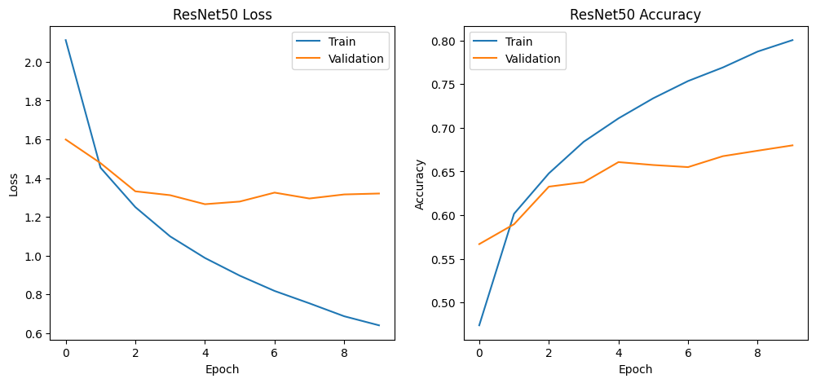
Model Step 2
09 / 20
ResNet50 baseline on IP102
Deeper residual model.
Uses skip connections to train strong features.
Outperformed AlexNet by 7.71 percentage points.
Best validation accuracy: 67.99%.
67.99%
Source link
https://colab.research.google.com/drive/1DKKesScd1g5nzw02esenjG8f6bETFJkK?authuser=1
Notes:
ResNet50 is our strongest completed IP102 result from the supplied logs.

Slide 10
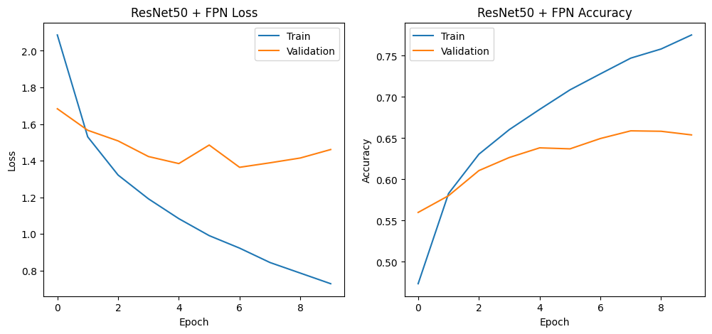
Model Step 3
10 / 20
ResNet50 + FPN on IP102
Adds multi-scale feature maps.
Designed to help with small insect regions.
Validation peaked at epoch 8.
Best validation accuracy: 65.89%.
65.89%
Source link
https://colab.research.google.com/drive/1qZPNGzH862IGcN7bnlFPAo1BNa6YGP5C?usp=sharing
Notes:
FPN did not beat our ResNet50 baseline on IP102 in the provided run, but it still learned steadily.

Slide 11
Model Step 3
11 / 20
ResNet50 + FPN on D0
Epoch 1
94.81%
Epoch 4
98.37%
Epoch 6
99.11%
Same model tested on smaller D0 dataset.
Epoch 10
97.77%
D0 is easier than IP102 in this run.
Reached very high validation accuracy.
Best validation accuracy: 99.11%.
99.11%
Notes:
The D0 result is very close to the paper's FPN result on D0.

Slide 12
Model Step 4
12 / 20
RAN model notebook
1
Input
2
Trunk branch
Residual Attention Network.
Uses trunk branch and mask branch.
3
Mask branch
Learns where the model should focus.
Notebook source is included for defense review.
4
Attention output
Final RAN metric was not included in the pasted results.
Source link
https://www.kaggle.com/code/mohamedtareqfarouq/resnet-pcsa-mask-advran
Notes:
Do not claim an accuracy if it is not final. Explain the architecture and show that the notebook exists.

Slide 13
Model Step 5
13 / 20
MMAL-Net notebook
1
Raw image
2
AOLM
Fine-grained classification model.
Uses raw, object, and part branches.
3
APPM
AOLM localizes object region.
APPM proposes discriminative parts.
4
Parts
Final MMAL metric was not included in the pasted results.
Source link
https://www.kaggle.com/code/to7a12/notebookc8f9f91bf6
Notes:
MMAL-Net is important because insects can be visually similar. It focuses on object regions and small parts.

Slide 14
Our Results
14 / 20
Our completed results
AlexNet baseline
60.28%
ResNet50 baseline
67.99%
ResNet50 + FPN
65.89%
Best IP102 result: ResNet50 baseline at 67.99%.
ResNet50 + FPN
99.11%
FPN on D0 reached 99.11%.
AlexNet confirms that deeper models are needed.
RAN and MMAL notebooks are linked for model continuation.
Notes:
Summarize the completed numeric results and be transparent about models that still need final metrics.

Slide 15
Paper Comparison
15 / 20
Comparison with paper on IP102
Paper Ensemble
74.13%
Paper ResNet50
70.79%
Our ResNet50
67.99%
Paper ensemble achieved 74.13%.
Our FPN
65.89%
Paper ResNet50 achieved 70.79%.
Our best IP102 result is 67.99%.
Our AlexNet
60.28%
Gap is expected because our runs used only 10 epochs.
Notes:
Make the comparison fair: paper uses full experiment settings and ensemble, while our completed logs are shorter runs.

Slide 16
Paper Comparison
16 / 20
Comparison with paper on D0
Paper Ensemble
99.78%
Paper FPN
99.23%
Our FPN
99.11%
Paper FPN result: 99.23%.
Our FPN result: 99.11%.
Gap is only 0.12 percentage points.
D0 validates that our FPN implementation is strong.
Notes:
This is the strongest comparison slide: our D0 FPN result is almost equal to the paper's FPN result.

Slide 17
Deployment
17 / 20
Streamlit deployment
1
Upload
2
Predict
Web app link prepared for image upload.
Expected flow: upload image, run model, show prediction.
3
Confidence
GitHub project link is reachable.
Automated Streamlit check redirected to login/auth, so final image upload test should be done in a browser session.
4
Top class
Source link
https://abdelrahmansa04-insect-pest-classification-app-ap6y2v.streamlit.app/
Notes:
Be honest in the defense: the link exists, but automated testing reached Streamlit authentication redirects. Open it live in the browser if access is available.

Slide 18
Defense Notes
18 / 20
What to say in the defense
1
Paper idea
2
Our runs
We studied the paper and reproduced the main model ideas.
Our best IP102 completed result is ResNet50.
3
Comparison
Our D0 FPN result is very close to the paper.
Future work: finish RAN/MMAL metrics and add ensemble voting.
4
Next work
Notes:
This slide helps the group present a confident narrative without overclaiming.

Slide 19
Sources
19 / 20
Project links
Paper GitHub
Our GitHub
Paper repository
Streamlit App
Our GitHub repository
Streamlit deployment
Paper arXiv
Colab and Kaggle notebooks
Notes:
Use this slide as backup if examiners ask where the code and notebooks are.

Slide 20
Questions
20 / 20
Thank You
Questions?
Notes:
Invite questions. Be ready to answer about model choice, result gaps, deployment status, and future ensemble work.

