Slide 1
Graduation Project Defense
01 / 20
Deep Learning-Based Insect Pest Classification
1
Image
2
CNN features
Using ResNet50, FPN, Attention Networks, MMAL-Net, and Ensemble Learning
3
Attention
4
Ensemble
Student: [Student Name]
Supervisor: [Supervisor Name]
University: [University Name]
Department: [Department Name]
Deep Learning-Based Insect Pest Classification
Notes:
Open by framing the project as a smart agriculture system that turns an insect image into a reliable class prediction. Mention that the defense will move from problem and data to models, results, deployment, and future work.

Slide 2
01 / Context
02 / 20
Agriculture needs fast, reliable pest recognition
1
Crop health
2
Pest pressure
Pests reduce crop quality and yield
Early identification supports timely treatment
3
Yield risk
Manual inspection is slow and specialist-dependent
Computer vision can scale field diagnosis
4
Smart action
Deep Learning-Based Insect Pest Classification
Notes:
Explain why pest classification matters economically and practically. Keep the point simple: early recognition helps farmers respond before damage spreads.

Slide 3
02 / Problem
03 / 20
Manual insect identification is hard to scale
1
Similarity
2
Variation
Fine-grained visual similarity between species
Large appearance variation across life stages
3
Noise
Lighting, pose, and background noise in images
Need for an automated AI-based solution
4
AI solution
Deep Learning-Based Insect Pest Classification
Notes:
Stress the fine-grained nature of the task: many classes look similar, while one class can look different across angle, maturity stage, and background.

Slide 4
03 / Objectives
04 / 20
Project objectives
1
Build
2
Improve
Build an intelligent insect classification system
Improve recognition accuracy using deep features
3
Compare
Compare ResNet50, FPN, RAN, MMAL-Net, and ensemble learning
Deploy a practical application for image upload and prediction
4
Deploy
Deep Learning-Based Insect Pest Classification
Notes:
Introduce the project goals as measurable deliverables: model comparison, accuracy improvement, and deployment rather than only model training.

Slide 5
04 / Dataset
05 / 20
IP102: large-scale insect pest benchmark
1
102 classes
102
75,222
Classes
Images
2
75,222 images
~19K boxes
Train / Val / Test
Natural long-tailed class distribution
Detection labels
Split
Multiple crop groups and pest categories
3
Long tail
Suitable for fine-grained pest recognition
4
Fine-grained
Deep Learning-Based Insect Pest Classification
Notes:
Describe IP102 as the main dataset. Point out the challenge: many classes, imbalanced data, and subtle visual differences.

Slide 6
05 / Data Pipeline
06 / 20
Preprocessing prepares images for robust training
1
Resize
2
Normalize
Resize images to model input size
Normalize RGB channels
3
Augment
Apply augmentation during training
Use PyTorch transforms for reproducible preprocessing
4
Tensor
Deep Learning-Based Insect Pest Classification
Notes:
Walk through the transformation pipeline. Emphasize that augmentation helps the model generalize to real field images.

Slide 7
06 / System Workflow
07 / 20
End-to-end classification pipeline
01
02
03
04
05
Input Image
Preprocessing
Deep Models
Soft Voting Ensemble
Final Prediction
Deep Learning-Based Insect Pest Classification
Notes:
Use this slide as the map of the whole system. Each later architecture slide explains one model block inside this pipeline.

Slide 8
07 / Model A
08 / 20
ResNet50 learns deeper features with residual connections
1
Input
2
Conv stem
Residual blocks pass information through skip connections
Skip paths reduce vanishing gradient issues
3
Residual blocks
Pretrained ImageNet features improve transfer learning
Strong baseline for image classification
4
Classifier
Deep Learning-Based Insect Pest Classification
Notes:
Explain residual learning in intuitive terms: instead of learning the full mapping, the block learns the residual change and keeps useful information flowing.

Slide 9
08 / Model B
09 / 20
FPN adds multi-scale feature reasoning
1
Backbone
2
Top-down path
Combines high-level semantics with low-level spatial detail
Top-down pathway strengthens smaller object features
3
Lateral links
Lateral connections preserve resolution
Useful when insects occupy small image regions
4
Multi-scale maps
Deep Learning-Based Insect Pest Classification
Notes:
Describe why FPN is useful for pest images: insects can appear small, so multi-scale features can help retain relevant detail.

Slide 10
09 / Attention Model
10 / 20
Residual Attention Network focuses the feature stream
1
Input
2
Trunk F(x)
Trunk branch extracts normal CNN features
Mask branch learns soft attention weights
3
Mask M(x)
Attention highlights informative insect regions
Residual attention keeps original signal available
4
Attention output
H(x) = (1 + M(x)) x F(x)
Deep Learning-Based Insect Pest Classification
Notes:
Explain the equation: F(x) is the trunk feature map and M(x) is an attention mask. Adding 1 means attention enhances features without fully suppressing the original signal.

Slide 11
10 / Fine-Grained Model
11 / 20
MMAL-Net targets fine-grained insect differences
1
Raw branch
2
AOLM
AOLM localizes the attention object region
APPM proposes discriminative insect parts
3
APPM
Raw branch captures global context
Object and part branches refine fine details
4
Parts branch
Deep Learning-Based Insect Pest Classification
Notes:
Position MMAL-Net as the model designed for fine-grained classification, where small parts such as wings, patterns, or body regions may separate classes.

Slide 12
11 / Ensemble
12 / 20
Soft voting combines model confidence
1
ResNet50
2
FPN
Average probability vectors from trained models
Reduces dependence on one architecture
3
RAN
Balances global, multi-scale, and attention features
Improves robustness for ambiguous samples
4
MMAL-Net
P = (P1 + P2 + P3 + P4) / 4
5
Soft vote
Deep Learning-Based Insect Pest Classification
Notes:
Explain that soft voting keeps confidence information, not just final class labels. The final class is selected from the averaged probabilities.

Slide 13
13 / Training Setup
13 / 20
Training environment and hyperparameters
Platform
Google Colab
GPU
NVIDIA T4
Batch size
[Set value]
Learning rate
[Set value]
Optimizer
Adam / SGD
Epochs
10
Loss
Cross-Entropy
1
Google Colab
2
NVIDIA T4
Deep Learning-Based Insect Pest Classification
3
10 epochs
4
Best checkpoint
Notes:
Fill in batch size and learning rate if your notebook used specific values. Mention checkpointing and best validation accuracy selection.

Slide 14
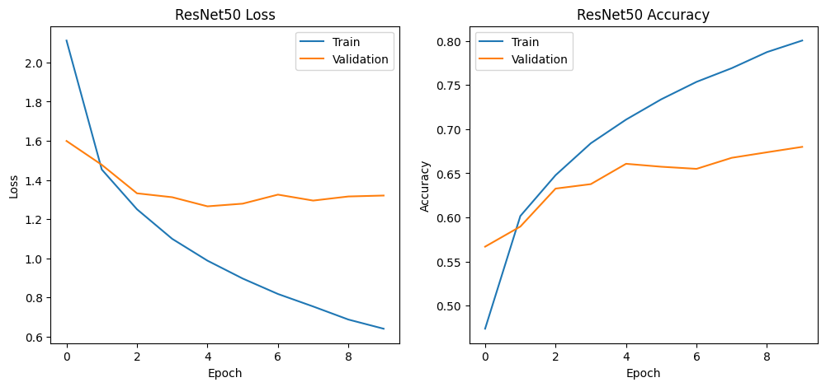
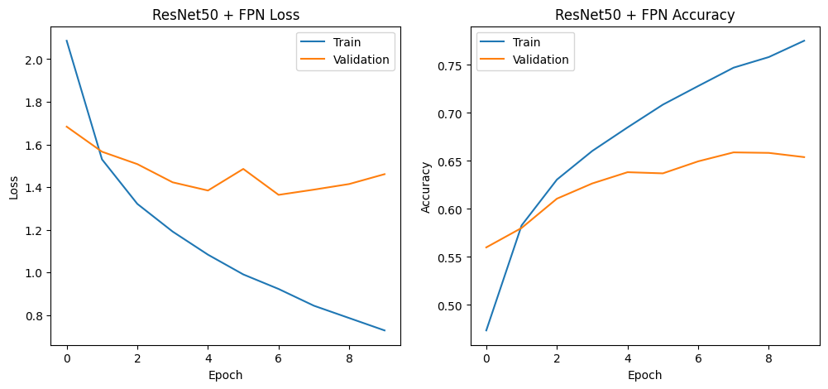
14 / Experimental Results
14 / 20
Baseline and FPN models show steady learning
ResNet50 best validation accuracy: 67.99%
ResNet50 + FPN best validation accuracy: 65.89%
Training accuracy increases across epochs
Validation curves show generalization gap near the end
Deep Learning-Based Insect Pest Classification
Notes:
Use the two training curves to discuss learning behavior. ResNet50 ended slightly higher on validation accuracy than the FPN run in the supplied results.

Slide 15
15 / Best Model
15 / 20
Best completed run: ResNet50 validation accuracy 67.99%
0.6735
0.6358
0.6735
0.6358
Accuracy
Precision
Accuracy
Precision
0.5780
0.5879
0.5780
0.5879
Best validation checkpoint at epoch 10
Recall
F1-score
Recall
F1-score
Useful baseline for later ensemble comparison
Top-5 predictions can support transparent model output
1
Top-1 class
2
Top-5 alternatives
3
Confidence
Deep Learning-Based Insect Pest Classification
Notes:
Distinguish best validation accuracy from the separate test metric block you provided. Mention that Top-5 prediction display helps users see close alternatives.

Slide 16
16 / Deployment
16 / 20
Streamlit turns the model into a usable application
1
Upload image
Image upload interface
2
Preview insect
Real-time pest class prediction
Confidence score visualization
3
Predict class
Top-5 class probabilities for decision support
4
Confidence scores
Deep Learning-Based Insect Pest Classification
Notes:
Explain the application workflow: user uploads an insect image, preprocessing runs, the model predicts class probabilities, and the UI shows confidence.

Slide 17
17 / Challenges
17 / 20
Main challenges during implementation
1
Runtime
2
Training time
Google Colab disconnections during long runs
Large training time and GPU limits
3
Similarity
Fine-grained similarity between pest classes
Checkpoint and experiment management
4
Deployment
Deployment path and dependency issues
Deep Learning-Based Insect Pest Classification
Notes:
Use this slide to show engineering maturity. Challenges are normal; what matters is how you managed checkpoints, tracked experiments, and simplified deployment.

Slide 18
18 / Future Work
18 / 20
Future work can move the system closer to field use
1
ViT
2
Mobile
Evaluate Vision Transformers
Optimize for mobile deployment
3
Detection
Add real-time pest detection
Explore Edge AI inference
4
Edge AI
Improve attention mechanisms and class balancing
Deep Learning-Based Insect Pest Classification
Notes:
Frame future work as practical extensions: stronger models, faster inference, and field-ready deployment.

Slide 19
19 / Conclusion
19 / 20
Deep learning enables scalable pest classification
1
Pipeline
2
Models
Built a complete image classification pipeline
Compared baseline and enhanced model families
3
Results
Achieved strong completed baseline performance
Prepared a deployable Streamlit user workflow
4
Application
Supports smart agriculture decision-making
Deep Learning-Based Insect Pest Classification
Notes:
Summarize the project as a full pipeline, not just an experiment. Close by tying model performance back to agricultural impact.

Slide 20
20 / Questions
20 / 20
Thank You
Questions?
1
Defense
2
Discussion
3
Next steps
Deep Learning-Based Insect Pest Classification
Notes:
Invite questions. Be ready to answer why ResNet50 was chosen, how soft voting works, and what caused differences between baseline and FPN results.

