Slide 1

Ahmed El-Mekawy
Abdelrahmen Elashry
Hajar HasabAllah
Mariam M. Rabi
GitHub Repository

Slide 2


Slide 3
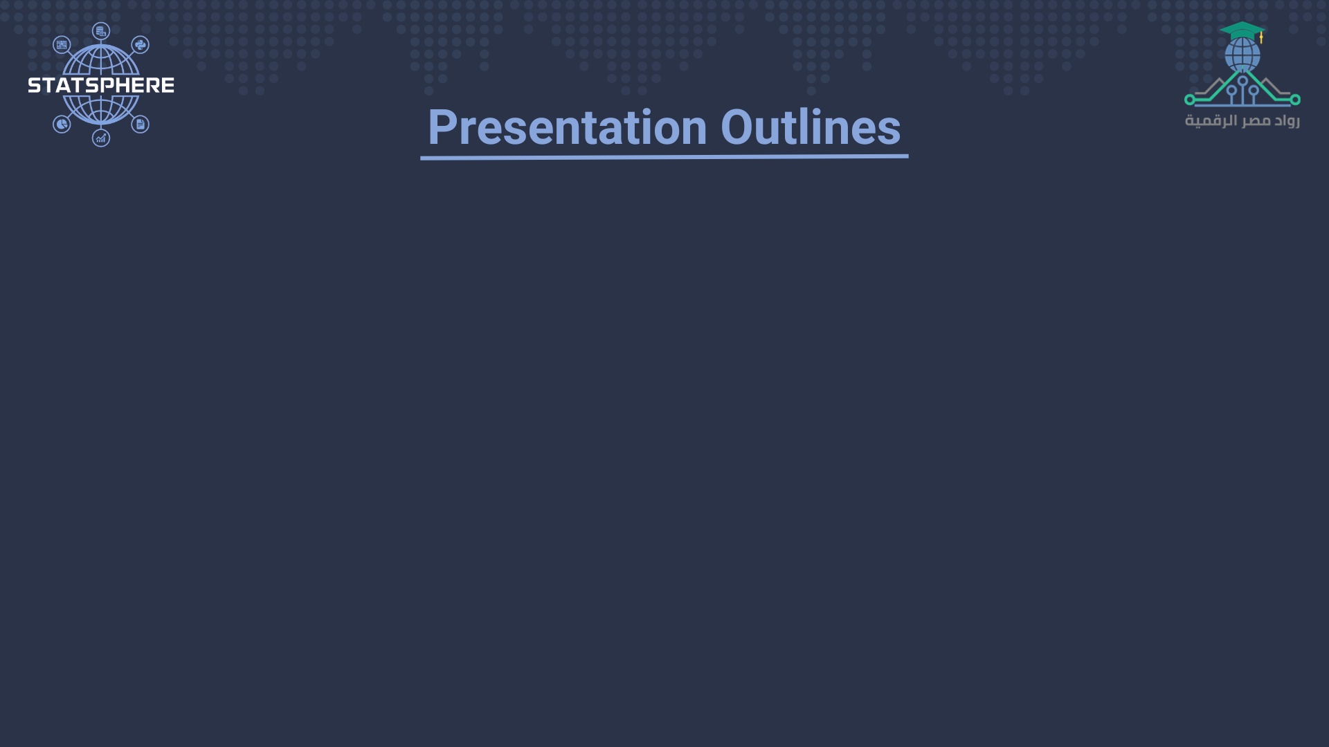
1. Introduction
5. Literature Review
2. Problem Statement
6. Methodology and Result
3. Project Goals
7. Limitations
4. Questions to Answer
8. Conclusion

Slide 4
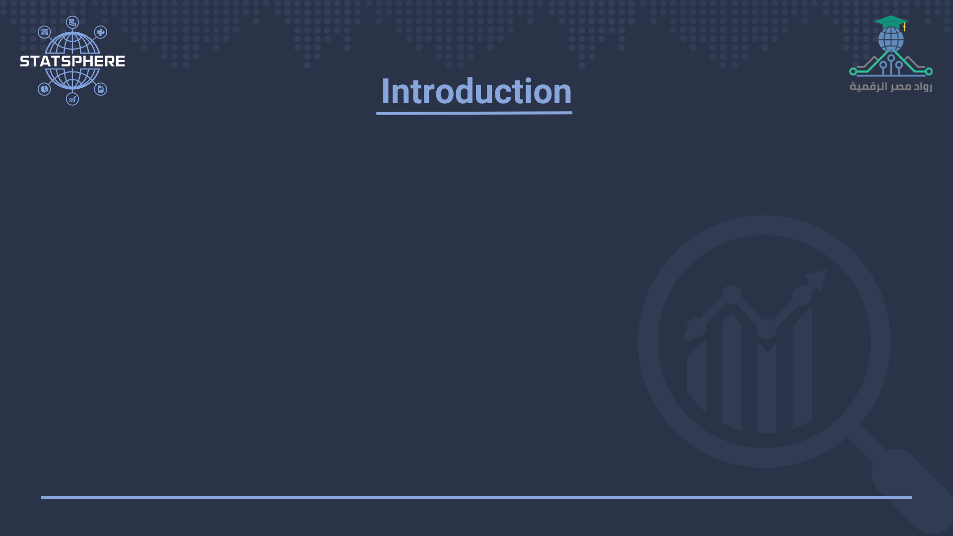
University students face continuous academic stress from quizzes, practical, midterms, and finals. With constant deadlines, Assignment, projects, and external commitments, this pressure can take a serious toll on mental health.
This project aims to fill that gap by analyzing mental health trends using survey data, focusing on PHQ-9 scores, self-reported stress levels, and students’ comfort in expressing emotions.
1. Introduction – Brief
4

Slide 5
Mental Health Metrics Among Egyptian University Students:
Finding | Statistic
Overall mental disorders prevalence | 16.93%
Mood disorders | 6.43%
Anxiety disorders | 4.75%
Psychological distress | 68.1% of students (72.1% females)
Non‑utilization of care | 90.3% did not seek help
Academic underperformance risk | +62% risk if mental issues in 1st semester
Suicidal ideation | 25.3% reported thoughts
Suicide attempts | 7.9% attempted
1. Introduction – Metrics
5

Slide 6
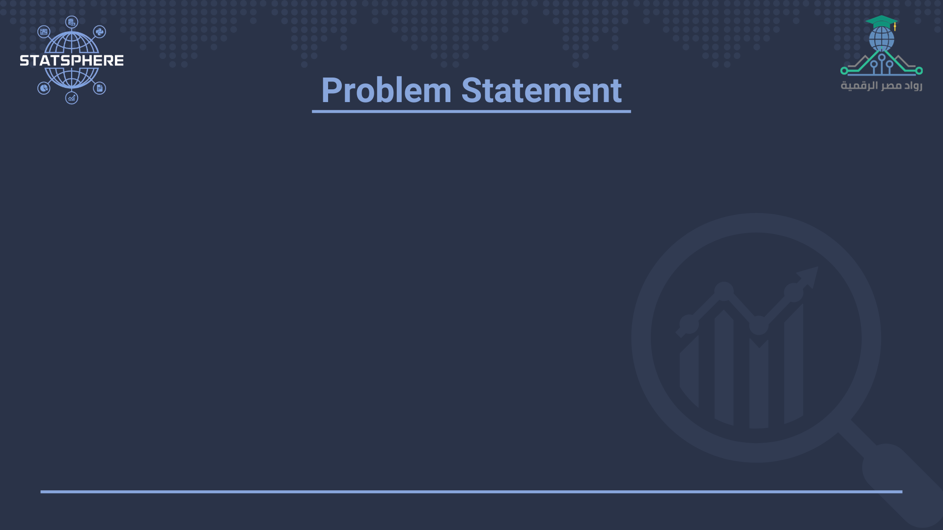
Academic stress is a prevalent issue among Egyptian university students, often leading to significant mental health challenges such as depression and elevated stress levels. Preliminary findings from our survey indicate that most students do not seek professional support, despite experiencing clear psychological distress.
This project aims to investigate the link between academic stress and mental health deterioration, highlighting the urgent need for institutional intervention and support mechanism.
2. Problem Statement
6

Slide 7
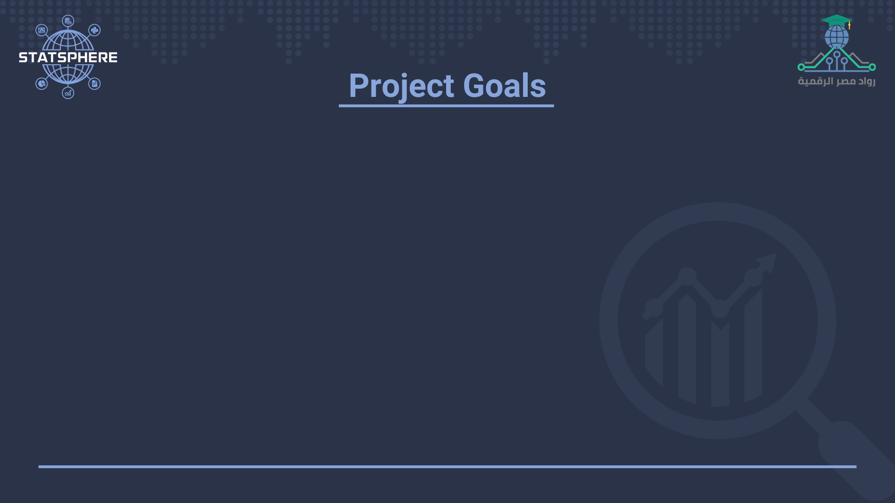
This project aims to analyze the impact of academic stress on the mental health of Egyptian university students using quantitative survey data. The main objectives are:
To measure levels of depression using the PHQ-9 scale and assess stress intensity through self-reported stress scores.
To examine how academic factors (e.g., project hours, Living Arrangement, Marital Status, academic level, gender, social support, workload) relate to mental health outcomes.
To explore students' expression comfort and its role in coping with academic pressure.
To identify patterns and correlations between academic stressors and psychological well-being.
To provide data-driven recommendations for universities to improve mental health support services and reduce academic-related distress.
3. Project Goals
7

Slide 8
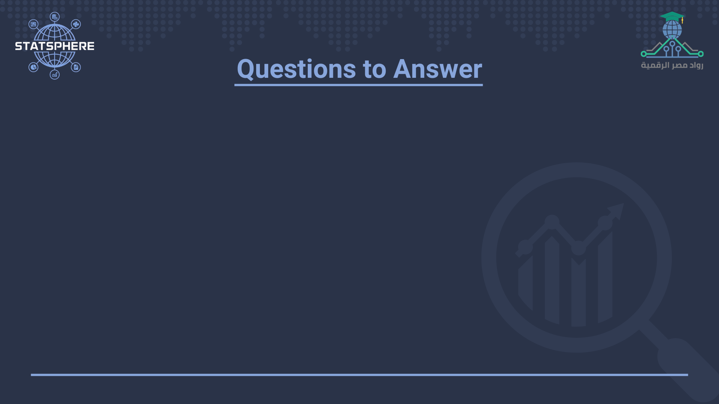
This project seeks to address the following research questions through quantitative analysis of student responses:
What is the relationship between academic stress and students’ mental health, as measured by PHQ-9 depression scores and self-reported stress levels?
Which academic and personal factors (e.g., project hours, Living Arrangement, Marital Status, academic level, gender, social support, workload) contribute most significantly to psychological distress?
4. Questions to Answer - I
8

Slide 9
How comfortable are students in expressing their emotions, and how does this relate to their mental well-being?
To what extent do students seek help, and what barriers prevent them from accessing psychological support?
What institutional measures can be proposed to mitigate academic stress and support student mental health?
4. Questions to Answer - II
9

Slide 10
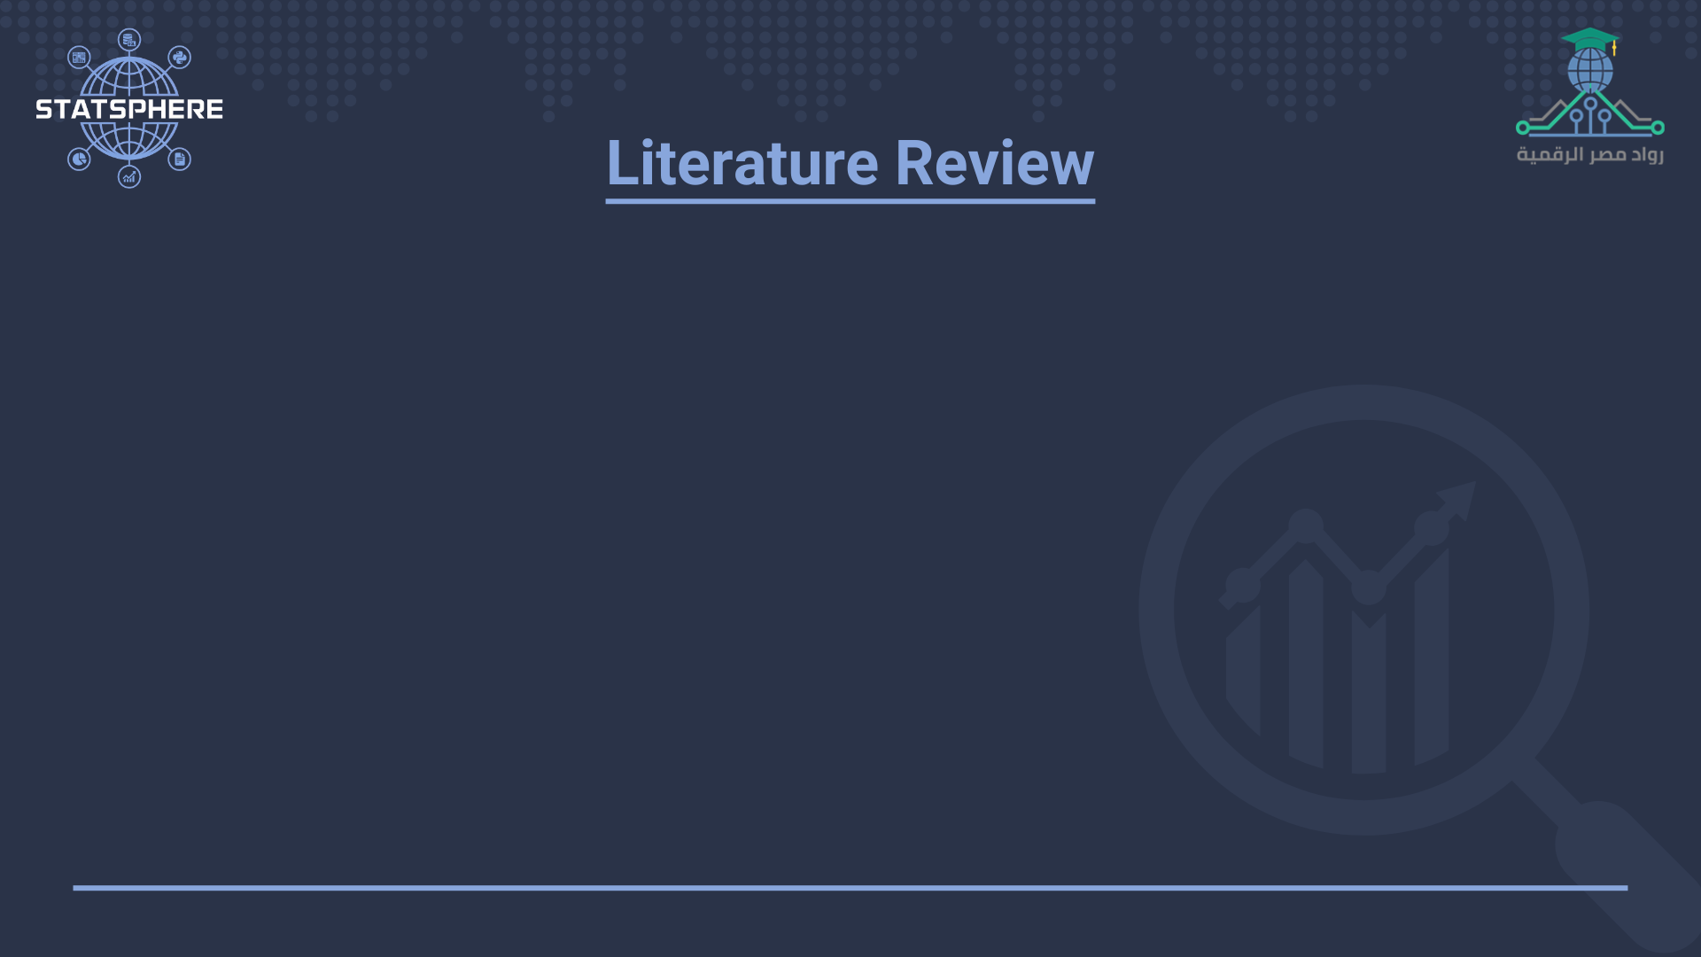
1- PHQ-9 (Patient Health Questionnaire):
The nine-item Patient Health Questionnaire (PHQ-9) is a depressive symptom scale and diagnostic tool introduced in 2001 to screen adult patients in primary care settings. The instrument assesses for the presence and severity of depressive symptoms and a possible depressive disorder.
The PHQ-9 is a component of the larger self-administered Patient Health Questionnaire (PHQ),but can be used as a stand-alone instrument. The PHQ-9 takes less than three minutes to complete. It is scored by simply adding up the individual items' scores.
5. Literature Review - PHQ-9 - I
10

Slide 11
1- PHQ-9 (Patient Health Questionnaire):
Survey items
It includes 9 items that assess the patient’s experiences over the past two weeks, covering:
• Lack of interest or pleasure (anhedonia)
• Feeling down or depressed
• Sleep disturbances
• Fatigue or low energy
• Appetite changes
• Low self-esteem
• Difficulty concentrating
• Psychomotor agitation or retardation
• Suicidal thoughts
Responses range from 0 (not at all) to 3 (nearly every day).
5. Literature Review - PHQ-9 - II
11

Slide 12
2- Stress Level:
Commonly identified stressors include familial expectations, financial burdens, employment concerns, and the challenge of balancing work and study commitments.
To assess these stressors, structured questionnaires using Likert-type scales have been frequently utilized.
5. Literature Review - Stress level - I
12

Slide 13
2- Stress Level:
In line with these methodologies, the current study adopts a customized self-report instrument that asks respondents to rate their stress level regarding the following factors:
• High family expectations
• Financial difficulties
• Fear of unemployment
• Balancing work and study
Participants respond using a 5-point Likert scale, ranging from 1 (Not at all stressed) to 5 (Extremely stressed). This design aligns with established tools in literature that aim to quantify perceived stress levels related to socioeconomic and personal challenges.
5. Literature Review - Stress level - II
13

Slide 14
3- Expression Comfort:
Commonly examined aspects in psychological research include individuals’ comfort levels when discussing personal and emotional issues with others.
Prior studies have emphasized that comfort in emotional disclosure is a critical factor influencing help-seeking behaviors and mental health outcomes.
5. Literature Review - Expression Comfort - I
14

Slide 15
3- Expression Comfort:
To assess this dimension, the current study adopts a structured self-report instrument that asks respondents to rate their comfort level in discussing psychological problems with four groups:
• Family members
• Friends
• A professional therapist
• No one
5. Literature Review - Expression Comfort - II
15

Slide 16
3- Expression Comfort:
Participants respond using a 4-point categorical scale:
1 = Comfortable
0 = Neutral
-1 = Uncomfortable
-2 = Very Uncomfortable
This scoring system reflects a weighted approach that allows for the calculation of an aggregated comfort score across all items.
5. Literature Review - Expression Comfort – III
16

Slide 17

1- Data Collection:
The data were collected using a structured questionnaire distributed to Egypt university student, The questionnaire included the following sections:
• Demographic information: age, gender, marital status, living situation, employment status, university, faculty, academic level, average study hours per week, and academic performance.
• PHQ9,
• Stress level,
• Expression Comfort,
• University Support.
6. Methodology - Data Collection
17

Slide 18
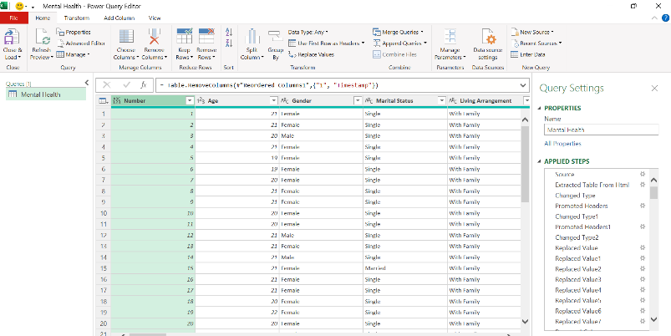
2- Data Preparation:
Before conducting the analysis, the collected data underwent several preparation steps:
1- Power BI integration:
To facilitate dynamic and automated data analysis, the dataset was linked to Power BI.
This integration allowed real-time uploading and updating of the data, enabling interactive visualization, automated dashboards, and live tracking.
6. Methodology - Data Preparation - Power BI integration
18

Slide 19

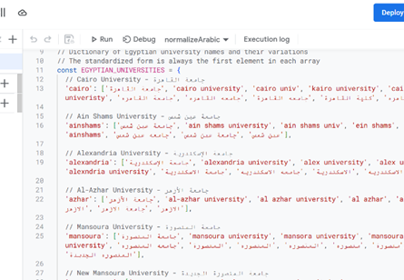
2- Data Preparation:
(Tool: AppScript , language: JavaScript)
An automated script, Enhanced Egyptian University Name Corrector, was applied to standardize university names in Arabic, detecting variations and misspellings.
It processed all rows in the dataset to ensure consistency, prevent duplicates, and enhance analysis accuracy.
2- Data cleaning:
6. Methodology - Data Preparation - Data cleaning
19

Slide 20

2- Data Preparation:
(Tool: Power Query in Power Bi Language: M Query)
• Replace Arabic Values with English Equivalents: Standardize data for further analysis.
• Replace Text with Numeric Values: Convert textual categories into numerical values to facilitate statistical analysis.
• Transform Column Types: Ensure the columns are treated as text before applying transformations.
3- Data coding :
6. Methodology - Data Preparation - Data coding
20

Slide 21
2- Data Preparation:
(Tool: Power Query in Power Bi Language: M Query)
• Replace Arabic Values with English Equivalents: Standardize data for further analysis.
• Replace Text with Numeric Values: Convert textual categories into numerical values to facilitate statistical analysis.
• Transform Column Types: Ensure the columns are treated as text before applying transformations.
3- Data coding :
6. Methodology - Data Preparation - Data coding
20

Slide 22
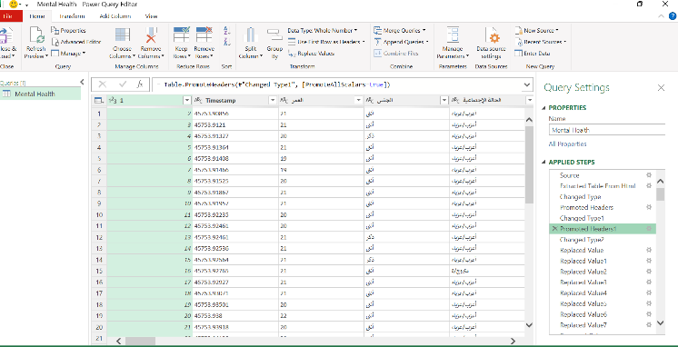
2- Data Preparation:
Before vs. After
6. Methodology - Data Preparation - Data coding
21

Slide 23
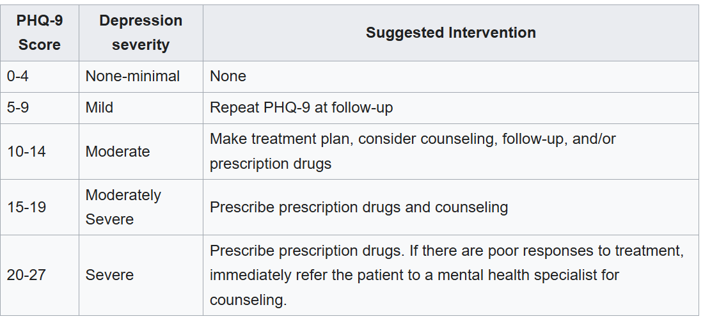
2- Data Preparation:
(Tool: Power Query in Power Bi Language: M Query)
Calculate PHQ9
4- Score calculation:
6. Methodology - Data Preparation - Score calculation - I
21

Slide 24
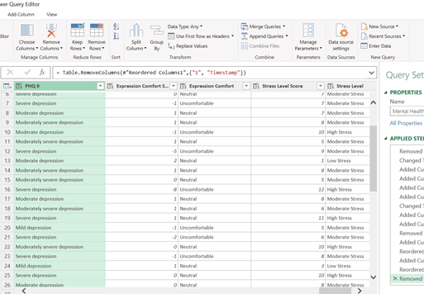
2- Data Preparation:
(Tool: Power Query in Power Bi Language: M Query)
Stress Level:
To categorize the participants' stress levels based on their total scores in the questionnaire, a simple classification method was used. If a participant scored 10 or above, they were classified as experiencing high stress. Scores between 5 and 9 indicated moderate stress, while scores below 5 were considered to reflect low stress.
4- Score calculation:
6. Methodology - Data Preparation - Score calculation - II
22

Slide 25
2- Data Preparation:
(Tool: Power Query in Power Bi Language: M Query)
Expression Comfort
To classify participants’ overall comfort level, the following system was applied:
Scores ≥ 3: Very Comfortable
Scores between 0 and 2: Neutral
Scores below 0: Uncomfortable
4- Score calculation:
6. Methodology - Data Preparation - Score calculation - II
22

Slide 26
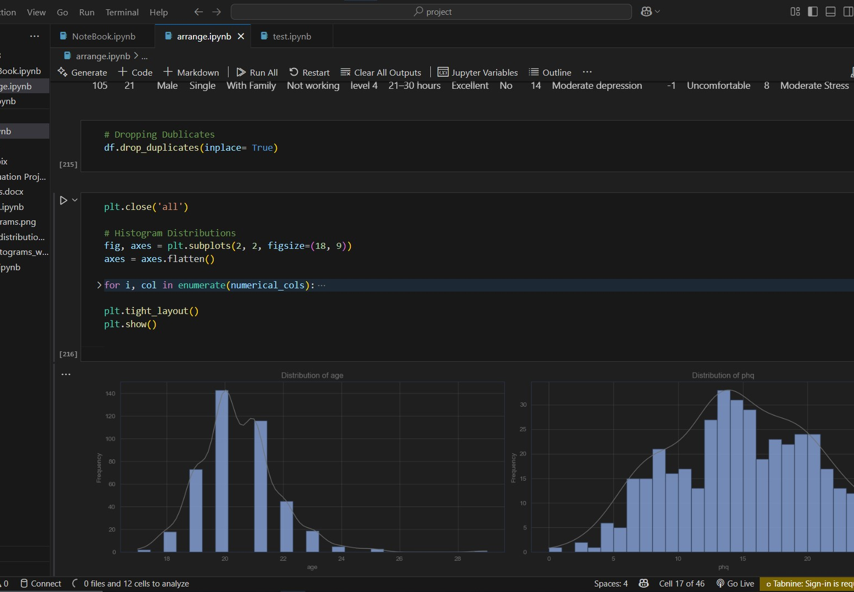
2- Data Preparation:
(Tool: VS Code: Jupyter Notebook: Python)
EDA & Machine Learning:
The primary objective is to develop a multi-class classification model to predict PHQ-9 depression severity levels using features such as (age), (gender),... The process includes data exploration, preprocessing, and model evaluation to determine the best-performing model. This predictive tool will support university mental health systems by identifying students requiring intervention.
5- Data Analysis& AI model
6. Methodology - Data Preparation - Data Analysis& AI model
23

Slide 27
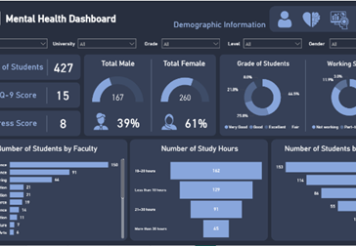
2- Data Preparation:
(Tool: Power Bi: Dashboard)
Answer questions and get insight at Dashboard:
The interactive dashboard offers a visual analysis of factors affecting depression severity (PHQ-9 levels) among university students. It presents key patterns and correlations between demographic, academic variables and mental health indicators.
The insights are designed to enhance understanding and guide data-informed decisions on student mental health support.
6- Interpretation
6. Methodology - Data Preparation - Interpretation
24

Slide 28

A major limitation of this study is response bias, as many participants provided incomplete or inconsistent answers, reducing the accuracy and reliability of the dataset.
Additionally, time compliance issues suggest that some respondents rushed through the survey without careful reflection, potentially compromising data integrity.
These factors may skew insights and limit the generalizability of findings.
7. Limitations
25

Slide 29

The analysis confirms that academic stress significantly affects students' mental health, with PHQ-9 scores and self-reported stress levels pointing to widespread psychological distress.
Addressing these challenges requires institutional intervention, tailored support systems, and improved awareness to foster a healthier learning environment.
While data limitations exist, the findings provide a foundation for future research and policy improvements.
8. Conclusion
26

Slide 30
