Slide 1
STG Team

Slide 2

STG team telegram link

Slide 3
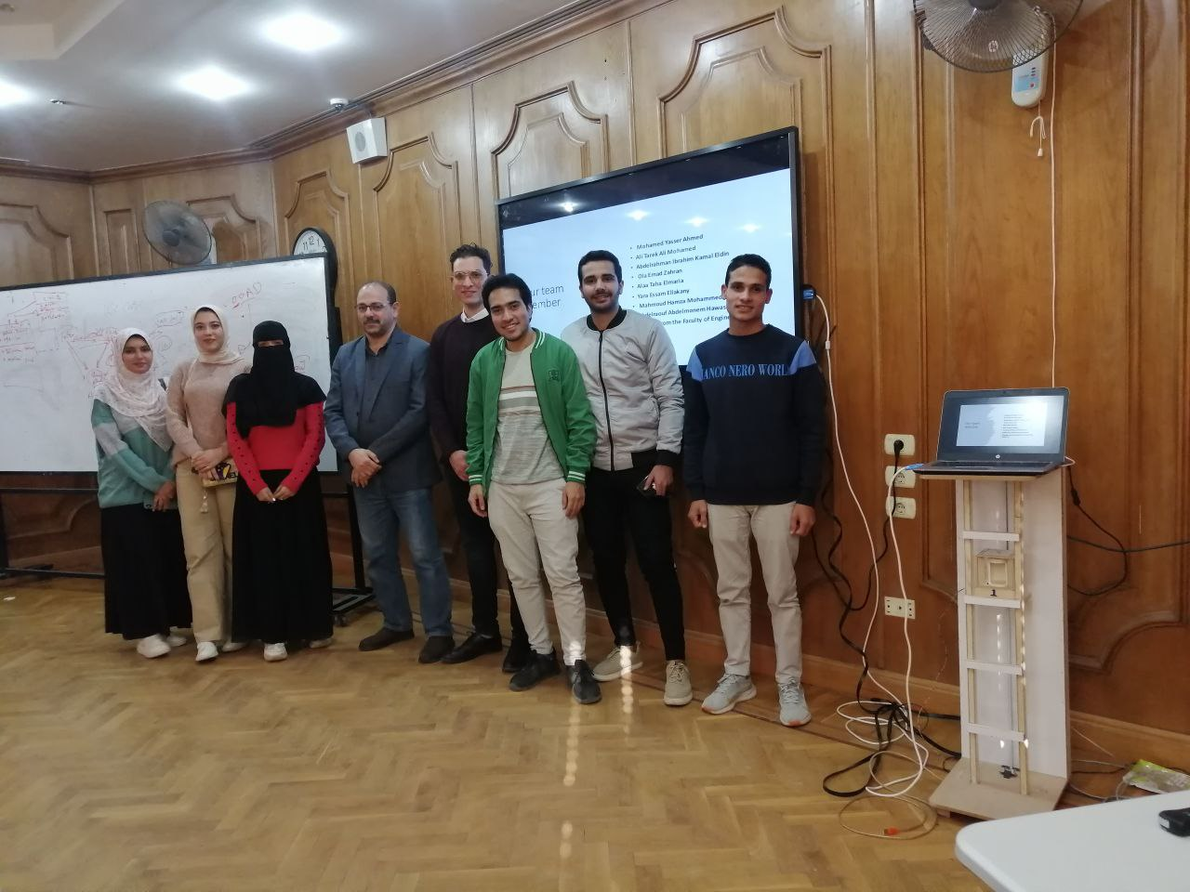
STG Team

Slide 4
Welcome to
Smart tour guide
By:
STG Team

Slide 5

How can I help you?
press button and speak.
e.g: recognize, translate, assistant, capture, QR code, music, time…

Slide 6

Voice assistant
press button and speak.

Slide 7

Speak now...

Slide 8


Slide 9


Slide 10


Slide 11

There is a problem!

Slide 12
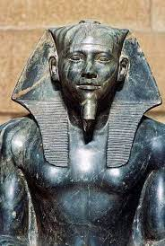
Khafre
Egyptian King of the 4th Dynasty.
He was the son of Khufu.
Khafre was the builder who made the second largest pyramid of Giza.

Slide 13
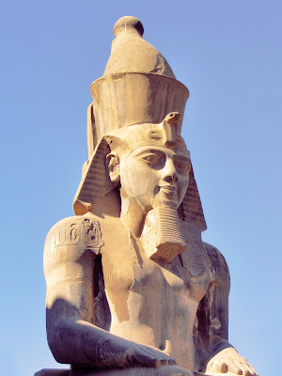
Ramesses II
(1303 BC – 1213 BC)
Third ruler of the Nineteenth Dynasty.
Most powerful period of ancient Egypt.
At age 14, he was appointed as Egypt's prince regent by his father, Seti I.

Slide 14
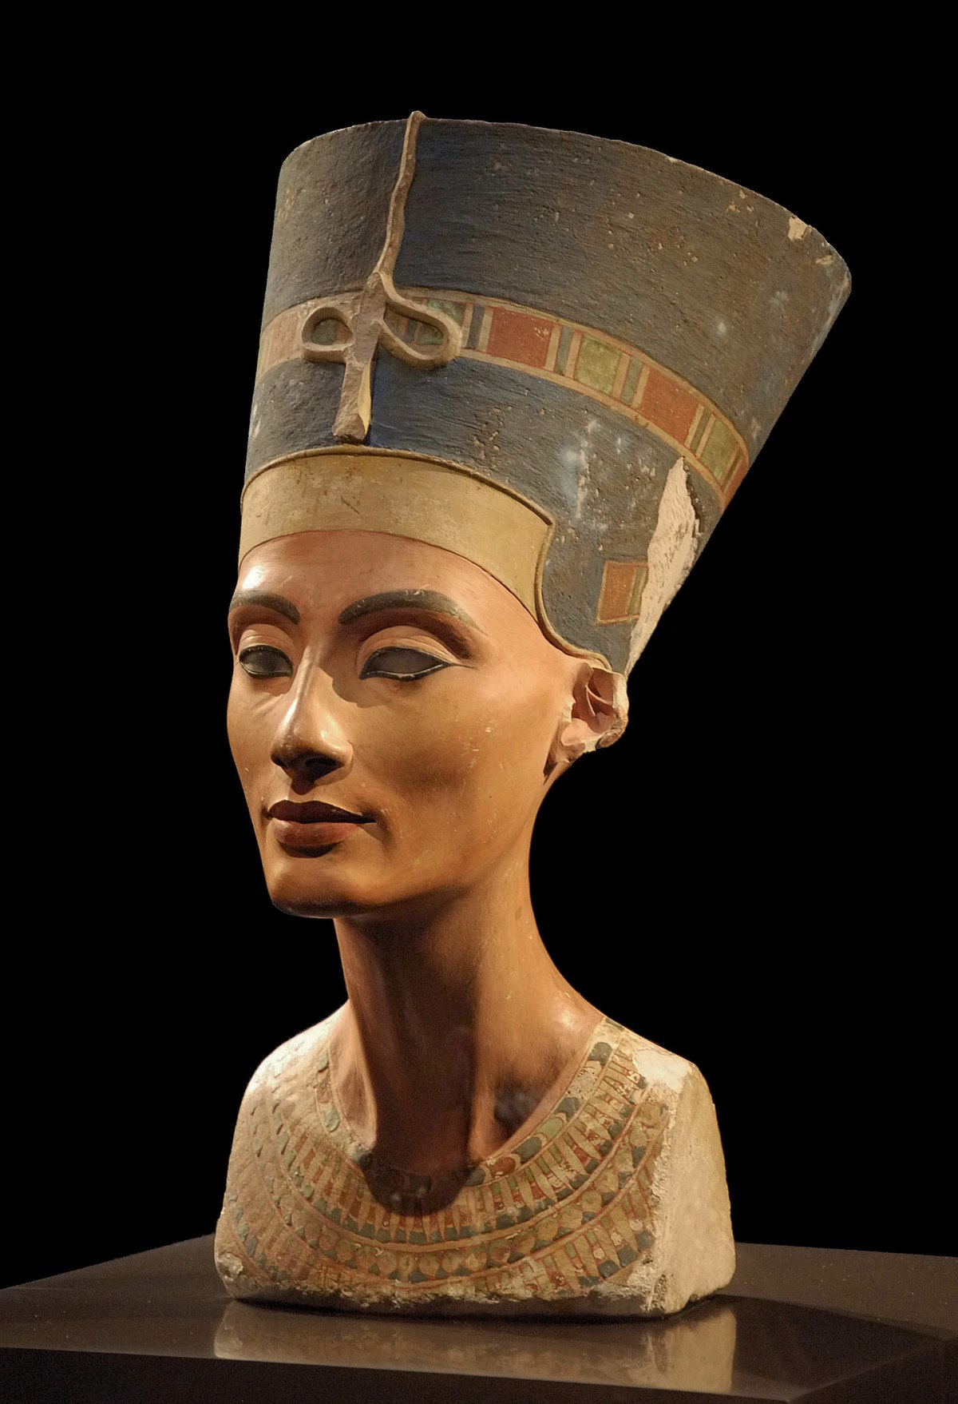
Nefertiti
(1370 BC – 1330 BC)
Was a queen of the 18th Dynasty.
The royal wife of Pharaoh Akhenaten.
known for their radical overhaul of state religious policy.

Slide 15
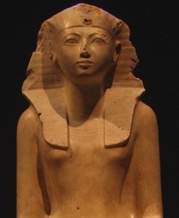
Hatshepsut
(1507–1458 BC)
The fifth pharaoh of the 18th Dynasty.
The principal wife of ThutmoseII.
Hatshepsut's reign is well-known for increased prosperity, large-scale construction projects such as the Karnak Temple Complex.

Slide 16
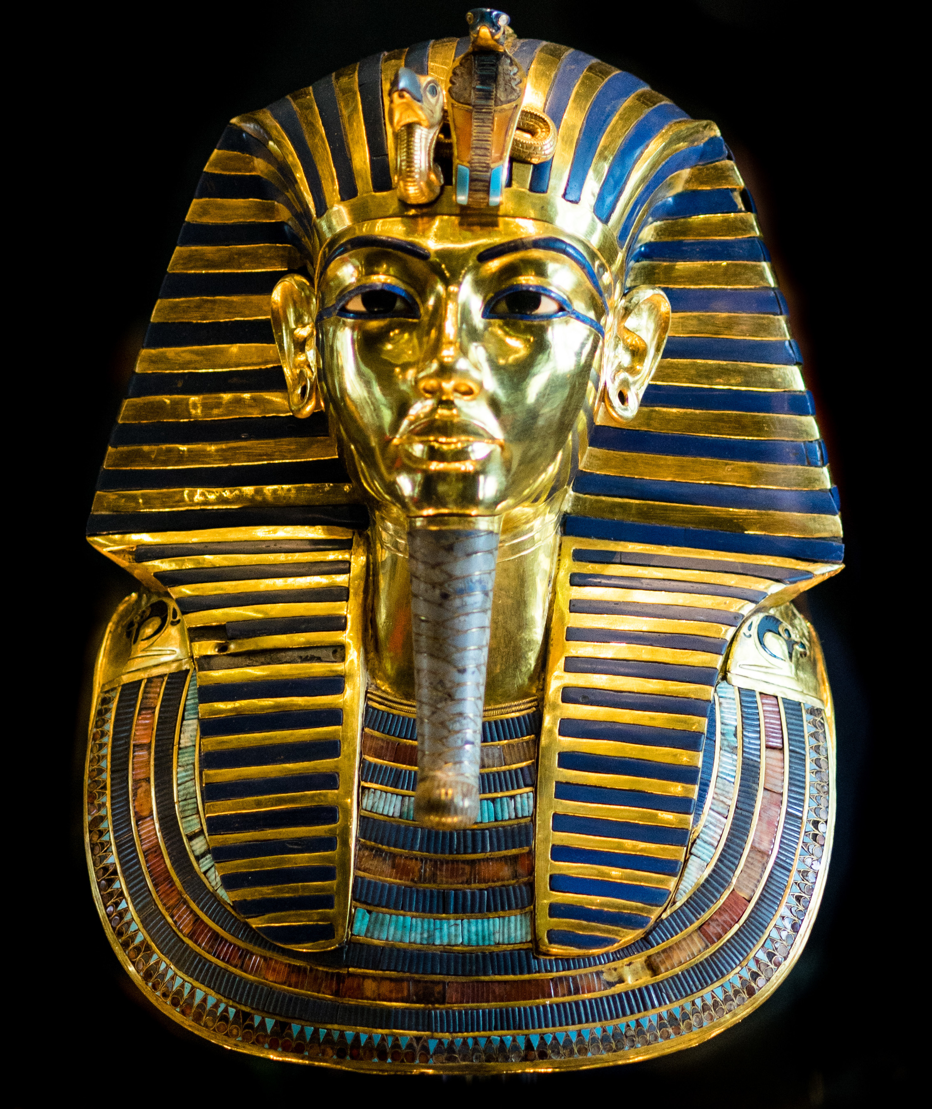
Tutankhamun
The antepenultimate pharaoh of the 18th Dynasty.
primarily known for restoring the traditional polytheistic ancient Egyptian religion.
Tutankhamun relocated Egypt's capital back to Thebes.

Slide 17
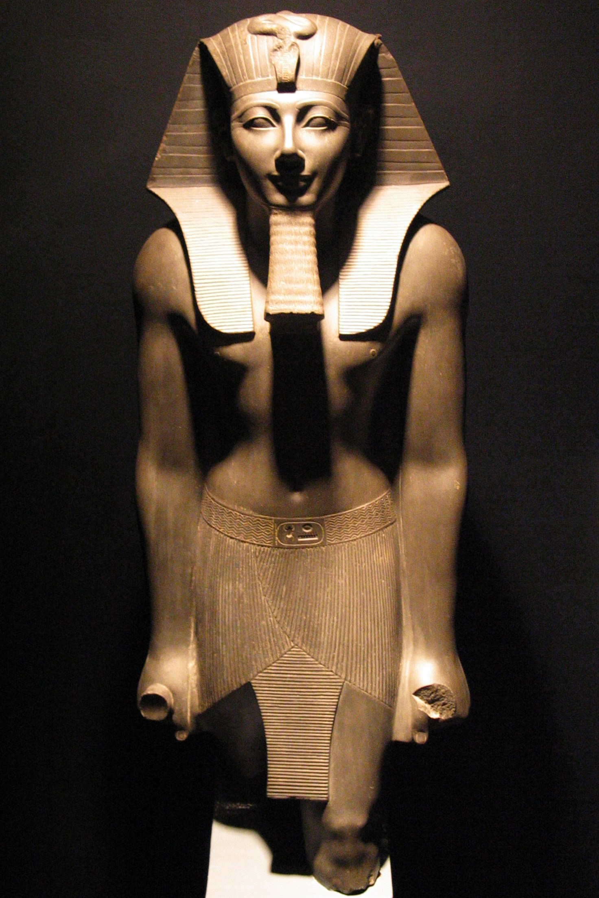
Thutmose III
Was the 6th pharaoh of the 18th Dynasty.
Ruled Egypt for almost 54 years
he created the largest empire Egypt had ever seen
When Thutmose III died, he was buried in the Valley of the Kings.

Slide 18
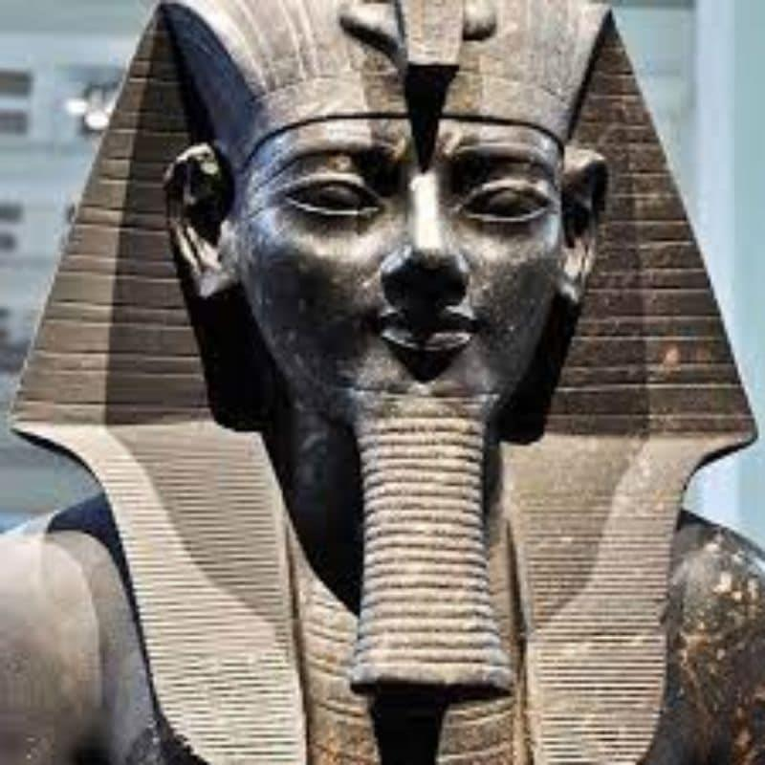
Amenhotep III
The 9th pharaoh of the 18th Dynasty.
His reign was a period of unprecedented prosperity and splendor.
He died in the 38th or 39th year of his reign

Slide 19
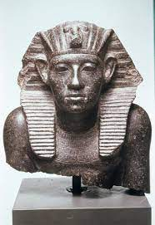
Amenemhat III
The sixth king of the Twelfth Dynasty of the Middle Kingdom.
He directed his efforts towards an extensive building focus on Faiyum.
Amenemhat III reigned for at least 45 years

Slide 20
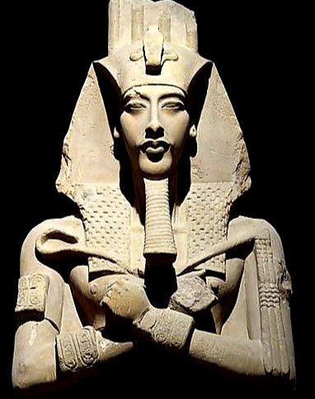
Akhenaton
The 10th ruler of the 18th Dynasty.
he was known as Amenhotep IV.
noted for abandoning Egypt's traditional polytheism and introducing Atenism, or worship centered around Aten.

