Slide 1

WattWise AI
Energy Forecasting
& Anomaly Detection
Advanced Machine Learning Project
Short-horizon forecasts • Explainable signals • Human review
Advanced Machine Learning | 2026
Notes:
WattWise AI project presentation. The cover is a conceptual illustration, not a photograph of a real home or appliance.

Slide 2
Project Team
Team Members
Name | Student ID | Role
Abdelrhman Mohamed Ahmed Al Ghonimi | 223101228 | Team Member
Denar Reda Roushdy Elsayed | 223101171 | Team Member
Mariem Abd-Elhamied Abo-Shaeshaa | 223101341 | Team Member
Shrouk Ashraf Seria | 223101203 | Team Member
Course
Advanced Machine Learning
WattWise AI | Advanced ML
02
Notes:
Team member names and student IDs were provided by the project team.

Slide 3
Problem and Scope
Question Addressed
How much energy will household appliances use in the next interval, and how far might observed use depart from the forecast?
Household Readings
Next-Interval Forecast
Residual Analysis
Human Review
Available sensor and energy readings at time t
Observed energy at the next row
Actual − predicted
A signal worth investigating
A residual does not diagnose waste or a fault. The UCI dataset has no verified waste or fault labels.
WattWise AI | Advanced ML
03

Slide 4
Dataset and Source
UCI Appliances Energy Prediction
Field | Value
Observations | 19,735
Original columns | 29
Sampling interval | 10 minutes
Coverage | Jan–May 2016
Missing values / duplicates | 0 / 0
Target | Appliance energy (Wh per interval)
UCI Machine Learning Repository
archive.ics.uci.edu/dataset/374/appliances+energy+prediction
WattWise AI | Advanced ML
04
Notes:
Source: UCI Machine Learning Repository, Appliances Energy Prediction. Candanedo, Feldheim & Deramaix (2017), Energy and Buildings, DOI: 10.1016/j.enbuild.2017.01.083. Dataset facts are from the inspected source CSV and reports.

Slide 5
Data-to-Forecast Pipeline
UCI Dataset
19,735 rows
Validate & Clean
Timestamps
Feature Engineering
63 features
Chronological Split
70 / 15 / 15
Select on
validation only
Held-out Test
then review
Forecast Inputs
At time t: sensor readings, current energy use, and available historical features.
Target: appliance energy observed in the next row, usually 10 minutes later.
WattWise AI | Advanced ML
05

Slide 6
Feature Engineering and Leakage Controls
63 features in the recorded experiment
Feature group | Examples
Current appliance use | appliances_current
Consumption lags | 1, 2, 3, 6, 12, 144 samples
Shifted rolling summaries | Mean and standard deviation over 3, 6, 12, 144 samples
Recent changes | Energy, lighting, and selected temperature/humidity readings
Cyclical time | Hour, day, daily and weekly cyclical encodings
Leakage Controls
• Forward-fill from past values only; never back-fill from the future.
• Rolling windows are shifted and exclude the next-step target.
• Chronological splits use disjoint target timestamps.
WattWise AI | Advanced ML
06

Slide 7
Temporal Evaluation and Candidate Models
Chronological Split
Train 70% | n=13,713
Validation 15%
Test 15%
Train 13,713 | Validation 2,938 | Test 2,939
Candidate Models
Baselines: Persistence, Dummy, Ridge
Forests: Random Forest, Extra Trees
Boosting: HistGradientBoosting, XGBoost
Ensembles: Voting (top 3), Temporal Stacking
The validation set selects the model and residual threshold; test data do not enter selection.
WattWise AI | Advanced ML
07

Slide 8
Tuning and Ensemble Models
Expanding-Window Validation
Optuna
MAE tuning inside training
Tuned Model
3 outer × 3 inner folds
Base Models
3 expanding folds
Ensembles
Voting: equal-weight average of the three models with the lowest validation error.
Temporal stacking: out-of-fold forecasts train a linear meta-learner.
Before Final Comparison
Candidates were refit on the same training and validation data, then scored on identical test rows. Ensemble CV is omitted because ensembles were selected using validation.
WattWise AI | Advanced ML
08

Slide 9
Model Selection on Validation
Selection metric: minimum validation MAE
Model | MAE · Wh | RMSE · Wh | R²
Voting (top 3) ✓ | 21.939 | 56.356 | 0.610
Tuned HistGradientBoosting | 21.989 | 56.821 | 0.603
HistGradientBoosting | 22.121 | 57.325 | 0.596
XGBoost | 22.335 | 55.860 | 0.617
Selected Model
Voting (top 3)
Equal weights: Tuned HistGradientBoosting | HistGradientBoosting | XGBoost
WattWise AI | Advanced ML
09

Slide 10
Held-Out Test Model Comparison
n = 2,939 | MAE / RMSE: Wh per 10 min | R²: unitless
Model | MAE | RMSE | R² | Selection
Tuned HistGradientBoosting | 22.268 | 58.872 | 0.581
Voting (top 3) | 22.385 | 58.723 | 0.583 | Selected
HistGradientBoosting | 22.662 | 59.814 | 0.568
XGBoost | 22.820 | 58.326 | 0.589
Temporal Stacking | 23.722 | 57.941 | 0.594
Extra Trees | 26.159 | 57.324 | 0.603
HistGradientBoosting (squared) | 26.644 | 57.693 | 0.598
Persistence | 26.723 | 66.786 | 0.461
Ridge | 27.878 | 59.990 | 0.565
Random Forest | 28.987 | 58.660 | 0.584
Dummy mean | 52.354 | 90.977 | -0.000
Retrospective test leaders — MAE: Tuned HistGradientBoosting | RMSE: Extra Trees
WattWise AI | Advanced ML
10

Slide 11
Temporal Cross-Validation Results
3 expanding folds | mean ± population standard deviation
Model | CV MAE · Wh | CV RMSE · Wh | CV R²
Persistence | 30.387 ± 1.021 | 73.219 ± 1.493 | 0.480 ± 0.027
Dummy mean | 60.099 ± 1.275 | 101.743 ± 4.454 | -0.001 ± 0.001
Ridge | 36.608 ± 8.038 | 69.480 ± 2.314 | 0.527 ± 0.075
Random Forest | 31.720 ± 1.812 | 64.880 ± 0.728 | 0.590 ± 0.046
Extra Trees | 30.113 ± 1.907 | 64.122 ± 0.348 | 0.600 ± 0.040
HistGradientBoosting | 27.049 ± 1.022 | 67.234 ± 1.177 | 0.561 ± 0.027
HistGradientBoosting (squared) | 29.386 ± 2.179 | 64.941 ± 1.546 | 0.588 ± 0.057
XGBoost | 27.083 ± 1.461 | 65.273 ± 0.643 | 0.586 ± 0.032
Tuned HGB · nested | 27.093 ± 1.159 | 67.308 ± 1.296 | 0.560 ± 0.029
Nested tuning: 3 outer × 3 inner folds. No CV score for validation-composed ensembles.
WattWise AI | Advanced ML
11

Slide 12
Residual Error Diagnostics
Selected model | held-out test
MAE 22.385 Wh RMSE 58.723 Wh R² 0.583
MAE by time block / demand range
Time block 1
20.4
Time block 2
18.2
Time block 3
28.6
High demand >110 Wh
86.4
Absolute-Error Quantiles
P50 7.85 Wh P90 41.13 Wh P95 109.36 Wh P99 297.15 Wh
Largest miss | Actual 580 Wh · Predicted 59.72 Wh · Absolute error 520.28 Wh
WattWise AI | Advanced ML
12

Slide 13
Anomaly Detection: Synthetic Experiment
No ground-truth anomaly labels are available. We injected 60 positive spikes at 2 standard deviations into a copy of the test set.
Detector and threshold | Precision | Recall | F1 | PR-AUC
Residual threshold: validation p99 | 0.026 | 0.017 | 0.020 | 0.263
Isolation Forest (training p99) | 0.035 | 0.083 | 0.049 | 0.022
Detection Workflow
Review signal
Not an automated diagnosis
Isolation Forest
Fit on training data
Forecast residuals
Validation threshold
Scores are weak and depend on the synthetic injection design; they do not measure detection of natural events.
WattWise AI | Advanced ML
13

Slide 14
Interpretability and Feature Ablation
Feature ablation • validation on HistGradientBoosting
Feature set | Count | MAE | RMSE | R²
All features | 63 | 22.121 | 57.325 | 0.596
Without consumption history | 49 | 22.265 | 57.473 | 0.594
Top 20 mutual information | 20 | 22.012 | 57.264 | 0.597
Strongest Signal in the Selected Model
Current Appliance Energy Use
Recent changes and lagged values follow. Reliance was measured as the change in mean absolute error on training data.
Feature importance describes model reliance; it does not prove causation.
WattWise AI | Advanced ML
14

Slide 15
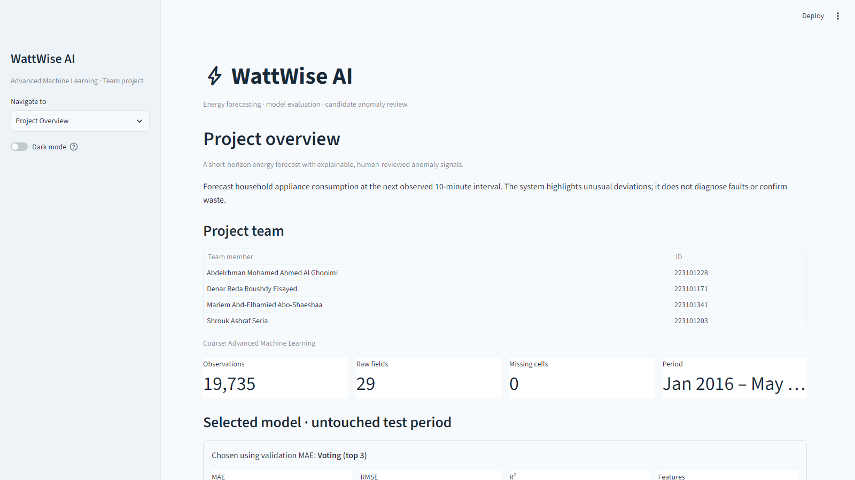
Application Interface: Overview
WattWise AI | Advanced ML
15

Slide 16
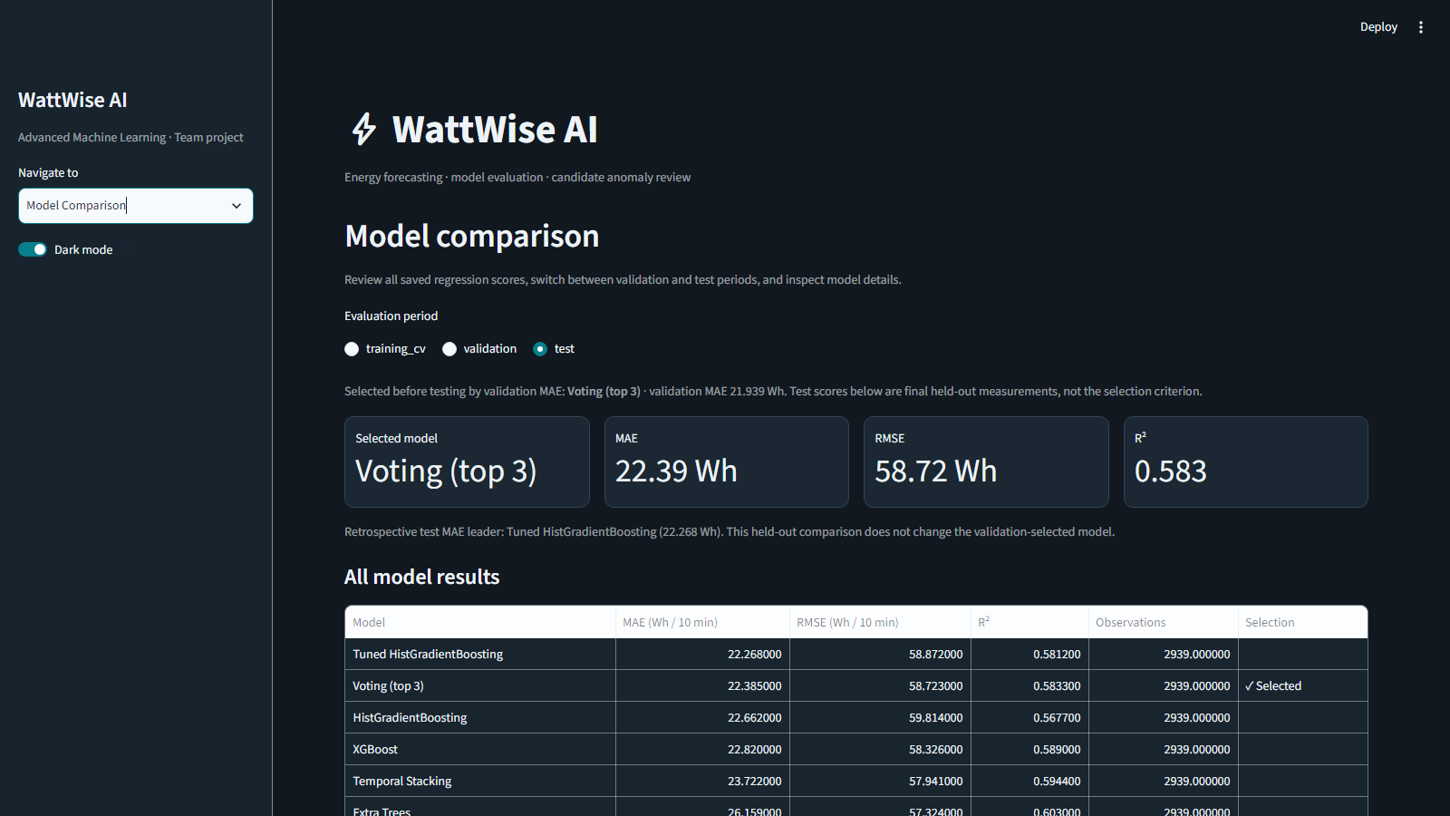
Application Interface: Model Comparison and Dark Theme
WattWise AI | Advanced ML
16

Slide 17
Artifacts and Reproducibility
Key Project Artifacts
Purpose | File
Model and inference | artifacts/wattwise_bundle.joblib
Candidate comparison | reports/model_comparison.csv
Metrics and diagnostics | reports/metrics/final_metrics.json
Artifact integrity | reports/metrics/artifact_manifest.json
Test errors | reports/metrics/largest_test_errors.csv
Project Verification
28 automated tests passed • code-quality and build checks passed
All four notebooks executed • application pages and model comparison reviewed
Train: python -m wattwise.train | UI: streamlit run app.py
WattWise AI | Advanced ML
17

Slide 18
Limitations and Next Steps
Area | Finding
Limited generalization | One home and a limited time span; performance in other homes is untested.
Consumption peaks | Errors are larger during high-demand intervals and the later time block.
Anomaly labels | No verified real-world events are available to validate waste detection.
Next steps | More homes, verified labels, drift monitoring, and uncertainty evaluation.
Conclusion
We forecast upcoming energy use and surface residuals to guide human review.
WattWise AI • Advanced Machine Learning
WattWise AI | Advanced ML
18

