Slide 1
Optile Job scheduler
System Architecture
Application Architecture
System implementation
Application packages
Swagger UI
Areas to improve
Assumptions
Appendix

Slide 2
System Architecture
Scheduler to accept job requests.
Scheduler
Job 1
Validate
Job request
Job 2
Execute
Job n

Slide 3
Application Architecture
Scheduler to accept job requests.
Rest Controller
Job service
Job Executer
Job Entity
Job 1
Job Adapter
To Jobs
Job 2
Job Repository
Job n
HSQLDB (in memory)
Job table

Slide 4
System Implementation
Scheduler is a spring boot microservice that will receive job request.
Each job will have a priority, start time, immediate Boolean flag.
Each job is a microservice [spring boot], has post URL and validate URL and configuration parameters.
Once scheduler get the job, validation service will be invoked to insure proper configuration parameters before storing the job in the priority queue.
If scheduled job is valid, it will be stored into DB and picked before it’s execution time.
Scheduler will run every 1 minute a crone job that read the scheduled jobs and execute it.
Priority for the queue is considering the start time and priority using the following formula
start timestamp + Priority * 1 billion
Immediate jobs considered with priority 1 and start time as current timestamp, hence same formula is applied.
set for jobs based on start time
Technology stack : Spring boot , Spring data, DB :HSQLDB, Swagger UI, Java 8, maven

Slide 5
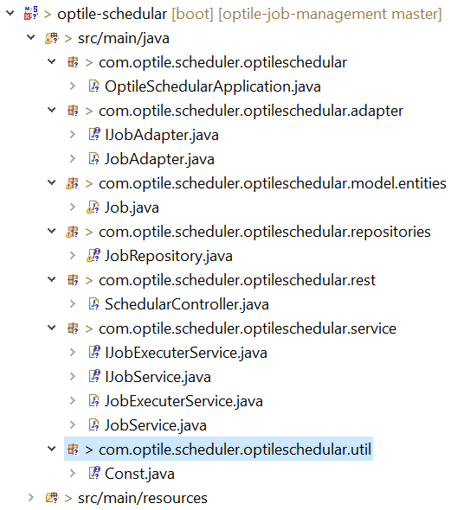
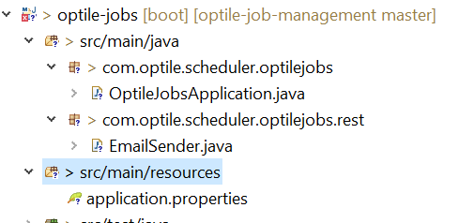
Application packages
Below packages for scheduler and sample job service.

Slide 6
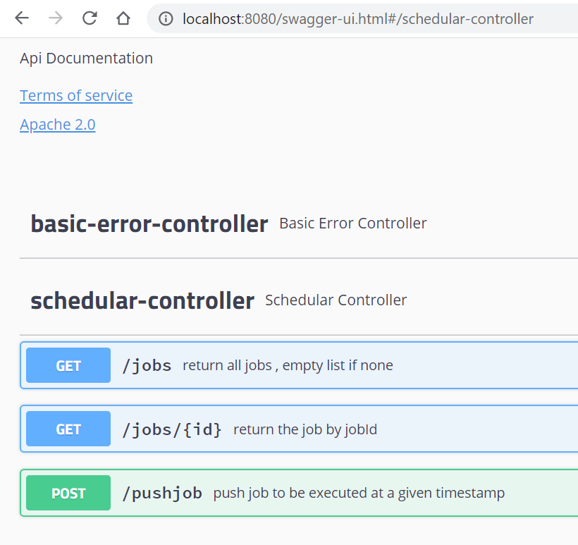
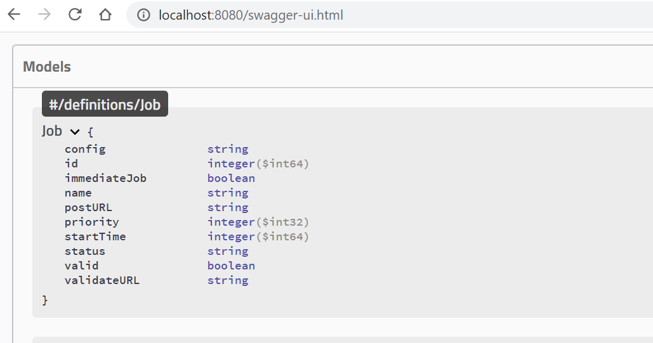
Swagger UI
Below is swagger UI for scheduler API’s

Slide 7
Test cases
Two test cases for the major API’s are executed and successful
Get all jobs
Push Job

Slide 8
System improvements
Dockers to be configured to the microservices architecture
Elk stake to be used to monitoring the system
Deploying to AWS cloud service to ensure scaling and availability with low cost.
Serverless [Lambda functions] is a job option supporting scaling and AWS offers first 1 million transactions free of cost.
Kubernetes to be used for continues integration
More unite test cases to be written to cover the code.
Sonarcloud to be used to review code quality
Netfelx zuul API gateway for API versioning, security and service metrics

Slide 9
Assumptions
Max thread pool size is 10.
Job execution will follow microservices architecture, hence each job will be a webservice call.
If two jobs has the same start time, priority will be considered in the execution. Otherwise job with lowest start time will be executed after job with higher start time even if its priority is higher [low number].
Lowest priority is 10 and highest priority is 1.

Slide 10
Appendix
GitHub URL
https://github.com/Abdelrhman-Fathy/optile-job-management
Consumed time in the task [16 hours]
Developed by
Abdelrahman Fathy
+971504805502
Abdelrhman.fathy@gmail.com

