Slide 1
FirstPass
RISK TRIAGE
RED escalate
AMBER confirm
Clearing the contract-review queue, and how I think.
GREEN auto-clear
A working prototype, a live console, and measured results,
🔒 on-prem · local AI · no cloud
built to run entirely on your own servers.
Abdelrhman Rayis
AI Pioneer · work-sample presentation
github.com/Abdelrhman-Rayis/FirstPass

Slide 2
WHAT I'LL COVER
Five short steps, the way I'd tackle any new problem.
1
How I approach a problem I have not seen before
First principles, five whys, systems thinking, 80/20.
2
The scenario, and its root cause
Your contract queue, and why it really backs up.
3
FirstPass: the solution, running live
An agentic triage layer, in a browser, on your server.
4
Does it actually help?
Measured properly: safety, accuracy, hours saved.
5
Private by design, and how I would add value
Local AI, the standards that matter, and my fit.
FirstPass · AI Pioneer · Abdelrhman Rayis
02

Slide 3
THE PLAN
Value from day one: a skill that grows into an agentic loop.
DAY 1
DAY 2
WEEK 1
WEEK 2
1
Skill
2
Agent memory
3
System
4
Agentic loop
›
›
›
Deploy the contract-triage skill, after understanding the business.
The playbook becomes the agent's memory of standard positions.
The console, routing and evals grow around it.
The full loop, with the learning flywheel.
↺ Feedback loop: gather feedback and improve every two weeks. The queue gets shorter each cycle.
WHERE IT RUNS
Cloud, fast: synthetic test data, no GDPR issue
›
🔒 Local Hermes, on your server: real data
When real client data is involved, reasoning moves in-house. Value fast, privacy kept.
FirstPass · AI Pioneer · Abdelrhman Rayis
03

Slide 4
HOW I THINK
I don't jump to a solution. I find the root of the problem first.
Four mental models I reach for before writing a line of code:
First principles
Five whys
Systems thinking
80 / 20
Strip the task to its atoms. What is really being decided here?
Keep asking why until the symptom gives up its root cause.
Look at the whole flow. Where is the constraint, and the leverage?
Find the small share of cases that carries most of the value and risk.
The point: a creative solution is worthless if it solves the wrong problem. Models keep me honest.
FirstPass · AI Pioneer · Abdelrhman Rayis
04

Slide 5
THE SCENARIO
The case in front of me: a queue longer than the day.
“Most are 80% boilerplate. Where we get redlines, they are usually edits we have seen before. Right now, every single contract still gets read by a person, and the queue is usually longer than the day. At end of month or quarter it can get overwhelming.”
PortSwigger, the task brief
80%
100%
EoQ
of a typical contract is boilerplate, agreed a hundred times before
still get a full cold read by a scarce, expensive human
sales spikes turn the queue into a bottleneck on revenue
The cost is not just time. A slow queue slows every deal sitting behind it.
FirstPass · AI Pioneer · Abdelrhman Rayis
05

Slide 6
FIVE WHYS
Drilling past the symptom to the root of the issue.
1
Why is the queue longer than the day?
›
Every contract gets a full human read.
2
Why does each one need a full read?
›
It is read cold, start to finish, every time.
3
Why is it read cold?
›
There is no way to tell the safe ones from the risky ones up front.
4
Why can't we tell them apart?
›
The team's standard positions live in people's heads, not in a checkable form.
5
Why is that the case?
›
The process was built around people, with no triage layer in front of it.
ROOT CAUSE
A lawyer's scarce attention is spent identically on the safe 80% and the risky 20%. There is no risk-based triage. That is what I need to fix, not the reading speed.
FirstPass · AI Pioneer · Abdelrhman Rayis
06

Slide 7
FIRST PRINCIPLES
Reframed: contract review is a risk gate, not a reading task.
Strip it to the atoms and every review is the same five decisions:
Read
Classify
Compare to standard
Spot the deviation
Accept / redline / escalate
1
2
3
4
5
›
›
›
›
THE INSIGHT
Only two of those five steps need legal judgement. The rest is mechanical.
80% of contracts are boilerplate, and the redlines that come up are edits seen before: a finite, reusable playbook. So the share needing net-new legal thinking is small, and it shrinks as the playbook fills. Yet today one scarce resource, a lawyer's attention, is spent identically on the safe 80% and the risky 20%.
FirstPass · AI Pioneer · Abdelrhman Rayis
07

Slide 8
SYSTEMS THINKING
The fix is structural: insert a triage layer.
TODAY
NDA
Form
NDA
Form
one human queue
›
Every item pays the same full cost. Volume spikes have nowhere to go.
WITH FIRSTPASS
contracts
triage layer
GREEN auto-clear
You already do this
›
AMBER confirm
Burp Suite triages security findings by severity so humans focus on the real threats. FirstPass is the same move, pointed at the contract queue.
RED escalate
Leverage point: route attention by risk, so human judgement flows only to the 20% that needs it.
FirstPass · AI Pioneer · Abdelrhman Rayis
08

Slide 9
BUSINESS ANALYSIS
The process, its friction, and the right fix at each step.
Not everything should be AI. I picked the right tool for each point in the process.
Intake & parse
Mixed formats, manual logging, no priority
Auto-ingest and extract. This is n8n / RPA territory.
AUTOMATION
Classify & pull terms
Implicit, redone by hand every time
The model reads and understands the document.
AGENTIC
Check the playbook
Standard positions live in people's heads
Retrieve the position, match the clause by meaning.
AGENTIC
Spot risk & red flags
Fatigue, and the risky 20% slips through
Rules for hard flags, the agent for paraphrase and novelty.
HYBRID
Draft redline & route
Re-writing edits seen before; first-in-first-out
Draft from the playbook, score GREEN / AMBER / RED.
AGENTIC
Decide & capture
Nothing is learned; novel issues re-solved each time
The lawyer decides RED; the decision feeds the knowledge base.
HUMAN + LOOP
FirstPass · AI Pioneer · Abdelrhman Rayis
09

Slide 10
THE SOLUTION
One agentic loop: contract in, a routed and redlined decision out.
Ingest
Classify
Retrieve playbook
Detect
Score
Draft redline
Route
1
2
3
4
5
6
7
›
›
›
›
›
›
8 LEARN the lawyer's decision is written back to the playbook, so next time it is routine
GREEN
AMBER
RED
Auto-clear with a spot-check. Never auto-signed.
Known deviation. The redline is already drafted. Lawyer confirms.
Novel or high risk. Escalate with terms and issues pre-extracted.
FirstPass · AI Pioneer · Abdelrhman Rayis
10

Slide 11
WHY AN AGENTIC LOOP, NOT N8N
Deterministic automation is the wrong tool for a judgement task.
n8n, Zapier and RPA are excellent when the logic can be fully specified up front. Contract wording never can: it is unstructured, endlessly paraphrased, and full of clauses no fixed rule has seen. That is a reasoning problem, not a plumbing one.
WHAT THE JOB NEEDS
n8n / RPA
Rules only
Agentic loop
Move data and call APIs (the plumbing)
✓
~
~
Understand unstructured contract language
–
~
✓
Handle paraphrased or novel clauses
–
–
✓
Apply a risk policy and judgement
–
~
✓
Improve from feedback over time
–
–
✓
Explainable, with a human in the loop
~
✓
✓
Not either / or: n8n moves the contracts, the agentic loop reviews them. Deterministic automation for the pipes, an agentic loop for the judgement, a human on the risky 20%.
FirstPass · AI Pioneer · Abdelrhman Rayis
11

Slide 12
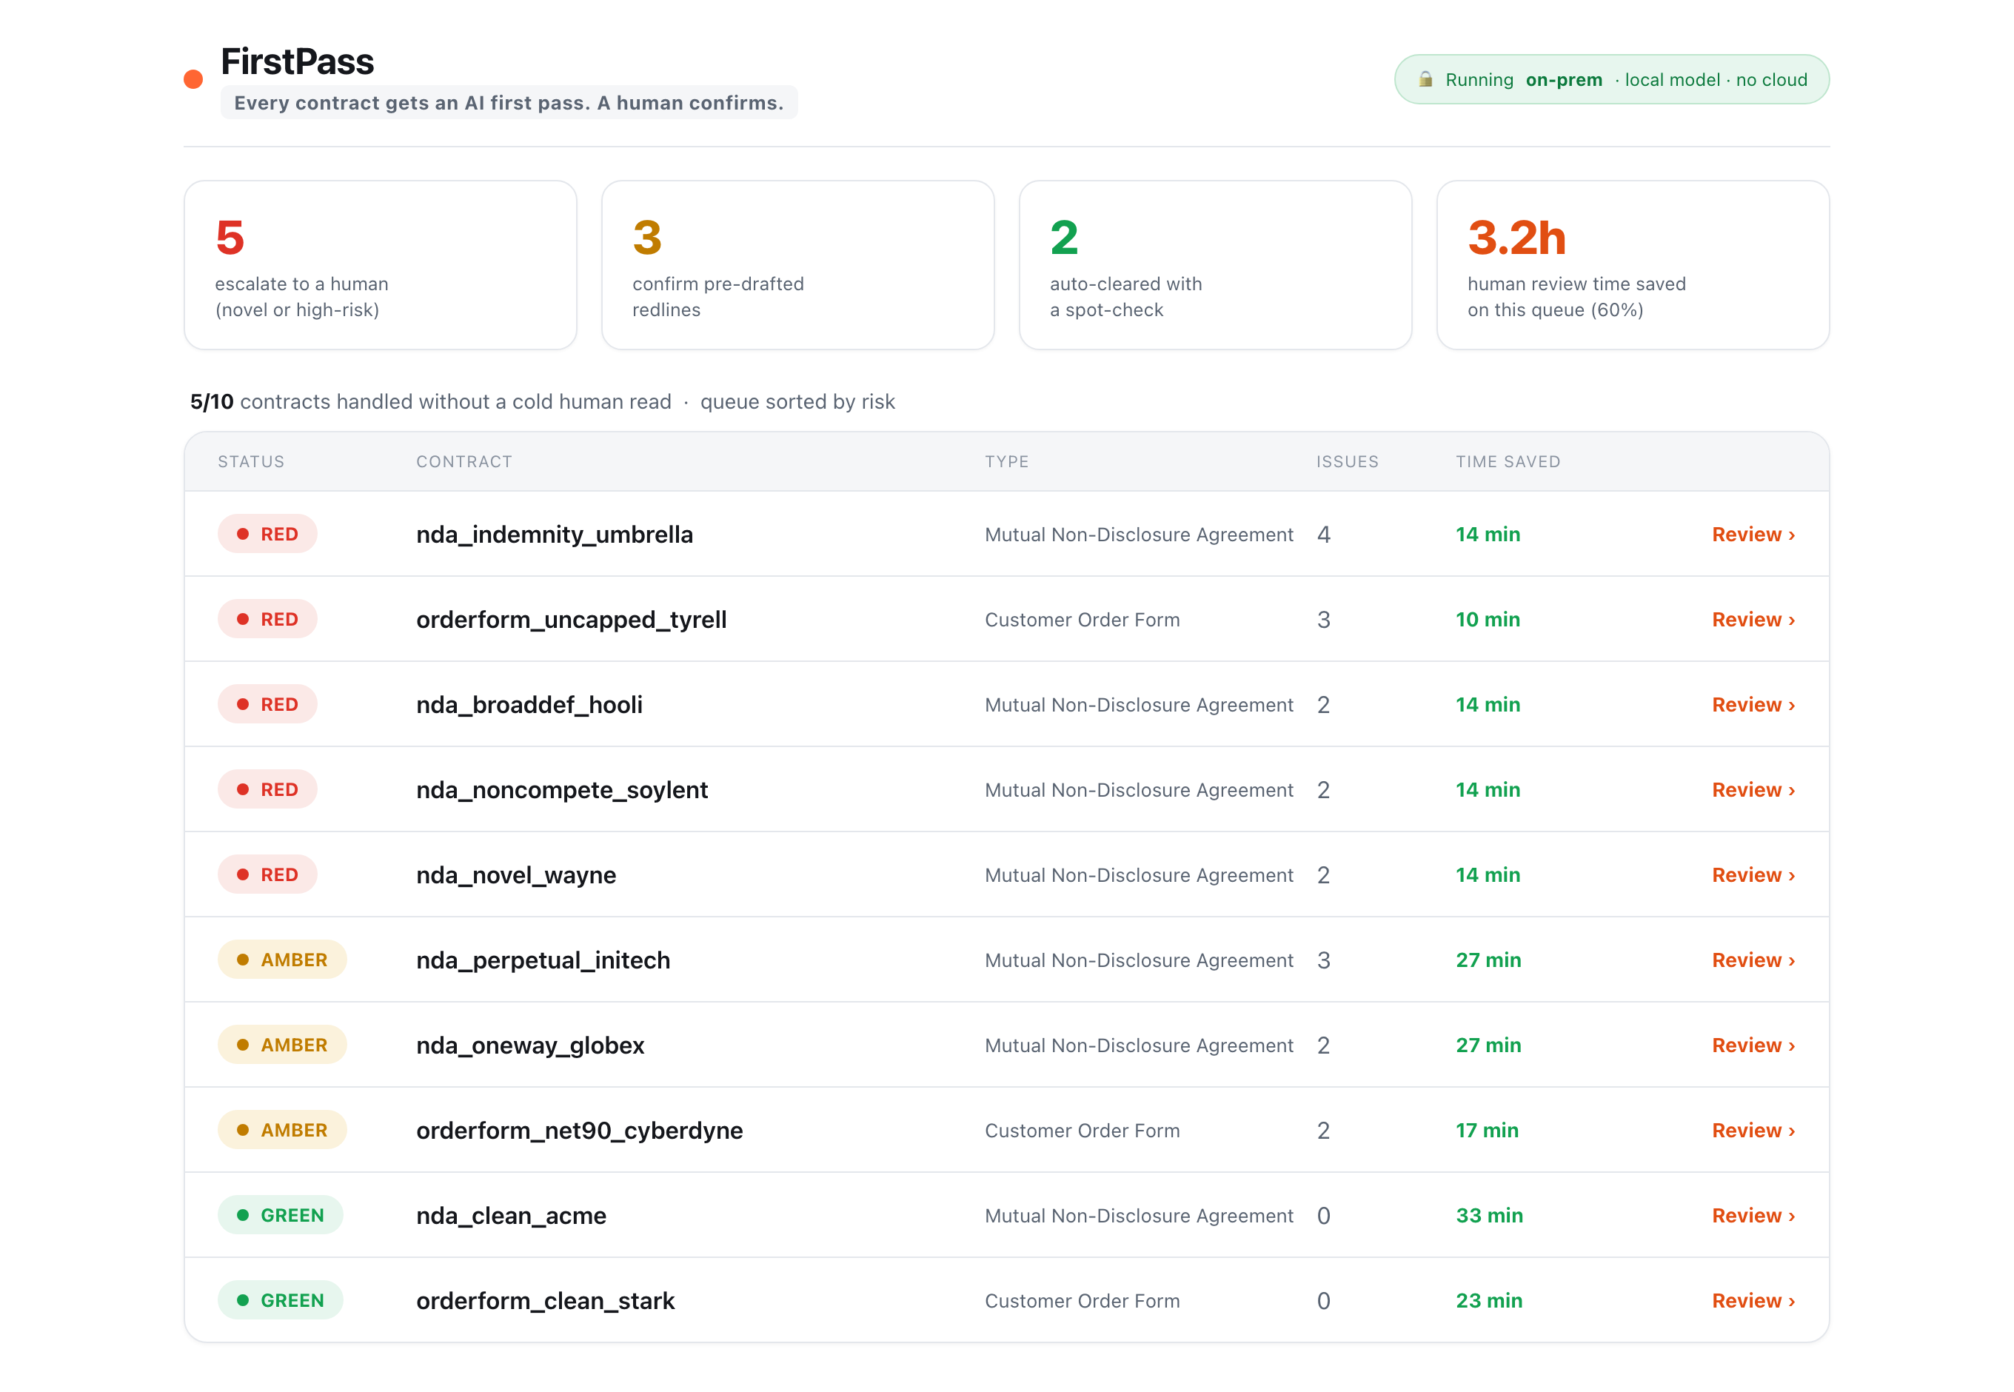
IT RUNS TODAY
A working console, not a mockup.
The queue a lawyer opens each morning.
Sorted by risk. The safe 80% is already cleared, the redlines are drafted, and only the real risk is waiting for a human.
🔒 Runs on your server
In-browser, local, offline. No contract text ever leaves the building.
FirstPass · AI Pioneer · Abdelrhman Rayis
12

Slide 13
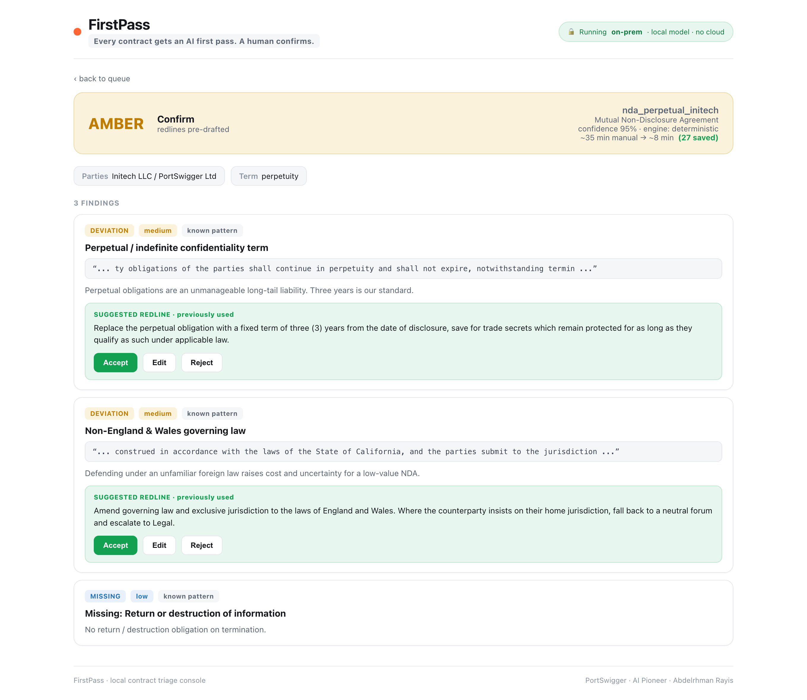
INSIDE A REVIEW
Every issue arrives with the redline already drafted.
The lawyer confirms, they do not start from scratch.
Key terms extracted. Each deviation shows the evidence, the plain-English reason, and the exact redline the team has used before.
Accept, edit or reject. One click.
This is the artefact someone uses on Monday morning.
FirstPass · AI Pioneer · Abdelrhman Rayis
13

Slide 14
DOES IT HELP?
Measured properly, on a labelled set, reproducibly.
0
100%
93 / 93
58%
unsafe misses: nothing risky was auto-cleared
triage verdict accuracy (10 of 10)
material-issue precision / recall, no LLM
of human review minutes removed
EXTRAPOLATED TO 200 CONTRACTS / MONTH
EXTERNAL BENCHMARK · LAWGEEX 2018
~73 hours
94% vs 85% AI beat 20 lawyers at NDA issue-spotting
26 sec vs 92 min average review time
The category is proven. This applies it to your queue, privately.
of legal time returned every month, about two weeks of a reviewer, pointed back at real risk.
FirstPass · AI Pioneer · Abdelrhman Rayis
14

Slide 15
IT GETS SMARTER
A knowledge base and a skill set that grow with every case.
A lawyer resolves a novel case
It becomes a rule in the knowledge base
That case is now routine, redline ready
Next month's queue is shorter
›
›
›
KNOWLEDGE BASE
SKILLS THAT COMPOUND
The playbook is plain English. Every decision a lawyer makes is captured as a rule with the redline they used. It fills with PortSwigger's own positions, so the system knows more each week.
A new contract type or clause is not new code, it is a new skill added to the playbook. The agent's abilities grow without an engineer, and none of it is lost when I leave.
Demonstrated: python evals/demo_learning.py closes the one gap the eval found, recall 93% to 100%, one playbook edit, no code.
FirstPass · AI Pioneer · Abdelrhman Rayis
15

Slide 16
PRIVATE BY DESIGN
Local AI on your server, and built to the standards that matter.
WHY LOCAL
HOW
Contracts are privileged and confidential, and you are a security company. So the reasoning model runs on your own server, not a third-party API. No contract text ever leaves your infrastructure: privacy is kept by construction, not by policy.
The deterministic engine needs no model at all: that is the floor. The reasoning layer is an open-weight model (Hermes 3, Llama 3.3, Qwen, Mistral) served locally with Ollama or vLLM. It ships as a skill on day one, then moves fully in-house.
BUILT TO THE STANDARDS THAT MATTER
UK GDPR / DPA 2018
ISO/IEC 27001
ISO/IEC 42001
EU AI Act / NIST AI RMF
Personal data in contracts, handled lawfully
Information security, on-prem by default
AI management system, governed and audited
Human-in-the-loop, explainable, risk-based
FirstPass · AI Pioneer · Abdelrhman Rayis
16

Slide 17
MY FIT
Why I applied, and how I would add value here.
WHY I APPLIED
HOW I ADD VALUE
PortSwigger is treating AI as the way it works, not a side project.
I already do this: drop into a domain, build a real thing, measure it, hand it over.
I want to be somewhere the ambition and the tooling are taken seriously.
Ship artefacts, not slides
A working tool someone uses on Monday.
Bring the expert with me
I work alongside the domain expert, not above them.
Measure everything
I care as much about the eval as the build.
Leave capability, not dependency
The playbook and skills stay when I move on.
FirstPass · AI Pioneer · Abdelrhman Rayis
17

Slide 18
Thank you.
This was one corner. There are twenty-five more.
The legal queue was the brief. The method is the point: find the risk gate, insert triage, measure it, keep it private, teach it to compound, then move on.
Legal today. Support, marketing, finance, recruitment next. Same loop, new domain.
Questions?
Abdelrhman Rayis · abdelrhman.rayis@gmail.com
Prototype, live console, evals and this deck are all in the submitted repo.

