Slide 1

Graph Coloring
Task 10

Slide 2
Algorithm used
1- Greedy algorithm. 2- Backtracking algorithm.
3- Naive Approach

Slide 3
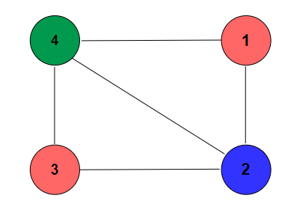
1- Greedy algorithm(PSUDOCODE)
Graph _Coloring (G[V][V], color[M])
1. color[1] = 1
2. for v <--- 2 to number of vertices V
3. do color[v] = -1 //End FOR LOOP
4. for i <--- 2 to number of vertices V
5. for c <--- 1 to M number of colors
6. for j <--- 1 to number of vertices V
7. do color[i] = c
8. do if G[i][j] = 1 and color[j] = c
9. color[i] = -1
10. break //End IF //End FOR LOOP
11. if color[i] != -1
Break //End IF //End FOR LOOP
if color[i] = -1
do print "The solution isn’t found"
return 0 //End IF
16. if i = number of vertices V
17. then Display_Solution(color[M])
18. return 1 //End IF
19. //End FOR LOOP

Slide 4

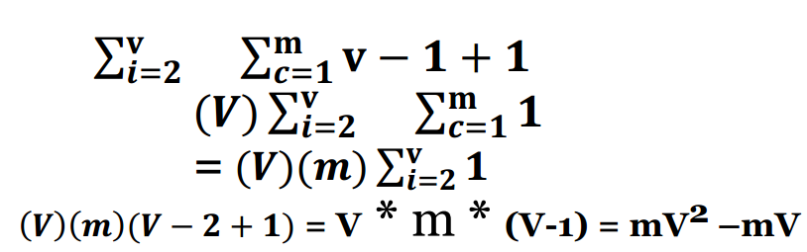
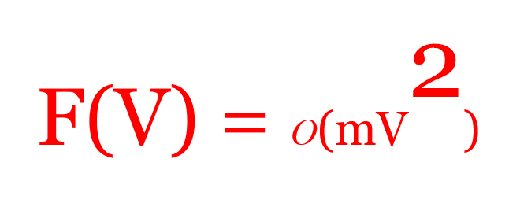
Time complexity

Slide 5
2- Backtracking Algorithm(PSUDOCODE)
Graph_Coloring(G[V][V],M)
1. for i <--- 1 to V
do color[i] <--- -1
//End For Loop
4. do if GraphColoringTrace(G,color,1) = 0
5. then print "Solution does not exist"
6. then return 0
7. //End IF
8. Display_Solution(color)
9. return 1

Slide 6
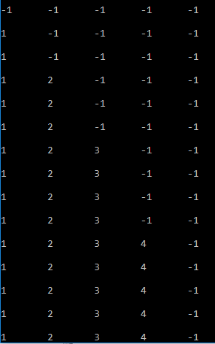
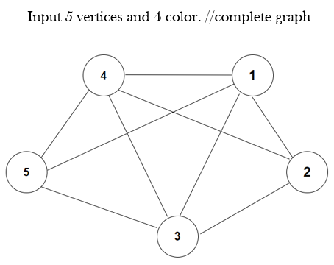
2- Backtracking Algorithm(PSUDOCODE)
GraphColoringTrace(G[V][V],Color[M],v)
1. do if v = V+1
2. then return 1
3. for c <--- 1 to M
4. do if Check_Availability(v,G,color,c) = 1
then color[v] = c
do if GraphColoringTrace(G,Color[M],v+1) = 1
then return 1
//END IF
then color[v]= -1
9. //END IF
10. //END FOR LOOP
11. return 0

Slide 7
(Check_Availability)
Check_Availability(v,G[V][V],color[M],c)
1. for i <--- 1 to V
2. do if G[v][i] = 1 and c= color[i]
3. then return 0
4. return 1

Slide 8
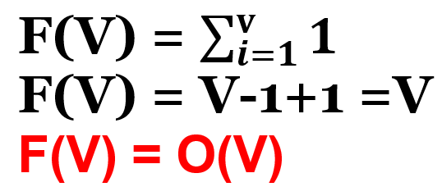
Time complexity
Basic operation is function check_Availability
Check_Availability(G[V][V],color) time complexity:-
Because # all of the combination of colors = m^{V}. So the time complexity is O(m^{V})
Hint: this time complexity is max but the average is less than it.

Slide 9
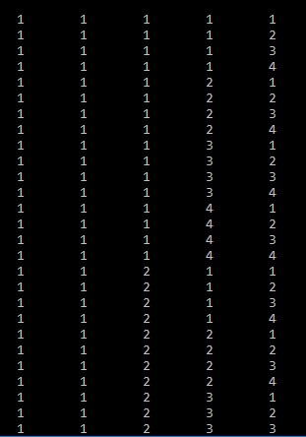
3- Naive Approach(PSUDOCODE)
Graph_Coloring(G[V][V], i, color[M])
1. do if i = number of vertices V + 1
2. then do if check_Availability(G,color)=1
3. then printSolution(color)
then return 1
// END IF
6. return 0
7. //END IF
6. for j <--- 1 to M
7. do color[i] = j
8. do if Graph_Coloring (G, i+1, color)= 1
then return 1
// END IF
do color[i] = 0
//END FOR LOOP
11. return 0

Slide 10
(Check_Availability)
check_Availability(G[V][V],color[M])
1. for i <--- 1 to Number of Vertices V
2. for j <--- i+1 to Number of Vertices V
3. do if G[i][j] and color[j] =color[i]
4. then return 0
5. return 1

Slide 11
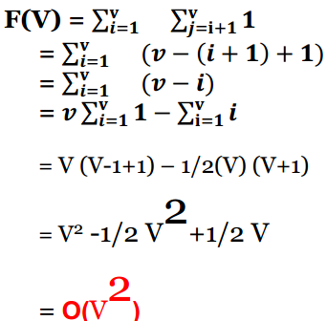
Time complexity
Basic operation is function check_Availability
Check_Availability(G[V][V],color[M]) time complexity:-
Because # all of the combination of colors =
M POW (V).
F(V)= m POW(2V) + c , So the time complexity is
O(M POW(2V)).
Hint: this time complexity is max but the average is less than it.

Slide 12

Email: abdelrahman_20180314@fci.Helwan.edu.eg
PLEASE contact with me if you have anything not clear

