Slide 1
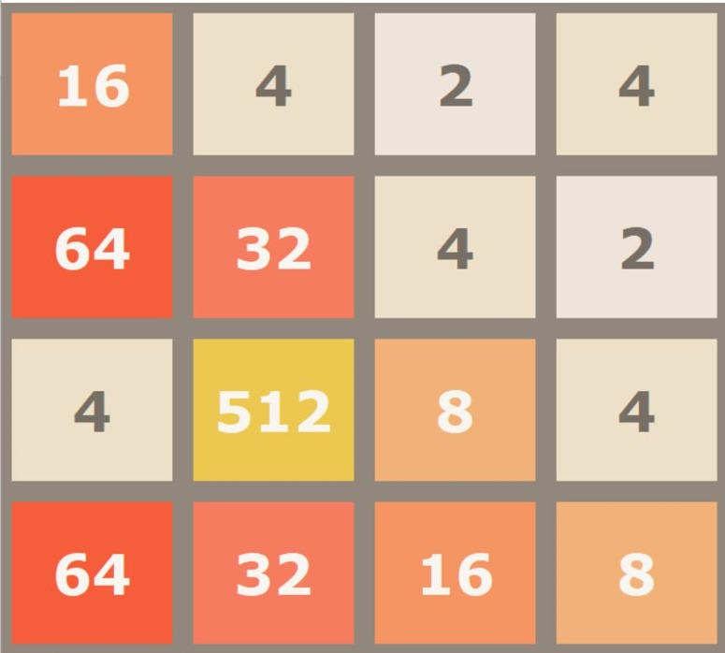

Deep Q-Network for 2048 Game
Problem Definition
2048 is a puzzle game played on a 4×4 grid, where the player slides
numbered tiles in one of four directions (up, down, left, or right).
When two tiles with the same number merged
Goal
The objective is to combine tiles until a 2048-value tile is created.

Slide 2
Environment & State
Actions & Agent
Rewards & Penalty
→ Environment
→ Actions
→ Rewards
Increase in Tile Value: When the value of a tile increases due to a merge (e.g., merging two tiles of value 2 to form a tile of value 4).
Game interface (The environment is represented by a 4x4 grid where each cell can contain a tile with a numerical value),
stochastic environment: after merging one tile added with value 2 (90%) or value 4 (10%).
The moves that the agent can make [up → 0, left →1, right → 2, down → 3].
→ Agent
The AI model that observes the game board, decides moves (up, down, left, right), receives rewards/penalties, and the environment responds by updating the game grid and learns to maximize the score.
Number of Merges: The reward also considers the number of merges that occurred during the move.
→ State
→ Penalty
The current configuration of the 2048 game board, including the positions, tile values and empty spaces.
Small penalty if no tiles merge after a move.
Additional penalty if the board has very
few empty spaces.

Slide 3
→ Predicted Output (Without Implementation)
→ Game Explanation
1. Initialize game board (4x4 grid with 2 tiles).
2. Initialize Q-network with random weights.
3. For each episode (until game over):
Reset 2048 board to initial state
4. While game not over:
a. Pass the current board state to CNN to predict Q-values for all actions.
b. With probability ε: Choose random action (exploration).
Else: Choose action with max Q-value (exploitation).
c. Execute action, get reward (merge score + empty cells bonus + max tile bonus) and next state.
d. Update Q-value.
e. Store (s, a, r, s') in replay memory.
5. Sample random batch from replay memory and train Q-network.
6. Termination:
Win: Reached 2048.
Lose: No valid moves left.
7. Reduce epsilon gradually (to explore less and exploit more over time)
8. Repeat until convergence or max episodes.

Slide 4





Why Deep Q-Learning for 2048?
Q-Learning
SARSA
Uses a table for state-action values.
Like Q-Learning but on-policy.
Too many states in 2048 → make it slow and memory heavy.
Still stuck with huge tables and less exploration.
Handles Complexity
Generalization
DQL’s neural network tackles 2048’s high state complexity, while Q-Learning and SARSA’s tables fail to scale.
1
DQL learns patterns in complex boards, avoiding the need to memorize every state.
2
DQN
4
3
Exploration
DQL’s epsilon-greedy method explores complex state spaces better than SARSA’s on-policy approach.
Efficiency
DQL’s experience replay speeds up learning in complex environments, outpacing Q-Learning and SARSA’s slower updates.

Slide 5

Thank You
Hassan Hamed Zoghly
Abdelrhman Ahmed Ezzat
Ahmed Abdellatif Amer
Mustafa Nasser Fouda

