Slide 1
“ESCAPE 3D”
A computer graphics course project

Slide 2
THE GAME IDEA
You’re playing in a haunted house, trying to escape.
Your way out is fulfilled by monsters trying to kill you.
You have to fight them, solve the puzzles and find the car’s key to escape the area.

Slide 3
Important to know
The basic way to draw an element on the screen is by calling glBegin() in the display function, provided a parameter (e.g. GL_POLYGONS), then define the vertices to be drawn, then ending with glEnd(), but this way of displaying is too slow.
In this game we used another technique called “Display lists”.
Display lists are used to optimize the performance of rendering (i.e. rendering faster). They are mostly used for rendering larger objects, which require a large number of glVertex calls.
Display lists can store on the GPU a list of OpenGL command. Any OpenGL command can be stored in a display list. At the display list creation, those command are compiled in the display list. Afterwards, those commands can be called lots of time in a faster way (data is already sent to the GPU) than the classic rendering (direct mode).
For more information please visit this website .

Slide 4
GAME FILES
Menu.py #Contains the game intro, title menu and the settings.
Main.py #The main file for the in-game display.
Collision.py #Detects the player’s collision with objects in the world.
Loader.py #Contains the loader for 3D models “.obj” and materials “.mtl”.
Object.py #Class to create 3D models in the game.
Player.py #Class for the player properties.
Texture.py #Loads any texture in the game (e.g. Skybox).
World.py #Renders the world terrain.
Zombie.py #Class for making zombie objects, and their properties.

Slide 5
SUB FOLDERS
Menu #Contains all audio & texture files used in the main menu.
Models #Contains all 3D models in “.obj” format
Options #Contains option file that controls the game options.
Sounds #Contains all audio files used in the game, in “.wav” format.
Texture #Contains texture images in “.png & .jpeg & .jpg” formats.

Slide 6
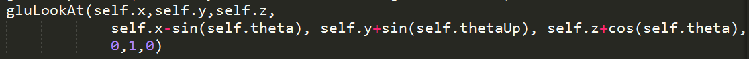
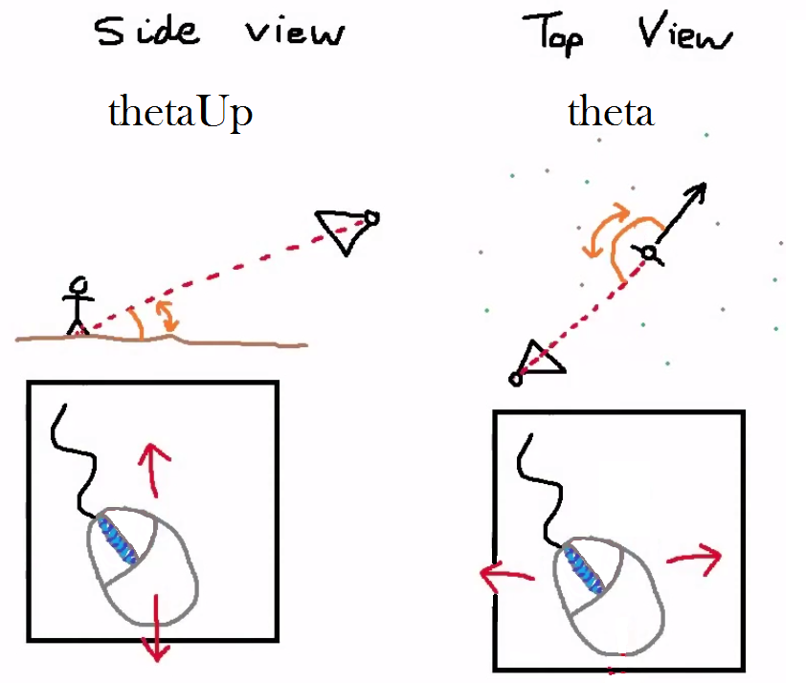
PLAYER MOVEMENT CAMERA
The player in any FPS game is the represented by the camera, so player movement depends on the position of the camera and viewing angles depend on the camera view.
The eye is the position of the player .
The center is the point in front of the player.

Slide 7
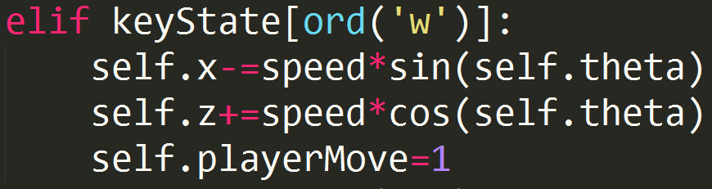
PLAYER MOVEMENT MOVE
Moving in (x, z) coordinates depends on the theta of the player.
With very simple geometric calculation, if the player presses ‘w’ to move forward the increment of x and z will be according to a function of theta.

Slide 8
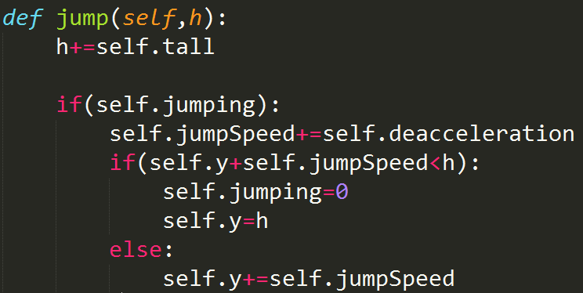
PLAYER JUMPING
Jumping is effected by (gravity, player’s strength).
The initial speed of the player’s jump is equal to his strength.
Then the speed is decreased linearly till it become negative and the player start to fall down.
The player stops falling when he touches the ground with height = h.

Slide 9
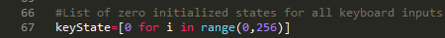
KEYBOARD
The main problem is that glutKeyboardFunc doesn’t take continuous input, the idea to solve that is to make a list of flags, whenever the user presses a button, the matching flag is set to 1. Releasing the button resets the flag to 0.
We use glutKeyboardUpFunc to know the key that user released.
Also we ignore repeated key input with glutIgnoreKeyRepeat( GL_TRUE ).

Slide 10
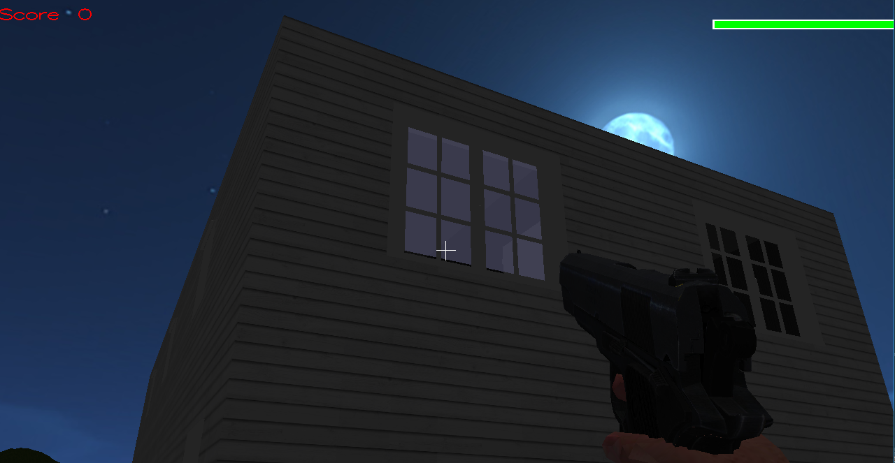
WINDOWS
The difference between a window and any other polygon is that the window have transparency, so we use glColor4f(R,G,B,A) after enabling GL_BLEND.

Slide 11
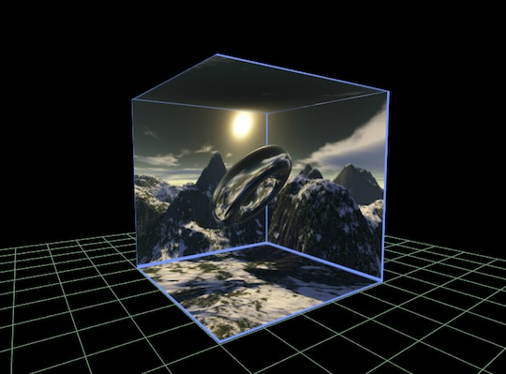
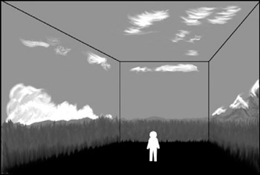
SKYBOX
Skybox: one of the most important techniques used in 3D games to make the game more realistic.
The idea is very simple and the result in amazing.

Slide 12
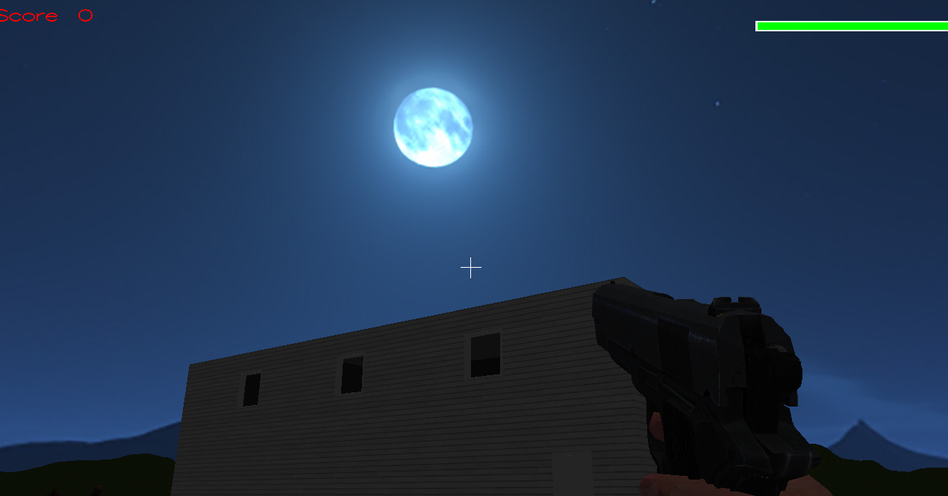
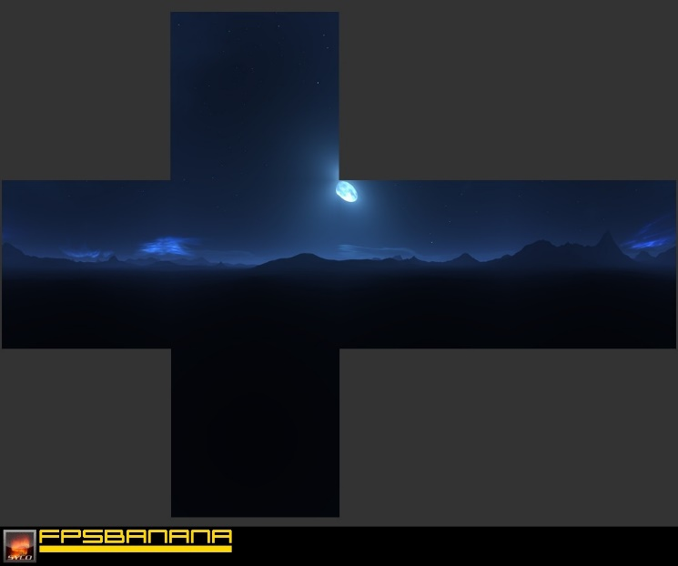
SKYBOX cont.
Skybox is made out of 6 different images representing 6 sides of a box (cube), loaded and projected in a specific order.

Slide 13

WORLD “Terrain”
We use Height Map Technique to render the terrain.
Every pixel in the image gives us a height of a point in the world.
The most white is the highest and most black is lowest height.
Note that any image has three color channels with 256 color range (0~255), but in this case we are working on grayscale images, therefore the three color channels are equal in value.
We use Pillow “PIL” library to read the image’s pixels.
The game height map

Slide 14
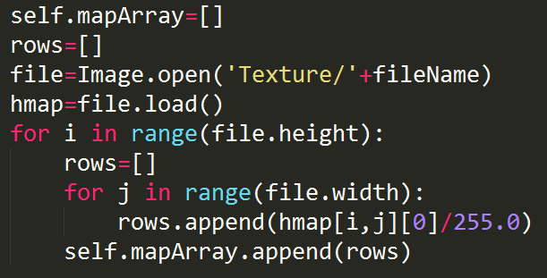
WORLD “Terrain” IMG. PROCESSING
Read all the pixels by looping over each pixel in a row, for all rows.
On scale from 0 to 1, calculate the height value from the color value (the 3 channels are equal, any channel divided by 255) then store them in a list.
Store the rows of pixels in a 2D array.

Slide 15
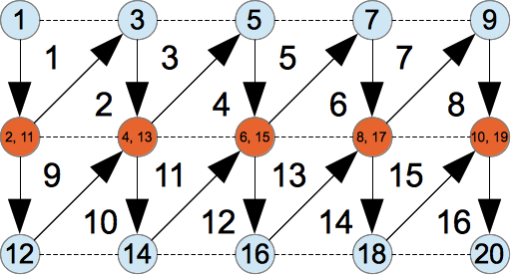
WORLD “Terrain” RENDERING
Now as we have a 2D array that returns the float height value (0~1) for the given [#row][#pixel], we will use the visualized algorithm using GL_TRIANGLE_STRIP to render the height map.

Slide 16
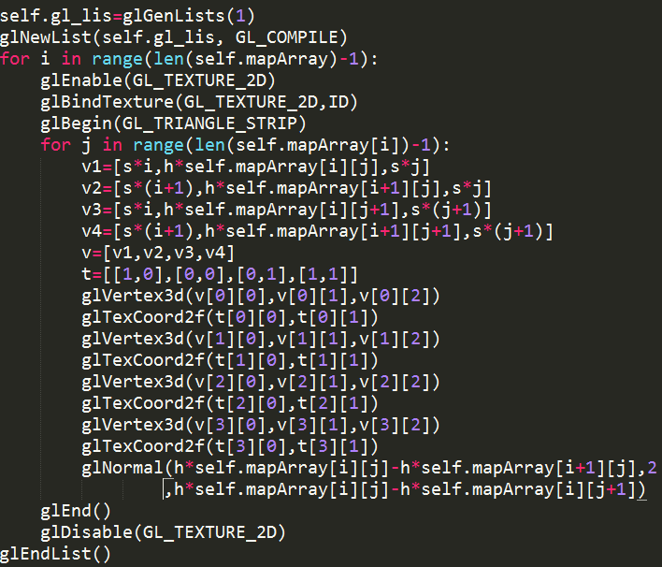
WORLD “Terrain” CODE
Using the array we made and the previous algorithm, we will start drawing triangle strips filled with the ground’s texture to create the world terrain.
Note that we can control the height scale and the filled area easily.
For fast rendering in game frames, do the rendering process once then save it in glList, then call the list in the display function. This increases the performance widely.
Don’t forget to calculate the normal for each triangle, otherwise the lighting will not work correctly.

Slide 17
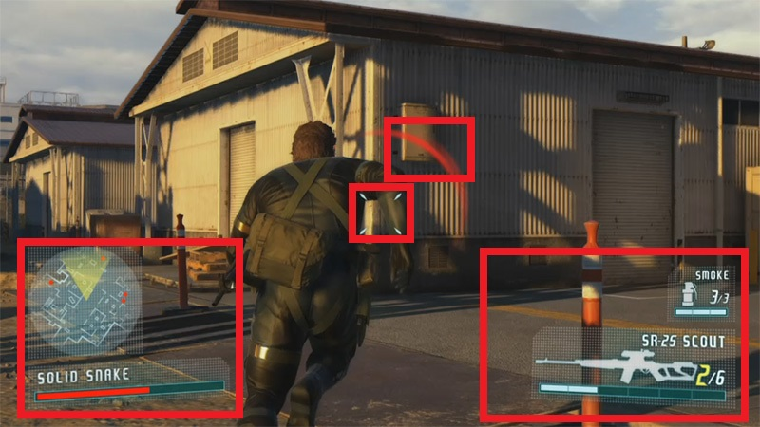
HUD (Head Up Display)
Challenge: 2D over 3D projection!
How to write a 2D text over a 3D game ?
How to load a 2D image over a 3D game ?
The technique is very simple:
1. Push the projection matrix.
2. Create orthographic projection.
3. Push the model view matrix.
4. Draw the 2D stuff (text, images, etc..).
5. Pop the projection matrix again.

Slide 18
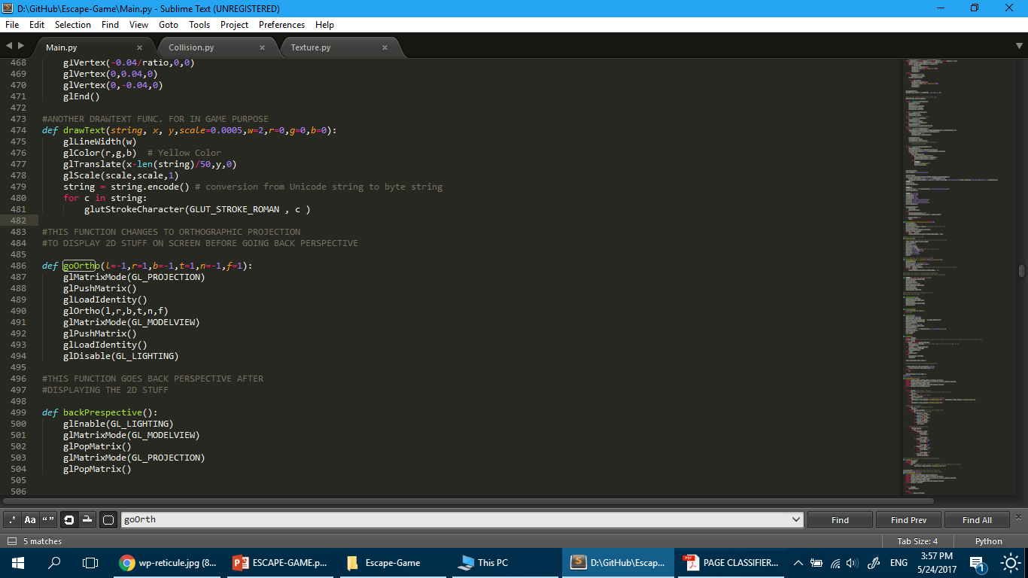
HUD (Head Up Display) CODE
1. Call
2. Draw any thing
3. Call

Slide 19
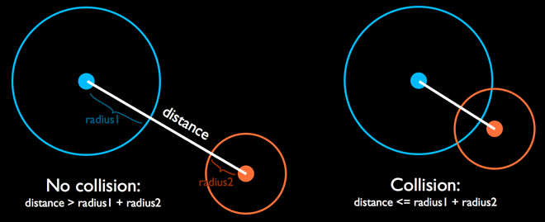
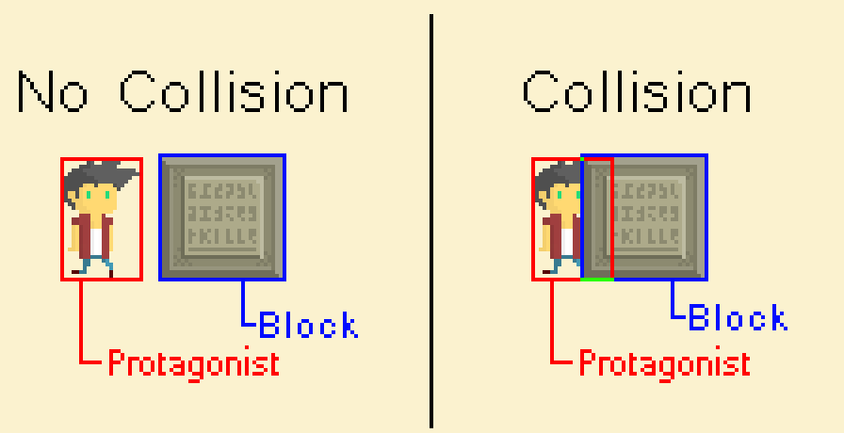
COLLISION DETECTION
We use two ways to check the collision.
First, for collision with walls we use AABB collision detection.
Second, for collision with objects in the world we use sphere collision detection technique.

Slide 20
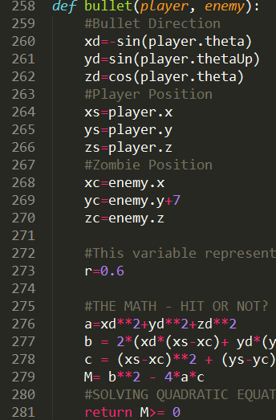
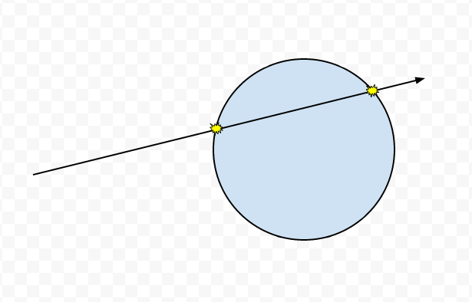
BULLET COLLISION DETECTION
To detect the collision of a bullet with the monster “the zombie”, we use Ray Tracing technique.

Slide 21
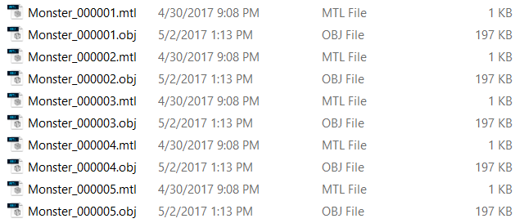
MODELS ANIMATION
Animation is done by displaying a sequence of different frames for the 3D model, each is saved as separated object “.obj” file, in order to make illusion of movements.
We used blender 3D software to animate and export the 3D models.

Slide 22
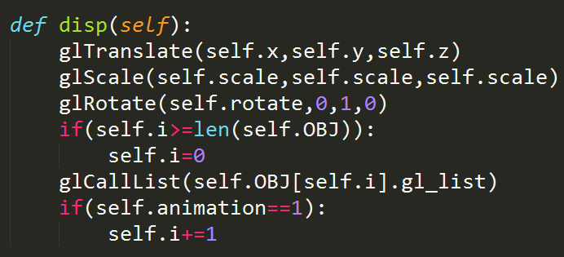
MODELS ANIMATION CODE
Make appropriate translation, scaling and rotation.
Display current frame “ i ” using glCallList()
If animation is on, increase “ i “ to get next the display frame.

Slide 23
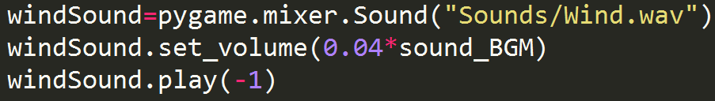
SOUND & AUDIO
Pygame library is used to play all sound files.
Play(-1) repeats the sound indefinitely.

Slide 24
Menu.py
Uses orthographic projection.
Loads different background images for game intro and title menu.
Contains different display functions that are called in glutTimerFunc() as controlled by flags.
displayIntro() : called first by glutDisplayFunc() to start the game with the intro.
displayMenu(): called by glutTimerFunc() after the intro is done (or skipped). Back button calls displayIntro() again.
displaySettings() : called when the user selects the Settings button.
displayCredits() : called when the use selects the credtis button.
All buttons and animated text are written text by glutStrokeChar() with OpenGL built in fonts.
Buttons are selected or modified as controlled by mouse and keyboard functions.

Slide 25
Zombie.py
Zombie
Initiates zombie frames. Position in x, y, z . The properties like rotation, scale, height and sound.
Height() #to edit zombie position depend on the height of the world Dist() #calculate the distance between zombie and the player Disp() #display zombie’s frames Walk() #make zombie walk toward the player

Slide 26
Object.py
obje
Initiates object frames (If needed). Position in x, y, z . The properties like rotation, scale, height and sound.
Disp() #display object’s frames. dispDoor() #special display if the object is door.

Slide 27
Player.py
player
Initiates gun frames, foot sound. His properties like speed, height, jump strength and health.
updateCamera() updateTool() #Changes between weapons displayTool() #Displays current equipped tool jump() Move() #Make the player move in the world also check the collision

Slide 28
TEAM MEMBERS
ABDELRAHMAN METWALY (L)
ABDELRAHMAN TAREK
ABDELRAHMAN EMAM
AHMED WALEED
AMR KHALID
KHALED EL-DEEP
KHALID AAMIR
MOHAMED LEBDA
SHAKIR GAD
ZEYAD EL-SAWY

Slide 29
Don’t forget to try the game ! Available as open source on github
https://github.com/spearkiller0/Escape-Game

Slide 30
THANK YOU !

