Slide 1


NETWORK SECURITY PROJECT
FTP Intrusion Detection

Slide 2
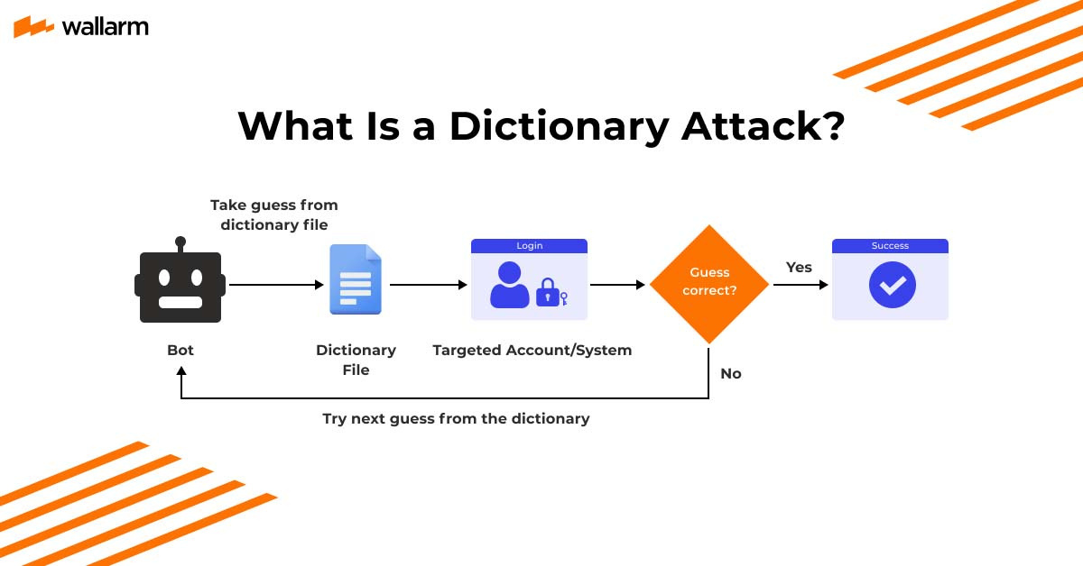
Introduction to FTP Vulnerabilities
Understanding Dictionary Attacks

Slide 3
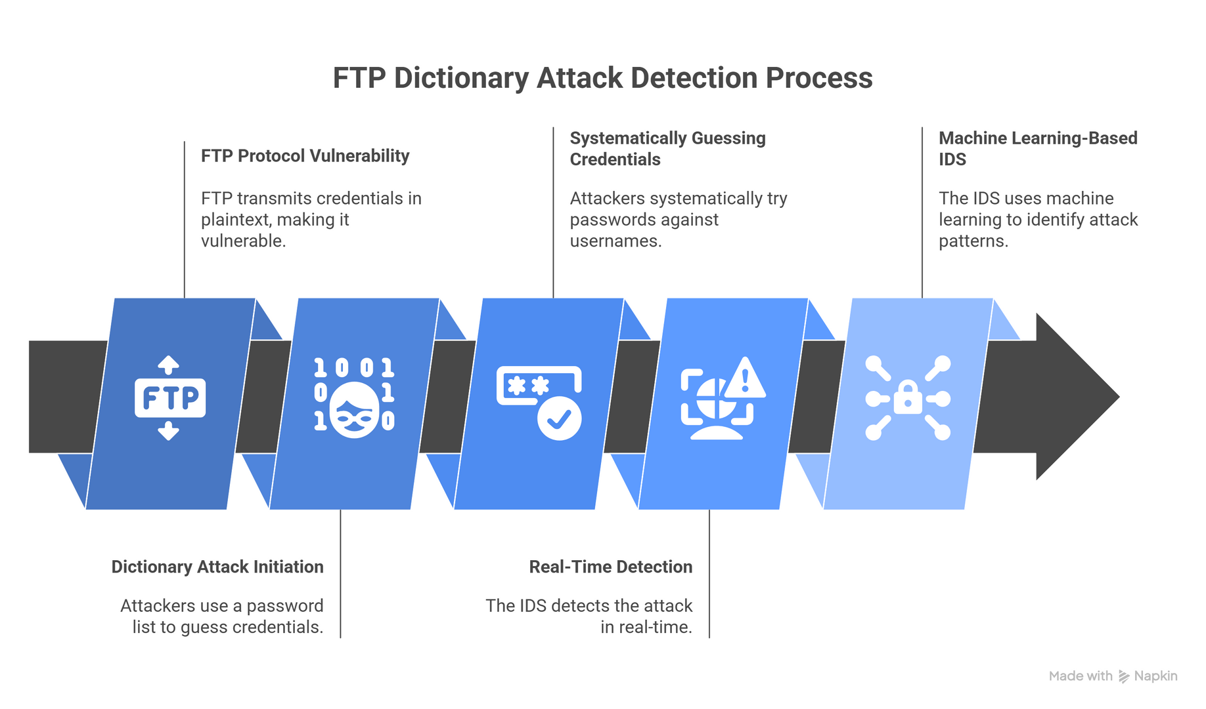
FTP Protocol Overview

Slide 4
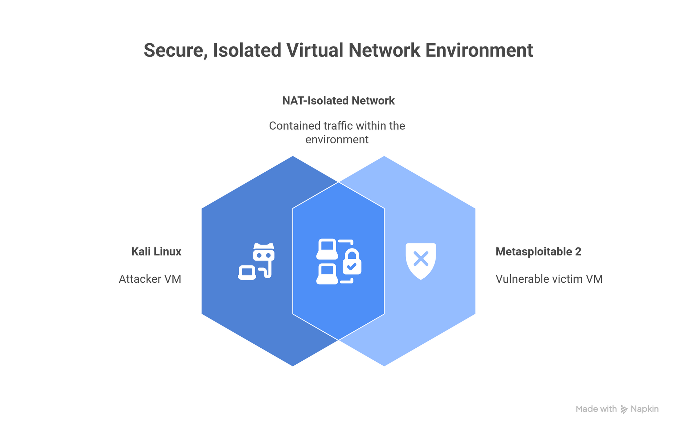
Lab Setup and Topology

Slide 5

Attack Execution and Data Labeling
Phases of Attack Simulation
The attack simulation included reconnaissance to identify FTP vulnerabilities, benign traffic generation for baseline, and executing a dictionary attack to demonstrate FTP's inherent weaknesses.

Slide 6
Dataset Overview
Analyzing PCAPNG Traffic
Raw PCAPNG Traffic
Time-Window Aggregation
The initial dataset consists of 13,244 packet records captured in PCAPNG format. This raw traffic data includes various FTP commands and responses, providing a comprehensive view of network interactions during the simulated attacks. The diversity in packet types allows for a robust analysis of the traffic patterns associated with both benign and malicious activities.
To enhance the signal-to-noise ratio, the traffic data is aggregated into 1-second time intervals, resulting in 1,554 summarized windows. This transformation helps in filtering out individual noisy packets, leading to a more meaningful analysis of behavioral patterns over time. The aggregation facilitates a clearer understanding of traffic trends, crucial for effective machine learning model training.

Slide 7
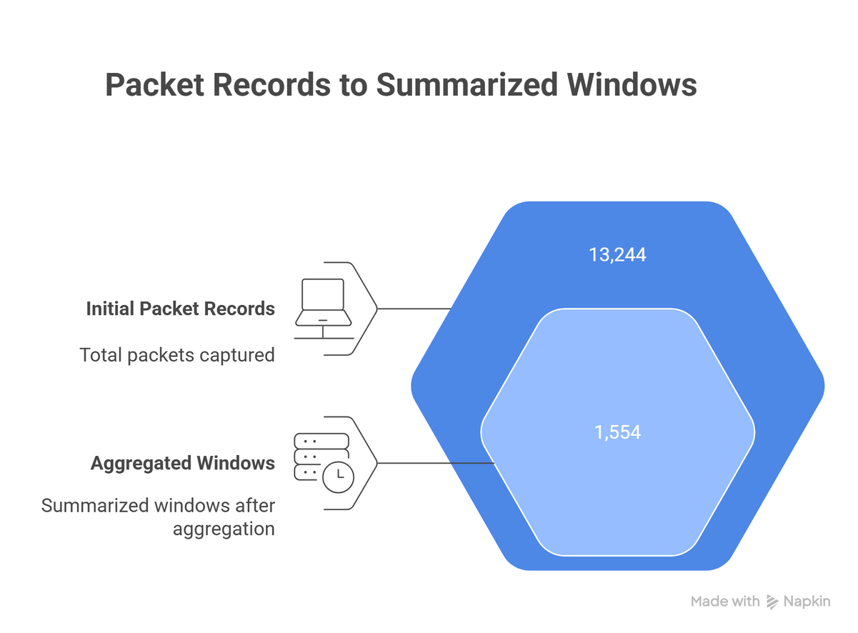
Feature Engineering
Packet Count
The packet_count feature indicates the total number of packets exchanged, reflecting overall traffic volume during FTP sessions.
Byte Sum
Byte Mean
The byte_sum feature measures the total bytes transferred, providing insight into the data mass transferred during FTP operations.
The byte_mean feature calculates the average packet size, helping to identify traffic patterns associated with legitimate and malicious activities.

Slide 8
Machine Learning Models
Logistic Regression
Chosen for its computational efficiency, Logistic Regression performed better in this dataset, providing a simpler yet effective approach to attack detection.
Evaluation of classifiers and their performance metrics
Random Forest
The Random Forest classifier is a powerful ensemble model, using multiple decision trees to enhance detection accuracy and robustness against overfitting.
Evaluation Metrics
Key metrics include recall, focusing on minimizing false negatives, with precision also considered, ensuring a comprehensive assessment of the model's performance.

Slide 9
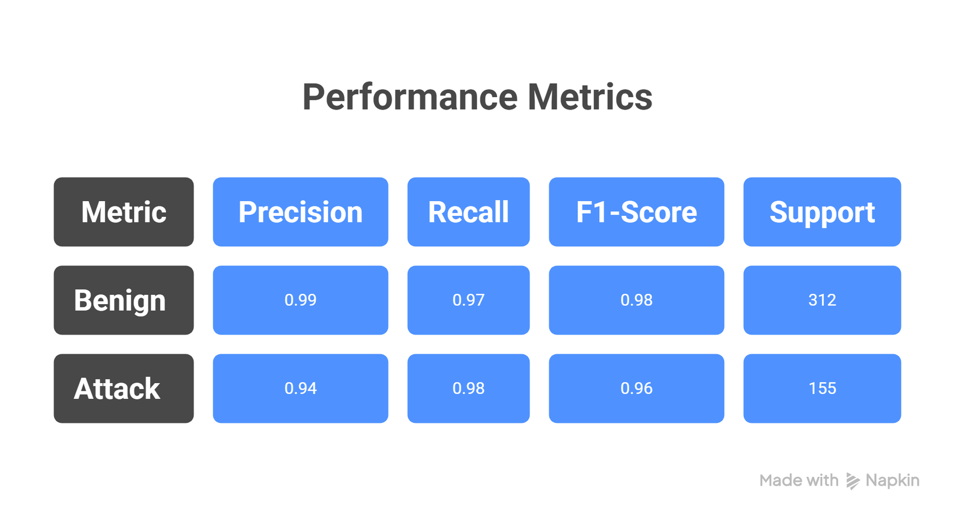
Classification Report Highlights
Key Metrics Overview

Slide 10
Conclusion and Future Directions
Project Recap
The project demonstrates that machine learning can effectively detect FTP dictionary attacks, achieving high recall and accuracy through feature analysis.
Summary of findings and next steps for improvement
Defense Layer
Implementing this detection system provides a critical defense layer for FTP servers vulnerable to automated brute force attacks.
Deep Learning Models
Future work will explore deep learning models like RNNs and LSTMs to enhance detection of subtle or low-frequency attack patterns.

