Slide 1
Master Project

Slide 2
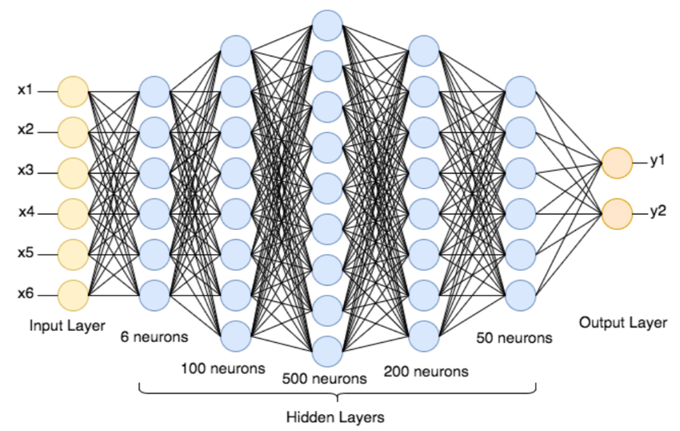
ANN

Slide 3
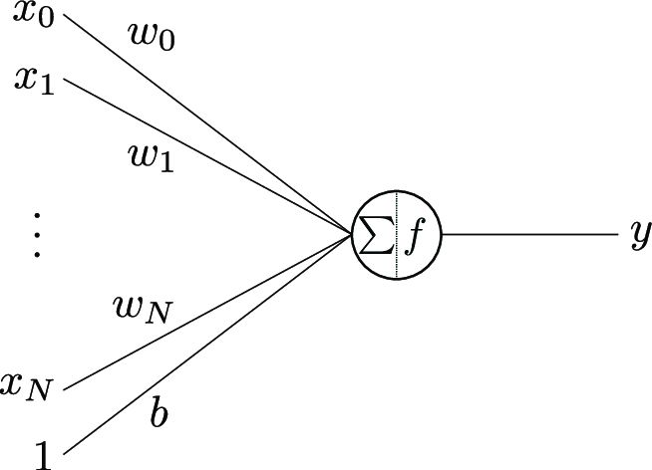
Neuron

Slide 4
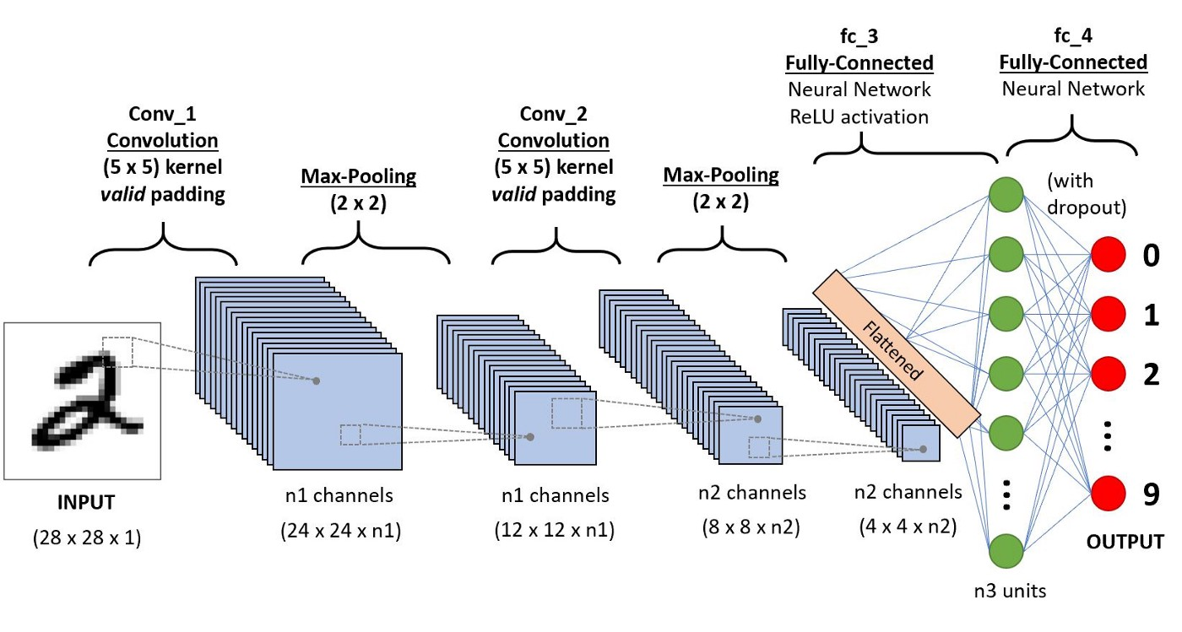
CNN

Slide 5
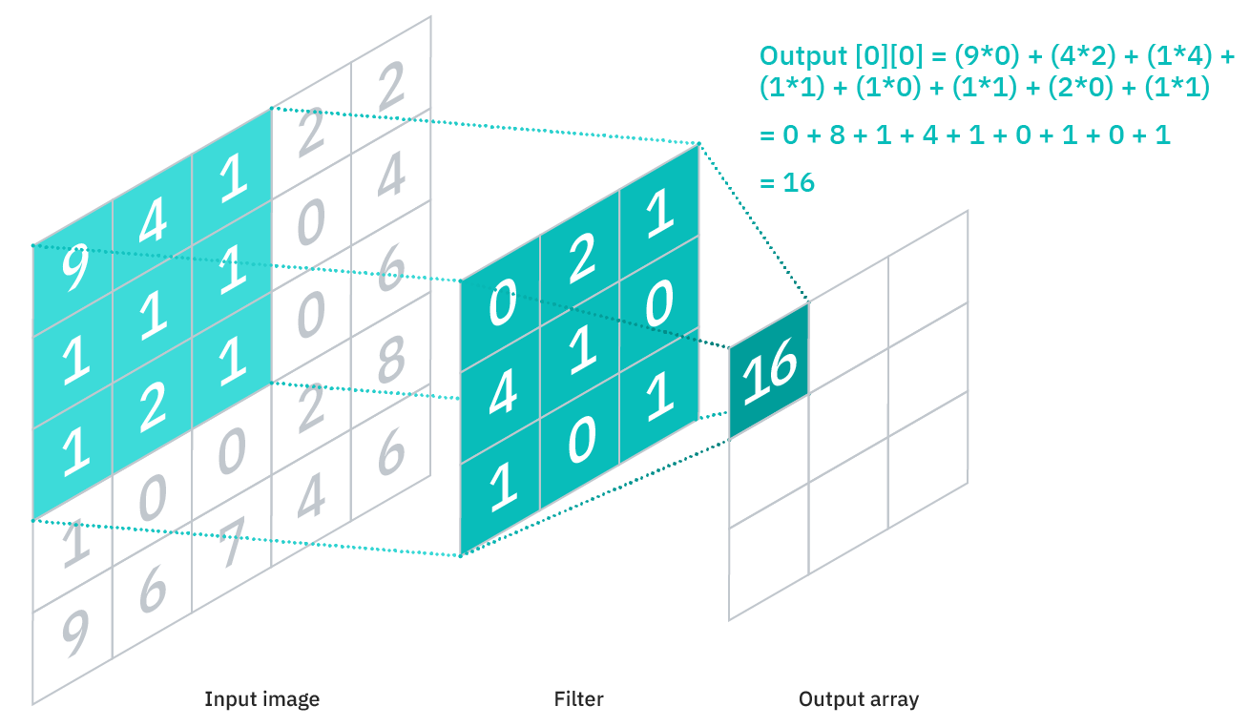
Convolutional Layer

Slide 6
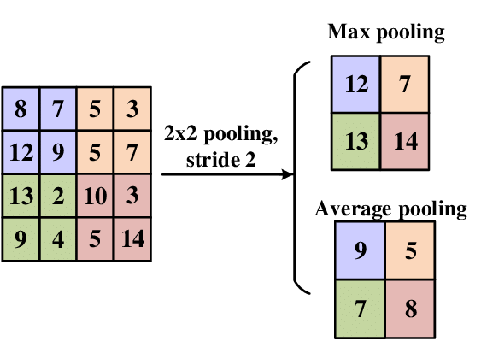
Pooling layer

Slide 7
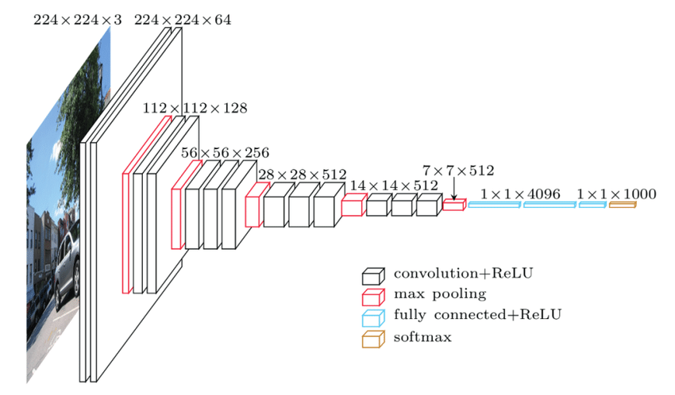
VGG Net

Slide 8

Resnet Net

Slide 9
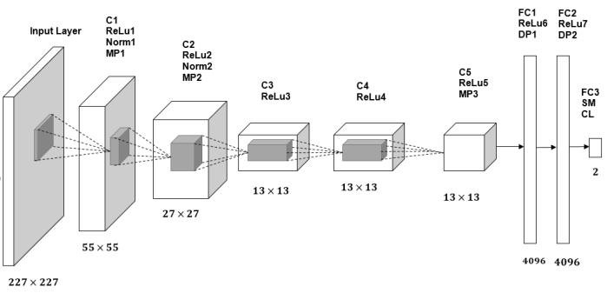
Alex Net

