Slide 1
Feature | Country Code Picker | Android Country Picker
Country Selection | Secondary Feature | Primary Feature
Full phone number support | Primary Feature | Out of Scope
Multilanguage Support | Available | Coming Soon… (Right now English Only)
ISO Countries | Available | Available
Non-ISO Countries | Available | Coming Soon
Implementation | Java | Kotlin
Emoji Flag | Beta | Available
Flag image | Available | Coming Soon
Modular | No | Yes (Dialog can be launched, or country list can be loaded into RecyclerView independently)
Info fields | Alpha2Code,Name | alpha2, alpha3, englishName, demonym, capitalEnglishName. areaKM2, population, currencyCode, currencyName, currencySymbol, cctld, flagEmoji, phoneCode, name

Slide 2
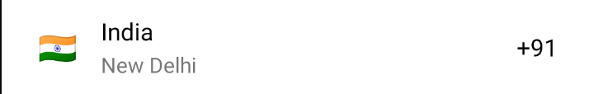
CPRow
Anatomy of country row
(Android Country Picker)
Secondary Text
Highlighted Text
Flag
Primary Text

Slide 3

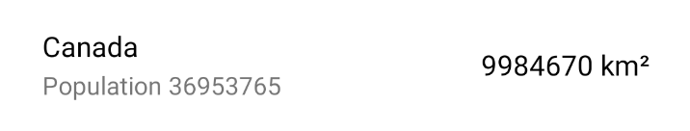

CP Row possibilities
Examples of row customization
(Android Country Picker)
Default row configuration
(Android Country Picker)
Many More…

Slide 4

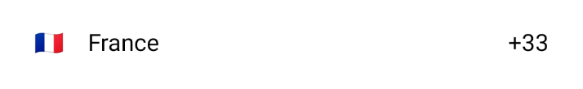

Custom text
Custom primary text
(Android Country Picker)
Custom highlighted text
(Android Country Picker)
Custom secondary text
(Android Country Picker)

Slide 5
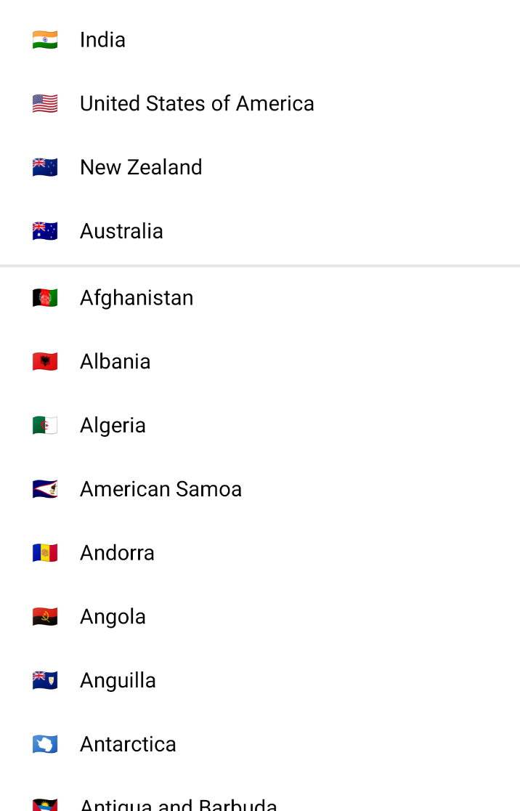
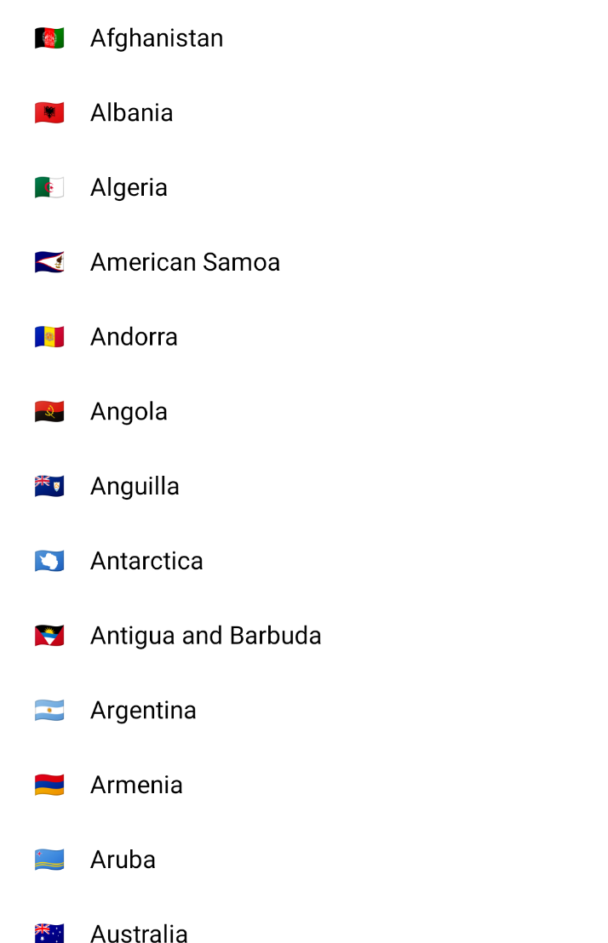
Default Country List RecyclerView
(Android Country Picker)
Country List - RecyclerView
(Android Country Picker)
Preferred
Countries
All
Countries

Slide 6
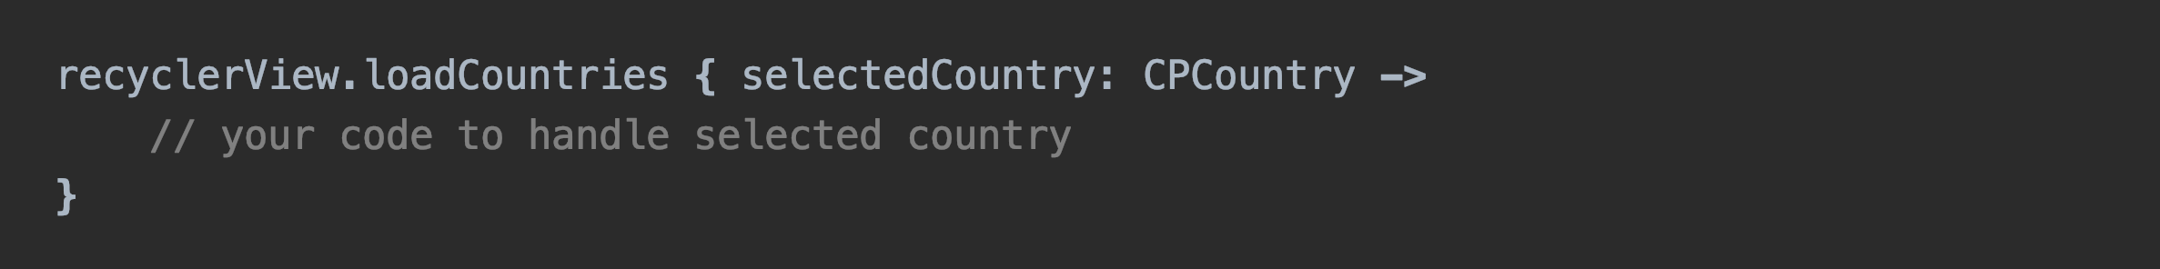
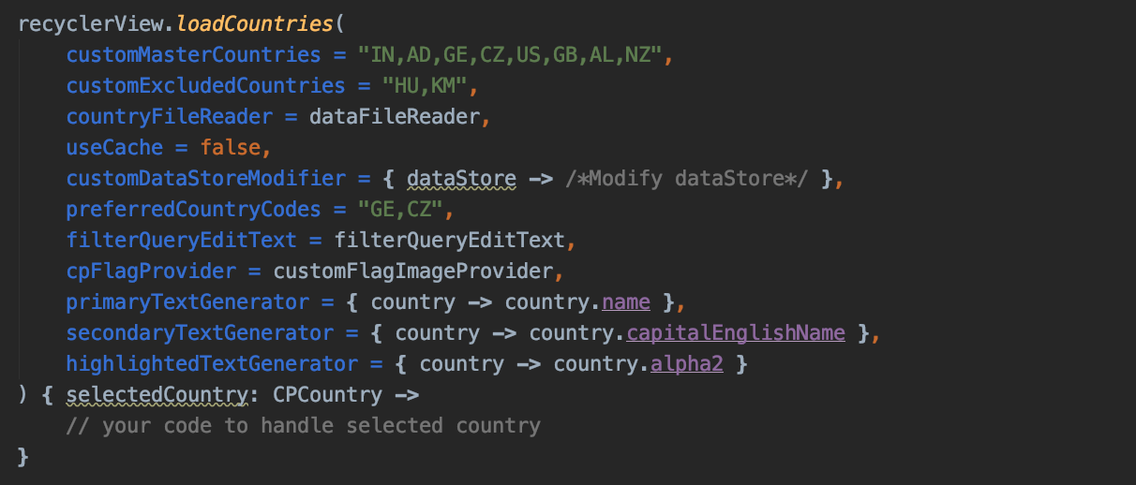
CP RecyclerView extension function
(Android Country Picker)
Default
OR
Available configuration options
Show only these countries
Datastore
Configuration
Show all countries but these
Custom Country data reader
Use cache when preparing CPDataStore
CPList
Configuration
Modify texts / country list
Show these countries on top of the list
EditText of Filter / Search query
Flag Image Provider
CPRow
Configuration
Main text of country row
Text below main text
Text towards end of the country row
Handle selected country

Slide 7
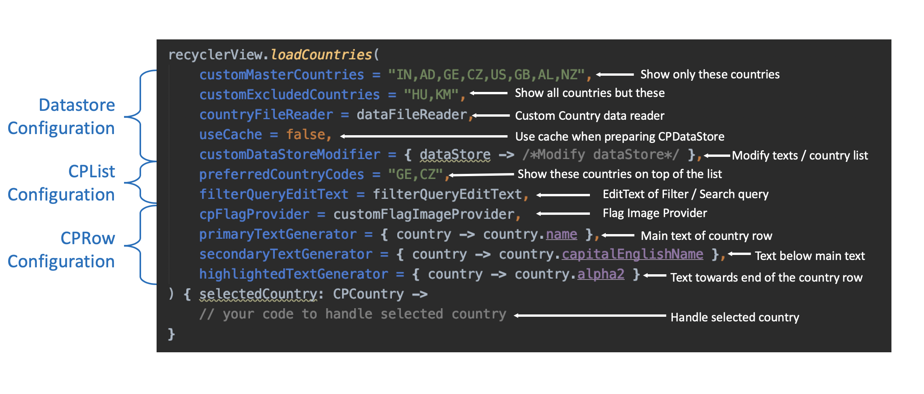

Slide 8
CPRecyclerViewHelper
Constructor Params
cpDataStore: CPDataStore
cpListConfig: CPListConfig cpRowConfig: CPRowConfig
onCountryClickListener: ((CPCountry) -> Unit)
Public Methods
attachRecyclerView(recyclerView: RecyclerView)
attachFilterQueryEditText(queryEditText: EditText?)
updateDataForQuery(query: String)

Slide 9
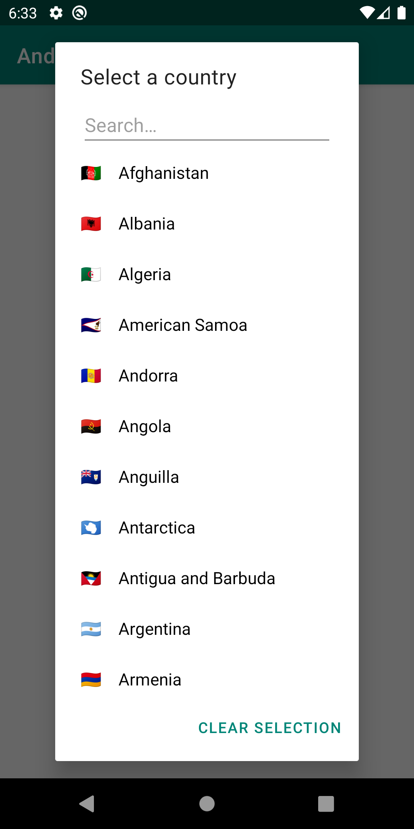
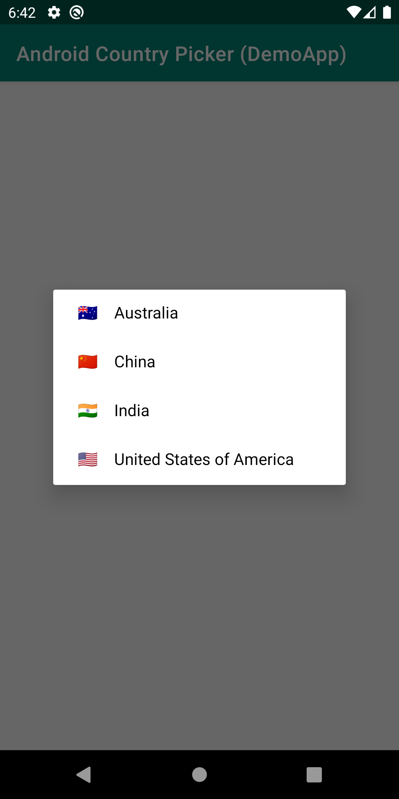
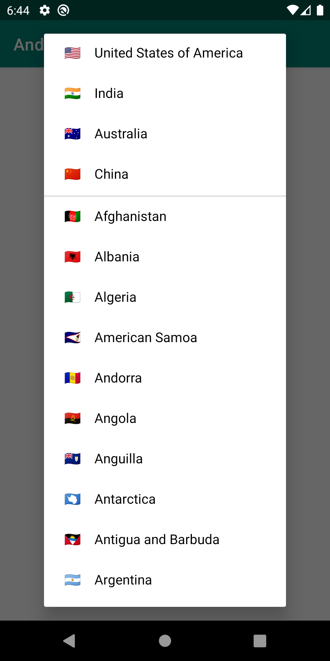
Country Picker Dialogs
(Android Country Picker)

Slide 10
Country Picker Dialog Anatomy
(Android Country Picker)
Title
Search
County List
Check Country List (RecyclerView) wiki page
County Row
Check Country Row wiki page
Clear Selection

Slide 11
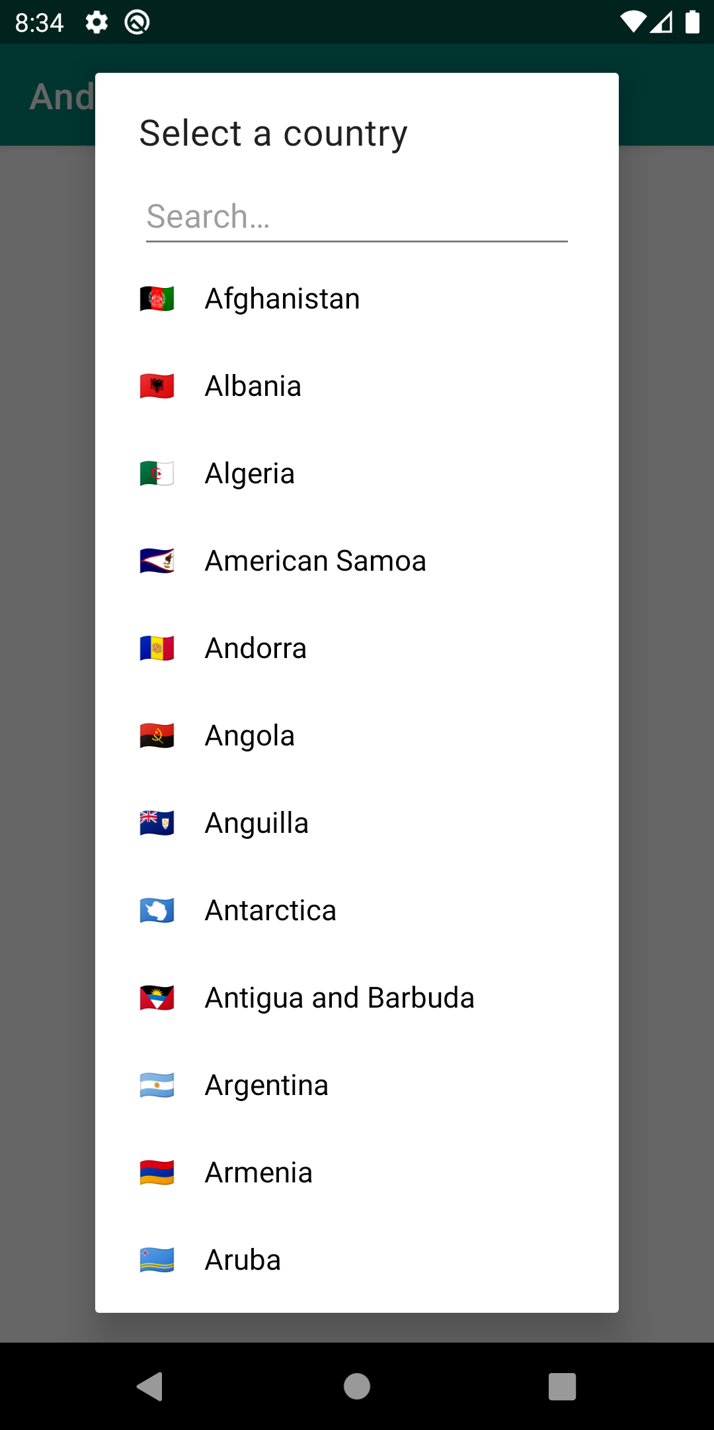
Default Country Picker Dialog
(Android Country Picker)

Slide 12
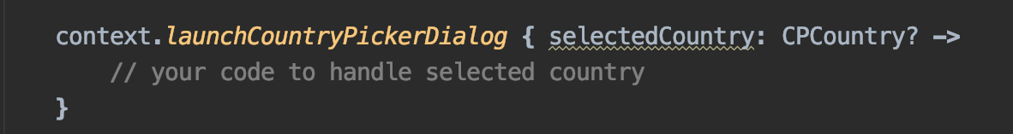

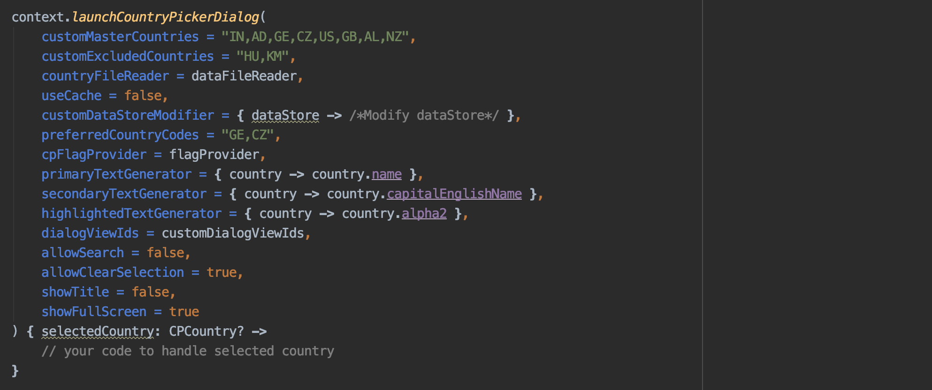
CP Dialog extension function
(Android Country Picker)
Default
OR
Available configuration options
Show only these countries
Datastore
Configuration
Show all countries except these
Custom Country data reader
Use cache when preparing CPDataStore
CPList
Configuration
Modify texts / country list
Show these countries on top of the list
Custom Flag Image Provider
CPRow
Configuration
Main text of country row
Text below main text
Text towards end of the country row
Use custom view for dialog
CPDialog
Configuration
Enable / disable search
Allow to clear selection (returns null when cleared)
Show / hide title
Switch between Full screen dialog and Regular Dialog
Handle selected country

Slide 13

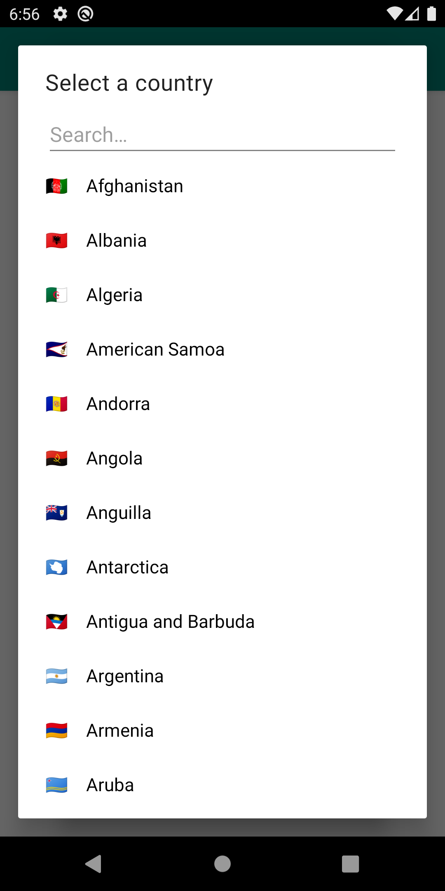
CP Dialogs Sizes
(Android Country Picker)
Regular Size (Default)
Full Size

Slide 14


Android Country Picker
/hbb20/AndroidCountryPicker
Many More…

Slide 15

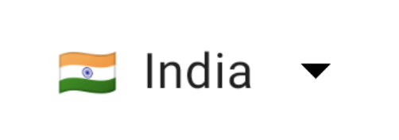

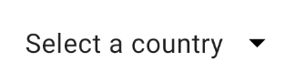

Slide 16
Elements of country picker view
(Android Country Picker)
Country Info
Emoji Flag TextView +
Flag Image View
Dropdown

