Slide 1
ARCHITECT, POPULATE AND EXPLORE A DATA WAREHOUSE FOR STOCK MARKET ANALYSIS
Abdelwahab Soliman
Wael Mohammad
Yusuf Madkour
February 21, 2021

Slide 2
Agenda
Problem Definition
Data Sources
Model Design
ETL
Applications

Slide 3


How to Invest in the Stock Market ?

Slide 4

Problem Definition

Slide 5
Stock Market Background
Stock: Represents ownership in a company and represents a proportionate claim on its assets and earnings.
Index: Represents aggregated prices of a group of stocks, the movement of an index is the net effect of the movements of each individual component.
Source: Investopedia
Problem Definition
Notes:
A stock is a security that represents the ownership of a fraction of a corporation

Slide 6




Indices
505 large-cap companies | 30 large-cap companies | 2500+ large-cap companies | Smallest 2500 companies
Information Technology | Industrials | Information Technology | Healthcare
Source: Investopedia
Problem Definition
Notes:
Each index has its own criteria
No. of companies in each index
Industries

Slide 7
How is Profit Made?
Capital Gain: An increase in a stock’s value, it is realized when you sell the asset.
Dividend Yield: Expressed as a percentage, is a ratio that shows how much a company pays out each year relative to its stock price.
An investor usually invests in a group of stocks rather than a single stock, this group is referred to as a portfolio.
Source: Investopedia
Problem Definition

Slide 8

Objective
To differentiate between different types of stocks and recommend the best investment portfolio
Problem Definition

Slide 9

Data Sources

Slide 10




Data Sources

Slide 11
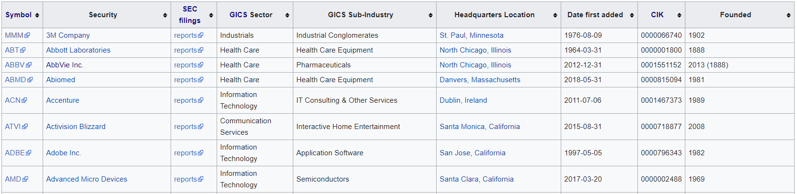
Wikipedia
List of S&P500 Companies
Challenges
Multiple values in the same cell
Irrelevant Columns
Data Sources

Slide 12
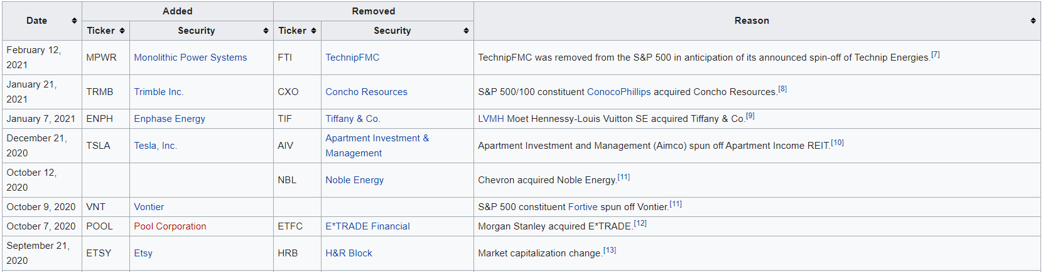
Wikipedia
S&P500 Market Change (1999 – Present)
Challenges
Reasons as sentences are not easy to work with
Inconsistent Date Format
Data Sources

Slide 13
Kaggle
Daily Stock Measurements (2013 – 2018)
Date | Open | High | Low | Close | Volume | Name
08-02-13 | 15.07 | 15.12 | 14.63 | 14.75 | 8407500 | AAL
11-02-13 | 14.89 | 15.01 | 14.26 | 14.46 | 8882000 | AAL
12-02-13 | 14.45 | 14.51 | 14.1 | 14.27 | 8126000 | AAL
13-02-13 | 14.3 | 14.94 | 14.25 | 14.66 | 10259500 | AAL
14-02-13 | 14.94 | 14.96 | 13.16 | 13.99 | 31879900 | AAL
15-02-13 | 13.93 | 14.61 | 13.93 | 14.5 | 15628000 | AAL
19-02-13 | 14.33 | 14.56 | 14.08 | 14.26 | 11354400 | AAL
20-02-13 | 14.17 | 14.26 | 13.15 | 13.33 | 14725200 | AAL
21-02-13 | 13.62 | 13.95 | 12.9 | 13.37 | 11922100 | AAL
22-02-13 | 13.57 | 13.6 | 13.21 | 13.57 | 6071400 | AAL
No challenges found as the dataset is clean and well-structured
Open, High, Low and Close are in USD
Data Sources

Slide 14
DataHub
Yearly Stock Measurements (2014)
Name | Sector | Price | Price/Earnings | Dividend Yield | Earnings/Share | 52 Week Low | 52 Week High | Market Cap | EBITDA | Price/Sales | Price/Book | SEC Filings
3M Company | Industrials | 222.89 | 24.31 | 2.3328617 | 7.92 | 259.77 | 175.49 | 1.38721E+11 | 9048000000 | 4.3902707 | 11.34 | http://www.sec.gov/cgi-bin/browse-edgar?action=getcompany&CIK=MMM
A.O. Smith Corp | Industrials | 60.24 | 27.76 | 1.1479592 | 1.7 | 68.39 | 48.925 | 10783419933 | 601000000 | 3.5754826 | 6.35 | http://www.sec.gov/cgi-bin/browse-edgar?action=getcompany&CIK=AOS
Yearly Stock Measurements (2017)
Company Symbol | Company Name | GICS Sector | Price | Dividend Yield | Price To Earnings Ratio | Earnings Per Share | Book Value | Week 52 Low | Week 52 High | Market Cap | EBITDA | Price To Sales Ratio | Price To Book Ratio
MMM | 3M Company | Industrials | 189.09 | 2.48 | 23.17 | 8.16 | 17.26 | 158.28 | 190.54 | 112.74 | 8.7 | 3.74 | 10.95
ABT | Abbott Laboratories | Health Care | 45 | 2.34 | 48.03 | 0.94 | 13.94 | 36.76 | 45.83 | 77.76 | 4.59 | 3.74 | 3.24
Challenges
Data for 2015 and 2016 is missing
EBITDA and Market Cap are expressed differently in 2014 and 2017
Data Sources

Slide 15
DataHub
Data Fabrication for 2015 and 2016
$$Statistic in 2015=random value between\left(statistic in 2014,Average(2014, 2017)\right)$$
$$Statistic in 2016=random value between\left(Average(2014, 2017), statistic in 2017\right)$$
Data Sources

Slide 16
Zenodo
Index Daily Measurements (2010 – 2017)
Index | Date | Close | Volume | mom | mom3 | ROC_5 | ROC_20 | EMA_10 | EMA_200
DJI | 03-04-17 | 20650.2109 | 12.2616 | -0.0006 | -0.0020 | 0.4829 | -1.4514 | 20691.8224 | 19363.0931
NASDAQ | 03-04-17 | 5894.6802 | -0.0255 | -0.0029 | 0.0038 | 0.9299 | 0.7779 | 5879.8797 | 5434.1156
NYSE | 03-04-17 | 11463.9102 | 0.0186 | -0.0025 | 0.0002 | 0.4344 | -0.7264 | 11481.8796 | 10995.7069
Russell 2000 | 03-04-17 | 1369.6700 | 0.0186 | -0.0117 | 0.0032 | 0.9099 | -1.0533 | 1371.2219 | 1298.3218
S&P500 | 03-04-17 | 2358.8401 | 0.0186 | -0.0016 | 0.0011 | 0.7367 | -0.6934 | 2359.4540 | 2231.3815
DJI | 04-04-17 | 20689.2402 | -2.2316 | 0.0019 | 0.0033 | -0.0592 | -1.1256 | 20691.3529 | 19376.2886
NASDAQ | 04-04-17 | 5898.6099 | -0.0342 | 0.0007 | 0.0028 | 0.3995 | 1.1087 | 5883.2852 | 5438.7374
NYSE | 04-04-17 | 11470.5400 | -0.0615 | 0.0006 | 0.0020 | -0.2027 | -0.3110 | 11479.8178 | 11000.4316
Russell 2000 | 04-04-17 | 1368.1801 | -0.0615 | -0.0011 | 0.0078 | 0.0673 | -0.4873 | 1370.6688 | 1299.0169
S&P500 | 04-04-17 | 2360.1599 | -0.0615 | 0.0006 | 0.0029 | 0.0674 | -0.3475 | 2359.5823 | 2232.6629
No challenges found
Source: CNN-based stock market prediction using a diverse set of variables
Data Sources

Slide 17

Model Design

Slide 18
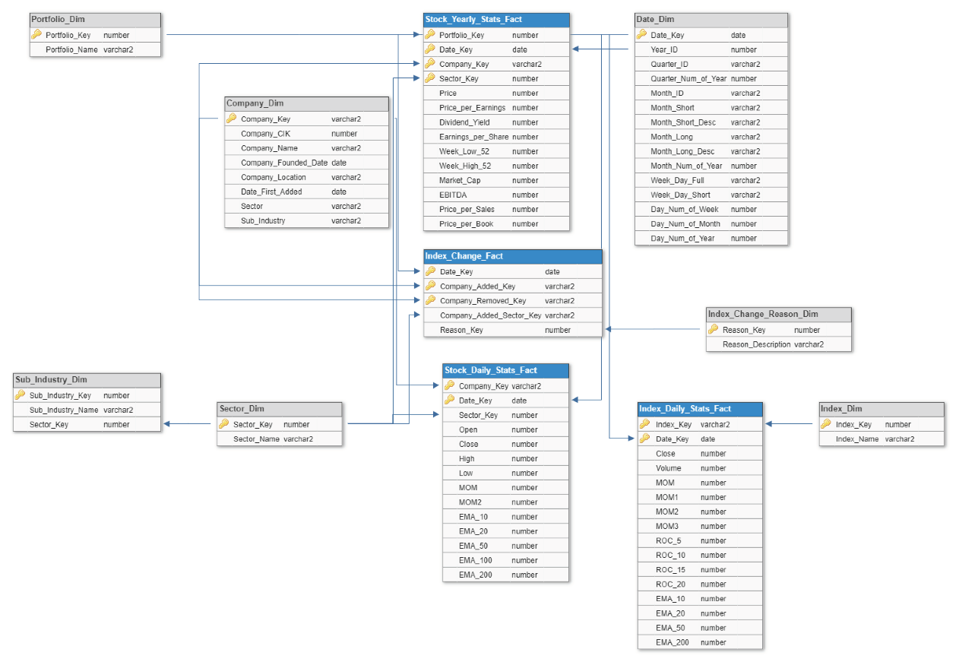
Model Design
Schema: Galaxy
Business Process: Stock market analysis and portfolio recommendation
Granularity: Daily
Dimensions: Sector, Sub Industry, Company, Date, Index Change Reason, Index, Portfolio
Facts: Stock Yearly Stats, Index Change, Stock Daily Stats, Index Daily Stats
Model Design

Slide 19

Model Design
Model Design

Slide 20

ETL

Slide 21
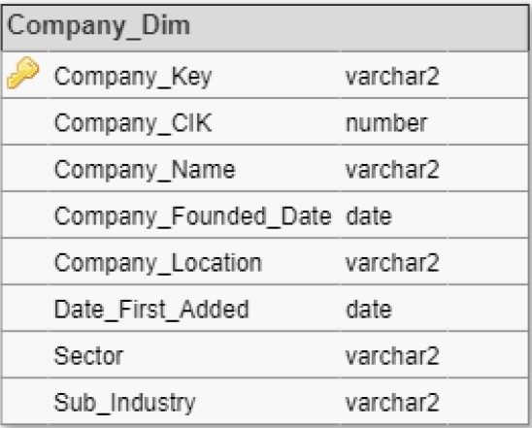
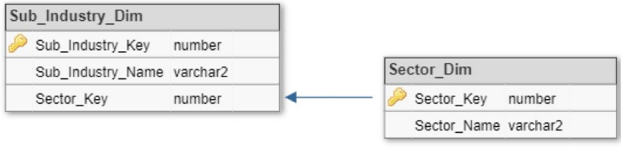
List of S&P500 Companies
Steps 1- Download data from Wikipedia into Excel Workbook
2- Clean
3- Load into Data Model
Symbol | Security | SEC filings | GICS Sector | GICS Sub-Industry | Headquarters Location | Date first added | CIK | Founded
MMM | 3M Company | reports | Industrials | Industrial Conglomerates | St. Paul, Minnesota | 09-08-76 | 66740 | 1902
ABT | Abbott Laboratories | reports | Health Care | Health Care Equipment | North Chicago, Illinois | 31-03-64 | 1800 | 1888
ABBV | AbbVie Inc. | reports | Health Care | Pharmaceuticals | North Chicago, Illinois | 31-12-12 | 1551152 | 2013 (1888)
Symbol | Security | GICS Sector | GICS Sub-Industry | Headquarters Location | Date first added | CIK | Founded
MMM | 3M Company | Industrials | Industrial Conglomerates | St. Paul, Minnesota | 09-08-76 | 66740 | 1902
ABT | Abbott Laboratories | Health Care | Health Care Equipment | North Chicago, Illinois | 31-03-64 | 1800 | 1888
ABBV | AbbVie Inc. | Health Care | Pharmaceuticals | North Chicago, Illinois | 31-12-12 | 1551152 | 2013
ETL
Notes:
Clean:
- Remove SEC filings
- Remove extra years in Founded Columns
- Fix Date Format

Slide 22
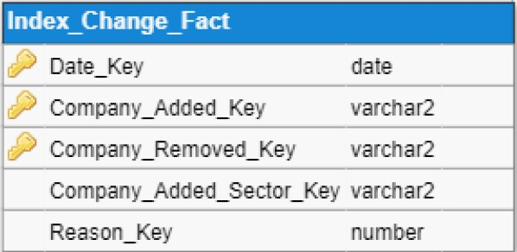
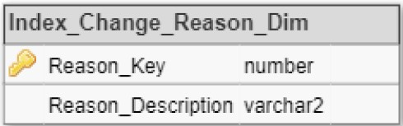
S&P500 Market Change
Steps 1- Download data from Wikipedia into Excel Workbook
2- Clean
3- Transform
4- Load into Data Model
Date | Added |  | Removed |  | Reason
 | Ticker | Security | Ticker | Security
21-Jan-21 | TRMB | Trimble Inc. | CXO | Concho Resources | S&P 500/100 constituent ConocoPhillips acquired Concho Resources.^{[7]}
07-Jan-21 | ENPH | Enphase Energy | TIF | Tiffany & Co. | LVMH Moet Hennessy-Louis Vuitton SE acquired Tiffany & Co.^{[8]}
21-Dec-20 | TSLA | Tesla, Inc. | AIV | Apartment Investment & Management | Apartment Investment and Management (Aimco) spun off Apartment Income REIT.[9]
21-Sep-20 | ETSY | Etsy | HRB | H&R Block | Market capitalization change.[12]
Date | Added | Removed | Reason
21-1-2021 | TRMB | CXO | Acquisition
7-1-2021 | ENPH | TIF | Acquisition
21-12-2020 | TSLA | AIV | Spin-off
12-10-2020 |  | NBL | Acquisition
9-10-2020 | VNT |  | Spin-off
7-10-2020 | POOL | ETFC | Acquisition
21-9-2020 | ETSY | HRB | Market Capitalization Change
ETL
Notes:
Clean:
- Standardize reasons
- Fix date format
Load into Data Model:
- New companies into Company_Dim
- Reasons into Reason_Dim
- Whole row into Fact table
Transform:
- Reason text to numeric reason key

Slide 23
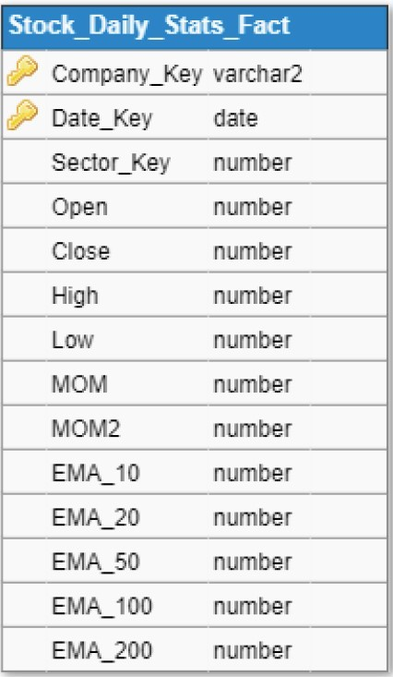
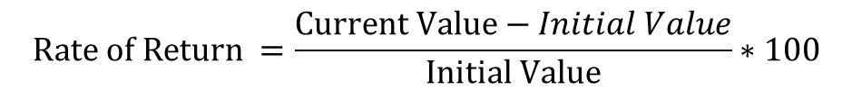
Daily Stock Measurements
Steps 1- Download data from Kaggle
2- Load into Data Model
3- Add calculated fields
date | open | high | low | close | volume | Name
08-02-13 | 15.07 | 15.12 | 14.63 | 14.75 | 8407500 | AAL
11-02-13 | 14.89 | 15.01 | 14.26 | 14.46 | 8882000 | AAL
12-02-13 | 14.45 | 14.51 | 14.1 | 14.27 | 8126000 | AAL
13-02-13 | 14.3 | 14.94 | 14.25 | 14.66 | 10259500 | AAL
14-02-13 | 14.94 | 14.96 | 13.16 | 13.99 | 31879900 | AAL
$$Rate of Return =\frac{Current Value−Initial Value}{Initial Value}∗100$$
EMA = [Close – EMA (Previous day)] * Multiplier + EMA (Previous day)
Multiplier = [2 / (Time Periods +1)]
Initial EMA: Simple moving Average
ETL

Slide 24
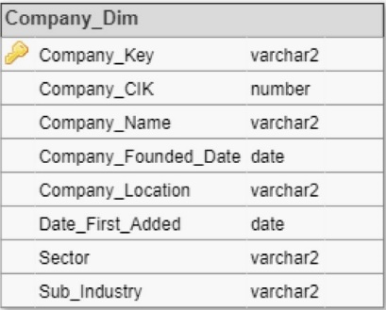
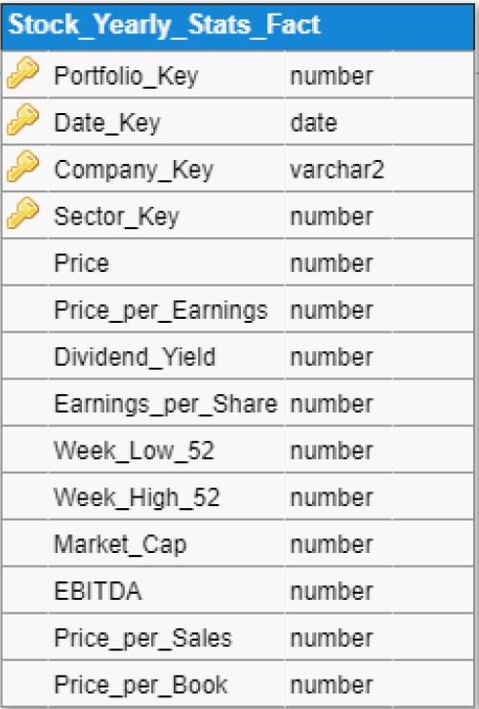
Yearly Stock Measurements
Steps 1- Download 2014 and 2017 data from DataHub
2- Add date to each year
3- Fabricate data for 2015 and 2016
4- Load into Data Model
Name | Sector | Price | Price/Earnings | Dividend Yield | Earnings/Share | 52 Week Low | 52 Week High | Market Cap | EBITDA | Price/Sales | Price/Book
3M Company | Industrials | 222.89 | 24.31 | 2.3328617 | 7.92 | 259.77 | 175.49 | 1.38721E+11 | 9048000000 | 4.3902707 | 11.34
A.O. Smith Corp | Industrials | 60.24 | 27.76 | 1.1479592 | 1.7 | 68.39 | 48.925 | 10783419933 | 601000000 | 3.5754826 | 6.35
Abbott Laboratories | Health Care | 56.27 | 22.51 | 1.9089824 | 0.26 | 64.6 | 42.28 | 1.02121E+11 | 5744000000 | 3.7404804 | 3.19
AbbVie Inc. | Health Care | 108.48 | 19.41 | 2.4995599 | 3.29 | 125.86 | 60.05 | 1.81386E+11 | 10310000000 | 6.291571 | 26.14
Accenture plc | Information Technology | 150.51 | 25.47 | 1.7144699 | 5.44 | 162.6 | 114.82 | 98765855553 | 5643228000 | 2.604117 | 10.62
Activision Blizzard | Information Technology | 65.83 | 31.8 | 0.43190324 | 1.28 | 74.945 | 38.93 | 52518668144 | 2704000000 | 10.59512 | 5.16
ETL

Slide 25
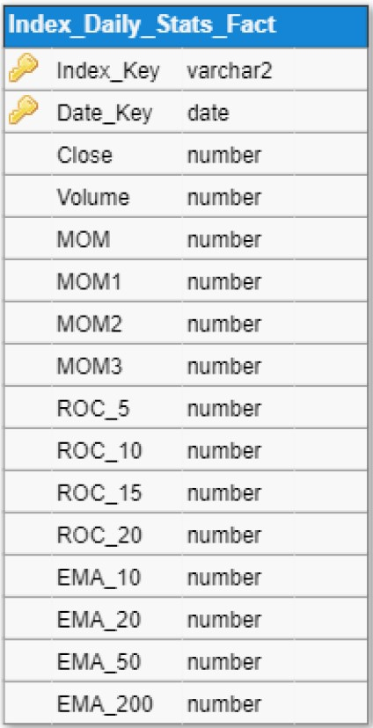
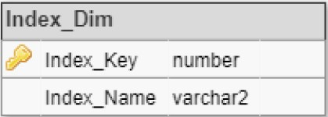
Index Daily Measurements
Steps 1- Download data from Zenodo and merge all indices in one Excel workbook
2- Import data into the model
Index | Close | Volume | mom | mom3 | ROC_5 | ROC_20 | EMA_10 | EMA_200
DJI | 20650.211 | 12.262 | -0.001 | -0.002 | 0.483 | -1.451 | 20691.822 | 19363.093
NASDAQ | 5894.680 | -0.026 | -0.003 | 0.004 | 0.930 | 0.778 | 5879.880 | 5434.116
NYSE | 11463.910 | 0.019 | -0.003 | 0.000 | 0.434 | -0.726 | 11481.880 | 10995.707
Russell 2000 | 1369.670 | 0.019 | -0.012 | 0.003 | 0.910 | -1.053 | 1371.222 | 1298.322
ETL

Slide 26

Applications

Slide 27
Index Performance
SELECT INDEX_KEY "Index", ROUND(AVG (ROC_15), 5) "Growth %"
FROM INDEX_DAILY_STAT_FACT
GROUP BY INDEX_KEY
ORDER BY AVG(ROC_15) DESC;
Index | Growth %
NASDAQ | 0.89
Russell 2000 | 0.74
S&P500 | 0.68
DJI | 0.65
NYSE | 0.45
Time of execution: 18 milliseconds
SELECT INDEX_KEY "Index", ROUND(STDDEV(MOM*100), 2) "Risk"
FROM INDEX_DAILY_STAT_FACT
GROUP BY INDEX_KEY
ORDER BY STDDEV(MOM);
Index | Risk
DJI | 0.87
S&P500 | 0.93
NYSE | 0.98
NASDAQ | 1.06
Russell 2000 | 1.28
Time of execution: 22 milliseconds
Data Source: Index Daily Statistics (2010 – 2017)
Applications
Notes:
Clean:
- Remove SEC filings
- Remove extra years in Founded Columns
- Fix Date Format

Slide 28
S&P500 Most Added Sectors
Sector | # of Companies Added
Information Technology | 40
Consumer Discretionary | 32
Industrials | 30
Health Care | 29
Real Estate | 19
Financials | 17
Communication Services | 14
Materials | 12
Consumer Staples | 10
Energy | 9
Utilities | 5
SELECT SECTOR_DIM.SECTOR_NAME "Sector", COUNT(INDEX_CHANGE_FACT.COMPANY_ADDED_SECTOR_KEY) "# of Companies Added"
FROM INDEX_CHANGE_FACT, SECTOR_DIM
WHERE COMPANY_ADDED_SECTOR_KEY IS NOT NULL
AND
SECTOR_DIM.SECTOR_KEY = INDEX_CHANGE_FACT.COMPANY_ADDED_SECTOR_KEY
GROUP BY SECTOR_DIM.SECTOR_NAME
ORDER BY "# of Companies Added" DESC;
Time of execution: 16 milliseconds
Data Source: Index Daily Statistics
Applications
Notes:
Clean:
- Remove SEC filings
- Remove extra years in Founded Columns
- Fix Date Format

Slide 29
Growth by Sector
Sector | Growth %
Information Technology | 0.0765
Health Care | 0.0689
Industrials | 0.0639
Communication Services | 0.0629
Financials | 0.0622
Consumer Discretionary | 0.0501
Consumer Staples | 0.0465
Materials | 0.0442
Utilities | 0.0297
Real Estate | 0.0238
Energy | 0.0178
SELECT SECTOR_NAME, TRUNC(AVG(MOM*100), 4) "Growth %"
FROM STOCK_DAILY_STATS_FACT, SECTOR_DIM
WHERE SECTOR_DIM. SECTOR_KEY= STOCK_DAILY_STATS_FACT.SECTOR_KEY
Group by STOCK_DAILY_STATS_FACT.SECTOR_KEY, SECTOR_NAME
ORDER BY AVG(MOM) DESC;
Time of execution: 250 milliseconds
Data Sources: Stock Daily Statistics with the added calculated fields and List of S&P 500 companies
Applications
Notes:
Clean:
- Remove SEC filings
- Remove extra years in Founded Columns
- Fix Date Format

Slide 30
Growth Stocks
Stock | Growth %
NVDA | 0.256
NFLX | 0.222
AMD | 0.188
ALGN | 0.177
EA | 0.175
MU | 0.172
AVGO | 0.172
DXC | 0.169
INCY | 0.167
FB | 0.166
SELECT * FROM
(SELECT STOCK_DAILY_STATS_FACT.COMPANY_KEY "Stock", ROUND(AVG(MOM*100), 3) "Growth %"
FROM STOCK_DAILY_STATS_FACT
GROUP BY STOCK_DAILY_STATS_FACT.COMPANY_KEY
ORDER BY AVG(MOM*100) DESC)
WHERE ROWNUM <= 10;
Time of execution: 186 milliseconds
Data Sources: Stock Daily Statistics with the added calculated fields and List of S&P 500 companies
Applications
Notes:
Clean:
- Remove SEC filings
- Remove extra years in Founded Columns
- Fix Date Format

Slide 31
Dividend Stocks
SELECT * FROM
(SELECT COMPANY_KEY "Stock", ROUND(AVG(STOCK_YEARLY_STATS_FACT.DIVIDEND_YIELD), 5) "Average Dividend Yield"
FROM STOCK_YEARLY_STATS_FACT
GROUP BY COMPANY_KEY
HAVING AVG(STOCK_YEARLY_STATS_FACT.DIVIDEND_YIELD) IS NOT NULL
ORDER BY "Average Dividend Yield"
WHERE ROWNUM <= 5;
Stock | Average Dividend Yield
CMG | 239.26679
CRM | 170.46692
NFLX | 148.31629
INCY | 116.10284
EQIX | 106.30865
Time of execution: 20 milliseconds
Data Source: Stock Yearly Statistics
Applications
Notes:
Clean:
- Remove SEC filings
- Remove extra years in Founded Columns
- Fix Date Format

Slide 32
Stock Performance
SELECT * FROM
(SELECT COMPANY_KEY "Stock", AVG(STOCK_YEARLY_STATS_FACT.PRICE_PER_EARNINGS) as "Average Price per Earnings"
FROM STOCK_YEARLY_STATS_FACT
GROUP BY COMPANY_KEY
Having AVG(STOCK_YEARLY_STATS_FACT.PRICE_PER_EARNINGS) IS NOT NULL AND AVG(STOCK_YEARLY_STATS_FACT.PRICE_PER_EARNINGS) > 0
ORDER BY "Average Price per Earnings")
WHERE ROWNUM <= 5;
Stock | Average Price per Earning
BCR | 0.42
PRGO | 0.88
BHI | 1.14
BBBY | 1.24
HAR | 1.25
Time of execution: 16 milliseconds
Data Source: Stock Yearly Statistics
Applications
Notes:
Clean:
- Remove SEC filings
- Remove extra years in Founded Columns
- Fix Date Format

