Slide 1
ELEC 677:
Energy-Efficient Machine Learning Systems
Q-Learning
Spring 2018
Student Name: Chance Tarver
Electrical and Computer Engineering
Rice University

Slide 2
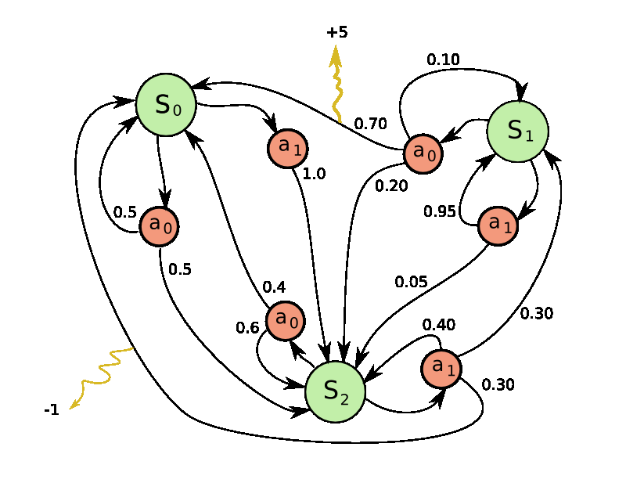
Markov Decision Process
What is the optimal policy for making decisions at each state?
States
Actions
Rewards

Slide 3
Markov Decision Process
Can’t rely on just the expected reward for the next action
Need a way to remember the outcomes for each action in each state

Slide 4
Q - Learning
Create a decision policy ranking the quality of each action.
action 1
action 2
action m
state 1
q_{1,1}
q_{1,2}
…
state 2
q_{2,1}
q_{2,2}
…
…
…
state n

Slide 5
Q - Learning
Start in some state.
action 1
action 2
action m
state 1
q_{1,1}
q_{1,2}
…
state 2
q_{2,1}
q_{2,2}
…
…
…
state n

Slide 6

Q - Learning
Perform an action and see which state we end up in and receive rewards
action 1
action 2
action m
state 1
q_{1,1}
q_{1,2}
…
state 2
q_{2,1}
q_{2,2}
…
state i
…
…
state n

Slide 7
Q - Learning
Update the Q table based on the reward we received and the quality of the new state.
action 1
action 2
action m
state 1
q_{1,1}
q_{1,2}
…
state 2
q_{2,1}
q_{2,2}
…
state i
…
…
Check out the quality
state n
$$Q\left(s_{t},a_{t}\right)=\left(1−α\right)Q\left(s_{t},a_{t}\right)+α\left(r_{t}+γ\max{Q(s_{t+1},a}\right)$$

Slide 8
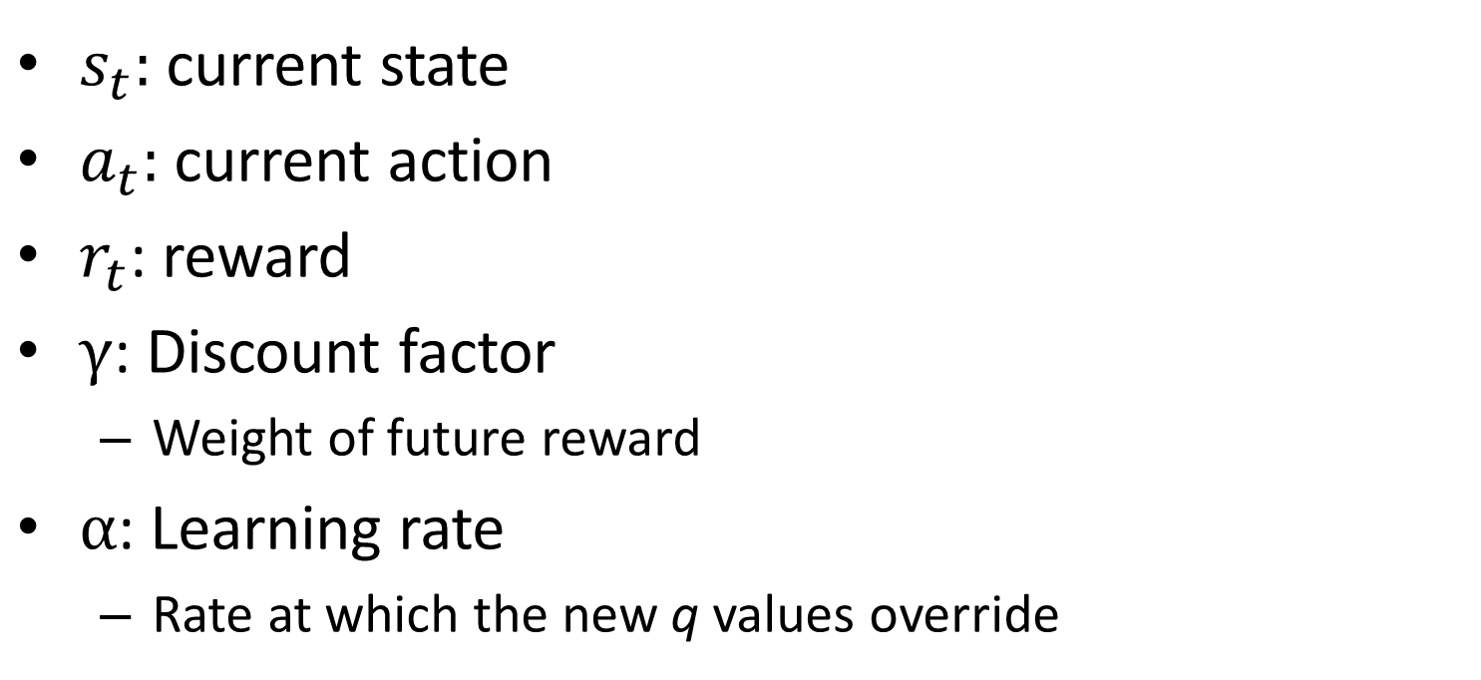
Parameters
$$Q\left(s_{t},a_{t}\right)=\left(1−α\right)Q\left(s_{t},a_{t}\right)+α\left(r_{t}+γ\max{Q(s_{t+1},a)}\right)$$
$s_{t}$: current state
$a_{t}$: current action
$r_{t}$: reward
$γ$: Discount factor
Weight of future reward
$α$: Learning rate
Rate at which the new q values override

Slide 9
Pros
Model-free reinforcement learning
Provably converges to find an optimal policy for any finite Markov decision process.
Computationally low complexity
Cons
May need large amount of exploration / experience to learn.

Slide 10
Demo
https://github.com/ctarver/QLearningMatlab

Slide 11
History
1989: “Learning from Delayed Rewards”
Watkins, Ph.D. Thesis, Cambridge University
http://www.cs.rhul.ac.uk/~chrisw/new_thesis.pdf
1992: “Q,-Learning”
Watkins and Dayan, Machine Learning
Proved convergence
http://www.gatsby.ucl.ac.uk/~dayan/papers/cjch.pdf

Slide 12
Selected Applications
Distributed Q-Learning for Aggregated Interference Control in Cognitive Radio Networks
IEEE TRANSACTIONS ON VEHICULAR TECHNOLOGY, VOL. 59, NO. 4, MAY 2010
Reinforcement Learning With Function Approximation for Traffic Signal Control
IEEE TRANSACTIONS ON INTELLIGENT TRANSPORTATION SYSTEMS, VOL. 12, NO. 2, JUNE 2011

Slide 13
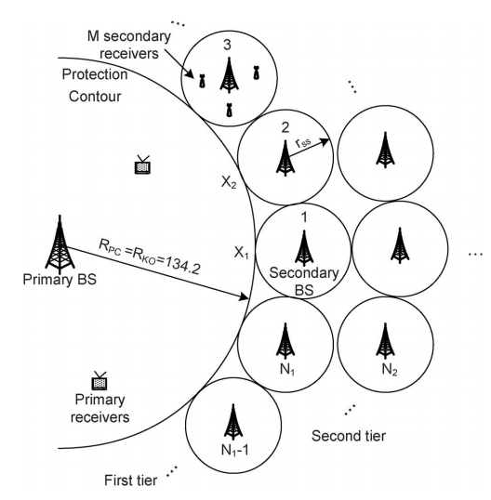
Distributed Q-Learning for Aggregated Interference Control in Cognitive Radio Networks
Underutilized spectrum with spectrum holes
Cognitive radio
IEEE 802.22, TV Whitespace
Learning Power-Allocation Policy by Q-Learning With Complete and Partial Information
http://ieeexplore.ieee.org.ezproxy.rice.edu/stamp/stamp.jsp?tp=&arnumber=5415567

Slide 14
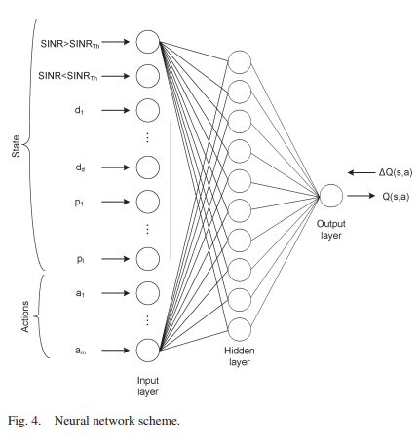
Distributed Q-Learning for Aggregated Interference Control in Cognitive Radio Networks
State at each node i:
I : binary indicator for if the SU is generating interference
d: approximate distance from each user and protection contour
p: current power
Actions:
Power levels that the secondary BS can assign to the ith secondary user.

Slide 15
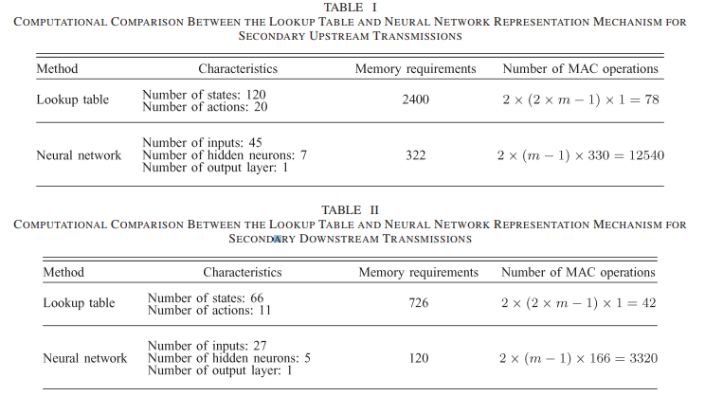
Distributed Q-Learning for Aggregated Interference Control in Cognitive Radio Networks

Slide 16
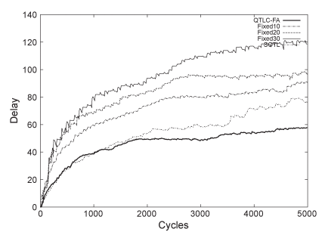
Reinforcement Learning With Function Approximation for Traffic Signal Control
State:
Vector of queue lengths and elapsed times for each lane
Actions:
Vector of sign configs
Cost Functions
Sum of the queue lengths of the individual lanes and the sum of the elapsed times on all lanes
http://ieeexplore.ieee.org.ezproxy.rice.edu/stamp/stamp.jsp?tp=&arnumber=5658157

Slide 17
Deep Q-Networks
Convolutional neural net before Q learning for object recognition.
Feb 2015: Google’s Deep Mind
General purpose agent
Able to outperform human in 49 Atari games
https://www.nature.com/articles/nature14236.pdf
Notes:
84x84, 256-greyscale pixels with last 4 screens → 256^ 84*84*4 = 10^67970 ( more states than atoms in the universe)

