Slide 1
ELEC 677:
Energy-Efficient Machine Learning Systems
Q Learning
Spring 2018
Student Name: Chance Tarver
Electrical and Computer Engineering
Rice University

Slide 2
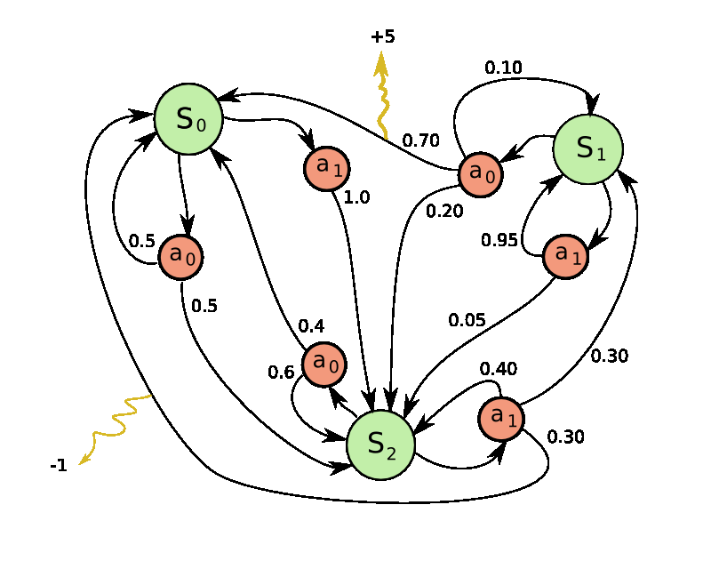
Markov Decision Process
What is the optimal policy for making decisions at each state?
States
Actions
Rewards

Slide 3
Markov Decision Process
Can’t rely on just the expected reward for the next action
Need a way to remember the outcomes for each action in each state

Slide 4
Q - Learning
Create a decision policy ranking the quality of each action.
action 1
action 2
action m
state 1
q_{1,1}
q_{1,2}
…
state 2
q_{2,1}
q_{2,2}
…
…
…
state n

Slide 5
Q - Learning
Start in some state.
action 1
action 2
action m
state 1
q_{1,1}
q_{1,2}
…
state 2
q_{2,1}
q_{2,2}
…
…
…
state n

Slide 6

Q - Learning
See which state we end up in and receive rewards
action 1
action 2
action m
state 1
q_{1,1}
q_{1,2}
…
state 2
q_{2,1}
q_{2,2}
…
state i
…
…
state n

Slide 7
Q - Learning
Update the Q table based on the reward we received and the quality of the new state.
action 1
action 2
action m
state 1
q_{1,1}
q_{1,2}
…
state 2
q_{2,1}
q_{2,2}
…
state i
…
…
Check out the quality
state n

