Slide 1



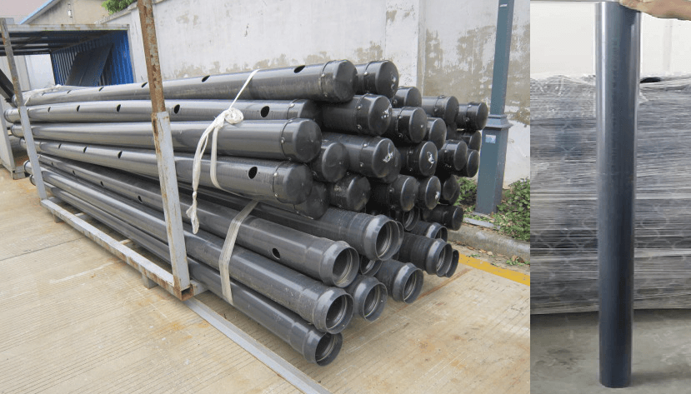
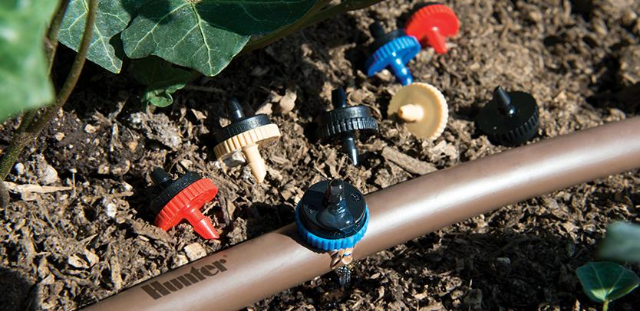
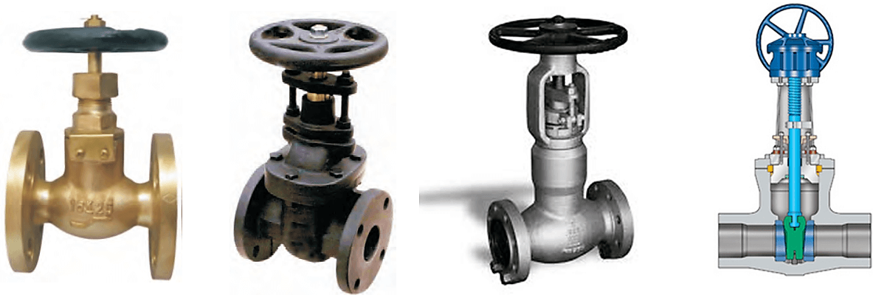
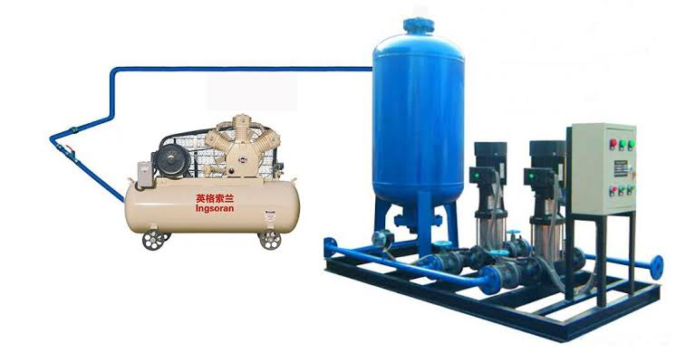
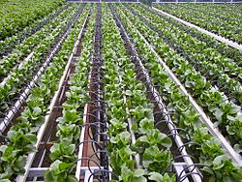
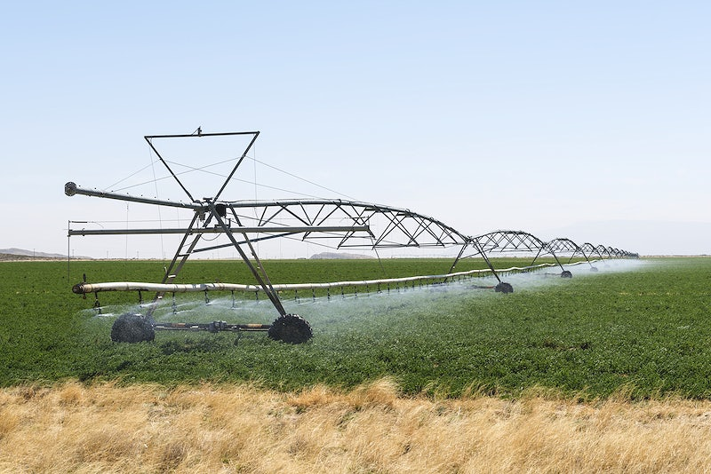
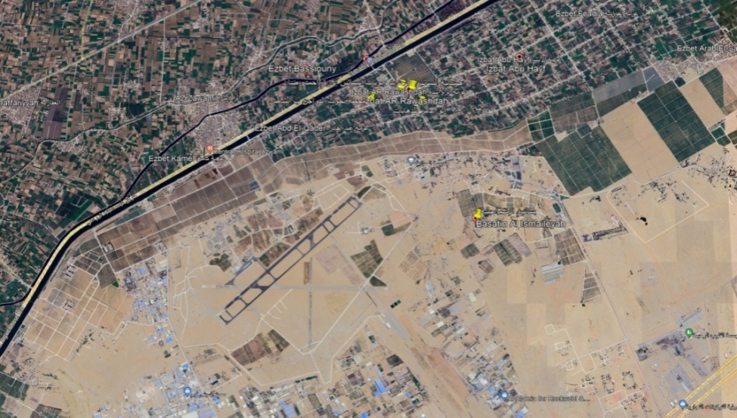
Evaluation of Modern Irrigation Project
¹Department of Civil engineering, Zagazig University, Zagazig, Egypt.
Introduction
Drip irrigation​ A type of localized irrigation in which drops of water are delivered at or near the root of plants.
Agriculture criteria drip irrigation
Height | Water duty | distance | Crop
3 – 6 m | 50 | 2*4 | Mango
6 – 12 m | 100 | 2*2 | Palm
6 – 12 m | 60 | 1*1 | Casuarina
Lateral irrigation system
It is one of the modern irrigation methods . In this type the filed takes the form of a circle. This type of irrigation is used to irrigate filed crops
Agriculture criteria pivot irrigation
Water Source in Egypt
Amount of water =Billon m³/ year
Height | Water duty | Distance | Crop
40-60 cm | 23.4m3/ fed/day | 15 cm | Wheat
120-220 cm | 26.1m3/ fed/day | 30 –40cm | Maize
6-12 m | 100L/day | 2*2 m | Palm
6- 12 m | 60 L/day | 1*1 m | Casuarina
Water supply =79.2
Water demand =91
River Nile=55.5
Rain = 1.3
Ground water =8.2
Reuse of sanitary =13.5
Agriculture = 65
Domestic =11
Evaporation = 10
Industrial =5
Design criteria
Hazen Williams : V = 0.355C D^{0.63} (H/L)^{0.54}
continuity equation : Q = A * V , Check velocity =Q/A
Pump capacity HP =ɣ*H*Q /75η , Pw = .746H/ η
the Blaney- Criddle method =192*K*P*(T+17.3)/100 ( m3 /fed / month )
Hargreaves method =180*K*C*d*T ( m3 /fed / month)
Results
Desalination of sea water =.7
Shortage =11.8
Modern irrigation system materia
Pvc pipe Dripper
Valves water hammer
Drip irrigation pivot irrigation
Anshas orchard site study , it is located in Sharkia Governorate, delta Egypt, its geographical coordinates are 30° 30' 10" North, 31° 33' 27" East . with an area 2117 fedden.
Prof. Asst :Ahmed Helmey Prof. Asst : Sayed Mukhtar
Prof. Asst : Ismail Abd-Elaty Prof. Asst : Ismail Fathy
pivot irrigation network | Drip irrigation network
26.1 m3 /day | 25.89 m3 /day | Water consumption per feddan
5669 m3 /day | 8035 m3 /day | Total water consumption
4,791,568 LE | 13,549,390 LE | Total Cost
Conclusion
A drip and pivot irrigation network has been designed
Velocities, pressures, disposals, water quantity and losses were calculated for each irrigation network
The amount of water consumed in the drip and pivot irrigation networks was compared
Calculation and comparison of drip and pivot irrigation network prices
Calculate and compare evaporation and transpiration rates
Recommendation
A cost study is being done Detailed project cost calculation
2. Software is used to design networks and accurately calculate velocities and pressures
3. In the case of hot areas and times, irrigation should be done at low temperatures or at night
4. Studying the use of different irrigation systems such as sub-surface irrigation
5. Studying the use of different materials for pipes and calculating the difference in losses and costs
6. Calculate the return of each project
Ahmed Mohamed Atef Ebrahim Mohamed Elsayed
Mohamed Ashraf Abd elslam Abdalrashid Saeed Soliman
Abdelwahab Amged Elsayed Ahmed Ali Bakhtroh

