Slide 1
Human resources slide 1
Neurofibromatosis Type 1 (NF1): Clinical Insights & Dashboard
Exploratory Analysis of Familial vs. Sporadic Cohorts (N = 296)

Slide 2
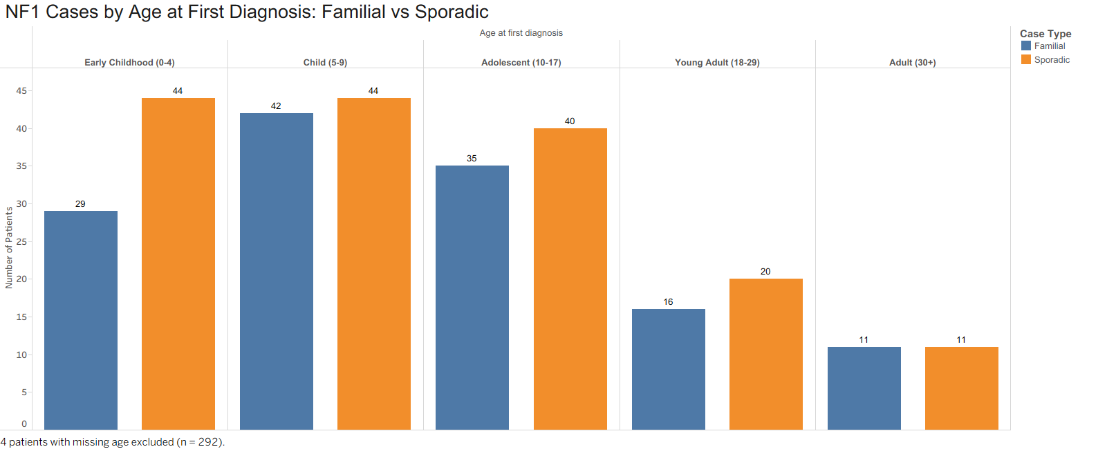
Human resources slide 9
This grouped bar chart displays patient counts distributed across five clinical age categories from early childhood through adulthood. For each age bracket, side-by-side blue and orange bars compare Familial and Sporadic case counts at initial diagnosis.

Slide 3
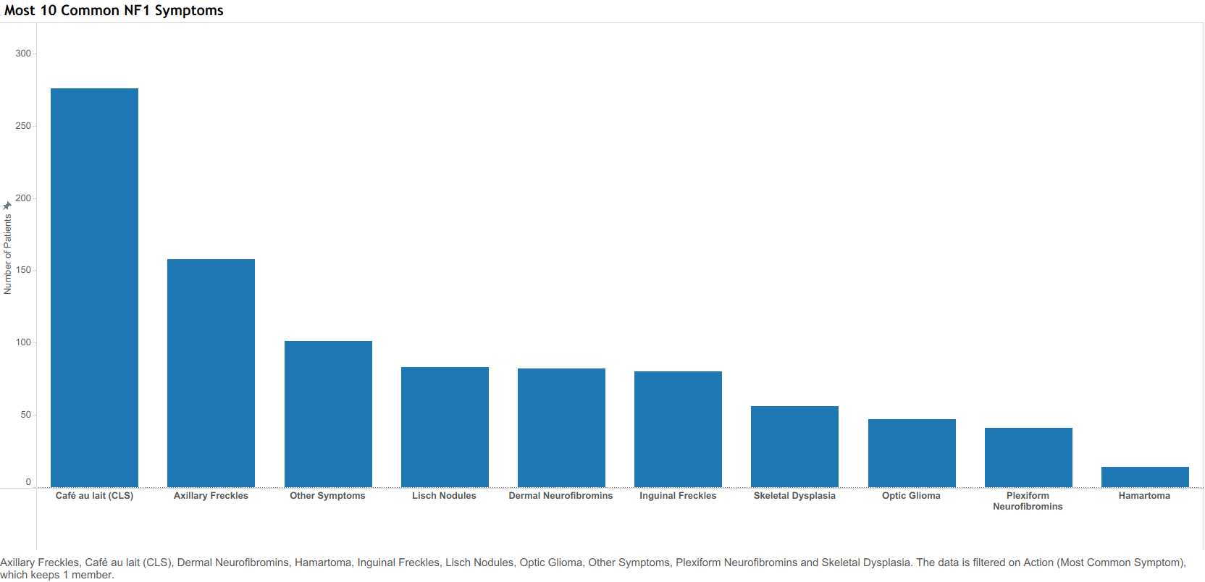
Human resources slide 9
This vertical bar chart illustrates the overall prevalence of the top ten clinical symptoms recorded in the dataset. Symptoms are arranged in descending order from left to right, allowing for immediate visual comparison of frequency across the entire patient cohort.

Slide 4
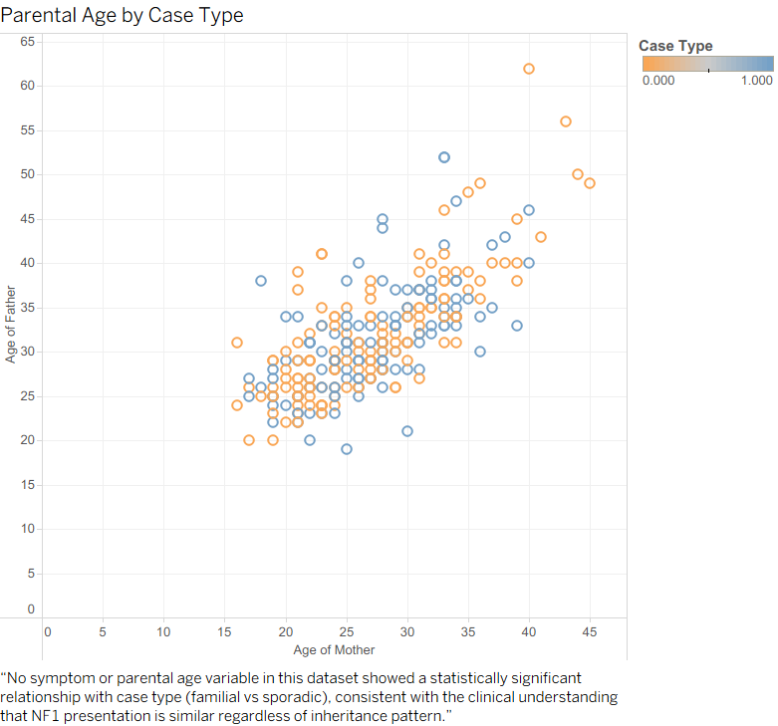
Human resources slide 9
This scatter plot maps mother and father ages at the time of initial clinical evaluation across the cohort. It compares parental age patterns between Familial and Sporadic cases to explore whether older parental age is more commonly associated with sporadic diagnoses.

Slide 5
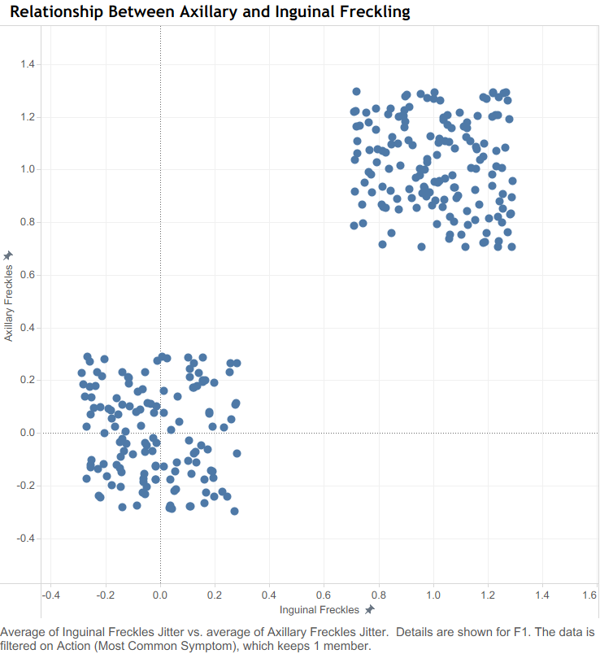
Human resources slide 9
This jittered scatter plot maps the bivariate relationship between axillary and inguinal freckling symptoms across all patients. The artificial jittering technique separates overlapping binary data points to clearly display distinct clinical clustering patterns.

Slide 6
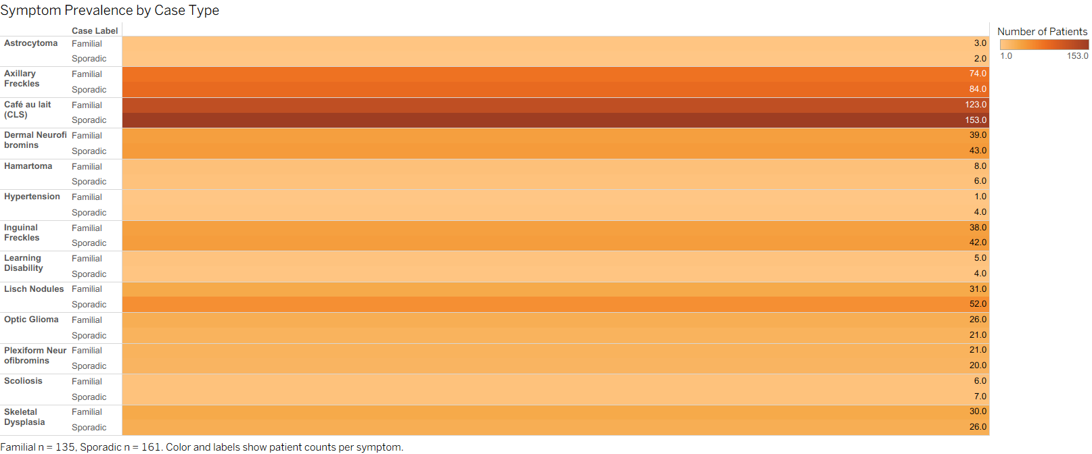
Human resources slide 9
This heatmap matrix visualizes pairwise co-occurrence rates across all thirteen clinical NF1 symptoms simultaneously. providing a comprehensive overview of feature correlation across the entire dataset.

Slide 7
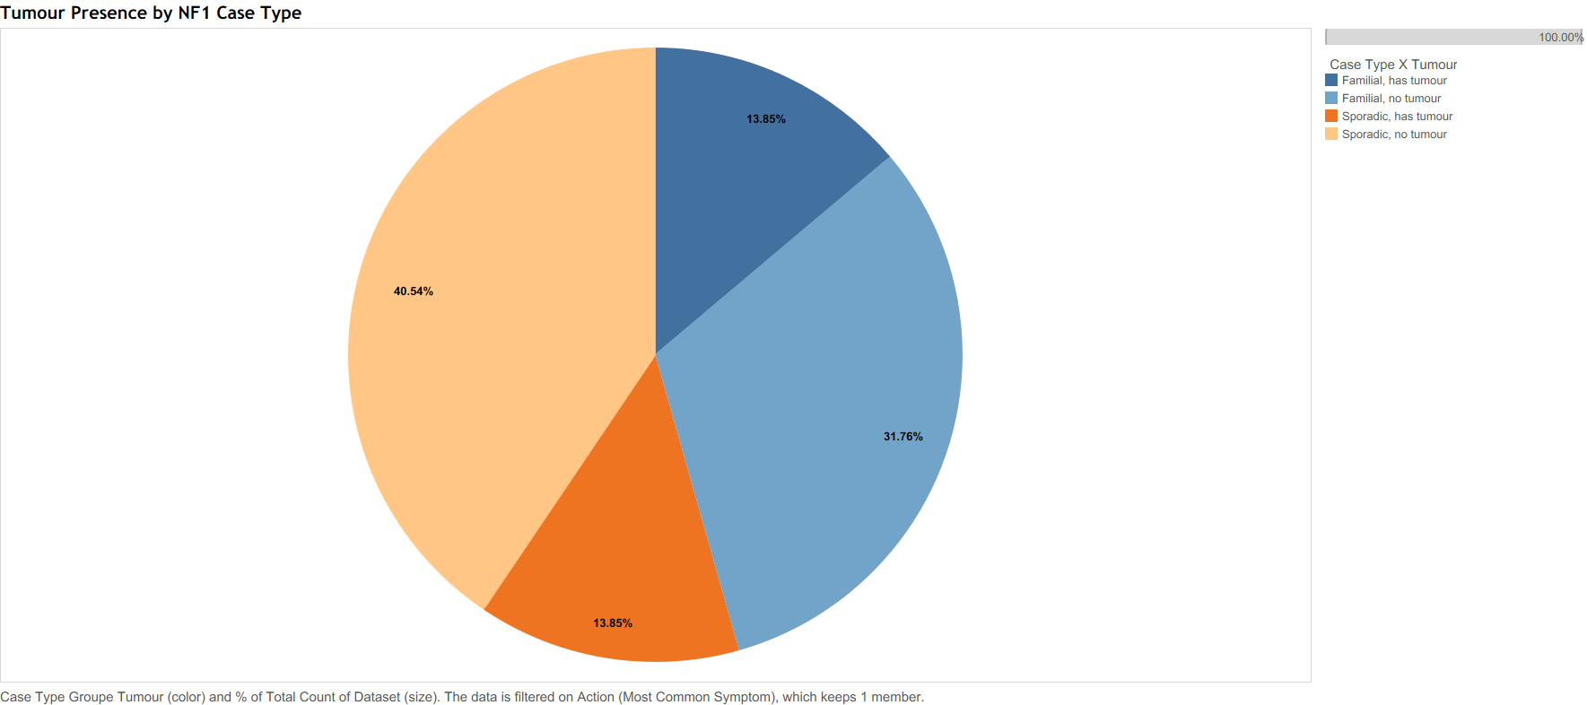
Human resources slide 9
This proportional pie chart categorizes the patient population into four distinct segments based on inheritance background and tumour status. Each slice represents the relative percentage breakdown comparing Familial and Sporadic cases with or without active tumour presence.

Slide 8
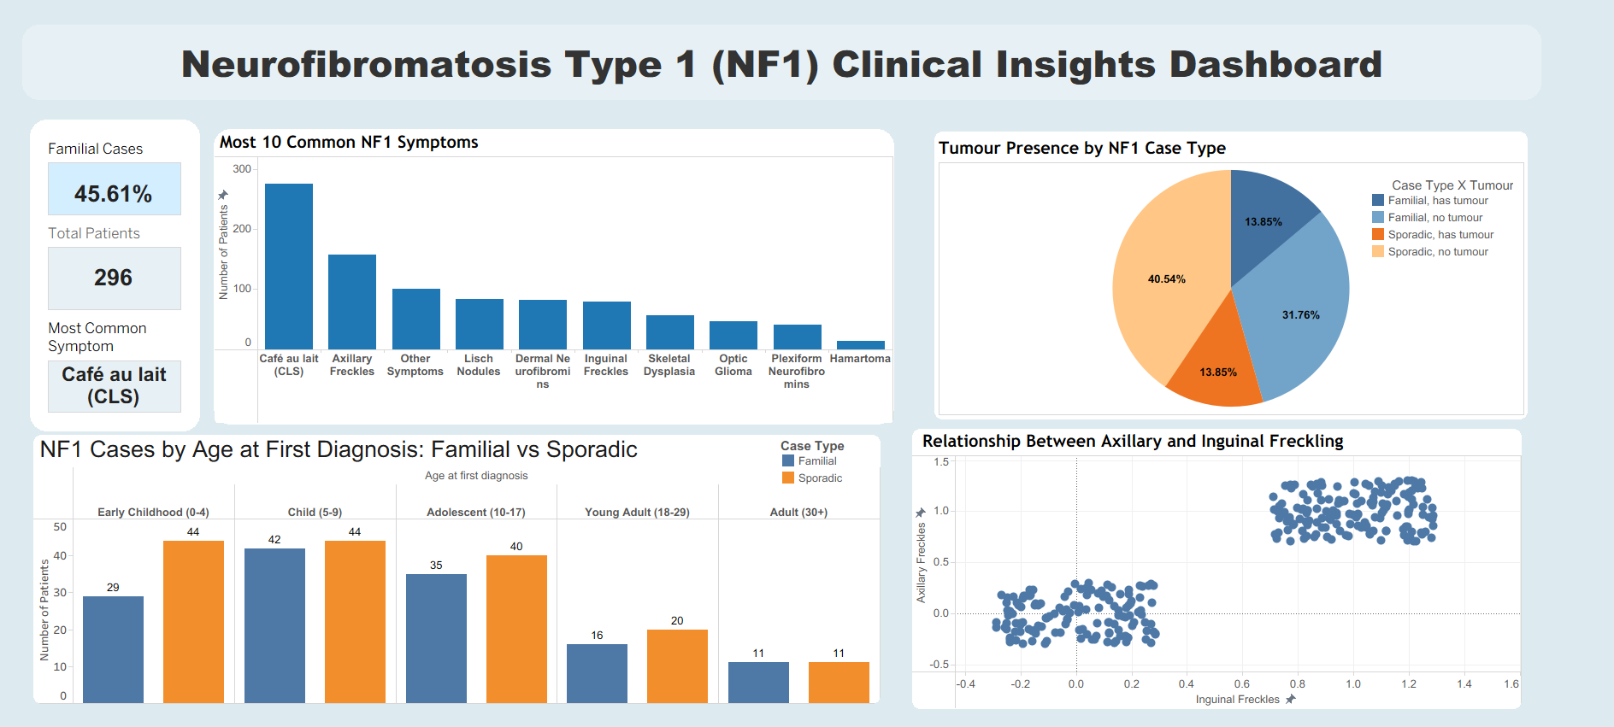
Human resources slide 9
This dashboard brings together all four main charts in a clean grid layout. A top header introduces the project title, while a left side panel highlights three key summary numbers for quick and easy review.

Slide 9
Key Insights :
Most Common Sign: Café au lait spots are the primary symptom, appearing in almost every patient in the study.
Early Diagnosis: Most cases are discovered in early childhood, usually before children turn ten years old.
Inherited vs. Non-Inherited: Patients who inherited the condition and those who developed it randomly show very similar symptoms and tumor risks.
Connected Symptoms: Auxilary and Inguinal freckling strongly go hand-in-hand, almost always appearing together in the same patient.

