Slide 1

End-to-end quantum simulation of space telescopes
Womanium Global Quantum Computing & Entrepreneurship Program
Abderrahman Aberda (Team SHARP-G Webbians)

Slide 2
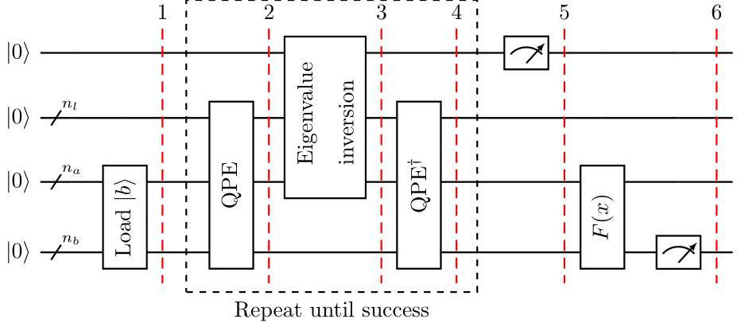
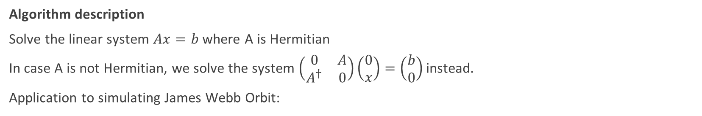
HHL Algorithm
Algorithm description
Solve the linear system $Ax=b$ where A is Hermitian
In case A is not Hermitian, we solve the system $\left(\begin{matrix}0 & A \\ A^{†} & 0\end{matrix}\right)\left(\begin{matrix}0 \\ x\end{matrix}\right)=\left(\begin{matrix}b \\ 0\end{matrix}\right)$ instead.
Application to simulating James Webb Orbit:
HHL Algorithm circuit @ Qiskit

Slide 3
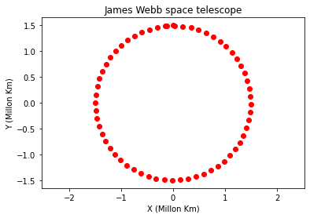
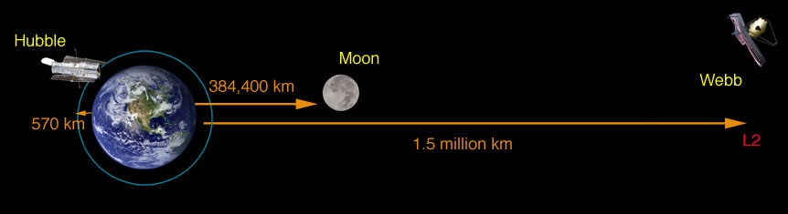

HHL Algorithm
James Webb's Orbit simulation
Differential equation
$\left(\begin{matrix}0 & −2π/T \\ 2π/T & 0\end{matrix}\right)\left(\begin{matrix}y \\ x\end{matrix}\right)=\left(\begin{matrix}\dot{x} \\ \dot{y}\end{matrix}\right)$
Backward Euler method -> Linear system
$\left(\begin{matrix}1 & 2πΔt/T \\ −2πΔt/T & 1\end{matrix}\right)\left(\begin{matrix}x_{i} \\ y_{i}\end{matrix}\right)=\left(\begin{matrix}x_{i+1} \\ y_{i+1}\end{matrix}\right)$
Simulation parameters
$T=6 months , Δt={10}^{−1} ,$
$\left(\begin{matrix}x_{0} & y_{0}\end{matrix}\right)=\left(\begin{matrix}0 & 1.5\end{matrix}\right)$, duration = T
@ NASA

Slide 4
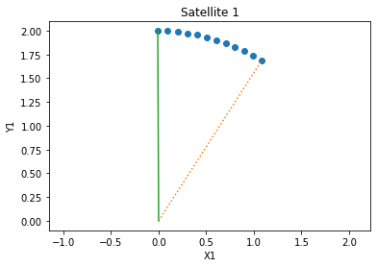
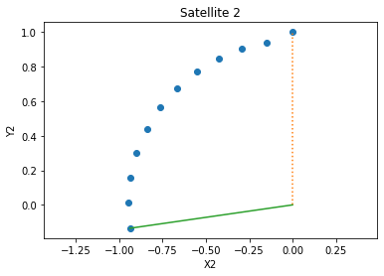

HHL Algorithm
Simulation of 2 satellites
$$Δt=\frac{1}{40} ;t_{End}=\frac{1}{4}; \left\{\begin{aligned}T_{1}=3 \\ r_{1}=2\end{aligned}\right. And \left\{\begin{aligned}T_{2}=1 \\ r_{2}=1\end{aligned}\right.$$

Slide 5
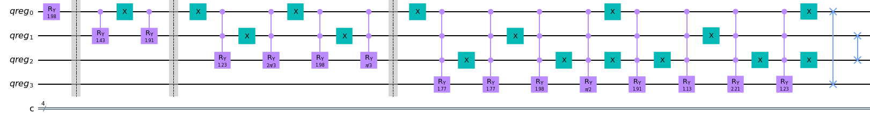
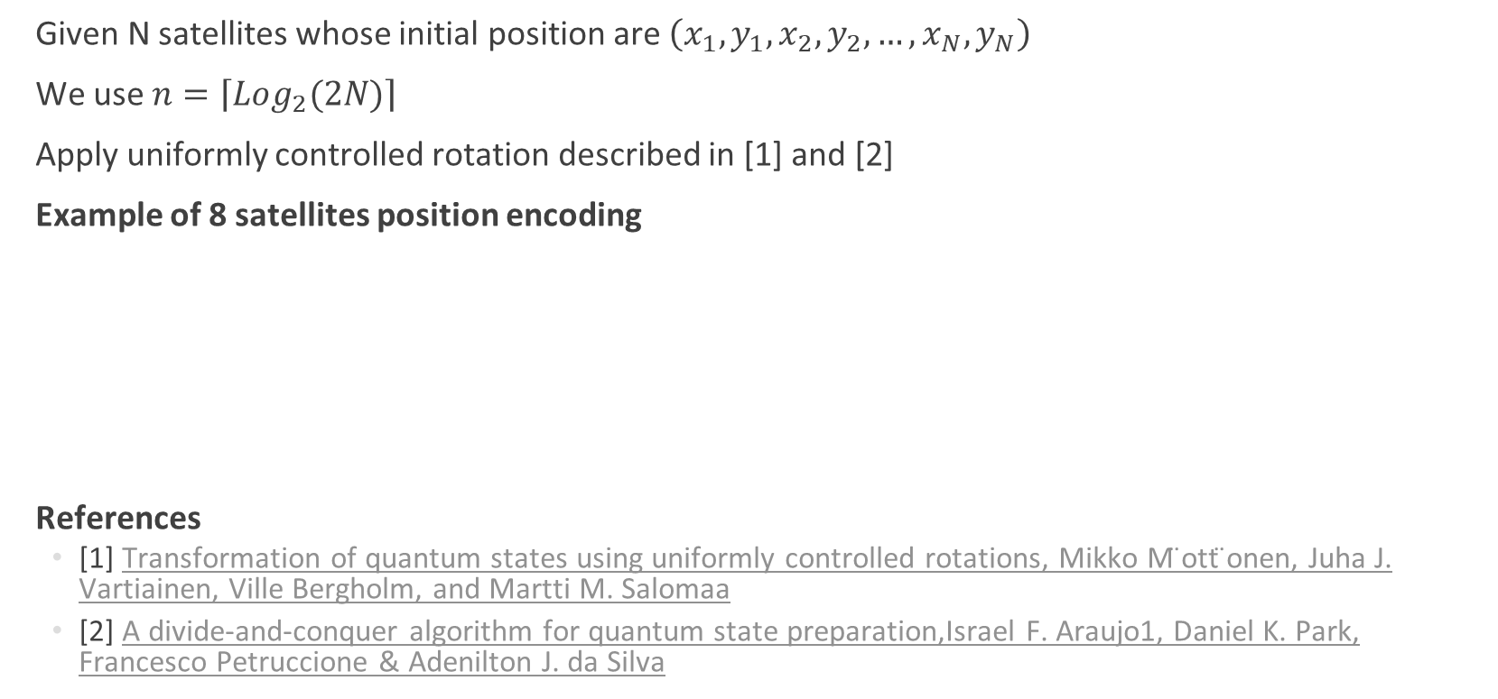
Amplitude Encoding of the input
Given N satellites whose initial position are $\left(x_{1},y_{1},x_{2},y_{2},…,x_{N},y_{N}\right)$
We use $n=\left\lceil Log_{2}(2N)\right\rceil$
Apply uniformly controlled rotation described in [1] and [2]
Example of 8 satellites position encoding
References
[1] Transformation of quantum states using uniformly controlled rotations, Mikko M ̈ott ̈onen, Juha J. Vartiainen, Ville Bergholm, and Martti M. Salomaa
[2] A divide‑and‑conquer algorithm for quantum state preparation,Israel F. Araujo1, Daniel K. Park, Francesco Petruccione & Adenilton J. da Silva

Slide 6
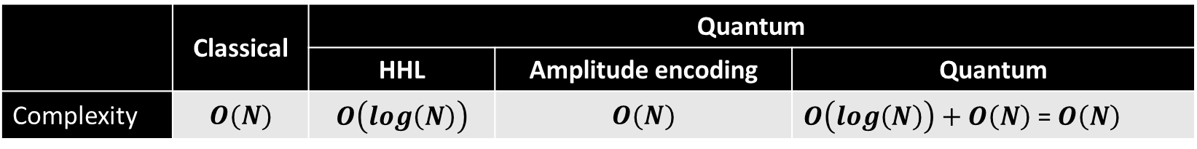
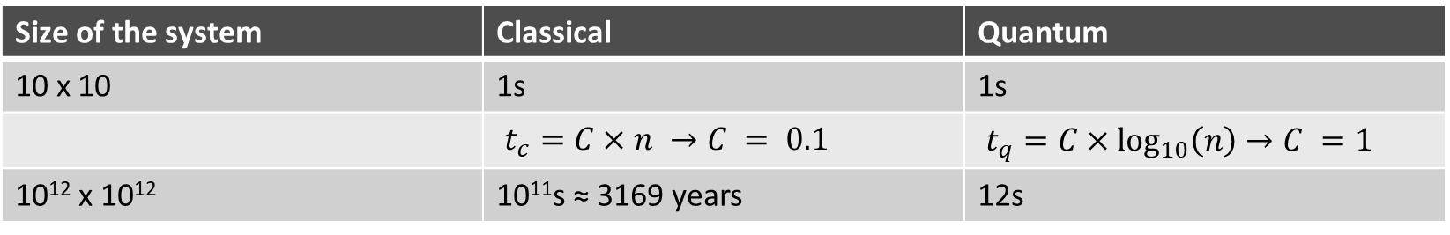
Amplitude Encoding of the input
 | Classical | Quantum
 |  | HHL | Amplitude encoding | Quantum
Complexity | $$O(N)$$ | $$O\left(log\left(N\right)\right)$$ | $$O(N)$$ | $O\left(log\left(N\right)\right)+O\left(N\right)$ = $O\left(N\right)$
Size of the system | Classical | Quantum
10 x 10 | 1s | 1s
 | $t_{c}=C×n →C = 0.1$ | $t_{q}=C×\log_{10}\left(n\right)→C =1$
10¹² x 10¹² | 10¹¹s ≈ 3169 years | 12s
The encoding step is slowing down the quantum algorithm which makes it lose its advantage!

Slide 7
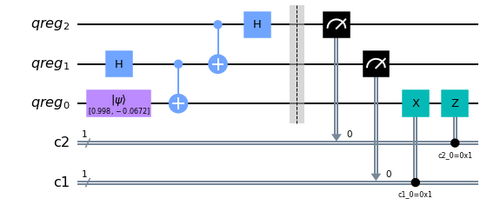


Quantum teleportation
Imagine that a quantum sensor prepares the states,
$→$ all we have to do is teleport them to the quantum computer
$$×n_{qubits}$$

Slide 8
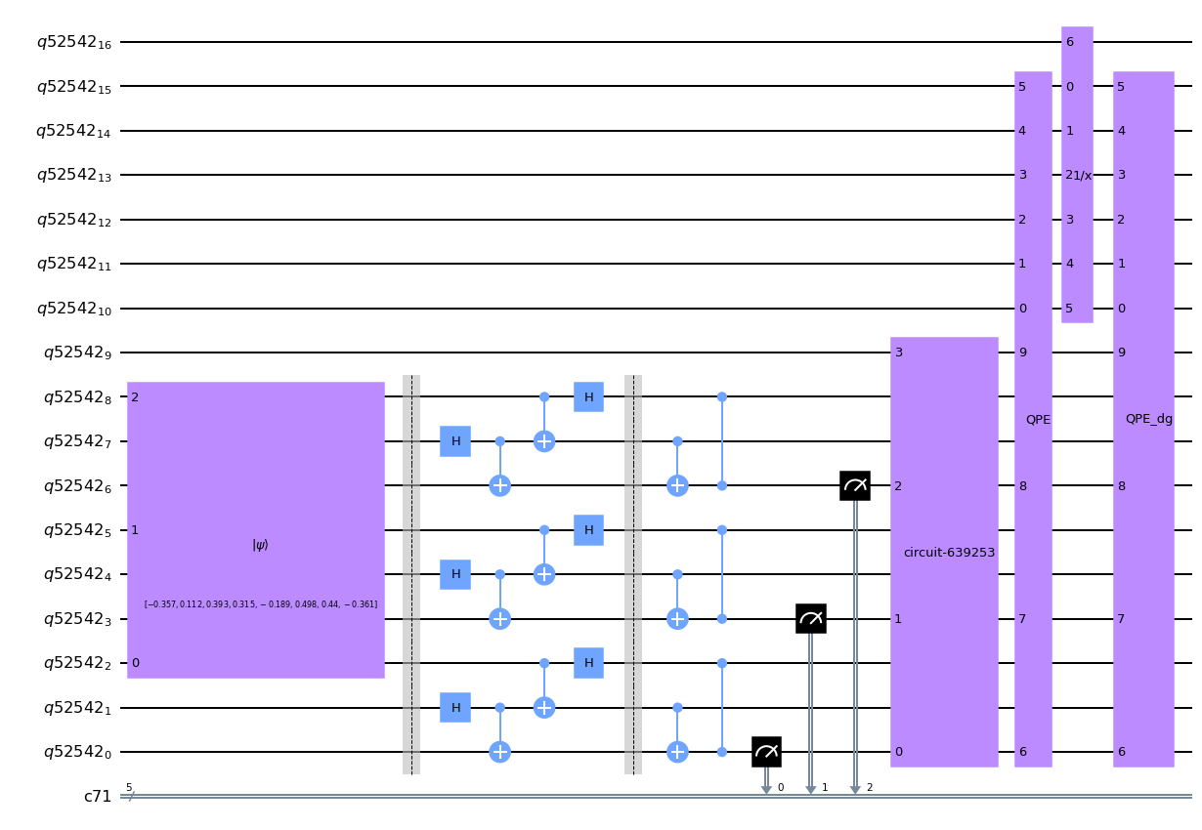
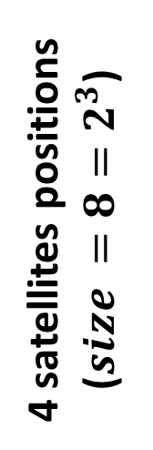
Quantum teleportation
4 satellites positions ($size =8=2^{3}$)

Slide 9
Molecular dynamics Synthesis of 2D materials
Goal
Molecular dynamics aims to predict atoms position time evolution using classical approximation to quantum equations governing the movement
Approximations
DeBroglie wavelength is very small with regards to interatomic distances
The possibility to dissociate electron motion from that of nuclei according to Born–Oppenheimer approximation.
Applications
Production of new material with high performances adapted to usage in future Qubits and Quantum computers
@Wikipedia

Slide 10

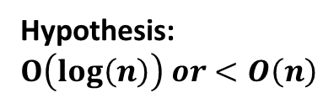

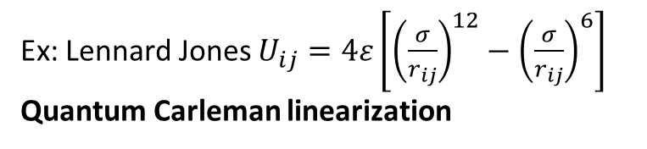
Molecular dynamics
Input preparation
Substrate
Position : Crystal
Velocity : Controlled by temperature
Gas
Position : Random
Velocity : Fixed
Introduced one by one
Input preparation
Given a set of N atoms composed of n substrate atoms and N-n deposited atoms
We consider crystalline substrates and gas deposition
Substrate
- The substrate atoms follow a certain pattern thus we can hope there exists an algorithms that can prepare it in Log(n) or at least poly log(n) time
- Initial speed 0
Gas
Position and speed of the rest of atoms is arbitrary, thus it can be generated by algorithm profiting from the randomness related to quantum mechanics, maybe the result of this challenge " Random number generation using boson sampling "
Hypothesis: $O\left(log\left(n\right)\right) or<O\left(n\right)$
Random number generation using boson sampling
Equations
$${\vec{f}}_{i}=m \ddot{{\vec{r}}_{i}}=−\vec{\text{∇}}U$$
Ex: Lennard Jones $U_{ij}=4ε\left[{\left(\frac{σ}{r_{ij}}\right)}^{12}−{\left(\frac{σ}{r_{ij}}\right)}^{6}\right]$
Quantum Carleman linearization
Apply boundary conditions (Ex: periodicity) + Temperature + pressure
Read output
Hypothesis: $O\left(log\left(n\right)\right) or<O\left(n\right)$

Slide 11
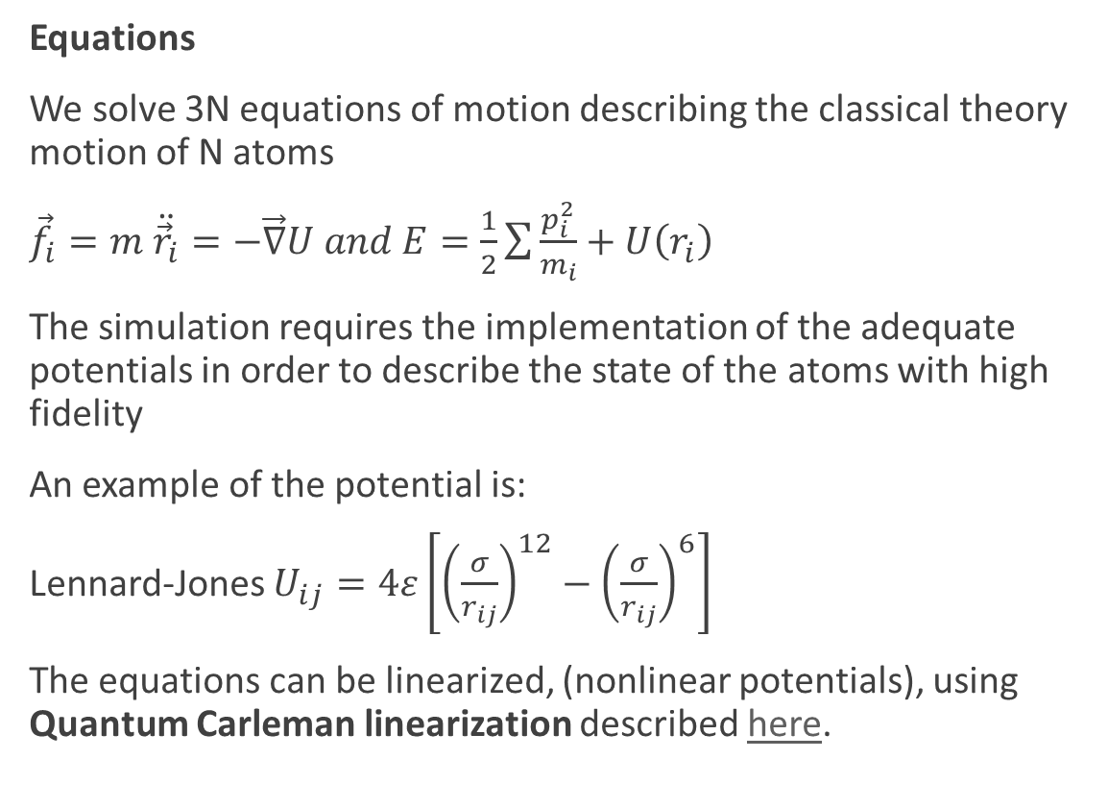
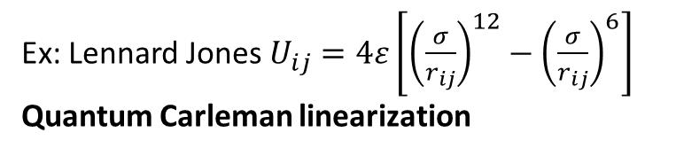

Molecular dynamics
Input preparation
Substrate
Position : Crystal
Velocity : Controlled by temperature
Gas
Position : Random
Velocity : Fixed
Introduced one by one
Equations
We solve 3N equations of motion describing the classical theory motion of N atoms
${\vec{f}}_{i}=m \ddot{{\vec{r}}_{i}}=−\vec{\text{∇}}U and E=\frac{1}{2}\sum{\frac{p_{i}^{2}}{m_{i}}+U\left(r_{i}\right)}$
The simulation requires the implementation of the adequate potentials in order to describe the state of the atoms with high fidelity
An example of the potential is:
Lennard-Jones $U_{ij}=4ε\left[{\left(\frac{σ}{r_{ij}}\right)}^{12}−{\left(\frac{σ}{r_{ij}}\right)}^{6}\right]$
The equations can be linearized, (nonlinear potentials), using Quantum Carleman linearization described here.
Hypothesis: $O\left(log\left(n\right)\right) or<O\left(n\right)$
Random number generation using boson sampling
Equations
$${\vec{f}}_{i}=m \ddot{{\vec{r}}_{i}}=−\vec{\text{∇}}U$$
Ex: Lennard Jones $U_{ij}=4ε\left[{\left(\frac{σ}{r_{ij}}\right)}^{12}−{\left(\frac{σ}{r_{ij}}\right)}^{6}\right]$
Quantum Carleman linearization
Apply boundary conditions (Ex: periodicity) + Temperature + pressure
Read output
Hypothesis: $O\left(log\left(n\right)\right) or<O\left(n\right)$

Slide 12
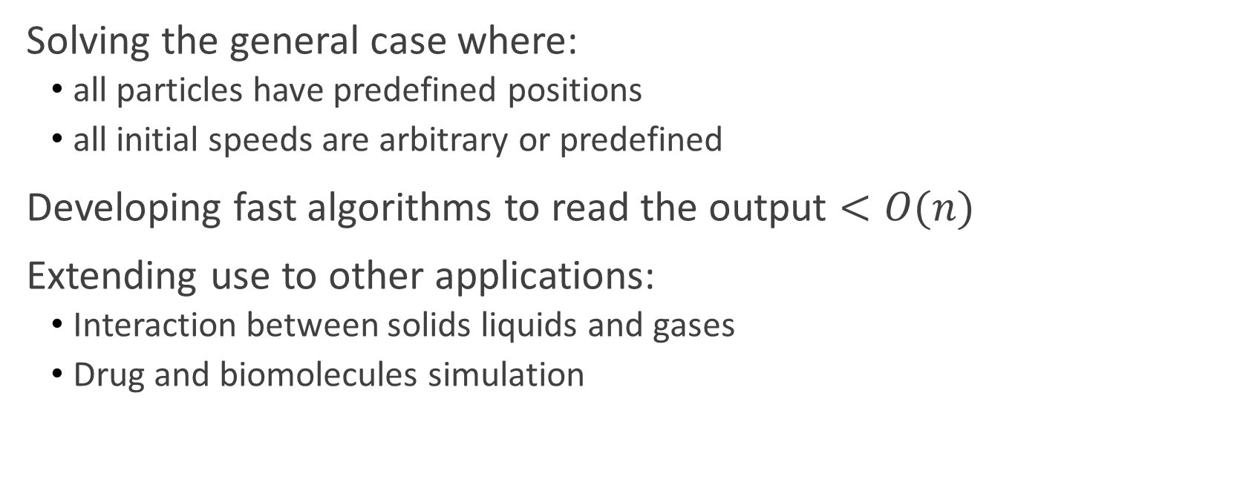
Future perspectives
Solving the general case where:
all particles have predefined positions
all initial speeds are arbitrary or predefined
Developing fast algorithms to read the output $<O(n)$
Extending use to other applications:
Interaction between solids liquids and gases
Drug and biomolecules simulation

Slide 13

Thanks

