Slide 1
PITCH DECK
XNLP
Work in progress

Slide 2
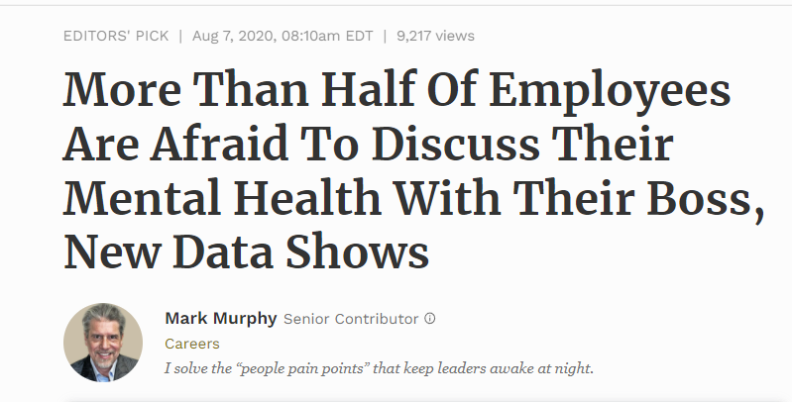
Work in progress

Slide 3

That’s where Sophie comes in. An AI that walks you through any work-related crisis.
Sophie is your own personal advisor. Whether you got discriminated against, Harassed, unfairly treated. Sophie will listen to you and provide you with adequate and appropriate advice. Sophie will not only guide you and suggest how you can personally and legally react to the issue at hand. But it will also gather anonymous Data, categorize it and present it as an Index to the HR department. Which can serve as an Indicator on how well or bad specific departments are doing in specific topics like discrimination and sexual harassment.
Work in progress

Slide 4

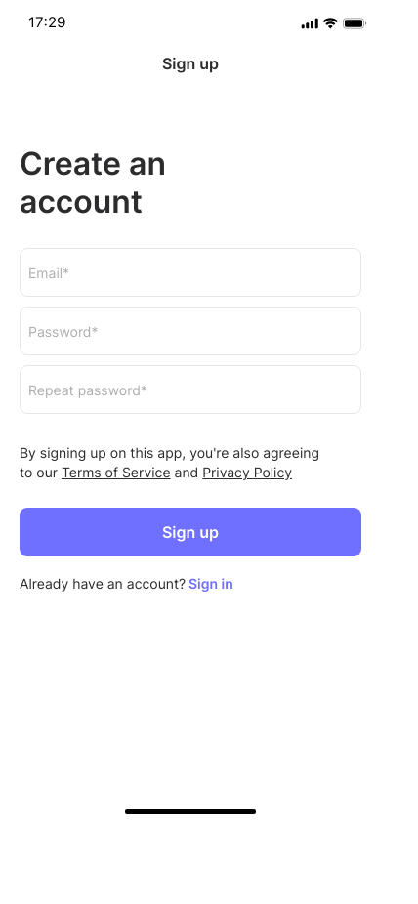

Work in progress

Slide 5
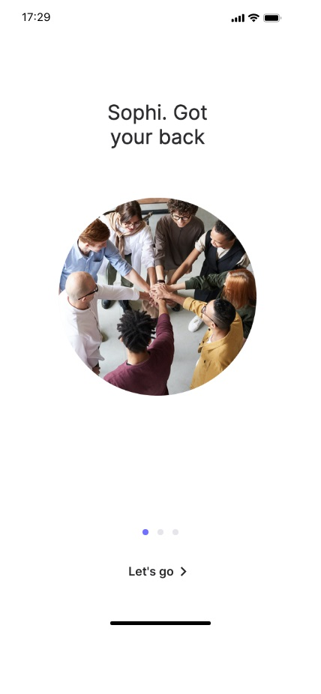

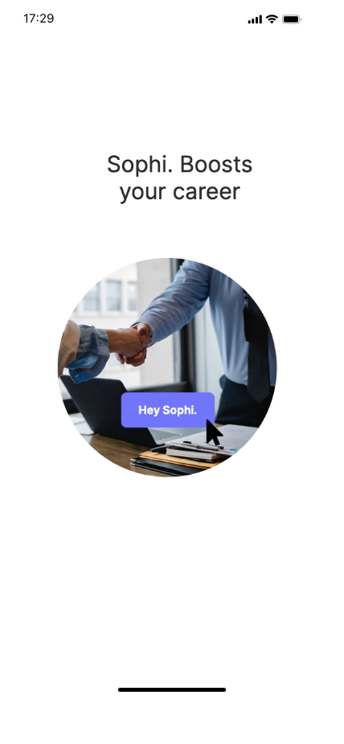
Work in progress

Slide 6
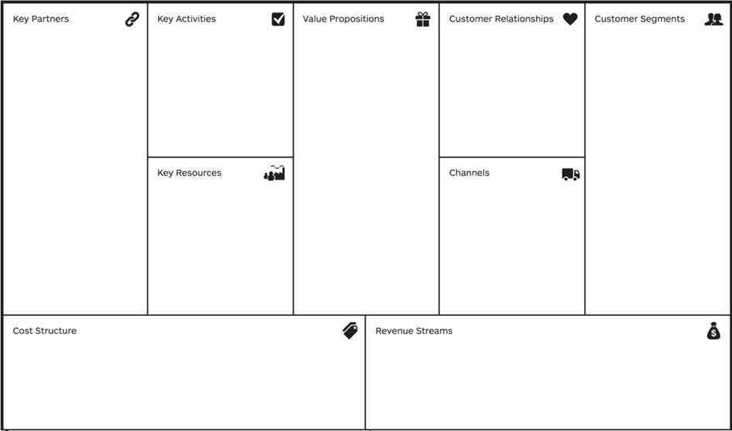
Business Canvas Model
Work in progress

Slide 7
THANK YOU
Work in progress

