Slide 1


Network Management & SNMP
Niveau: 4èmeSE
Sabrine Laffet
Unité Pédagogique: Réseaux
Module : Services et administration des réseaux
A.U: 2021/2022
Notes:
4 éme GL

Slide 2
Outline
Objectives
Definition of network management
Network Management requirements
Network Management systems
Simple Network Management protocol (SNMP)

Slide 3
Learning Objectives
Describe the key requirements that a network management system should satisfy,
Describe an overview of the architecture and key elements of a network management system,
Describe the SNMP (Simple Network Management Protocol).

Slide 4

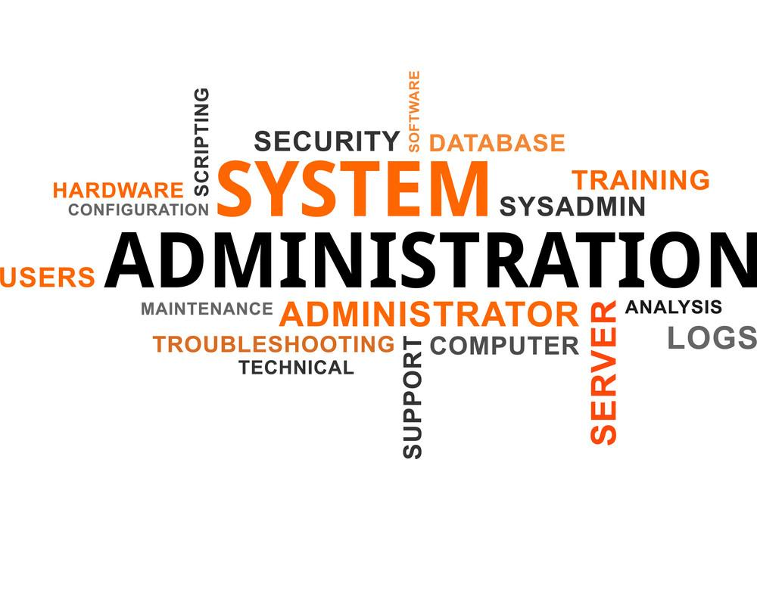
Introduction
Our networks are surrounded
by threats, this will lead to
downtime, loss of data We
shall then ensure the
availability of our networks!!
Lost productivity and missed deadlines.
Lost revenues and damaged credibility
It harms the relationship and affects their goals.

Slide 5

Solution: Network management
Network Management
Network Network Monitoring Control
Accounting Management
Performance Management
Fault Management
Configuration Management
Security Management
‹#›

Slide 6

What is Network management ?
Helps an organization achieve availability, performance, and security goals
Helps an organization measure how well design goals are being met and adjust network parameters if they are not being met
Facilitates scalability
Helps an organization analyze current network behavior, apply upgrades appropriately, and troubleshoot any problems with upgrades

Slide 7
Network management Requirements
Key areas of network management as suggested by the International Organization for Standardization (ISO).
Fault management
Accounting management
Configuration management
Performance management
Security management
Notes:
ISO (International Organization for Standardization) has created a network management model. 5 areas of network management are classified
This classification has gained broad acceptance by vendors of both standardized and proprietary NMS

Slide 8
Fault Management
The facilities that enable the detection, isolation, and correction of abnormal operation of the OSI environment.
It involves the following steps:
Discover where the fault is coming from,
Isolate the fault,
Modify the network and reconfigure without the failed component,
Repair or replace the failed component,
Restore the network to its initial state.
Notes:
To maintain proper operation of a complex network, care must be taken that systems as a whole, and each essential component individually, are in proper working order. When a fault occurs, it is important, as rapidly as possible, to • Determine exactly where the fault is. • Isolate the rest of the network from the failure so that it can continue to function without interference. • Reconfigure or modify the network in such a way as to minimize the impact of operation without the failed component or components. • Repair or replace the failed components to restore the network to its initial state

Slide 9
Accounting Management
The facilities that enable charges to be established for the use of managed objects and costs to be identified for the use of those managed objects.
Network managers track the use of network resources by end user or end-user class
An end user or group of end users may be abusing its access privileges and burdening the network at the expense of other users,
End users may be making inefficient use of the network, and network manager can assist in changing procedures to improve performance,
The network manager is easier to plan for network growth if end user activity is known in sufficient detail.

Slide 10
Configuration Management
The facilities that exercise control over, identify, collect data from, and provide data to managed objects for the purpose of assisting in providing for continuous operation of interconnection services.
Configuration management is concerned with :
Initializing a network,
Gracefully shutting down part or all of the network,
Maintaining, adding, and updating the relationships among components and the status of components themselves during network operation.

Slide 11
Performance Management
The facilities needed to evaluate the behavior of managed objects and the effectiveness of communication activities (network hardware, software and media).
Monitoring Tracks activities on the network,
Enables performance management to make adjustments to improve network performance,
Examples of measured activities: Overall throughput, Percentage utilization, Error rates, Response time…

Slide 12
Security Management
Those aspects of OSI security essential to operate OSI network management correctly and to protect managed objects.
Maintain and distribute user names and passwords
Generate, distribute, and store encryption keys
Analyze router, switch, and server configurations for compliance with security policies and procedures
Collect, store, and examine security audit logs

Slide 13
Network Management Systems
A network management system is a collection of tools for network monitoring and control :
A managed device is a network node that collects and stores management information,
An agent is network-management software that resides in a managed device,
A network-management system (NMS) runs applications to display management data, monitor and control managed devices, and communicate with agents,

Slide 14
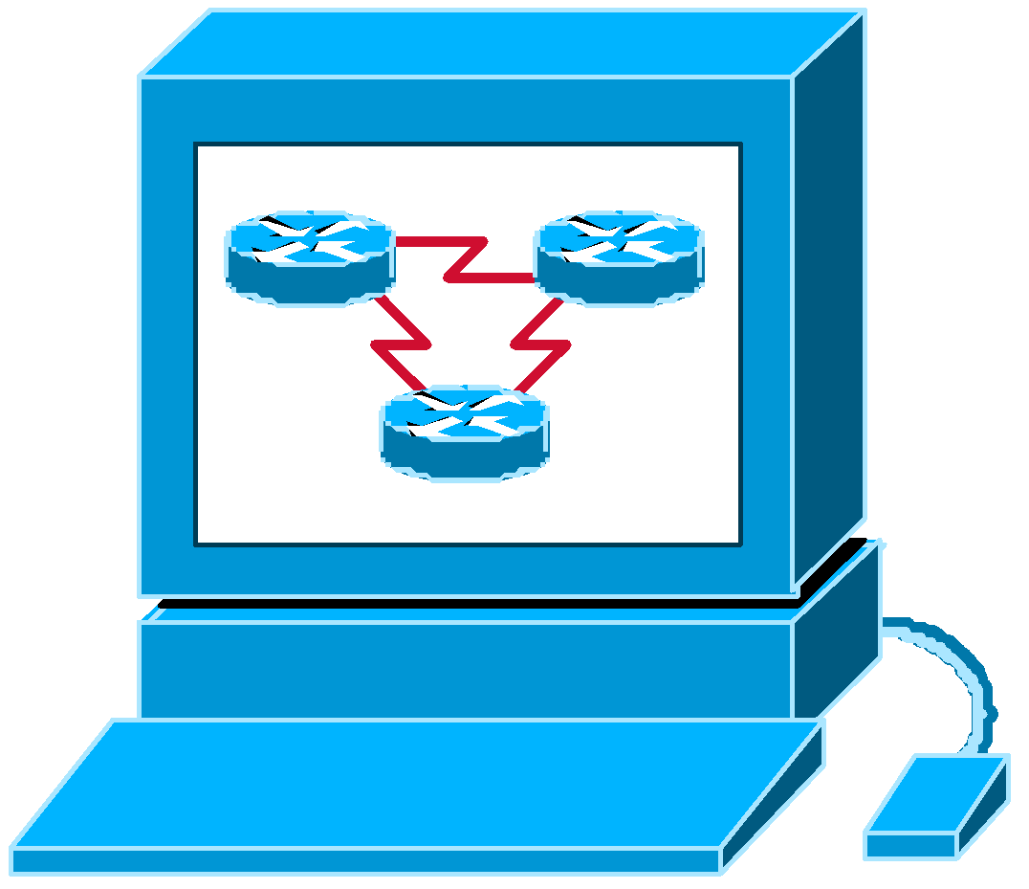
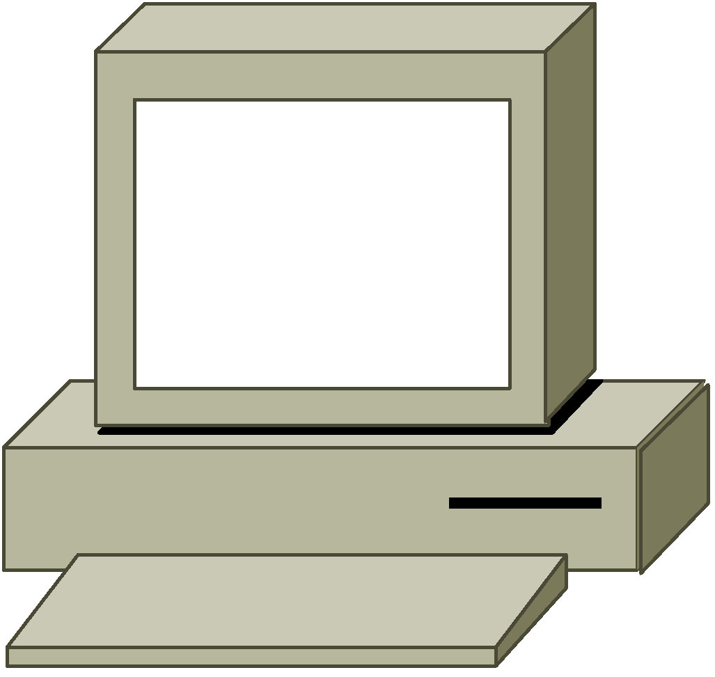


Network Management Systems
NMS
Agent
Agent
Agent
Management Database
Management Database
Management Database
Managed Devices

Slide 15
Network Management Protocols
1987: OSI approach
Common Management Information Protocol (CMIP)
CMIP is the management (application layer) protocol
Common Management Information Service (CMIS)
CMIS is the service interface to CMIP
1989 : Simple Network Management Protocol (SNMP)
It is defined by IETF (Internet Engineering Task Force). It is an application layer protocol
CMIP/CMIS is being replaced by SNMP.
SNMP uses the concept of manager and agent
Notes:
It was expected that OSI management standards will eventually be used in the Internet. So a tentative simple solution was developed for the time being:

Slide 16
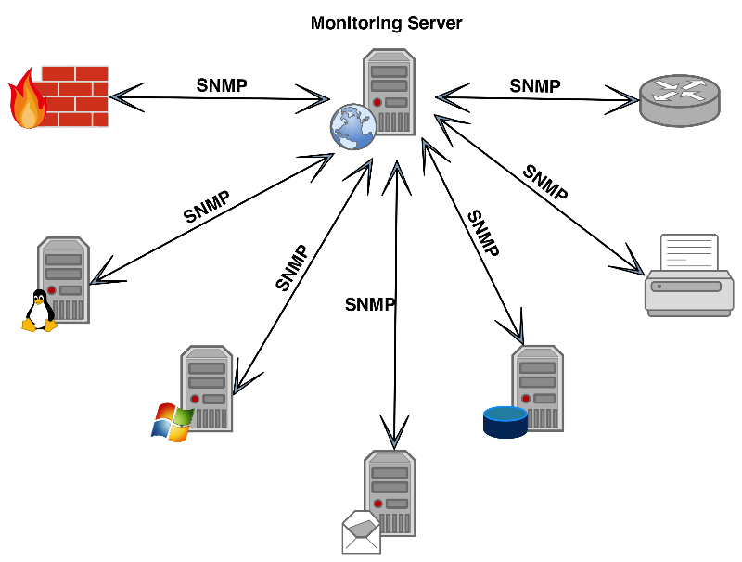
Simple Network Management Protocol (SNMP)
What is it ?
A Protocol that Facilitates the exchange of management information between network devices,
Part of TCP/IP suite
Why was it developed ?
To control and monitor status of network devices,
How is it beneficial ?
Enables network administrators to:
Manage network performance
Find and solve network problems
Plan for network growth

Slide 17
SNMP Basic Components
The model of network management that is used for SNMP includes the following key elements :
Network Management station (manager)
Collects and stores management information, and makes this information available to NMS using SNMP
Could be a work station or PC
Network Management System (NMS)
Executes applications that monitor and control managed devices
Basically it will run on manager
Agent
process running on each managed node collecting information about the device it is running on.
Management Information Base (MIB)
Used by both the manager and the agent to store and exchange management information

Slide 18
Network Management Architecture
NMS
User Interface
Network Management Application
Management Station
SNMP
SNMP
SNMP
AGENT
AGENT
AGENT
MIB
MIB
MIB
Managed Devices
Router
Host
Printer

Slide 19
SNMP MIB
Every management station or an agent in an SNMP architecture maintains a local database having information related to the network management.
This virtual information store is called MIB - objects database
An SNMP MIB contains definitions and information about the properties of managed resources and the services that the agents support.
The manageable features of resources, as defined in an SNMP MIB, are called managed objects

Slide 20
Managed Objects
Each managed object is assigned an object identifier (OID)
The OID is specified in a MIB file.
An OID can be represented as a sequence of integers separated by decimal points or by a text string:
Example:
1.3.6.1.2.1.4.6
iso.org.dod.internet.mgmt.mib-2.ip.ipForwDatagrams
🡺 When a SNMP manager requests an object, it sends the OID to the SNMP agent.

Slide 21
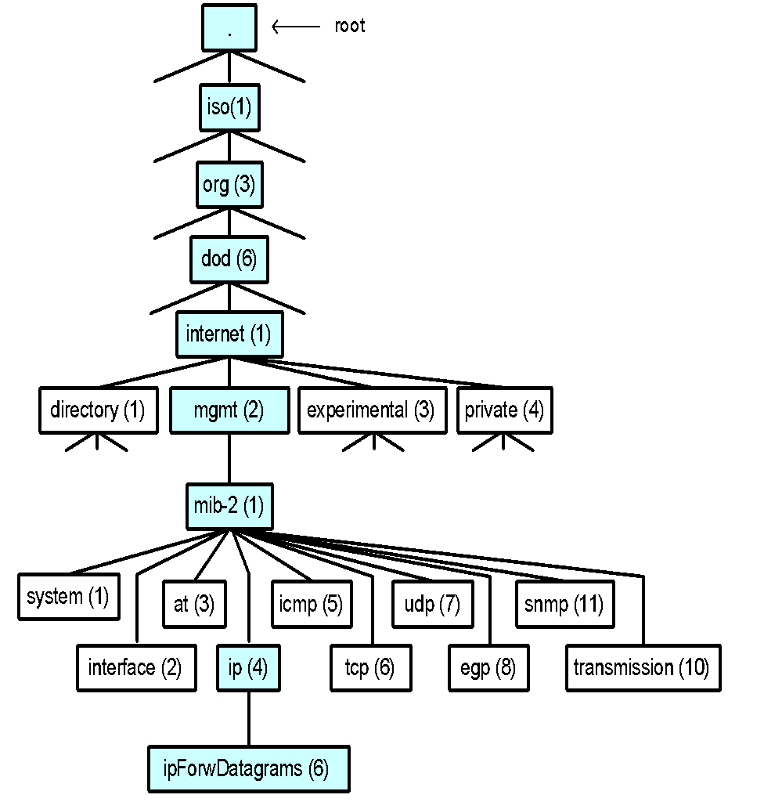
Organization of Managed Objects
Managed objects are organized in a tree-like hierarchy and the OIDs reflect the structure of the hierarchy.
Each OID represents a node in the tree.
The OID 1.3.6.1.2.1 (iso.org.dod.internet.mgmt.mib-2) is at the top of the hierarchy for all managed objects of the MIB-II.
Manufacturers of networking equipment can add product specific objects to the hierarchy.

Slide 22
Ports & UDP
SNMP uses User Datagram Protocol (UDP) as the transport mechanism for SNMP messages
Ethernet Frame
IP Packet
SNMP Message
CRC
UDP Datagram
Like FTP, SNMP uses two well-known ports to operate:
UDP Port 161 - SNMP Messages
UDP Port 162 - SNMP Trap Messages

Slide 23
SNMP Architectural Model
Management
Station
Network Elements (NEs)
Host
Router
Manager
Agent
Agent
SNMP
Network
Management
Protocol
SNMP
. . .
SNMP
UDP
UDP
UDP
IP
IP
IP
SNMP
Network
‹#›

Slide 24
Client Pull & Server Push
There are two approaches for the management system to obtain information from SNMP :
SNMP is a “client pull” model
The management system (client) “pulls” data from the agent (server).
SNMP is a “server push” model
The agent (server) “pushes” out a trap message to a (client) management system

Slide 25
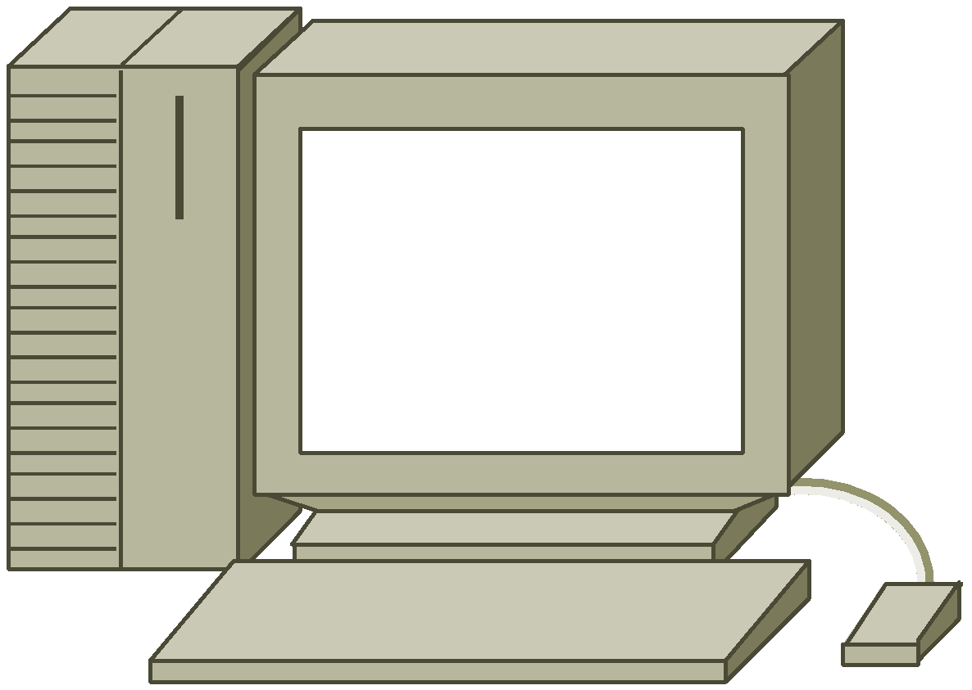




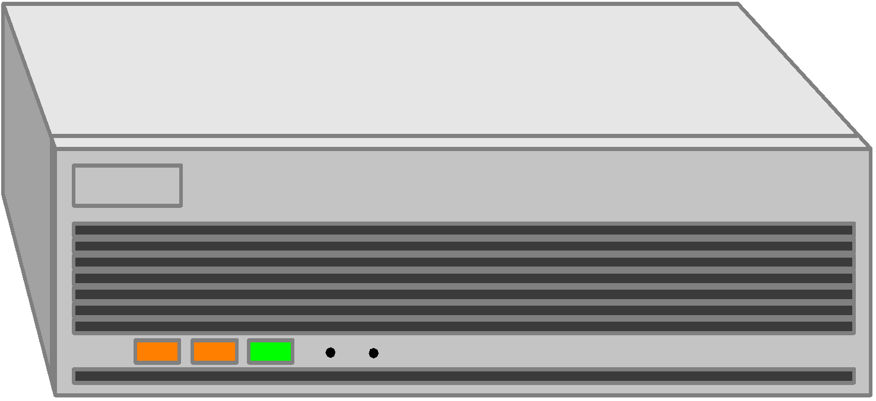

SNMP Architecture
Management
Station
PC
UNIX
NM
...
....
Polling
Notification
Firewall
/ Router
....
....
UNIX
...
PC
Internet
UNIX
PC
‹#›

Slide 26
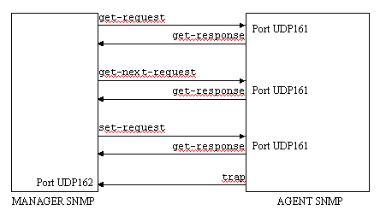
SNMP Transport
Agent will receives request on UDP port no. 161 and manager will send request on UDP port no. 161
Manger receives notifications from agent on port no. 162 that called trap event

Slide 27
SNMP Messages
Get Request
Get
GetNext
Set
Trap
Manager
Agent
Get Response
GetNext Request
Manager
Get Response
Agent
Set Request
Manager
Get Response
Agent
Trap Request
Manager
Agent

Slide 28
SNMP Messages
Get Request
Retrieve the values of objects in the MIB of an agent.
Get-Next Request
Retrieve the values of the next objects in the MIB of an agent.
Set Request
Update the values of objects in the MIB of an agent.
Trap Request
Report extraordinary events to the manager.

Slide 29
SNMP Versions
SNMPv1
Proposed in 1989
V1 is first version of SNMP basically has poor security.
SNMPv2
Proposed in 1993 and revised in 1995
V2 is revised version of V1 it improves in area of performance, security. It introduces Getbulkrequest & inform Request.
SNMPv3
Issued in 1998
Define a security capability for SNMP and an architecture for future enhancements
Used with the functionality provided by SNMPv2 or SNMPv1

Slide 30

SNMP advantages & disadvantages
Security gaps
Intruders access to the information carried along the network.
SNMP version 2 has fixed some security issues.
Not a particularly efficient protocol
Bandwidth is wasted with needless information.
E.g. : SNMP version multiple length
Simple design & implementation
users to easily program variables that they want to monitor.
Expansibility
Protocol can be updated to meet future needs.

Slide 31
Network Management Applications
Network Management Applications (NMAs) are software applications that live on Network Management Stations (NMSs) and retrieve data from management agents (MAs). NMA agents monitor and control devices on the network, which is trying to efficient operate servers, databases, and routers.
The top 8 NMAs tools :
DX Spectrum
Fortinet FortiManager
Cisco DNA Center
Cisco Prime
ExtremeCloud IQ
Micro Focus Network Node Manager
Huawei eSight
IBM Tivoli NetCool

Slide 32
Summary
Network management is becoming increasingly important with the advent of larger networks
Network management costs are high
Automated tools can lower management cost
Vendors finally paying belated attention to it
Standards such as SNMP and SNMPv2 are now emerging and are being adopted widely.

Slide 33
NEXT
1. Install and configure Nagios
2. Install Nagios Web Interface
3. Add Monitoring targets to Nagios server
4. Define Services
5. Monitor Client machine

Slide 34
Merci
Pour Votre Attention

