Slide 1
Annuler
les Changements
Quote

Slide 2
Reset
voyons maintenant comment annuler des actions
dans Git. Que ce soit un mauvais commit ou une
suppression par erreur
— Git offre des solutions.
Voici les commandes les plus utiles pour corriger tout ça.

Slide 3
Reset
git reset <commit>
Reset c'est la commande que nous utilisons lorsque
nous voulons déplacer le référentiel vers un emplacement précédent commit, en supprimant toutes les modifications apportées après cela commit

Slide 4


Reset
Étape 1 : Trouver le commit précédent par log
Étape 2 : Remettez le référentiel à cette étape :

Slide 5
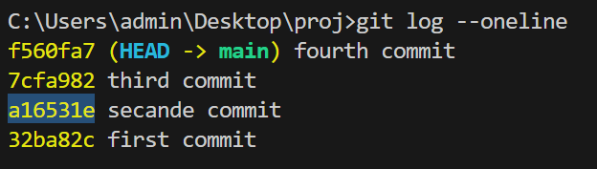

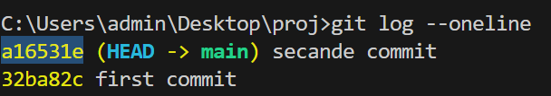
Example

Slide 6
Si tu specife l’option -–hard
Elle réinitialise tout — le commit, la zone de staging, et même le dossier de travail. Donc attention : elle efface complètement les changements.Si on utilise git reset sans option, Git utilise --mixed par défaut. Cela réinitialise le commit et la zone de staging, mais garde les changements dans le dossier de travail

Slide 7
Reset

Slide 8
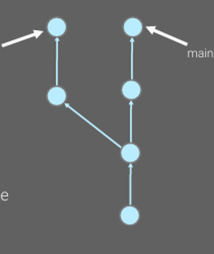
Reset

Slide 9
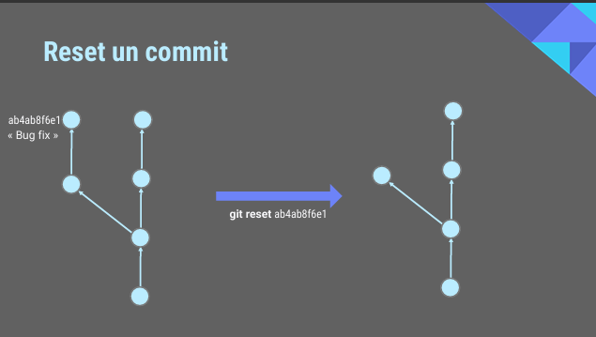
Reset

Slide 10
Reset vs Revert

Slide 11
Reset
Topic 1
Presentations are communication tools that can be used as speeches, reports, and more.
Topic 2
Presentations are communication tools that can be used as speeches, reports, and more.

Slide 12

THESIS
DEFENSE
Here is your presentation begins

Slide 13
Table of Contents
Topic 1
Topic 2
Topic 3
Topic 4

Slide 14
Name of the section
Add a short description

Slide 15

Overview
Topic 1
Topic 2
Presentations are communication tools that can be used as demonstrations, lectures, speeches, reports, and more. Most of the time, they're presented before an audience.
Presentations are communication tools that can be used as demonstrations, lectures, speeches, reports, and more. Most of the time, they're presented before an audience.

Slide 16

A picture is worth a thousand words

Slide 17

Introduction
Topic 1
Topic 2
Presentations are communication tools that can be used as demonstrations.
Presentations are communication tools that can be used as demonstrations.
Topic 3
Topic 4
Presentations are communication tools that can be used as demonstrations.
Presentations are communication tools that can be used as demonstrations.

Slide 18
This is a timeline
Topic 1
Topic 2
Topic 3
Topic 4
Presentations are communication tools that can be used as demonstrations.
Presentations are communication tools that can be used as demonstrations.
Presentations are communication tools that can be used as demonstrations.
Presentations are communication tools that can be used as demonstrations.

Slide 19
This is an infographic
Topic 1
Add a main point
Presentations are communication tools that can be used as demonstrations, lectures, speeches, reports, and more. Most of the time, they're presented before an audience.

Slide 20

This is a graph
Add a main point
Presentations are communication tools that can be used as demonstrations.

Slide 21


Results
Add a main point
Add a main point

Slide 22
le Besoin !
Probleme | GIT apporte
garder un historique clair de mon travail | Suivi des versions
plusieurs à coder ensemble | Collaboration efficace
tester quelque chose sans casser le projet principal | Branches
supprimer un fichier par erreur | Restauration facile
voir qui a modifié quoi et pourquoi | Traces claires avec les commits
sauvegarder mon projet en ligne | Intégration avec GitHub, GitLab, etc.

Slide 23
Problem ( le Besoin ! )
Je veux garder un historique clair de mon travail
Suivi des versions

Slide 24

Problem
Topic 1
Presentations are communication tools that can be used as speeches, reports, and more.
<?php
?>
Topic 2
Presentations are communication tools that can be used as speeches, reports, and more.

Slide 25
Our Story
Topic 1
Topic 2
Topic 3
Presentations are communication tools that can be used as demonstrations.
Presentations are communication tools that can be used as demonstrations.
Presentations are communication tools that can be used as demonstrations.

Slide 26

Conclusion
Topic 1
Presentations are communication tools that can be used as demonstrations.
Topic 2
Presentations are communication tools that can be used as demonstrations.
Topic 3
Presentations are communication tools that can be used as demonstrations.

Slide 27
THANKS
FOR WATCHING

