Slide 1
SkillCraft Dataset
Presented by Sami Laribi & Arslene Abdi
Notes:
© Copyright PresentationGO.com – The free PowerPoint and Google Slides template library

Slide 2
Plan
Dataset SkillCraft Description
Data Analyzing
Data cleaning
Fiting models
Logestic regression
Random forest
Multinomial
KNN
Model comparisons
Casting results on Flask
conclusion
Notes:
© Copyright PresentationGO.com – The free PowerPoint and Google Slides template library

Slide 3
Dataset SkillCraft Description
The dataset used in this project is the SkillCraft1 master table dataset from UCI machine learning repository. It aggregates screen movements into screen-fixations using a Salvucci & Goldberg (2000) dispersion-threshold algorithm, and defined Perception Action Cycles (PACs) as fixations with at least one action.
In simple words ,they actually tried to find the league of players based on their screen movement when playing the game.
Notes:
© Copyright PresentationGO.com – The free PowerPoint and Google Slides template library

Slide 4
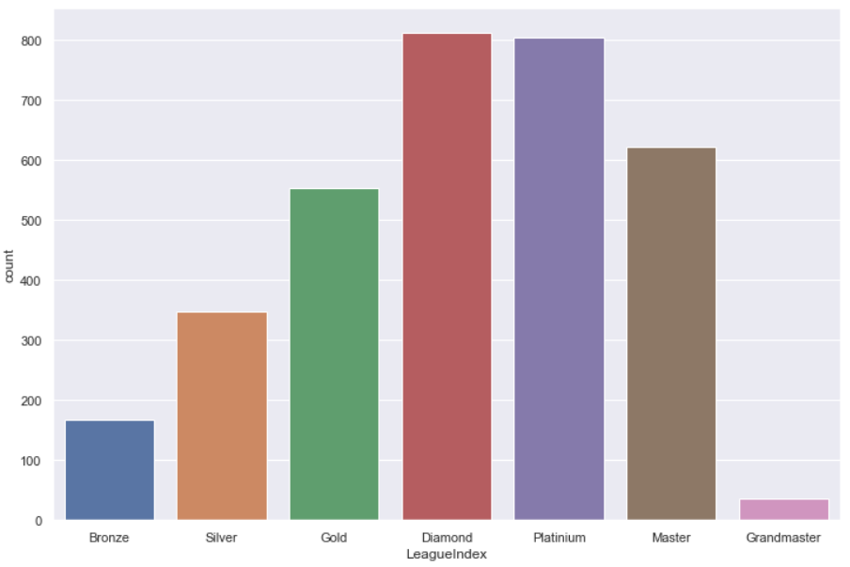
Data Analyzing
After analyzing our Dataset , we came up with these caracteristics :
Dimensions : 3395 rows × 20 columns
Target : LeagueIndex
Partitions of Data :
We have 7 classes in the league there is not the professionel leagues as mentioned in the dataset description and as we can see the Data varries a lot in this Dataset , and this is a little bit concerning in fitting models later as we can have an underfitted models.
Notes:
© Copyright PresentationGO.com – The free PowerPoint and Google Slides template library

Slide 5
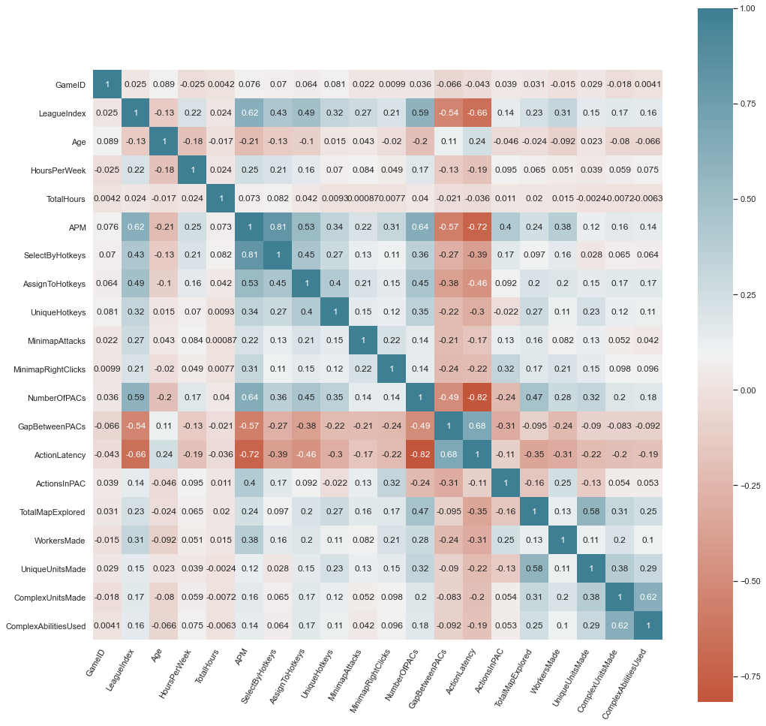
After analyzing each variable with the target and ploting their graphs we noticed that we need to remove some features in order to have better model .
As you can see there is a huge correlation between different features , so we had to clean our dataset , I can't spoil you but it did make a difference in improving the scores .
Cor(gameid,leagueindex)=0.025
Cor(age,leagueindex)=-0.13
Cor(actioninPAC,leagueindex)=0.14
Cor(complexabilitiesused,leagueindex)=0.16
Cor(uniqueunitmade,leagueindex)=0.15
Cor(complexunitmade,leagueindex)=0.17
Cor(Totalhours,leagueindex)=0.024
Notes:
© Copyright PresentationGO.com – The free PowerPoint and Google Slides template library

Slide 6
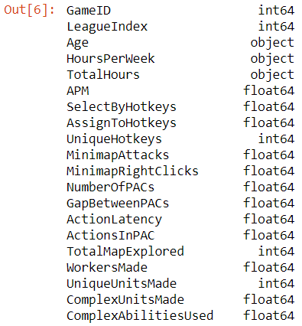
Data Cleaning
First of all , we noticed that there is some rows with '?' Inside witch we think its some corrupted data , so we had to remove them .
Then we searched for missing values , we hadn't found anything .
There is 3 features that have an object type that will make it difficult for the work so we had to change
them to 'integer'
Notes:
© Copyright PresentationGO.com – The free PowerPoint and Google Slides template library

Slide 7
Its time to remove the unwanted features :
"GameID","LeagueIndex","Age","TotalHours","ActionsInPAC",
"UniqueUnitsMade","ComplexUnitsMade","ComplexAbilitiesUsed"
Our dataset is clean and ready for some work .
Notes:
© Copyright PresentationGO.com – The free PowerPoint and Google Slides template library

Slide 8
Fiting models
Logestic regression :
We began our journey with logestic regression since it's the easiest one to come to mind and our target is categorical .
After implementing and fiting the model we had a score of 0.38 we thought that this score is too low so we tried cross-validation since it can give better results and we chose our fold number to be equal to 5 (its actually the default one it gives normally the best results) :
model_0 = LogisticRegressionCV(cv=5).fit(x_train, y_train)
and at last we got a score of 0.417
This score is actually very casual in such a dataset because of the variation of the distribution of the data that we saw before .
Notes:
© Copyright PresentationGO.com – The free PowerPoint and Google Slides template library

Slide 9
Naive Bayes :
We re going to use now the naive bayes model , there's actually different techniques but we chose the gaussian method since it’s the most fit for our data , and we got 0.34 ,
We didn't actually stop their we did the cross-validation since we could get better results and it was the case , we got 0.37 .
We couldn't plot anything with these two methods since we don't have variables to play with , so we tried the random forest method .
Notes:
© Copyright PresentationGO.com – The free PowerPoint and Google Slides template library

Slide 10
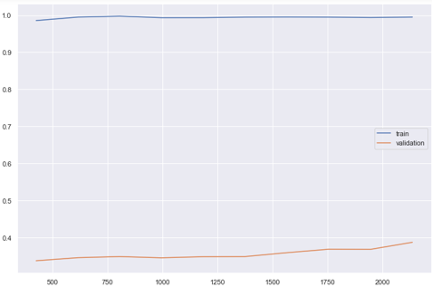
Random forest :
Its random forest turn , so we tried to implement the algorithm with random paremeters :
clf2 = RandomForestClassifier(n_estimators = 240, random_state = 123)
We got 0.41 its quiet good, but we wanted to go even
further , we tried the grid search , it’s a function that
finds the best parameters for a model , but unfortunately
we got only 0.39 because we didn't play with the random_state paremeter because it takes too much time for a single one and days
if we do it 100 time .
This the graph of repeated testing on Random forest
with different parameters :
The graph is like that because of the lack of data in the
dataset ! .
Notes:
© Copyright PresentationGO.com – The free PowerPoint and Google Slides template library

Slide 11
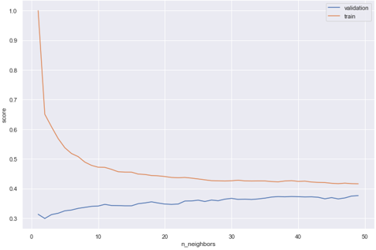
KNN :
Finally we went with our last hope KNN (k-nearest neighbors) to get the best scores, but sadly we got only 0.38 when k equal to 28 , and we got the same result with the grid search .
This is the graph of the algorith when k varies
from 1 to 50 , as you can see the score is rising
very slowly towards the 0.4 and this is due to
the repartition of data in the Dataset .
Notes:
© Copyright PresentationGO.com – The free PowerPoint and Google Slides template library

Slide 12
Models comparisons
We now will compare all the models that we've done in this table :
The best score is with the logestic regression with the cross-validation , but we can see that it has similar score with the random forest, but we took the simpler and no time costing one which is the logestic regression .
Logestic regression |  | Naive bayes |  | Random Forest |  | KNN
normal | Cross-validation | Gaussian | Cross-validation | Random parameters | Grid search | normal | Grid search
0.38 | 0.417 | 0.34 | 0.37 | 0.410 | 0.39 | 0.38 | 0.38
Notes:
© Copyright PresentationGO.com – The free PowerPoint and Google Slides template library

Slide 13
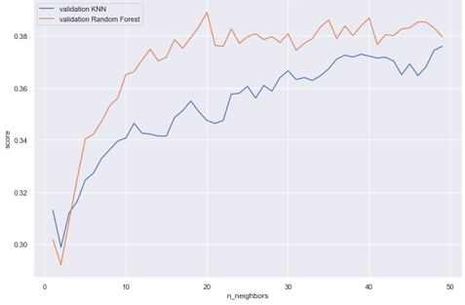
This a comparison graph between Random Forest and KNN which we can observe that random forest is better than KNN
Notes:
© Copyright PresentationGO.com – The free PowerPoint and Google Slides template library

Slide 14
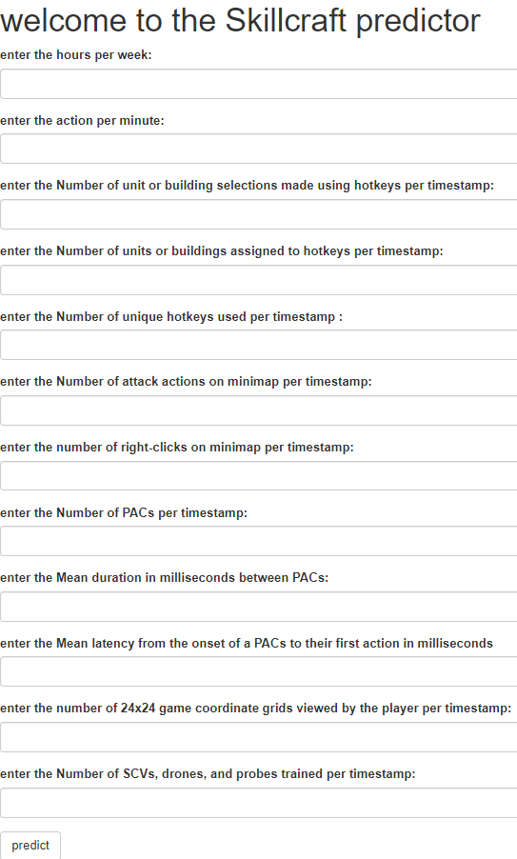

Casting results on Flusk
We have created a flask application that it contains a form which has the features that the person need to fill in order to have his league level as showed in the two pictures.
Notes:
© Copyright PresentationGO.com – The free PowerPoint and Google Slides template library

Slide 15
conclusions
After analysing the dataset and implementiing different algorithms , and with the scores that we got , we can say that the dataset is lacking for some data , all models are underfitted , if you remember there is some classes with almost no data in them , we suggest that we remove thae class "7" and make a fusion with the class "6" and the class "1" with the class "2" , so we get better predictions and results , or they can update the dataset with more information that will give it the push that it needs .
Notes:
© Copyright PresentationGO.com – The free PowerPoint and Google Slides template library

Slide 16
Thank you !
Notes:
© Copyright PresentationGO.com – The free PowerPoint and Google Slides template library

