Slide 1
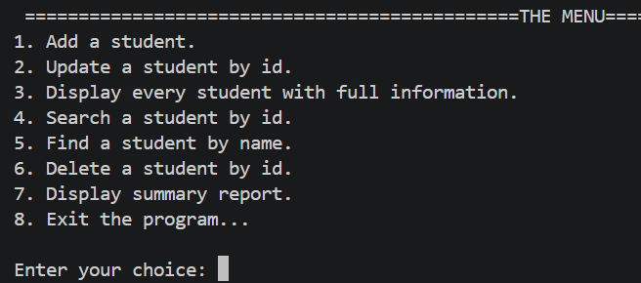
Introduction
This python program is designed to mange Student Service Desk & Registry.
It allows to add, update or delete a student,
find him by ID, search him by name, print a class report or every student with full information. And finally, the choice to exit the program.

Slide 2
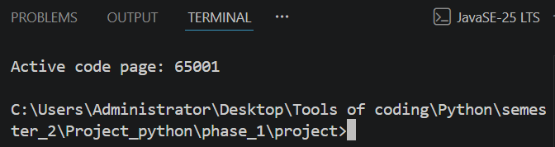
How to run the program ?
In Visual Studio Code, on top left, go to terminal,
then new terminal: you’ll arrive here
Or go to the main program, touch f4, or fn and f4
main.py
Write main.py
Then, touch the button
“enter”, you’ll see this

Slide 3
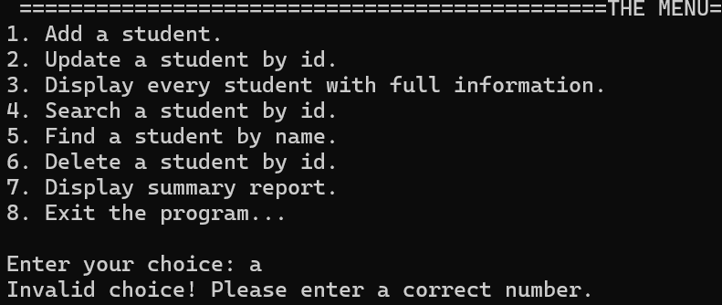
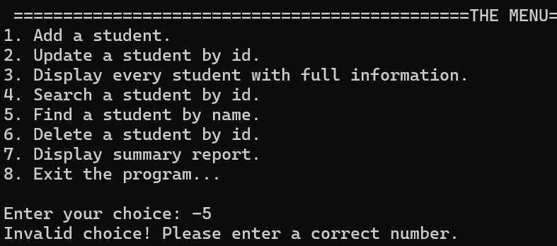
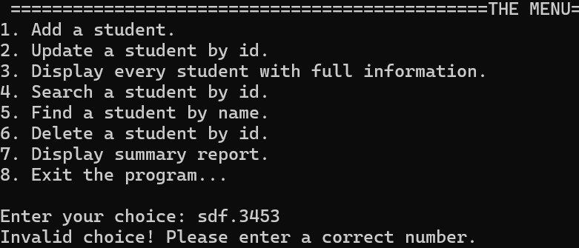
Error Handling: The choice
If you enter a letter, a number below 1 or above 8, or anything else, the program
will raise: “Invalid choice! Please enter a correct number”

Slide 4
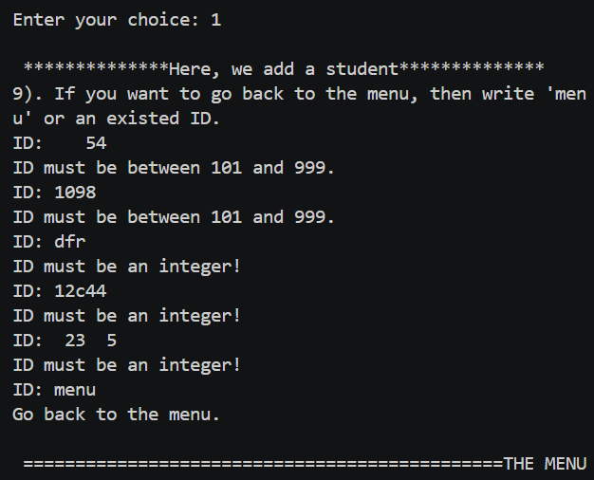
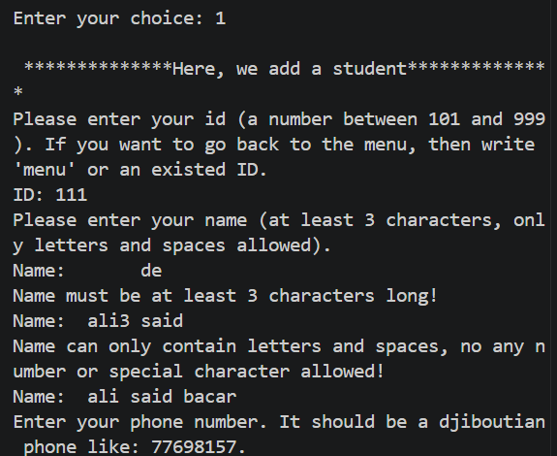
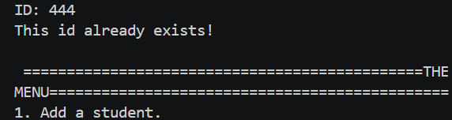
Validation: The choice , the ID Error Handling: The ID, the name
Adding a student
The choice “1” is validated and means
“add a student”.
The ID must be between 101 and 999 Without space
between them, only digits, otherwise it’s rejected.
The ID “111” is validated and means
“ask the name”.
The name is validated only if there are letters and
Spaces, and the length between the first and last
Letters is at least 3.

Slide 5
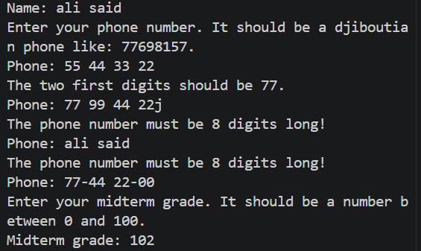
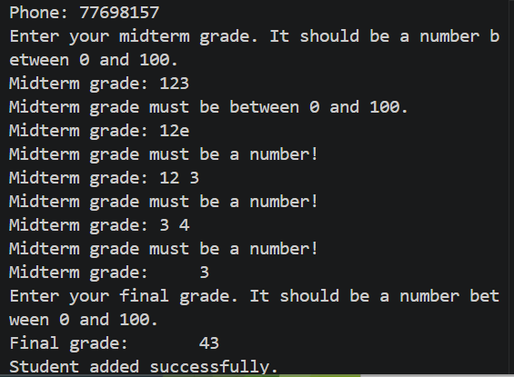
Validation:The name, the phone, the grade Error Handling: The phone, the grade
Adding a
student
Name accepted.
The phone must be 8 digits and the two first
Digits should be 77, otherwise will be asked
Until conditions matched.
77-44 22-00 is taken as a phone number.
The grade is registered only if it is a
Number between 0 and 100.
Grades 3 and 43 are corrected.

Slide 6
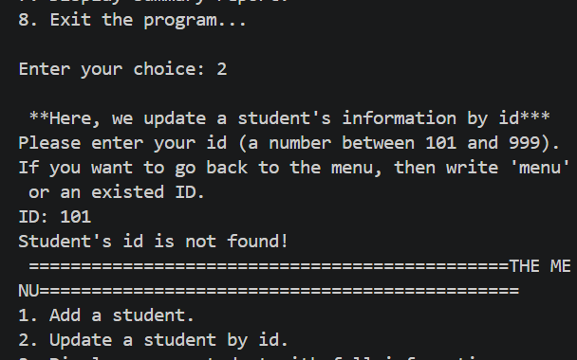
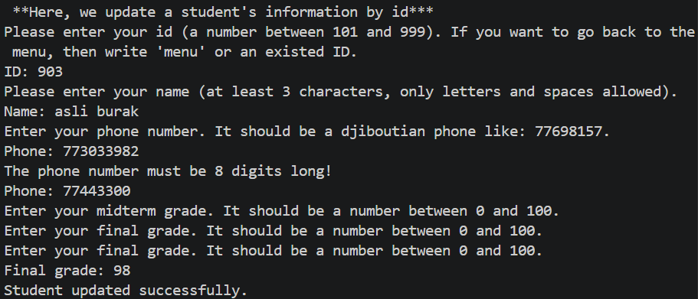
Updating a student
AS you see here, the ID doesn’t exist.
So, the program returns an error message
And go back to the menu.
And the ID was found, so the updating
Succeeded.

Slide 7
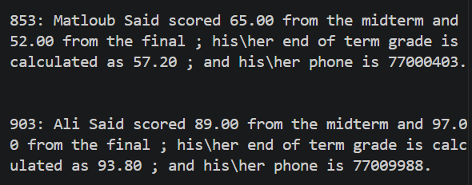
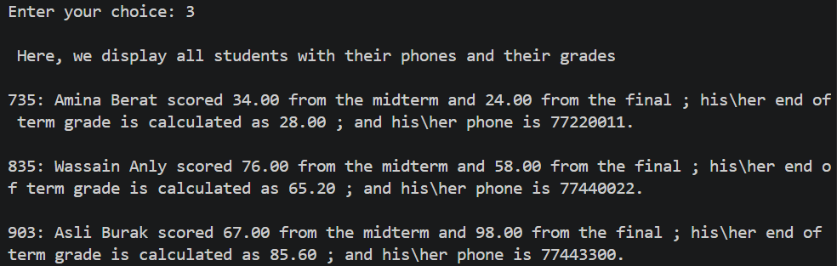
Display all the students with phones and grades
ID number 903 represents the student’s
Information before updating.
This screenshot shows all the current students
Remained.

Slide 8
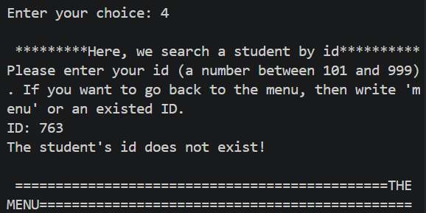
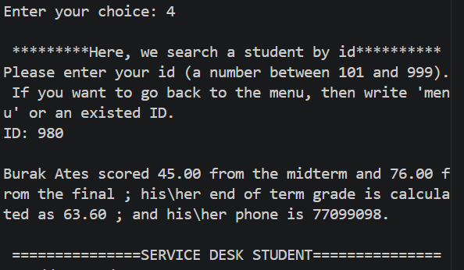
Search a student by ID
The student we’re looking for
Doesn’t exist, so the program returns
Back to the menu.
Here, the ID 980 is found, so the
Student is displayed with full
Informations.

Slide 9
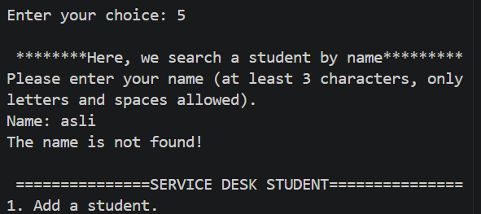
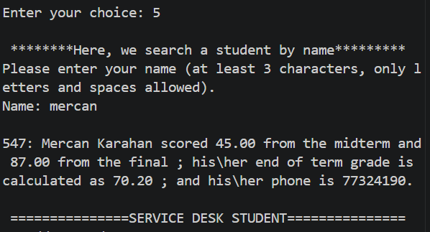
Find a student by name
The student “Asli” we’re looking for
Doesn’t exist, so the program returns
Back to the menu.
Here, the name “Mercan” is found,
so the student is displayed with full
Informations.

Slide 10
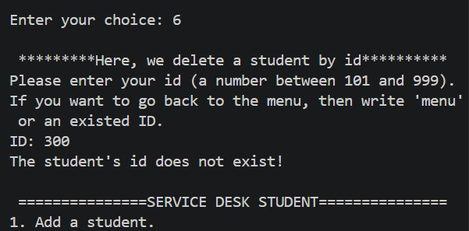
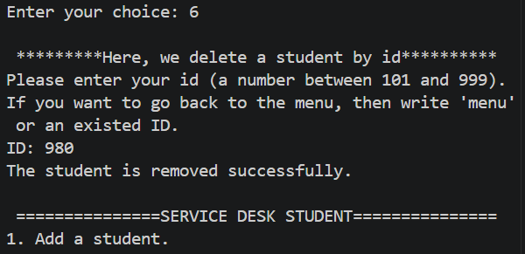
Delete a student by ID
The student “ID: 300” we’re deleting
Doesn’t exist, so the program returns
Back to the menu.
Here, the student “ID: 980” is found,
so she is deleted. She was “Mercan”.

Slide 11
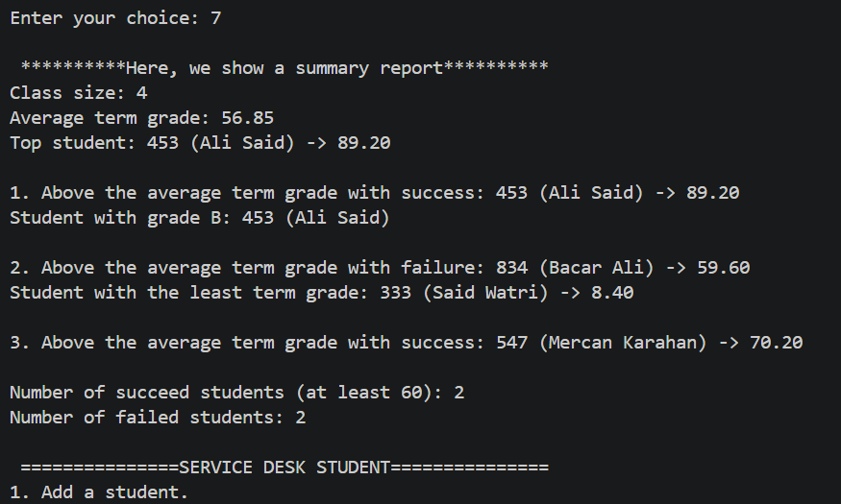
Summary Report
Here, we display the summary with statistics for the current students of the class

Slide 12
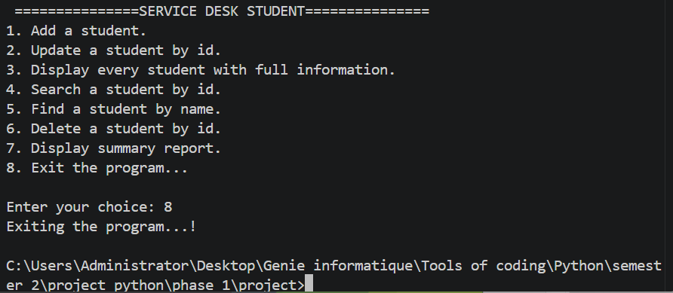
Exit the program
Finally, to exit the program, we put “8”, and it stops running by displaying a message
“Exiting the program…!”

