Slide 1
Midterm Prep

Slide 2
Things to Know
Unit 1: Hardware and Languages
Different Parts of the computer
Binary
Errors
Languages and Java
Basic Programming (Should be easier now)
Unit 2: Design, Variables
Flowcharts (should be easier now)
Variables and Constants (should be easier now)

Slide 3
Things to Know
Unit 3: Objects and Methods
Objects
Classes
Methods (should be easier now)
Unit 4: Conditionals and Loops
Conditionals
Recursion
Loops

Slide 4
Focus on
Vocabulary
Being able to explain what is happening
Using the vocabulary properly in context
Ideas
What is the idea behind conditionals, loops, objects
Focussing on these will help you improve overall.

Slide 5
Midterm Format
20 multiple choice (5 per unit)
12 short answer (3 per unit)
4 programming problems (1 per unit)
Retest policy: HW submission = Ability to replace test mark for that unit

Slide 6
HW Submission
Hand in Java files in a zip file
Make sure I know which program is for what problem

Slide 7
Unit 1

Slide 8
Hardware
What are the main categories of hardware needed for computing?

Slide 9
Hardware
What role does the motherboard play?

Slide 10
Binary
How do you represent in 8 bits:
10
-15
10 – 15 =
What is the range for 8 bits:
Two’s complement?
Unsigned?

Slide 11
Languages
What are the three levels of languages? What distinguishes each language from each other?

Slide 12
Languages
What are the primary differences between interpreted and compiled languages?

Slide 13
Coding
What are the three types of comments? Write an example of each
What goes in a header? What type of comments is a header?

Slide 14
Coding
Create a program with syntax errors. Explain what the error is and how to fix it.

Slide 15
Unit 2

Slide 16
Q1: Draw a flowchart for calculating the third angle of a triangle, given two angles
Input:
Output:

Slide 17
Q2: Create a class diagram of a vehicle. Include 2 attributes and 2 methods

Slide 18
Q3: What is a stage of the development process? Explain what is happening in that process.

Slide 19
Draw a class diagram for a student

Slide 20
Draw a flowchart for converting RMB to CAD.

Slide 21
What variable types are used to store:
Integers?
Floating point decimals?

Slide 22
Explain what is happening in this line. Use vocabulary!
int helloWorld = 37;

Slide 23
Indicate the values of x and y
public static void main (String [] args) {
int x = 31;
int y = x++;
x = y / --x;
y = Math.pow(++y, ++x);
x = Math.abs(x * y / -4);
}

Slide 24
Write the name of a variable that stores the number of students in a class

Slide 25
Write the name for the maximum number of students in a class

Slide 26
Write the name for a classroom file/program

Slide 27
Write a program that asks for the users age. Print out how old they will be in 10 years

Slide 28
Create a program that will round to the nearest tens (DO NOT USE CONDITIONALS!)

Slide 29
Unit 3

Slide 30
How does the naming of a class, method, variable, and object differ?

Slide 31
Create a class diagram for a Book
3 attributes
3 methods (exclude getter/setter methods)

Slide 32
What are wrapper classes?

Slide 33
What is the key difference between how primitive data is stored vs. objects?

Slide 34
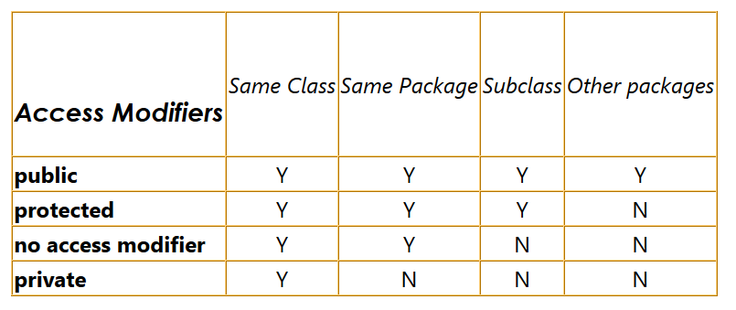
What access modifier do you choose for an attribute that you want to have access in other classes in the same package?

Slide 35
Name the different parts of a method header. What information does it give?

Slide 36
Create the following program:
public static String reverseThreeLetterWord(String word) {
}

Slide 37
Give a short demonstration of the difference between passing by value and passing by reference.

Slide 38
Write the relevant method. Where is this method located?
System.out.println(book); //prints out the address of the variable
System.out.println(page);// prints out the page number and number of words on the page

Slide 39
Trace this code. Write the order the methods run, and its output
public class Unit2Test {
public static void main (String [] args) {
int a = 5;
int b = methodThree(methodTwo(4),methodOne(8));
System.out.println(a + " " + b);
methodFour(a,b);
System.out.println(a + " " + b);
methodFive(b,a);
}
public static int methodThree(double a, double b){
return (int)(Math.pow(b, a));
}
public static double methodTwo(int a){
double b = (int)(a * 3 / 1.8);
return b-1;
}
public static double methodOne(int a) {
a = a - a / 4 * 3;
return a;
}
public static void methodFour(int a, int b) {
int c = b;
b = a;
a = c;
}
public static void methodFive(int a, int b) {
int c = b;
b = a;
a = c;
System.out.println(a + " " + b);
}
}

Slide 40
Explain with proper vocabulary:
int b = methodThree(methodTwo(4),methodOne(8));

Slide 41
Unit 4

Slide 42
What are the symbols for Boolean expressions?

Slide 43
What are two methods to compare Strings?

Slide 44
Write the conditional statement for checking if a letter is uppercase

Slide 45

For the following:
Prove that the first expression is equal to the second using a truth table.

Slide 46
What are two parts of a recursive function?

Slide 47
Solve for F(F(2) + F(5)
int F(int x)
{
if (1==x || 3==x) {
return x;
} else {
return x * F(x-1);
}
}

Slide 48
Flow chart
public static void determineKpop(String name, int age, boolean isShuai) {
if (name.length() > 5 && age < 30) {
if (age > 18 || isShuai) {
System.out.println("Like Turbo");
} else if (age > 12) {
System.out.println("Like Black Pink");
}
} else if (name.length() == 4 || age < 30) {
if (isShuai) {
System.out.println("Like SNSD");
} else {
System.out.println("Like TVXQ or DBSK");
}
} else {
System.out.println("Like Big Bang or F(x)");
}
}

Slide 49
Code
How would you use each of the three loops to print the sum of all the odd digits? ie. 12345 -> 9, 99293 -> 30

