Slide 1
The Systems Analyst and Information Systems Development
Systems analysis and design, 6th edition
Dennis, wixom, and roth

Slide 2
Learning Objectives
Explain the systems analyst’s role information systems development.
Describe the basic systems development life cycle and its phases.
Explain how organizations identify IS development projects.
Explain the importance of linking the information system to business needs.
Be able to create a system request.
Describe technical, economic, and organizational feasibility assessment.
Be able to perform a feasibility analysis.

Slide 3
The Systems Analyst
role and skills

Slide 4
Systems Analyst Role
Key role in developing information systems
Analyzing the business situation
Identifying opportunities for improvements
Designing an information system to implement the improvements

Slide 5
Systems Analyst Roles
Interaction with an array of people
Technical specialists (DBAs, network admins, programmers)
Business people (users, managers, steering committee)
Others (vendors, consultants)
Variety of specialized roles
People-oriented: change management analyst, project management
Business-oriented: requirements analyst, business analyst
Technically-oriented: infrastructure analyst
Generalist: systems analyst

Slide 6
What Do System Analysts Like About Their Work?
Challenge
Technology
Variety
Constant Change
Problem Solving

Slide 7
What Do System Analysts Dislike About Their Work?
Management’s lack of communication/recognition
End-user mistakes and demands
Stress/pressure/burnout
Ever-changing business technology
Unrealistic deadlines

Slide 8
Preparing for Your Career
Working knowledge of information technology
Computer programming experience & expertise
General business knowledge
Problem-solving skills
Interpersonal communication skills
Flexibility and adaptability
Character and ethics
Systems analysis & design skills

Slide 9
The Systems Development Life Cycle
The overall process of systems development

Slide 10
How Do Systems Get Built?
Systems Development Life Cycle (SDLC)
Planning
Analysis
Design
Implementation
Obsolete System
On-going Systems Planning
New Project Launched
Planning
Implementation
Planned
Project
System
Specifications
Design
System
Requirements
Analysis

Slide 11
Planning Phase
Project Initiation
Prepare system request
Perform preliminary feasibility analysis
Set Up the Project
Project Plan, including work plan & staffing plan

Slide 12
Analysis Phase
Determine Analysis Strategy
Study existing system and its problems
Collect and Analyze Requirements
Develop new system concept
Describe new system with analysis models
Prepare and Present System Proposal
Summarize results of the Analysis Phase
Go/No Go decision made by sponsor and steering committee

Slide 13
Design Phase
Determine Design Strategy
Build / Buy / Outsource
Design system components
Architecture, interface, database, programs
Assemble design elements into System Specification
Present to steering committee
Go / No Go decision before entering final phase

Slide 14
Implementation Phase
System Construction
Programming and testing
System Installation
Training
Conversion to new system
On-going system support

Slide 15
Project Initiation
How projects get started

Slide 16
Where Do IS Projects Come From?
Fulfill a business need
Enable a business initiative or strategy
Support a merger/acquisition
Fix a “point of pain”
Utilize a new technology
Outgrowth of Business Process Management (BPM)

Slide 17
What is BPM?
Business Process Management: A methodology used by organizations to continuously improve end-to-end business processes
Internal and cross-organizational processes
Benefits include:
Enhanced process agility
Process alignment with industry “best practices”
Increased process efficiencies

Slide 18
What is BPM? (continued)
Four-step continuous cycle:
Define and map the steps in a business process,
Create ways to improve on steps in the process that add value,
Find ways to eliminate or consolidate steps in the process that don’t add value,
Create or adjust electronic workflows to match the improved process maps.

Slide 19
BPM Identifies Business Needs
Business Process Automation
“Create or adjust electronic workflows to match the improved process maps”
Business Process Improvement
Study the business processes
Create new, redesigned processes to improve the process workflows, and/or
Utilize new technologies enabling new process structures
Business Process Reengineering
Total overhaul of work processes

Slide 20
Do We Have a Project Yet?
Strong business need leads to a person or group stepping up as the Project Sponsor
Driving force behind project
Specifies overall business requirements
Determines business value
Formally requests a project via the System Request

Slide 21
The Systems Request
The business reasons for the new system

Slide 22
System Request
Describes business reasons for project
Defines system’s expected value
Force the sponsor to formalize his/her ideas
Provide a framework for collecting initial project information
Standardize information to be used by steering (approval) committee
Lists project’s key elements

Slide 23
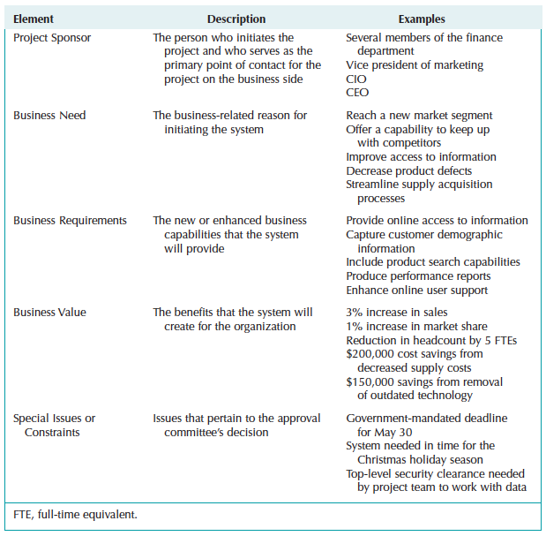
Elements of the Systems Request

Slide 24
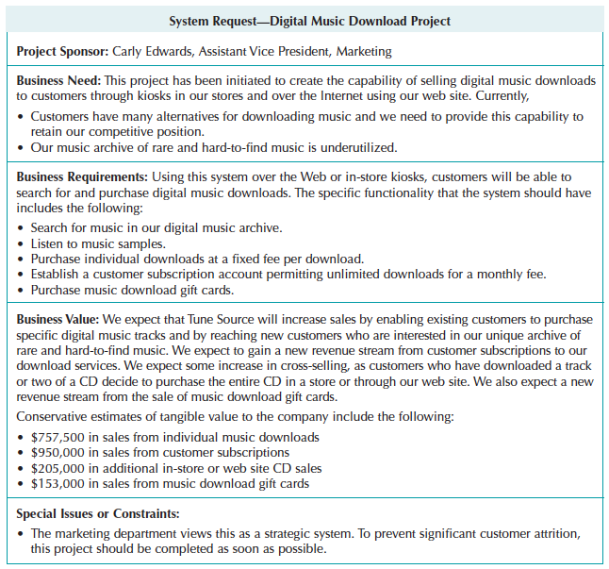
Systems Request for Tune Source Music Download System

Slide 25
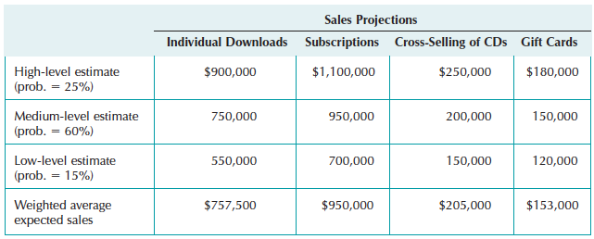
Estimating Business Value
Identify sources: increased sales; decreased costs; reduced headcount; lower turnover…
Assign values as initial estimates

Slide 26
Feasibility Analysis
Is this project really worth doing…
Can we do this project…
Will the organization accept this if we go ahead…

Slide 27
Feasibility Analysis
Detailed business case for the project
Technical feasibility
Economic feasibility
Organizational feasibility
Compiled into a feasibility study
Critically important to reassess feasibility throughout the project

Slide 28
Technical Feasibility: Can We Build It?
Sources of Technical Risk:
Users’ and analysts’ lack of familiarity with the business application area
Lack of familiarity with technology
Have we used it before? How new is it?
Project size
Number of people, time frame, distinct features
Compatibility with existing systems
Degree of integration required

Slide 29
Economic Feasibility: Should We Build It?
Identify costs and benefits
Assign values to costs and benefits
Determine cash flow
Assess financial viability
Return on investment
Break even point
Net present value

Slide 30
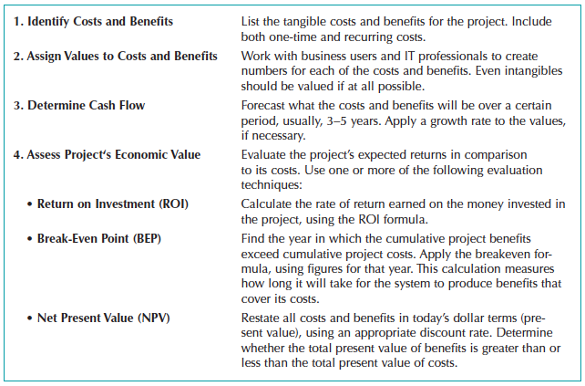
Costs and Benefits
Include development and operational costs
Consider tangible and intangible benefits

Slide 31
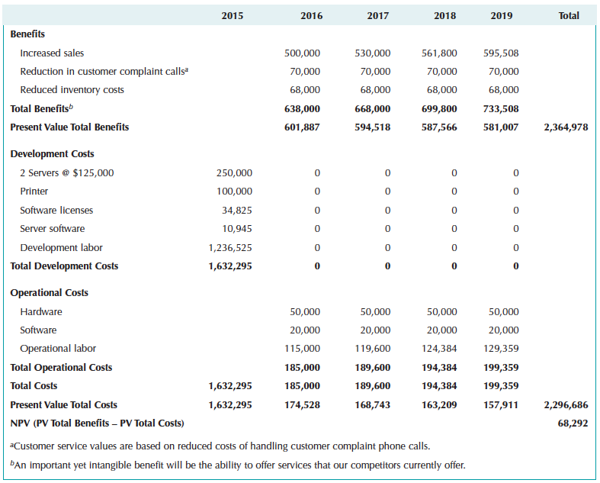
Cost-Benefit Analysis
Discounted cash flow method preferred
NPV preferred

Slide 32
Organizational Feasibility: If We Build It, Will They Come?
Strategic alignment
Are project goals aligned with business strategy?
Evaluate effect on various stakeholders
Strong and influential project champion?
Strong and widespread organizational management support?
Receptive / resistant system users?

Slide 33
Organizational Feasibility If We Build It, Will They Come?
Strategic alignment
Close alignment with strategy increases the likelihood of success
Stakeholder groups can be influenced
Presentations describing and promoting benefits
Emphasizing personal benefits as well as organizational benefits
Prototypes help prove the system concept
Real user involvement throughout project

Slide 34
Feasibility Assessment: Summing It Up
All projects have feasibility risks
Our goal is to know the risks we face and the significance of those risks
Project Sponsor, Project Manager, and other team members need this awareness
Once risks are known, steps can be taken to mitigate the risks
For example, if unfamiliar with a new technology
Provide enough budget for training
Provide enough budget to hire consultants with expertise
Allow more schedule time to move up the learning curve
Use a methodology that incorporates experimentation

Slide 35
Feasibility Assessment: Summing It Up
Essential to continuously review and revise the feasibility assessment
How well are we managing the risks we previously identified? Are adjustments needed?
Risk is being managed
Risk is not well managed and needs further attention
Are there any new risks that have appeared?
If so, what are the actions needed to address those risks?
Budgetary and schedule effect?

