Slide 1
Project Selection and Management
Systems analysis and design, 6th edition
Dennis, wixom, and roth

Slide 2
Learning Objectives
Explain how projects are selected in some organizations.
Describe various approaches to the SDLC that can be used to structure a development project.
Explain how to select a project methodology based on project characteristics.
Become familiar with project estimation.
Be able to create a project work plan.
Describe project staffing issues and concerns.
Describe and apply techniques to coordinate and manage the project.
Explain how to manage risk on the project.

Slide 3
Project Selection
How specific projects are chosen

Slide 4
Project Selection Issues
Ways to Characterize Projects
Size
Cost
Purpose
Length
Risk
Scope
Economic Value

Slide 5
Project Selection Issues
Approval committee uses the system request and the feasibility study
Project portfolio perspective – how does the project fit within the entire portfolio of projects?
Trade-offs needed: select projects to form a balanced project portfolio
Viable projects may be rejected or deferred due to project portfolio issues.

Slide 6
Project Portfolio Management
PPM software collects and manages information about all projects – on-going and awaiting approval.
Companies stay up to date on projects and adapt to changing conditions.
Features: project prioritization, employee allocation, real-time project monitoring, flagging cost and time variances, monitoring economic feasibility.

Slide 7
Creating the Project Plan
Once a project is approved, the project manager must:
Select the best project methodology
Develop a project work plan
Establish a staffing plan
Create ways to coordinate and control the project

Slide 8
Creating the Project Plan
Developing a plan for a successful result

Slide 9
Selecting a Project Methodology
Methodology: A formalized approach to implementing the SDLC
A series of steps to perform and deliverables to produce
Methodology Sources
Internally developed by organizations
Consulting firms
Software vendors
Government agencies

Slide 10
Selecting a Project Methodology - Issues
These factors influence the best choice:
Clarity of User Requirements
Familiarity with Technology
System Complexity
System Reliability
Time Frame
Schedule Visibility

Slide 11
Structured Systems Development
Based upon SDLC
Assumes a project phase is complete before moving to the next phase
Waterfall Development
Parallel Development
V-model
Goal – doing each phase thoroughly before moving forward ensures correct and high-quality outcomes

Slide 12
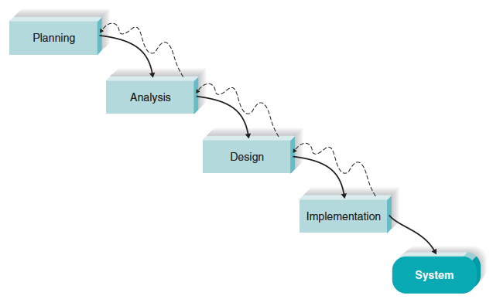
Waterfall Development Methodology
Move from phase to phase
Emphasis on deliverables from one phase flowing into the next phase

Slide 13
Waterfall Methodology Assessment
Strengths
weaknesses
System requirements identified long before construction begins
Requirements are “frozen” as project proceeds – no moving targets allowed
Must wait a long time before there is “visible” evidence of the new system
Takes a long time from start to finish

Slide 14
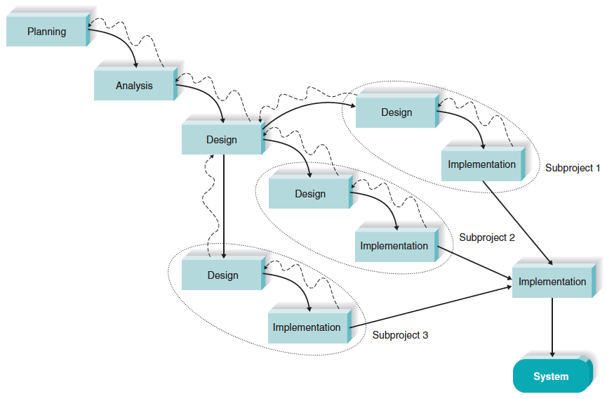
Parallel Development Methodology
Subdivide the project into subprojects that can be worked on at the same time.
Reduce the overall project length

Slide 15
Parallel Methodology Assessment
Strengths
weaknesses
Reduces overall project time (compared to Waterfall)
Reduces the need for rework; with shorter time frame, less chance of requirements changing
Creating subprojects requires careful design decisions
Integrating subprojects at the end can be complex and difficult

Slide 16
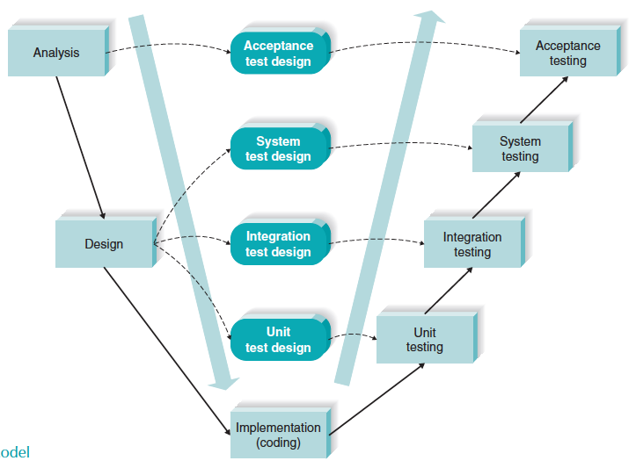
V-Model Development Methodology
Emphasizes system quality through text plan development

Slide 17
V-Model Methodology Assessment
Strengths
weaknesses
Simple and straightforward
Quality improves through the emphasis on testing
Including Quality Assurance expertise early in the project strengthens system quality
Rigid
Difficult to use in a dynamic business environment

Slide 18
Rapid Application Development
Incorporate special techniques and tools:
CASE tools
JAD sessions
Visual programming languages
Code generators
Goal – get some portion of system developed quickly and in the users’ hands

Slide 19
Three RAD Approaches
Iterative development
A series of versions developed sequentially
System Prototyping
Create prototype (model) of system and “grow” it into the final system
Throw-away prototyping
Prototype alternative designs in an experimental way
Build system following prototype design but discard the actual prototype

Slide 20
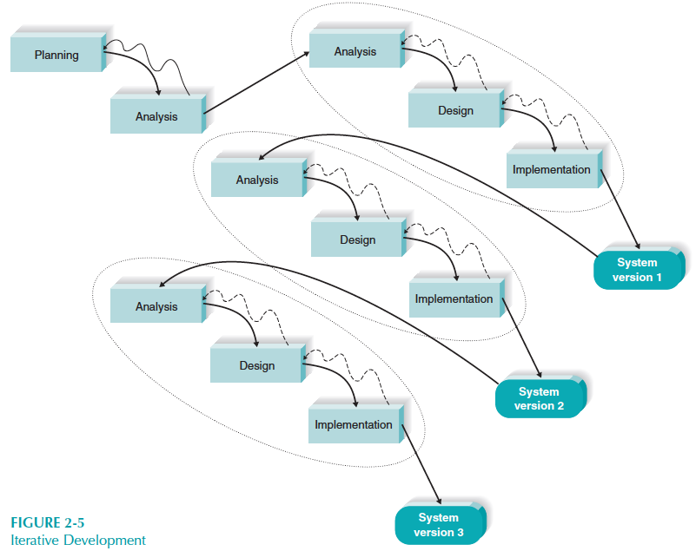

Iterative Development Methodology
RAD approach
Develop system in series of versions

Slide 21
Iterative Development Methodology Assessment
Strengths
weaknesses
Users get a system to use quickly
Users identify additional needs for later versions based on real experiences with current version
Users faced with using an incomplete system for a time
Users must be patient and wait for fully-functional system

Slide 22
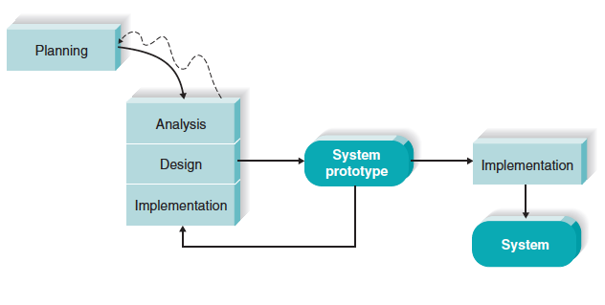
System Prototyping Development Methodology
RAD approach
Create a rough version of system quickly and “grow” it into final system with repetitive refinement

Slide 23
System Prototyping Methodology Assessment
Strengths
weaknesses
Users get to work with prototype very quickly
Feedback cycles let users identify changes and refine real requirements
Superficial analysis may cause problems
Initial design decisions may be poor
Overlooked features may be hard to add later

Slide 24
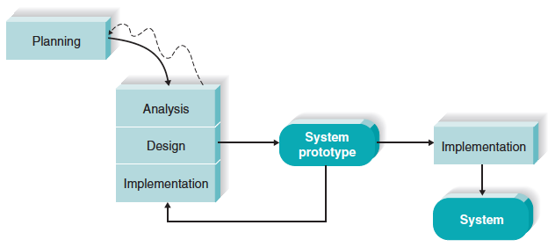
Throwaway Prototyping Development Methodology
RAD approach
Adds emphasis on experimenting with design options before design is finalized
Design options are thrown-away, but learning from them is factored into final design

Slide 25
Throwaway Prototyping Methodology Assessment
Strengths
weaknesses
Uncertainty is minimized
Important issues are understood before building the final system
May take longer (compared to system prototyping)

Slide 26
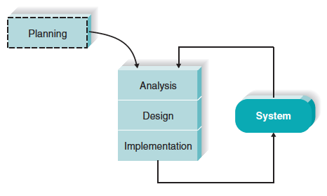
Agile Development Methodologies
Extreme Programming (XP), Scrum, and others
Focus on short cycles that produce a complete software product
Highly adaptable in dynamic environments

Slide 27
Agile Methodologies Assessment
Strengths
weaknesses
Fast delivery of results
Works well in projects with undefined or changing requirements
Requires discipline
Significant user involvement is essential
Initial high learning curve
Works best in smaller projects

Slide 28
Selection Summary
Ability to develop systems | Waterfall | Parallel | V-Model | Iterative | System Proto- typing | Throwaway Prototyping | Agile Develop- ment
With unclear user requirements | Poor | Poor | Poor | Good | Excellent | Excellent | Excellent
With unfamiliar technology | Poor | Poor | Poor | Good | Poor | Excellent | Poor
That are complex | Good | Good | Good | Good | Poor | Excellent | Poor
That are reliable | Good | Good | Excellent | Good | Poor | Excellent | Good
With a short time schedule | Poor | Good | Poor | Excellent | Excellent | Good | Excellent
With schedule visibility | Poor | Poor | Poor | Excellent | Excellent | Good | Good

Slide 29
Project Management Tasks
Preparing to launch the project

Slide 30
Project Manager’s Balancing Act
Project Management involves making trade-offs…
Project Size
Project Cost
Modifying one element
requires adjusting the others
Project Time

Slide 31
Project Estimation
The process of assigning projected values for time and effort
Sources of estimates
Methodology in use
Actual previous projects
Experienced developers
Estimates begin as a range and become more specific as the project progresses
Industry standards
Function point estimation (Appendix 2A)

Slide 32
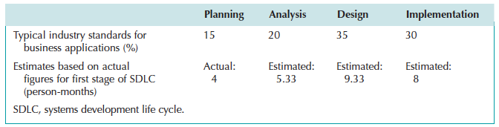
Project Estimates Using Industry Standard Percentages
Industry standard percentages
Example
IF 4 months are required for Planning, then
15% X = 4, where X = overall length of project
X = 4 / 15%
X = 26.66 months for entire project
Therefore:
Planning (15%): 4 months
Analysis (20%): 5.33 months
Design (35%): 9.33 months
Implementation (30%): 8 months
Total Project Length: 26.66 months

Slide 33
Identifying Tasks
Use established guidelines – existing methodologies
Use analogies – model previous projects’ task lists
Top-down approach – break high level tasks into smaller, detailed tasks
Organize into work breakdown structure

Slide 34
Example – Determining Tasks using Top-down Approach
Grade programming assignments
Create grading plan
Develop grading rubric
Develop test plan, test data, and check figures
Prepare programming projects for grading
Download submitted projects
For all projects, extract zipped files
For all projects,
Administer test plan and check performance and results
Check code for required elements
Apply rubric and determine final score.

Slide 35
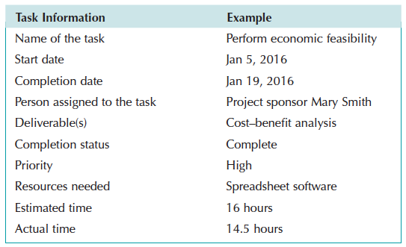
Typical Workplan Entry

Slide 36
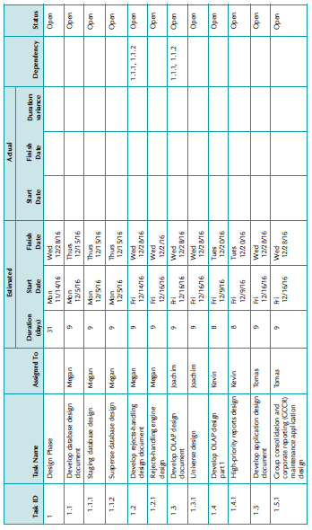
Project Work Plan

Slide 37
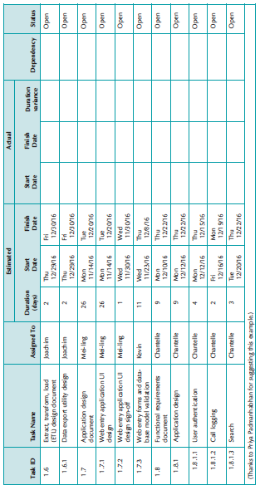
Project Work Plan

Slide 38
Staffing Considerations
Match skills to project needs whenever possible
Consider technical skills and interpersonal skills
All IS work is done in teams
Technical skills are not sufficient – need to be able to work with others
Use training and outside sources (consultants, vendor support) when skills are not readily available
Staffing levels will change over a project’s lifetime
Adding staff adds overhead; not always productive
Notes:
Availability is a problem with flex time and telecommuting options today.

Slide 39
Motivation
Use monetary rewards cautiously
Use intrinsic rewards
Recognition
Achievement
The work itself
Responsibility
Advancement
Chance to learn new skills
Notes:
Technical people generally are not motivated by money as long as they feel they are paid a fair salary.

Slide 40
Motivation
Consider the “de-motivators” … DO NOT
Assign unrealistic deadlines
Ignore good efforts
Accept a low-quality product
Give everyone on the project the same raise
Make an important decision without the team’s input
Maintain poor working conditions

Slide 41
Assuring Group Performance
Make sure team understands the project and its goals
Establish operating procedures (Project Charter)
Availability
Status reporting
Meetings
Ensure that team members get to know each other
Establish methods for dealing with problems

Slide 42
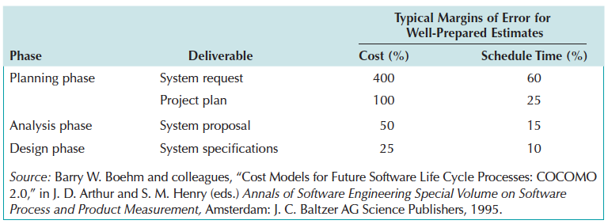
Project Estimates Require Refinement
Even projects with high-quality estimates will need refinement
Project managers must adjust estimated time throughout the project

Slide 43
Managing Scope
Beware of scope creep
Use JAD and prototyping to minimize scope creep pressure
Implement formal change approval process
Defer additional requirements as future system enhancements

Slide 44
Timeboxing
Time estimating techniques may reveal that the project requires more time than we have available
Timeboxing helps in these situations
Set a tight but realistic deadline. Identify core, essential functional requirements
Team limits its focus just to essential functions
High quality is stressed
Other functions will be added later
Repeat to add refinements and enhancements

Slide 45
When a Target Date is Missed…
Don’t assume you can catch up
The ONLY situation in which you can make up time is when:
The remainder of the project is simpler than the part you fell behind on, and
The remainder of the project is simpler than you expected when the original estimates were made.
Evaluate the complexity of the remainder of the project to determine the correct schedule adjustment.
Adding people is not always the right way to handle schedule slippages.
Notes:
If the rest of the project is simpler than the part that was late and is no more complex
than the original estimate assumed, you can’t make up lost time, but you can shift the
entire schedule back by the amount of time you are behind. E.g., shift the entire schedule
back three weeks if you are behind three weeks now. Requires moving the target date.
IF the rest of the project is as complex as the part that was late, you should adjust
estimates for all scheduled dates by the percentage your estimate was off for the current
phase. E.g., if you are three weeks late on a 12-week phase (25%), increase all remaining
deadlines by 25%.

