Slide 1
Requirements Determination
Systems analysis and design, 6th edition
Dennis, wixom, and roth

Slide 2
Learning Objectives
Explain the analysis phase of the SDLC.
Describe the content and purpose of the requirements definition statement.
Classify requirements correctly as business, user, functional, or nonfunctional requirements.
Employ the requirement elicitation techniques of interviews, JAD sessions, questionnaires, document analysis, and observation.
Define the role that each requirement elicitation technique plays in determining requirements.
Describe several analysis strategies that can help the analyst discover requirements.

Slide 3
The Analysis Phase
Determining what the new system should do

Slide 4
Overview of the Analysis Phase
Goal is to develop a clear understanding of the new system’s requirements
Understand the “As-Is” system
Identify Improvements
Develop the “To-Be” system concept
Use critical thinking skills to determine the true causes of problems
Apply knowledge of IS and business to outline ways to solve the problems in the new system

Slide 5
Requirements Determination
Understanding requirements

Slide 6
What is a Requirement?
A statement of what the system must do; or
A statement of characteristics the system must have
Types of requirements:
what the business needs (business requirements);
what the users need to do (user requirements);
what the software should do (functional requirements);
characteristics the system should have (nonfunctional requirements); and
how the system should be built (system requirements).

Slide 7
User Requirements
What the user needs to do to complete a needed job or task
Focus on user tasks that are integral to business operations
Understanding user tasks helps reveal ways that the new system can support those tasks

Slide 8
Functional Requirements
A process the system should perform as a part of supporting a user task, or
Information the system should provide as the user performs a task
Specify the support the system will provide to the user in fulfilling his/her work tasks

Slide 9
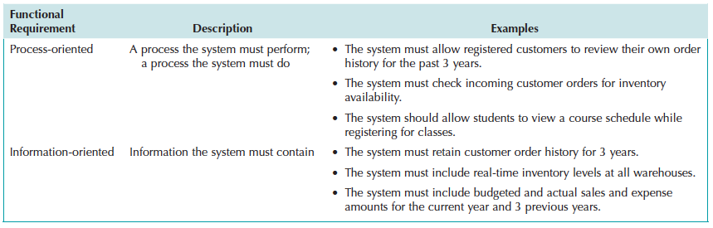
More on Functional Requirements
Process-oriented
Information-oriented

Slide 10
Nonfunctional Requirements
Behavioral properties the system must have
Operational – physical and technical operating environment
Performance – speed, capacity, and reliability needs
Security – access restrictions, needed safeguards
Cultural and political – issues that will affect the final system
Nonfunctional requirements are discussed in Chapter 8 (Architecture Design)

Slide 11
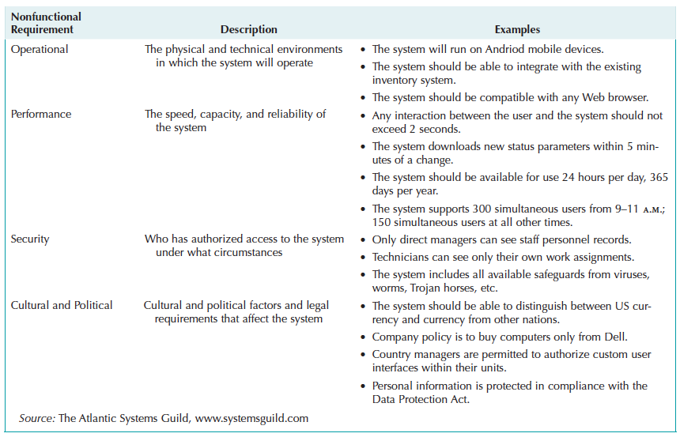
More on Nonfunctional Requirements
Behavioral properties the system must have

Slide 12
Documenting Requirements
Requirements definition report
Text document listing requirements in outline form
Organized in logical groupings
Priorities may be included
Key purpose is to define the project scope
what is included
what is not included.

Slide 13
Requirements Elicitation Techniques
Ways to discover requirements

Slide 14
Requirements Elicitation in Practice
Use every interaction with managers and users to garner interest, support, and enthusiasm for project
Choose participants carefully
Make respectful use of people’s time

Slide 15
Interviews
Most important and most used fact-finding technique
The systems analysts collects information from individuals face to face
Who should be interviewed?
Managers in early project stages to get broad understanding
Staff can provide details and specifics later.
Political issues are important – may be necessary to interview influential people, even if they are not too knowledgeable

Slide 16
Interviews, con’t.
Interview Structure
Top-Down (broad to specific; most common)
Bottom-up (specific to broad; useful for collecting details)
Question Type
Open-ended – broad concepts; opinions
Closed-ended – learn or confirm facts and details
Probing – resolve confusion; follow-up

Slide 17
Interview as a Requirements Elicitation Technique
strengths
weaknesses
Interviewee can respond freely and openly to questions.
Interviewee can be asked for more feedback.
Questions can be adapted or reworded for each individual.
Interviewee’s nonverbal communication can be observed.
Very time-consuming, and therefore costly, fact-finding approach.
Success is highly dependent on the systems analyst's human relations skills.
May be impractical due to the location of interviewees.

Slide 18
Interviewing – Practical Tips
Prepare, prepare, prepare!
Don’t waste the interviewee’s time
Take notes during and after the interview
Don’t be afraid to ask for clarification
Be aware of non-verbal cues (body language)
Send interview summary as soon as possible. Request confirmation and corrections

Slide 19
JAD – Joint Application Development
An extensive, structured group process
GOAL: produce complete requirements definition document
Directly involves project sponsor, key managers, and key users with systems analysts
Requires a trained facilitator
Requires a comfortable facility for long-term, intensive group work; preferably off-site
Expensive but valuable

Slide 20
Electronic JAD – e-JAD
Any group activity may experience problems with group dynamics
e-JAD helps group overcome group dynamic issues – dominance, status differences, fear of reprisal
e-JAD provides ways for members to contribute, comment on, and rate ideas anonymously
Requires a trained e-JAD facilitator and groupware software

Slide 21
JAD Practical Tips
Obtain training as a facilitator
Top management support needed to enable the right people to commit to the JAD sessions
Following completion of JAD sessions, distribute Requirements Definition document to group for confirmation and correction
Introduce JAD to organization with small demo project and build on that experience

Slide 22
Questionnaires
Special-purpose documents that allow the analyst to collect information and opinions from respondents.
Mass produced and distributed.
Respondents complete the questionnaire on their own time.
Facts are collected from a large number of people while maintaining uniform responses.
When dealing with a large audience, no other fact-finding technique can tabulate the same facts as efficiently.

Slide 23
Questionnaires, con’t.
Fixed-format questions
Similar to a multiple choice exam question
Must be able to anticipate potential answers to questions
Easy to tabulate results
Free-format questions
Like an essay question – open-ended
Response is unpredictable
Harder to tabulate results

Slide 24
Questionnaires as a Requirements Elicitation Technique
strengths
weaknesses
Most can be answered quickly (if properly designed).
Relatively inexpensive.
Allow individuals to maintain anonymity.
Can be tabulated and analyzed quickly (if properly designed).
Response is often low. How to motivate participation?
Incomplete questionnaires returned – are these worthless?
Tend to be inflexible.
Body language cannot be observed.
Cannot clarify a vague or incomplete answer to any question.
Difficult to prepare a successful questionnaire.

Slide 25
Questionnaires – Practical Tips
To Develop a (Good) Questionnaire
Determine what facts and opinions must be collected and from whom you should get them
Based on the needed facts and opinions, determine whether free- or fixed-format questions will produce the best answers. A mix of types may be ideal.
Write the questions
Pretest the questions on a small sample of “typical” respondents – not just other systems analysts
Use random sampling if necessary

Slide 26
Observation
Participate in or watch a person perform activities to learn about the system
Use when the validity of data collected using other methods is in question.
Use when the complexity of certain aspects of the system prevents end-users from providing a clear explanation

Slide 27
Observation as a Requirements Elicitation Technique
strengths
weaknesses
Data gathered may be highly reliable.
Can see exactly what is being done.
Relatively inexpensive (compared with other fact-finding techniques).
Can do work measurements (if needed).
People may perform differently when being observed.
Work may vary in difficulty and volume.
Some activities may take place at odd times.
The tasks being observed are subject to various types of interruptions.

Slide 28
Observation– Practical Tips
To Do Observation Well…
Properly plan for observation.
Obtain approval and inform people of your purpose.
Conduct observations first when the work load is normal, followed by observations during peak periods.
Obtain samples of documents or forms that will be used by those being observed.
Apply the sampling techniques discussed earlier for observation.
Review observation notes with appropriate individuals.

Slide 29
Document Analysis
Collect Facts from Existing Documentation
Organizational chart.
History that led to the project.
Documentation of previous system studies and designs performed by systems analysts and consultants.
Analyze Facts to Determine Currency
Even outdated documentation may be useful, but recognize what is current and what is outdated.

Slide 30
Document Analysis, con’t.
Analyze to Understand the Documentation
Take notes, draw pictures, and use systems analysis and design tools to model what you are learning or proposing for the system.
Use Appropriate Sampling Techniques

Slide 31
Document Analysis – Practical Tips
To Employ Document Analysis Well…
Good place to start
History
Vocabulary
Key personnel
Learn as much as you can from existing documentation. No one wants to spend time talking about things you could have learned about from existing documentation.

Slide 32
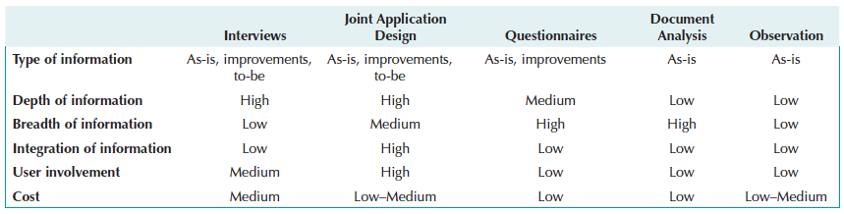
Comparing Techniques
Depth
Breadth
Integration
User involvement
Cost

Slide 33
Requirements Analysis Strategies
Ways to discover true underlying requirements

Slide 34
To Identify Small Improvements
Problem Analysis
Ask users to identify problems and solutions
Improvements tend to be small and incremental
Rarely finds improvements with significant business value
Root Cause Analysis
Challenge assumptions about why problem exists
Trace symptoms to their causes to discover the “real” problem

Slide 35
To Identify Moderate Improvements
Goal is to improve efficiency and effectiveness
Expect moderate changes to existing systems
Expect moderate impact and value to organization
Types of activities:
Duration Analysis
Activity-Based Costing
Informal Benchmarking

Slide 36
To Identify Major Improvements
Goal is radical redesign of business processes
Expect significant impact and value to organization
Existing system is “obliterated:
Activities focus on envisioning the business in new ways:
Outcome Analysis
Technology Analysis
Activity Elimination

Slide 37
Outcome Analysis
Consider desirable outcomes from customers’ perspective
Consider what the organization could enable the customer to do
Brainstorm on desirable customer outcomes enabled by IS

Slide 38
Technology Analysis
Analysts list important and interesting technologies
Managers list important and interesting technologies
The group goes through each list and identifies how each might be applied to the business and how the business might benefit
Brainstorming with special emphasis on technology use

Slide 39
Activity Elimination
Identify what would happen if each organizational activity were eliminated
Use “force-fit” to test all possibilities
Insist that all activities are potentially eliminated, even if it seems preposterous.
Brainstorming technique that helps to overcome “but we’ve always done it that way” limitations on thinking

Slide 40
Practical Tips – Summing It Up
Do your homework
Use indirect sources to get oriented to the environment (research, document analysis)
Respect the participants’ time
Select participants carefully – political influence can be important
Use requirements-gathering process to “promote” the project

Slide 41
Practical Tips – Summing It Up, con’t.
Document analysis
Problem history, terminology/vocabulary; key players
Observation
Rich data source but remember to interpret carefully. Focus on “real” system, not by-the-book
Surveys/questionnaires
Broad coverage, lower costs
Pretest with “typical” respondents
Be creative to encourage participation

Slide 42
Practical Tips – Summing It Up, con’t.
Joint Application Development (JAD/e-JAD)
Trained facilitator is essential to success
Select participants carefully
Proven to reduce scope creep because participants understand the process of identifying requirements

Slide 43
Practical Tips – Summing It Up, con’t.
Interviews
NOT a simple conversational dialogue
Planning and preparation pay off
Get a range of perspectives – managerial to operational
Use an approach that suits the interviewee
Allow time to digest what you have learned
Remember to follow-up to confirm/clarify
Be ready to handle unexpected behaviors

