Slide 1
Use Case Analysis
Systems analysis and design, 6th edition
Dennis, wixom, and roth

Slide 2
Learning Objectives
Explain the purpose of use cases in the analysis phase of the SDLC.
Describe the various parts of a use case and the purpose of each part.
Describe how use cases contribute to the functional requirements.
Describe how use cases inform the development of test plans.
Explain the process used to create a use case.

Slide 3
What is a Use Case?
Understanding the purpose of this tool

Slide 4
Role of Use Cases
Use cases express and clarify user requirements.
Purpose - define the expected interaction between user and system.
Use that interaction to more fully describe functional requirements
Used extensively in the analysis phase. Often a part of user interviews or JAD sessions.
Text-based use cases are easy for the users to understand.
Flow easily into the creation of process models and the data model.

Slide 5
Use Cases
Represents how a system interacts with its environment
Illustrates the activities that are performed by the users and the system’s responses.
Activities produce some output result.
Each use case describes how an external user triggers an event to which the system must respond.
In event-driven modeling, everything in the system can be thought of as a response to some triggering event.

Slide 6
Use Case Styles
Elements and formats

Slide 7
Elements of a Use Case
Each use case has a name and number, and brief description.
The priority may be assigned to indicate the relative significance.
The actor refers to a person, another system, or a hardware device that interacts with the system to achieve a useful goal.
The trigger for the use case – the event that causes the use case to begin.
Events triggers can be external or temporal

Slide 8
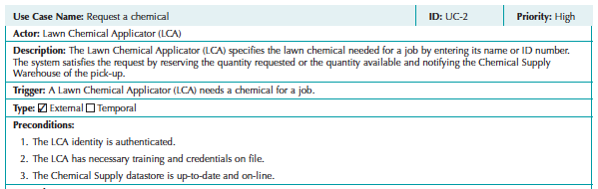
Use Case Basic Information
From Figure 4-1
Casual Format Use Case

Slide 9
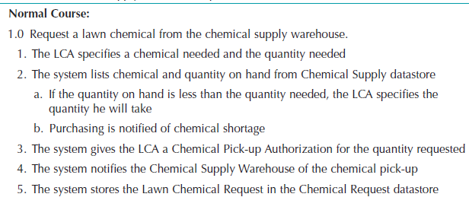
Normal Course
The major steps that are performed to execute the response to the event

Slide 10
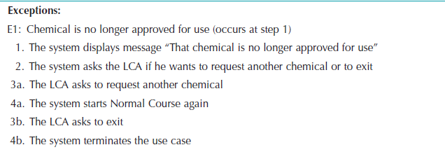
Exceptions
Error conditions encountered while performing use case steps.
NOT normal branches in decision logic.
Lead to an unsuccessful result.

Slide 11
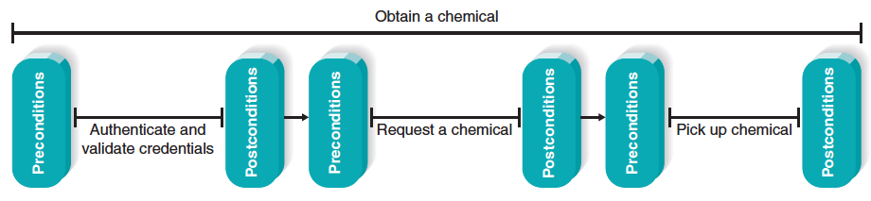
Use Cases in Sequence
Uses cases often performed in sequence.
No single use case should be too large.
Important to define initial and ending states.

Slide 12
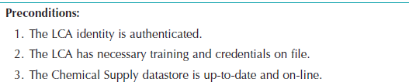
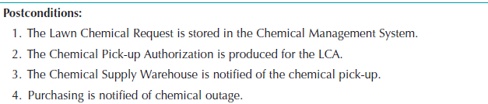
Preconditions and Postconditions
Preconditions define what must be complete before beginning this use case.
Postconditions define what is complete when this use case ends.

Slide 13
Fully-Dressed Use Case Format
Very thorough, detailed, and highly structured.
Adds new sections, including,
Alternative courses
Inputs and outputs for steps
Summary inputs and outputs.
See Figure 4-3 for example

Slide 14
Fully-Dressed Use Case Format, con’t.
Use this format when:
Users are not closely engaged with development team
Project has high complexity and high risk
Test cases need to be fully described
Remote collaborating teams need detailed, shared understanding of user needs.

Slide 15
Use Case Practical Tips
Use gradual refinement.
Concentrate on describing the user’s objectives with the system completely and accurately.
Keep both audiences in mind – users and developers.
Create use cases only when needed to clarify what the system must do from the user’s perspective. Not needed for simple events.

Slide 16
Use Cases and the Functional Requirements
Use cases are useful tools to clarify user requirements.
Use cases convey only the user’s point of view.
Transforming the user’s view into the developer’s view through functional requirements is one of the system analyst’s key contributions.
The derived functional requirements tell the developers more about what the system must do.

Slide 17
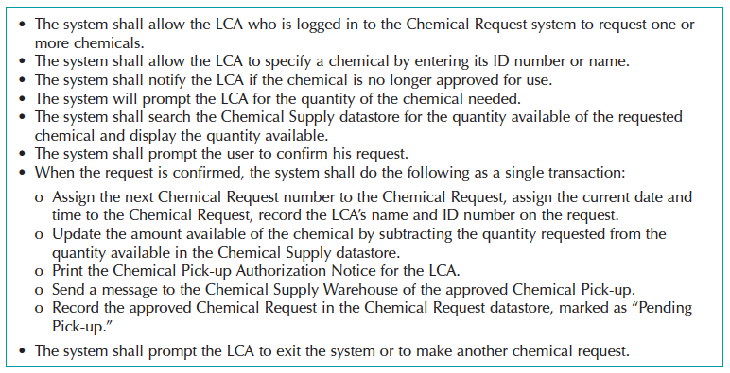
Detailed Functional Requirements
Use case content used to create more complete and descriptive functional requirements

Slide 18
Creating Use Cases
Identify events the system must respond to – develop Event-Response List
Create use case form for the complex events
For each use case:
Identify the major steps
Identify elements with each major step (inputs and outputs)
Confirm use case with users through role-playing
Revise functional requirements as needed

