Slide 1
Data Modeling
Systems analysis and design, 6th edition
Dennis, wixom, and roth

Slide 2
Learning Objectives
Explain the rules and style guidelines for creating entity relationship diagrams (ERDs).
Create an ERD.
Describe the use of a data dictionary and metadata.
Explain how to balance ERDs and data flow diagrams.
Describe the process of normalization.

Slide 3
Key Definitions
Data model
A formal way of representing the data that are used and created by a business system
Shows the people, places and things about which data is captured and the relationships among them.
Logical data model shows the organization of data without indicating how it is stored, created, or manipulated
Physical data model shows how the data will actually be stored in databases or files.

Slide 4
Key Definitions
Entity Relationship Diagram (ERD)
A popular way to depict the data model
Normalization is the process analysts use to validate data models.
Data models should balance with process models

Slide 5
Why Is Data Modeling Crucial?
Data is a resource to be shared by as many processes as possible.
Data organization must be flexible and adaptable to unanticipated business requirements – and that is the purpose of data modeling.

Slide 6
Other Data Modeling Issues…
Data structures and properties are reasonably permanent –more stable than the processes that use the data.
Typically very similar to the existing system.
Data models are much smaller than process models and are constructed more rapidly.
Constructing the data model helps analysts and users quickly reach consensus on business terminology and rules.

Slide 7
Entity Relationship Diagrams
What do erds tell us?

Slide 8
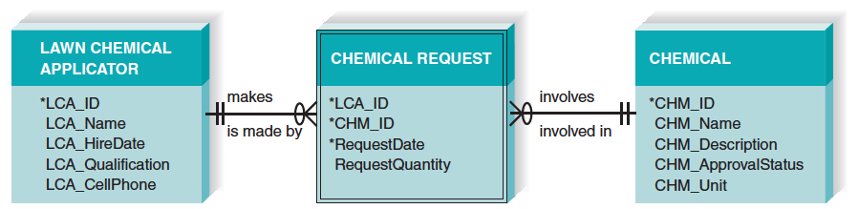
Reading an ERD

Slide 9
Using the ERD to Show Business Rules
Business rules are constraints that are followed when the system is in operation.
ERD symbols can show when one instance of an entity must exist for an instance of another to exist
The chemical must exist before chemical requests can be created for that chemical
The lawn chemical applicator must exist before chemical requests can be created by that lawn chemical applicator

Slide 10
Using the ERD to Show Business Rules, con’t.
ERD symbols can show when one instance of an entity can be related to only one or to many instances of another entity
One LCA can create many chemical requests; each chemical request is created by only one LCA
A chemical can be included on many chemical requests; a chemical request is for only one chemical

Slide 11
Using the ERD to Show Business Rules, con’t.
ERD symbols show when the existence of an entity instance is optional for a related entity instance
A chemical may exist without being included on any chemical requests

Slide 12
An ERD Example
Entities
CUSTOMER
has placed
ORDER
Customer ID
Name
Address
Telephone
Order ID
Order Date
Order Total Cost
Relationship
Attributes

Slide 13
Entity
A person, place, event, or thing about which data is collected
Must be multiple occurrences to be an entity
Person
Place
Object
Event
Concept
STUDENT
DORM
BOOK
LIBRARY
CHECK
OUT
STUDENT
BOOK
LIBRARY CHECK-OUT
COURSE

Slide 14
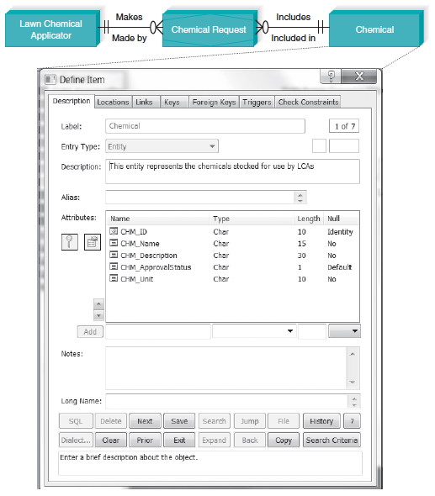
CASE Entry for Entity

Slide 15
Attributes
Information captured about an entity
Only those used by the organization should be included in the model
Attribute names are nouns
Sometimes entity name is added at the beginning of the attribute name for clarity

Slide 16
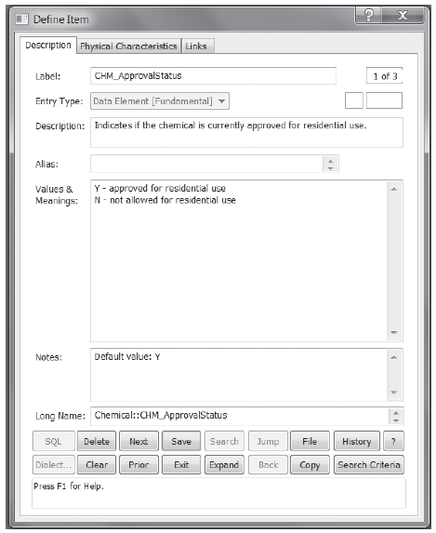
CASE Entry for Attribute

Slide 17
Attributes – Understand Them!
STUDENT
Composite Attribute
Address:
Street
City
State
Zip
Student ID
Student Last Name
Student First Name
Address
Date of Birth
Major
Gender
Grade Point
Multi-valued attribute:
May be more than one major allowed
Derived Attribute: Calculated from other values

Slide 18
Identifier Types
One or more attributes can serve as the entity identifier, uniquely identifying each entity instance
Concatenated identifier consists of several attributes
An identifier may be ‘artificial,’ such as creating an ID number
Final decision on identifiers may postponed to the Design Phase

Slide 19
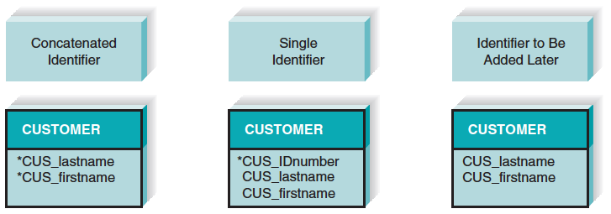
Identifier Types

Slide 20
Relationships
Associations between entities
The first entity in the relationship is the parent entity; the second entity in the relationship is the child entity
Relationships should have active verb names
Relationships go in both directions

Slide 21
Cardinality
Refers to the number of times instances in one entity can be related to instances in another entity
One instance in an entity refers to one and only one instance in the related entity (1:1)
One instance in an entity refers to one or more instances in the related entity (1:N)
One or more instances in an entity refer to one or more instances in the related entity (M:N)

Slide 22
Modality
Refers to whether or not an instance of a child entity can exist without a related instance in the parent entity
Not Null - an instance in the related entity must exist for an instance in another entity to be valid
Null - no instance in the related entity is necessary for an instance in another entity to be valid

Slide 23
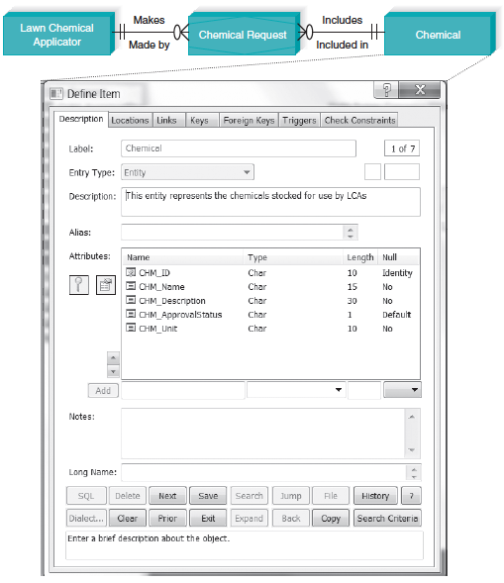
CASE Entry for Relationship

Slide 24
Binary Relationships
is assigned
PARKING PLACE
EMPLOYEE
is assigned to
one-to-one
PRODUCT LINE
includes
PRODUCT
is included in
one-to-many
STUDENT
registers for
COURSE
registers
many-to-many

Slide 25
Foreign Keys
A relationship implies that instances of one entity are related to instances of another entity
The primary key of one entity is migrated into the other entity as a foreign key.
A foreign key is a primary key of one entity that is contributed to (duplicated in) another entity for the purpose of identifying instances of a relationship. A foreign key (always in a child entity) always matches the primary key (in a parent entity).

Slide 26
Foreign Keys
Emp ID - PK
Emp Name
Emp Address
Parking ID - PK
Emp ID - FK
Location
is assigned
EMPLOYEE
PARKING PLACE
is assigned to
one-to-one
Prod Line ID - PK
Prod Line Descrip
PRODUCT
LINE
PRODUCT
Product ID - PK
Prod Line ID - FK
Prod Description
PRODUCT LINE
includes
PRODUCT
is included in
one-to-many
Student ID – PK
?? FK ??
Student Name
Student Address
Course ID – PK
?? FK ??
Course Name
Course Descrip
STUDENT
registers for
COURSE
STUDENT
COURSE
registers
many-to-many

Slide 27
Creating an ERD
How erds are developed

Slide 28
Overview
Drawing the ERD is an iterative process of trial and revision
ERDs can become quite complex
Steps in building ERDs…
Identify the entities
Add appropriate attributes for each entity
Draw the relationships that connect associated entities

Slide 29
Identify the Entities
Identify major categories of information
If available, check the process models for data stores, external entities, and data flows
Check the major inputs and outputs from the use cases
Verify that there is more than one instance of the entity that occurs in the system

Slide 30
Add Appropriate Attributes
Identify attributes of the entity that are relevant to the system under development
Check the process model repository entries for details on data flows and data stores
Check the data requirements of the requirements definition
Interview knowledgeable users
Perform document analysis on existing forms and reports
Select the entity’s candidate identifier (final decision may be postponed until Design phase)

Slide 31
Draw the Relationships
Start with an entity and identify all entities with which it shares relationships
Describe the relationship with the appropriate verb phrase
Determine the cardinality and modality by discussing the business rules with knowledgeable users

Slide 32
ERD Building Tips
Data stores of the DFD generally correspond to entities
Only include entities with more than one instance
Don’t include entities associated with implementation of the system (e.g., archive files of older data). They will be added later.

Slide 33
Advanced Syntax - Intersection Entities
A new entity is created to store information about two entities sharing an M:N relationship
Remove the M:N relationship between two entities and insert new entity between them
Create two 1:N relationships: original entities are parents to the new child intersection entity
Name the intersection entity
Migrate parent entity primary keys to new entity as foreign keys (possibly also concatenated primary key)

Slide 34
Resolving M:N with an Intersection Entity
registers for
COURSE REGIS-TRATION
registers
STUDENT
COURSE
Student ID - PK
Student Name
Student Address
Student ID (PK FK)
Course ID (PK FK)
Semester (PK)
Final Grade
Course ID - PK
Course Name
Course Descrip

Slide 35
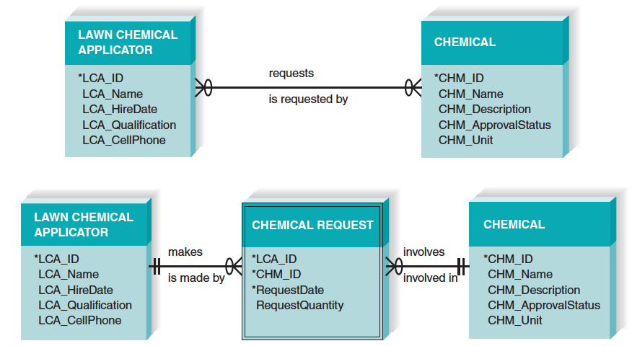
Resolving M:N Relationship
Additional Example

Slide 36
Validating an ERD
Ensuring a quality data model

Slide 37
Design Guidelines
Best practices rather than rigid rules
Entities should have many occurrences
Avoid unnecessary attributes
Clearly label all components
Apply correct cardinality and modality
Break attributes into lowest level needed
Labels should reflect common business terms
Assumptions should be clearly stated

Slide 38
Balancing ERDs with DFDs
All analysis activities are interrelated
Process models contain two data components
Data flows and data stores
The DFD data components need to balance the ERD’s data stores (entities) and data elements (attributes)
Many CASE tools provide features to check for imbalance
Check that all data stores and elements correspond between models
Data that is not used is unnecessary
Data that has been omitted results in an incomplete system
Do not follow thoughtlessly -- check that the models make sense!

Slide 39
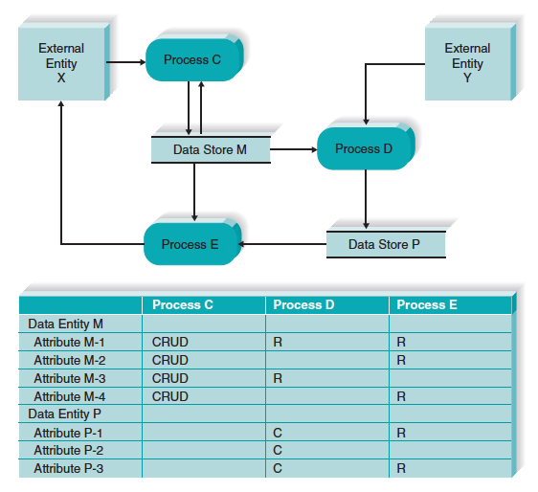
Use of a CRUD Matrix

Slide 40
Normalization
Technique used to validate data models
Series of rules applied to logical data model to improve its organization
Three normalization rules are common

Slide 41
Example 1: Unnormalized Entity
Begin with an entity from
the logical data model
Do any attributes (or groups of attributes) occur more than once for a single occurrence of the entity?
Yes

Slide 42
Example 1: 1st Normal Form
Do any attributes (or groups of attributes) occur more than once for a single occurrence of the entity?
If yes, remove the attributes (or groups) into separate entities.

Slide 43
Potential Anomalies with 1st Normal Form
Insert anomaly:
Insert a new Item?
Can’t do without OrderNumber
Deletion anomaly:
Assume only one order has been made for Item #456. What happens if that order is cancelled?
Will lose all information about Item # 456
Update anomaly:
The price of Item # 789 should be changed from $7.99 to $8.95. What problem occurs?
Need to search entire database for all occurrences of Item # 789

Slide 44
Potential Anomalies with 1st Normal Form
Reason anomalies exist?
Several non-key attributes depend only on ItemNumber and NOT on the full primary key (ItemNumber + OrderNumber)
ItemNumber
Quantity
Ordered
ItemName
OrderNumber
Quantity
Shipped
ItemPrice
ItemUnit

Slide 45
Example 1: 2nd Normal Form
For entities with concatenated keys…
Do any attributes depend on just part of the key rather than the entire key?
If yes, move partially-dependent attributes to a new entity…

Slide 46
Potential Anomalies with 2nd Normal Form
Reason Anomalies Exist:
The ORDER entity contains transitive dependencies
This means that several non-key attributes depend on another non-key attribute, and NOT on the Primary Key
CustomerAddress, CustomerType, DistrictNumber, and RegionNumber depend on the CustomerName, NOT the OrderNumber
Solution: remove these attributes to a separate entity
© 2015 John Wiley & Sons. All Rights Reserved.
46

Slide 47
Example 1: 3rd Normal Form
Do any attribute values depend on an attribute that is not the entity’s key?
If yes, move these attributes to a new entity.

Slide 48
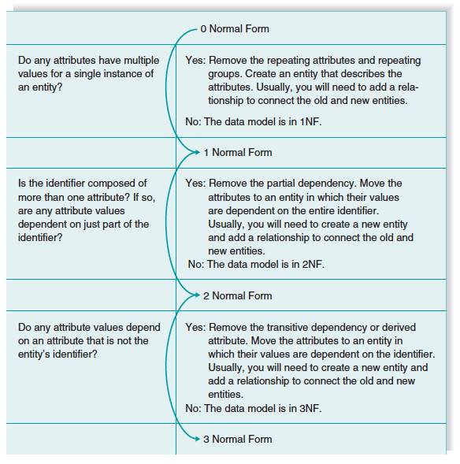
Summary of Normalization Steps

