Slide 1
Moving into Design
Systems analysis and design, 6th edition
Dennis, wixom, and roth

Slide 2
Learning Objectives
Explain the initial transition from analysis to design.
Create a system specification.
Describe three ways to acquire a system: custom, packaged, and outsourced alternatives.
Create an alternative matrix.

Slide 3
Transition from Requirements to Design
Brief preview

Slide 4
Key Ideas
In Systems Analysis we figure out…
What the business needs
In System Design we figure out…
How to build the system that fulfills those needs
All of the “logical” work from Systems Analysis is converted to the “physical”

Slide 5
Key Definitions
Design phase
Decide how to build the system
Create system requirements that describe all technical details for building the system
System specification
Final deliverable from design phase
Conveys exactly what system the development team will implement during the implementation phase

Slide 6
Design Phase Steps
Determine system acquisition strategy (make, buy, or outsource)
Determine the technical architecture for the system
Address security concerns and globalization issues
Make hardware and software selections
Determine the way that users will interact with the system (interface, inputs, and outputs)
Design the programs for the underlying processes
Design the way data will be stored
Create final deliverable - the system specification

Slide 7
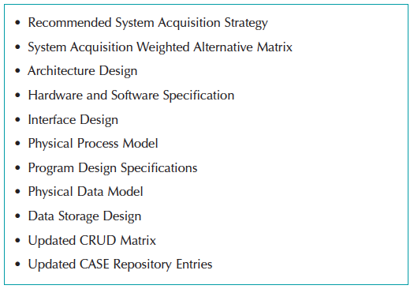
Elements of System Specification

Slide 8
System Acquisition Strategies
What is the best way to acquire this system?

Slide 9
Ways to Acquire a New System
Custom development (build from scratch) in-house
Purchase software package (and possibly customize it)
Install on our own computers, or
Obtain access from a software provider (host)
Outsource development to third party, who might
Build system from scratch for us, or
Purchase software for us, customize and install it

Slide 10
Custom Development
pros
cons
Get exactly what we want
New system built consistently with existing technology and standards
Build and retain technical skills and function knowledge in-house
Allows team flexibility and creativity
Unique solutions created for strategic advantage
Requires significant time and effort
May add to existing backlogs
May require skills we do not have
Often costs more
Often takes more calendar time
Risk of project failure

Slide 11
Purchased Software Packages (purchased or obtained from ASP or SaaS)
Pros
cons
No need to “reinvent the wheel” for common business needs
Tested, proven product
Cost savings
Time savings
Utilize vendors’ expertise
Some customization may be possible
Rarely a perfect fit
Organizational processes must adapt to software
Reliance on vendor for maintenance and future enhancements
Won’t develop in-house functional and technical skills
Unique needs may go unmet
May require system integration

Slide 12
Purchased Software
Application service providers (ASP) supply access to software on a pay-as-you-go basis
Many applications today are “in the cloud”…
ASP – provider hosts someone else’s software
SaaS – software vendor hosts its own software
Considerable savings – no hosting infrastructure needed; host provides everything
Risks include
Fear of losing confidential information
Performance

Slide 13
Purchased Software
Analyze the vendor as well as the software functionality
Verify vendor claims with others
Look carefully at vendor support
Assess long-term viability of vendor as an on-going business
A new software company may have a great idea, but can they survive as a business over the long haul?
If the vendor is an acquisition target, what will happen to the product?

Slide 14
Systems Integration
Building systems by combining packages, existing (legacy) systems, and custom software written for integration
Integrating data between various parts of the system is the key challenge
Many consultants specialize in systems integration

Slide 15
Outsourced Development
pros
cons
Hire expertise we don’t have
May save time and money
Lower risk
No opportunity to build in-house expertise
Reliance on vendor
Future options limited
Security – potential loss of confidential information
Performance based on contract terms

Slide 16
Outsourcing
Hiring an external vendor, developer, or service provider to supply the system
Can also obtain custom system created by outsourcer
Can reduce costs and/or add value (resources, experience)
Risks include
Losing confidential information
Losing control over future development
Losing learning opportunities

Slide 17
Outsourcing Contracts
Time and arrangements
Fixed-price
Value-added

Slide 18
Outsourcing Guidelines
Keep lines of communication open
Define and stabilize requirements before signing the contract
View the relationship as a partnership
Select vendor, developer, or provider carefully
Assign someone to manage the relationship
Don’t outsource what you don’t understand
Emphasize flexible requirements, long-term relationships, and short-term contracts

Slide 19
Influences on the Acquisition Strategy
What factors do we consider?

Slide 20
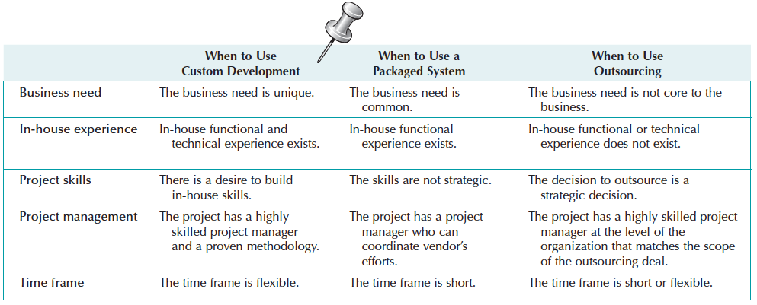
Acquisition Strategy Selection Factors

Slide 21
Selecting an Acquisition Strategy
How do we choose?

Slide 22
Developing Our Options
Need to collect information
What tools and technologies are needed for a custom development project?
What vendors make products that address the project needs?
What service providers would be able to build this application if outsourced?

Slide 23
Request for Proposals (RFP)
Solicits proposals from vendor, developer, or service provider
Explains the system to be built and criteria for selecting among applicants
Request for Information (RFI) -- a shorter and less detailed version
Request for Quote (RFQ) – use when you just need a price

Slide 24
Request for Proposal Contents
Description of desired system
Special technical needs or circumstances
Evaluation criteria
Instructions on how to respond
Desired schedule
Other information that will help the submitter to make a more complete or accurate proposal

Slide 25
Developing an Alternative Matrix
Combine several feasibility analyses into one matrix
Include technical, economic, and organizational feasibilities
Assign weights to indicate the relative importance of the criteria
Assign scores to indicate how well the alternative meets the criteria

Slide 26
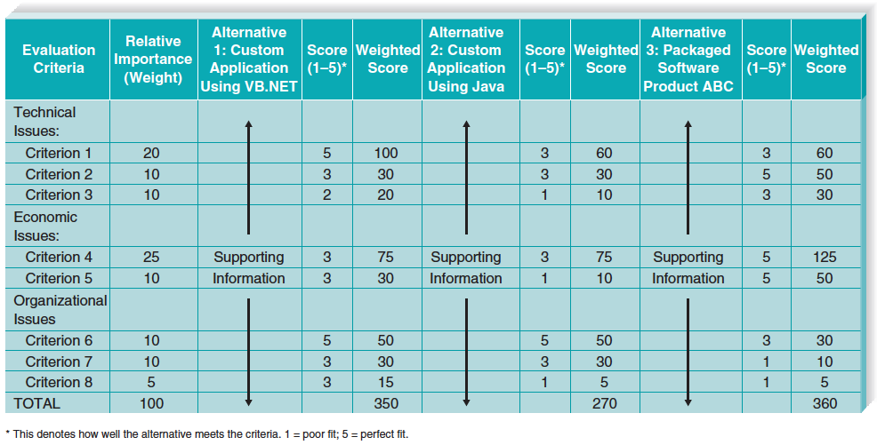
Sample Alternatives Matrix

Slide 27
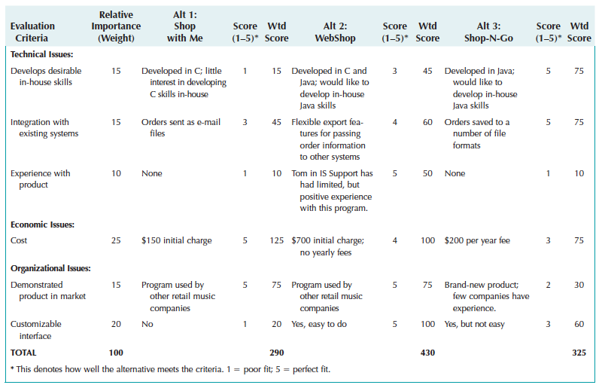
Tune Source Alternatives Matrix

