Slide 1
Architecture Design
Systems analysis and design, 6th edition
Dennis, wixom, and roth

Slide 2
Learning Objectives
Describe the fundamental components of an information system.
Describe client–server, server-based, and mobile application architectures.
Describe how cloud computing can be incorporated as a system architecture component.
Explain how operational, performance, security, cultural, and political requirements affect the architecture design.
Create a hardware and software specification.

Slide 3
Key Definitions
Architecture design
Plans for how the system will be distributed across computers and what hardware and software will be used for each computer.
Hardware and software specification
Describes the hardware/software components in detail to aid those responsible for purchasing those products.

Slide 4
Elements of an Architecture Design
Assigning software components to hardware

Slide 5
Objective of Architecture Design
Assign the software components of the information system to the hardware devices of the system in the most advantageous way.
The major architectural components of any system are the software and the hardware.

Slide 6
Architectural Components
Software systems can be divided into four basic functions:
Data storage.
Data access logic: the processing required to access stored data.
Application logic: the logic documented in the DFDs, use cases, and functional requirements.
Presentation logic: the display of information to the user and the acceptance of the user’s commands.

Slide 7
Architectural Components (cont’d)
The three primary hardware components:
Client computers: Input-output devices employed by users (e.g., PCs, laptops, handheld and mobile devices, smart phones)
Servers: Larger multi-user computers used to store software and data.
Network: Connects the computers.

Slide 8
Client-Server Architectures
Client-server architectures balance the processing between client devices and one or more server devices.
Generally, clients are responsible for the presentation logic, and
the server(s) are responsible for the data access logic and data storage.
Application logic location varies depending on the C-S configuration chosen.

Slide 9
Benefits of Client-Server
Scalable
Can support different types of clients and servers through middleware.
The presentation logic, the application logic, and the data processing logic can be independent.
If a server fails, only the applications requiring that server are affected – highly reliable.

Slide 10
Client-Server Tiers
There are many ways in which the application logic can be partitioned between the client side and the server side.
The arrangement in Figure 8-1 is called two-tiered architecture.

Slide 11
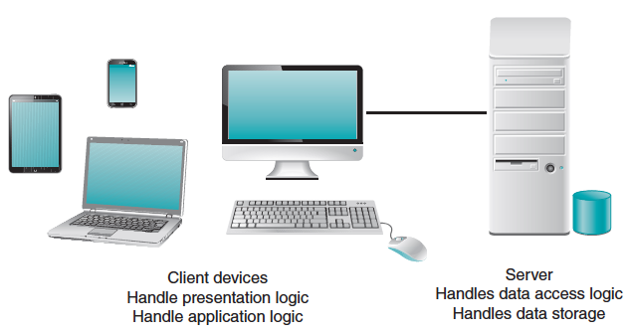
Two-Tiered Client-Server Architecture
Thick client – most of application logic on the client side (shown here)
Thin client – little application logic on the client side; most shifted to server side

Slide 12
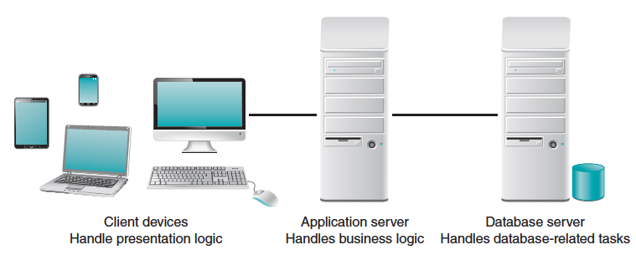
Three-Tiered Client-Server Architecture
Adds “specialized” servers – one for application logic; one for data base tasks

Slide 13
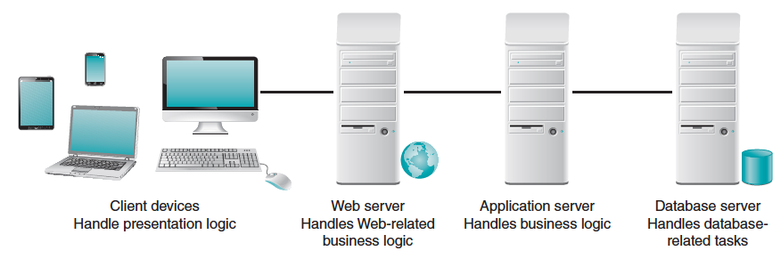
n-Tiered Client-Server Architecture
Adds “specialized” servers – one for Web-related business logic; one for application logic; one for data base tasks

Slide 14
Adding “Tiers” in the Architecture
advantages
disadvantages
Modular business logic components are shareable across applications
Separating the processing among multiple servers makes it possible to balance the server loads efficiently.
More tiers place a higher load on the network.
More difficult to implement since the servers must communicate effectively.

Slide 15
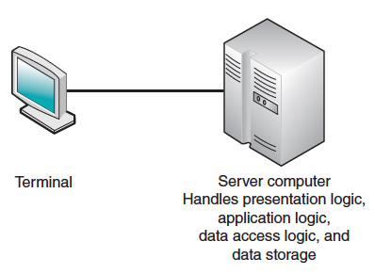
Server-Based Architecture
Zero-client used today in virtual desktop infrastructure (VDI)

Slide 16
Mobile Application Architecture
Rich client – involves processing on the mobile device using its resources. Presentation logic, business logic, and data access logic on the client side.
Thin Web-based client – business and data access logic on the server side; always connected to server.
Rich Internet application – browser-based; uses some technologies on client device to provide a rich user interface (e.g., Flash).

Slide 17
Mobile Application Options
Native app – written to run on specific device with specific operating system.
Cross-platform frameworks – develop in web-based technologies and use framework to deploy to multiple devices.
Mobile Web app – browser-based; platform independent. Most limited user experience.

Slide 18
Advances in Architecture Configurations
Advances in hardware, software, and networking have given rise to a number of new architecture options.
Virtualization: Creation of a virtual device or resource.
Cloud computing: Computing resources obtained as a service.

Slide 19
Virtualization
Server virtualization involves partitioning a physical server into smaller virtual servers.
Storage virtualization involves combining multiple network storage devices into what appears to be single storage unit.

Slide 20
Cloud Computing
Cloud computing – everything from computing power to computing infrastructure, applications, business processes to personal collaboration can be delivered as a service wherever and whenever needed.
The “cloud” can be defined as the set of hardware, networks, storage, devices, and interfaces that combine to deliver aspects of computing as a service.

Slide 21
Advantages of Cloud Computing
Elasticity: the resources allocated can be increased or decreased quickly, based on demand.
Cloud customers can obtain cloud resources in a straightforward fashion.
Cloud services typically have standardized APIs (application program interfaces).
Customers are billed for resources as they are used.

Slide 22
Comparing Architecture Options
Most systems are built to use the existing infrastructure in the organization, so often the current infrastructure restricts the choice of architecture.
Each of the architectures discussed has its strengths and weaknesses.
Client-server architectures are strongly favored on the basis of the cost of infrastructure.
Cloud computing deserves consideration today.

Slide 23
Creating an Architecture Design
Applying the nonfunctional requirements

Slide 24
Selecting an Architecture Design
Lower costs often used to justify choice of client-server
Recommended selection process:
Expand nonfunctional requirement details
Base architecture selection on the detailed nonfunctional requirements
Operational,
Performance,
Security, and
Cultural/political

Slide 25
Operational Requirements
Requirement | Definition | Example
Technical Environment | Special hardware, software, and network requirements imposed by business requirements | All office locations have always-on network connection permitting real-time database updates
System Integration | The extent to which the system will operate with other systems | The system will read and write to the main inventory database
Portability | The extent to which the system will need to operate in other environments | The system must operate with mobile devices (Android and iOS)
Maintainability | Expected business changes to which the system should be able to adapt | The system must accommodate new manufacturing plants

Slide 26
Performance Requirements
Requirement | Definition | Example
Speed | Time within which the system must perform its function | Network transaction response time <= 4 seconds
Capacity | Total and peak number of users and the volume of data expected | Maximum of 2000 simultaneous users at peak use times
Availability and Reliability | Extent to which the system will be available to the users and the permissible failure rate due to errors | 99% uptime performance

Slide 27
Security Requirements
Requirement | Definition | Example
System Value Estimates | Estimated business value of the system and its data | A complete loss of all system data would cost $20 million
Access Control | Limitations on who can access what data | Inventory item changes can be made only by managers for items in their own department
Encryption and Authentication | Defines what data will be encrypted where and whether authentication will be needed for user access | Data will be encrypted from the user’s computer to the Web site to provide secure ordering
Virus Control | Controls to limit viruses | All uploaded files will be checked for viruses before being saved in the system

Slide 28
Cultural/Political Requirements
Requirement | Definition | Example
Multilingual | The language(s) the system users will need | The system will operate in English, French, and Spanish
Customization | Specification of what aspects of the system can be changed by local users | Country managers will be able to define new fields in the product database to capture country-specific information
Making Unstated Norms Explicit | Explicitly stating assumptions that differ from country to country | All weights will be stated in pounds and in kilograms
Legal | The laws and regulations that impose system requirements | Personal customer information cannot be transferred from European Union countries to US

Slide 29
Designing the Architecture
Technical environment requirements, driven by business requirements, often define the application architecture.
If not, other nonfunctional requirements become important.

Slide 30
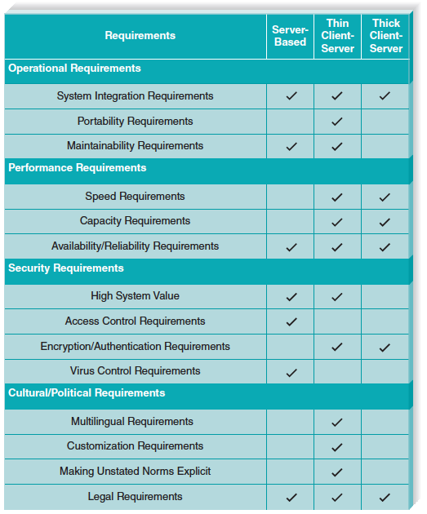
Nonfunctional Requirements and the Architecture Design

Slide 31
Hardware Software Specification
Outlining needs in new system

Slide 32
HW/SW Specification Purpose
Used if new hardware or software must be purchased
Communicates project needs
Actual acquisition of hardware and software may be done by a purchasing department -- especially in larger firms.

Slide 33
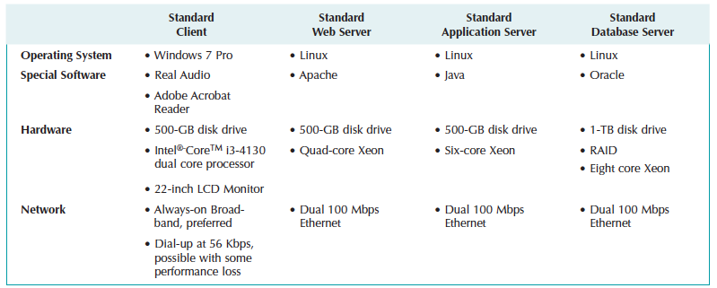
Sample HW/SW Specification

