Slide 1
User Interface Design
Systems analysis and design, 6th edition
Dennis, wixom, and roth

Slide 2
Learning Objectives
Explain the concept of usability with regard to the user interface.
Describe several fundamental user interface design principles.
Explain the process of user interface design.
Explain ways to understand the perspectives of the users of the user interface.
Describe ways to define the structure of the user interface.
Explain the standards that should be established for the user interface.
Describe various ways to prototype the user interface.
Discuss ways to evaluate and test the user interface.
Discuss special concerns associated with touch-screen-enabled user interfaces.
Be able to design a highly usable user interface.

Slide 3
Key Definitions
System Interface: “connections” with other systems, where systems exchange information with each other. Designed as a part of program design.
User Interface: “connections” with users. Focus of this chapter.
The navigation mechanism provides the way for users to tell the system what to do
The input mechanism defines the way the system captures information
The output mechanism defines the way the system provides information to users or other systems

Slide 4
Key Definitions, con’t.
Graphical user interface (GUI): most common type of interface in use today.

Slide 5
Usability Concept
The system is easy to use and easy to learn
Tasks are completed more efficiently and with more accuracy
Mistakes with system are reduced
User satisfaction with new system is increased
Adoption of system is more likely

Slide 6
Interface Design Principles
General guidelines for user interface design

Slide 7
Principles for User Interface Design
Layout
Content awareness
Aesthetics
Usage level
Consistency
Minimize user effort

Slide 8
Layout Concepts
The screen is often divided into three boxes
Navigation area (top)
Status area (bottom)
Work area (middle)
Information can be presented in multiple areas
Like areas should be grouped together

Slide 9
More Layout Concepts
Areas and information should minimize user movement from one to another
Ideally, areas will remain consistent in
Size
Shape
Placement for entering data
Reports presenting retrieved data

Slide 10
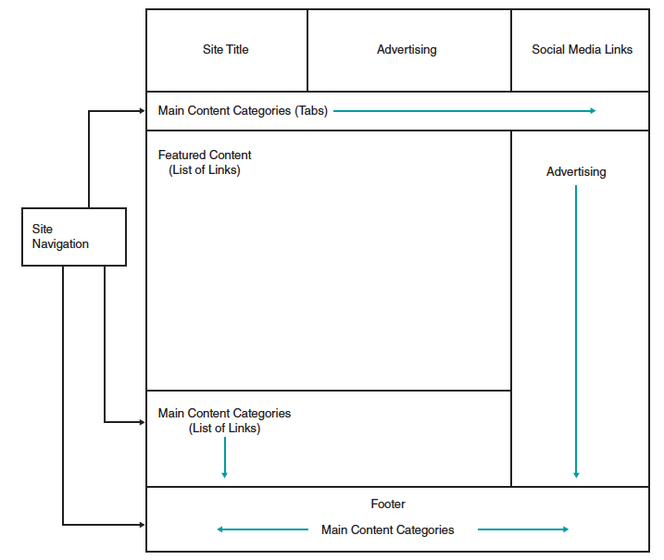
Model Layout for Web Page
Note use of multiple layout areas for site navigation

Slide 11
Content Awareness
All interfaces should have titles
Menus should show
where you are
where you came from to get there
It should be clear what information is within each area
Fields and field labels should be selected carefully
Use dates and version numbers to aid system users

Slide 12
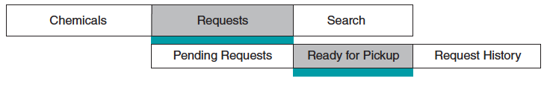
Content Awareness
Note the use of highlighting to indicate menu selections
Breadcrumbs provide additional clues on navigational path

Slide 13
Aesthetics
Interfaces need to be functional and inviting to use
Avoid squeezing in too much, particularly for novice users
Design text carefully
Be aware of font and size
Avoid using all capital letters

Slide 14
More Aesthetics
Colors and patterns should be used carefully
Test quality of colors by trying the interface on a black/white monitor
Use colors to separate or categorize items

Slide 15
Usage Level
Some people will be frequent, heavy users of the system
Frequent users desire ease of use – quick and easy completion of job tasks
Other people may use the system infrequently
Infrequent users desire ease of learning – quick and easy ways to figure out what to do.

Slide 16
Usage Level
User interface design should anticipate the types of users expected.
For systems primarily used by frequent users, include ways to perform tasks directly (hot keys, short-cut keys, etc.).
For systems primarily used by infrequent users, include careful menu designs, tool tips, and extensive help systems.
For systems with both user types, incorporate both user preferences in design as much as possible

Slide 17
Consistency
Elements are the same throughout the application
Enables users to predict what will happen
Reduces learning curve
Considers elements within an application and across applications
Pertains to many different levels
Navigation controls
Terminology
Report and form design

Slide 18
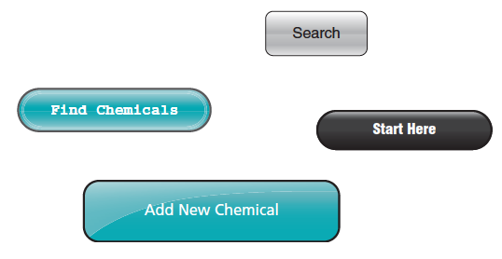
Example of Inconsistent Elements
Note the different button styles, colors, and font styles.

Slide 19
Minimize Effort
Three clicks rule
Users should be able to go from the start or main menu of a system to the information or action they want in no more than three mouse clicks or three keystrokes

Slide 20
Special Issues of Touch Screen Design
Ideal for information display but not data entry.
Place content at top and navigation controls at bottom so finger does not obscure content area.
Place labels on top of navigation controls.
Size objects correctly for “fat fingers.”
Include adequate spacing between objects.

Slide 21
Special Issues of Touch Screen Design, con’t.
Consider needs of left-handed and right-handed users.
Bright colors/backgrounds can help reduce glare and hide fingerprints.
Use each device’s standardized gesture interactions to enhance the user’s ease of learning and ease of use.

Slide 22
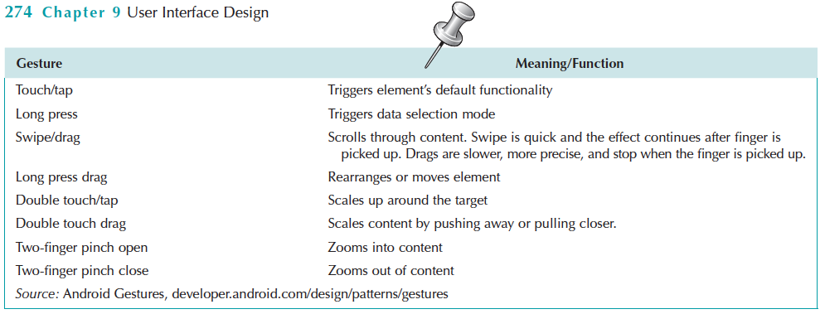
Android Device Common Hand Gestures

Slide 23
User Interface Design Process
The path to a successful user interface

Slide 24
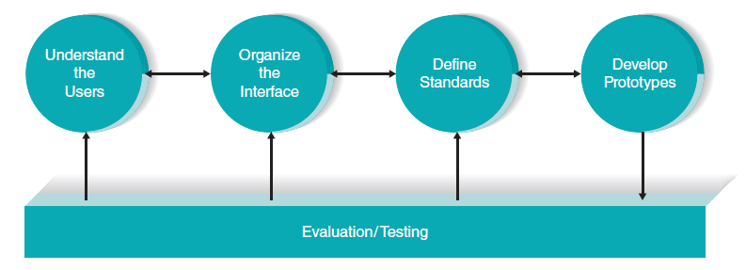
User Interface Design Process
Understand the Users
Organize the Interface
Define Standards
Develop Prototypes
Evaluation / Testing

Slide 25
Understand the Users
Users likely will have very different goals and intentions when using the system.
Use personas to develop characterizations of various user groups.
Interests
Typical behaviors
Goals and objectives
Expectations
Plan a user interface that will be satisfying for that particular user group.

Slide 26
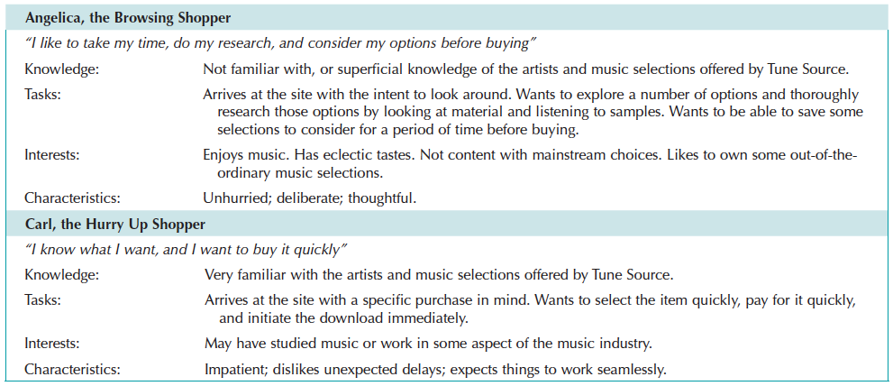
Personas for Tune Source

Slide 27
Understand the Users, con’t.
Use scenarios outline the steps that the users perform to accomplish some part of their work.
Presented in a simple narrative tied to the related DFD.
Document the most common paths through the use case so interface designs will be easy to use for those situations.

Slide 28
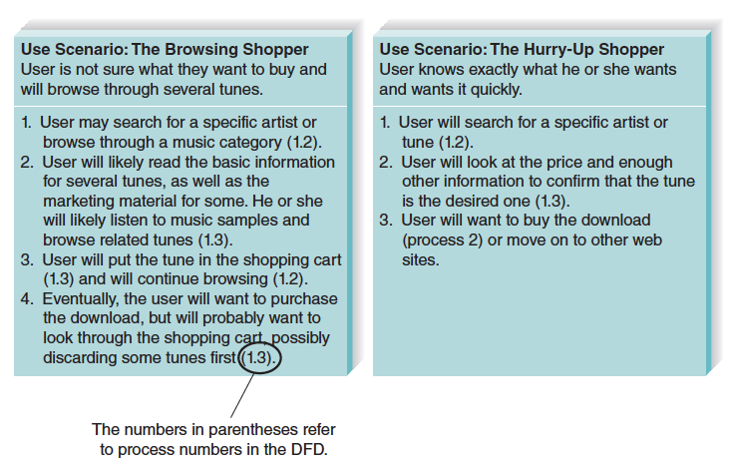
Use Scenarios for Tune Source

Slide 29
Organize the Interface
Define the basic components of the interface and how they work together to provide functionality to users.
Use Interface Structure Diagram (ISD)
Shows how all screens, forms, and reports are related
Shows how user moves from one to another
Similar to DFD in using boxes and lines
Boxes denote screens
Lines show movement from one to another
Different from DFD in having no standard rules or format

Slide 30
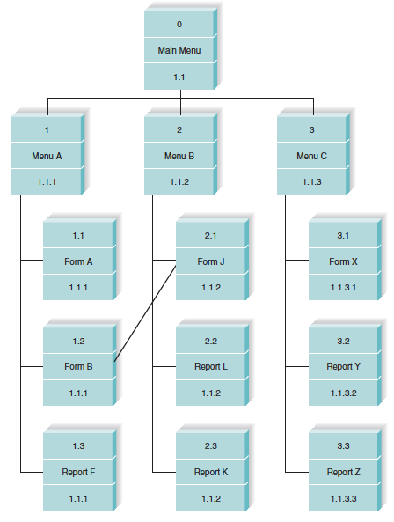
Interface Structure Diagram for Tune Source

Slide 31
Organize the Interface, con’t.
For Web sites, use site map.
Show how all the information on the site fits together.
Helps establish the hierarchy of information on the site.

Slide 32
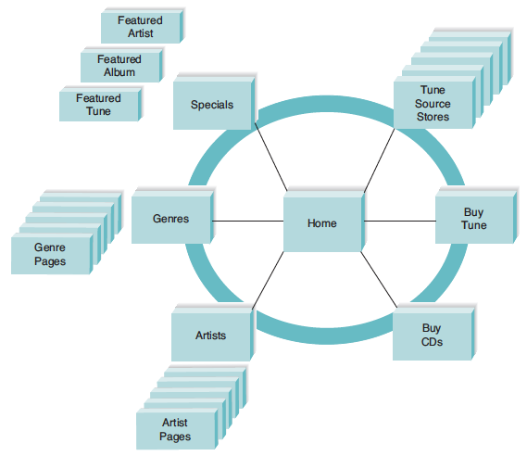
Site Map for Tune Source

Slide 33
Define Standards
Clarify decisions on all key interface elements to ensure consistency:
Basic common elements across individual screens, forms, and reports within the application
Interface metaphor (e.g., calendar, checkbook, shopping cart)
Interface objects (e.g., customer/client; employee/associate)
Interface actions (e.g., buy/purchase/check out; exit/quit)
Interface icons (pictures) representing status or actions (e.g., trashcan for delete; disk for save)
Interface templates (layout guide for all screens)

Slide 34
Interface Design Prototyping
A mock-up or simulation of screens, forms, or reports
Common methods include:
Paper sketches
Wireframe diagrams
Storyboarding
Wireflow diagrams
HTML prototype
Language prototype

Slide 35
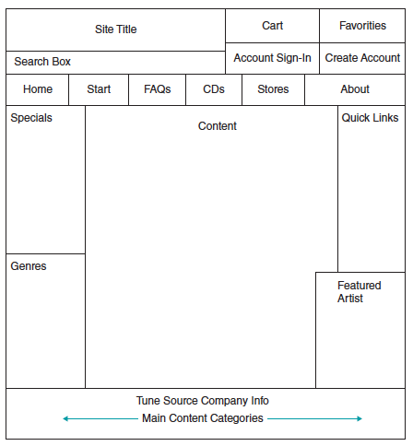
Wireframe Diagram for Tune Source

Slide 36
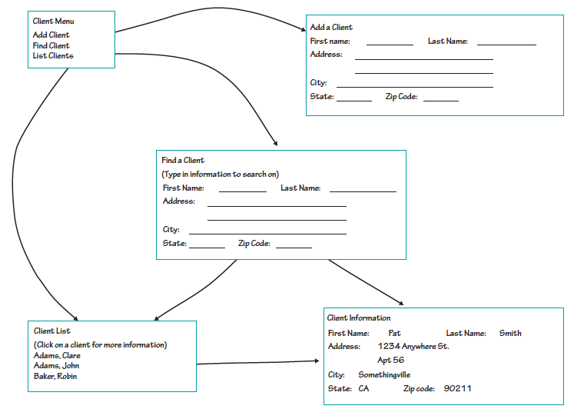
Storyboard Example

Slide 37
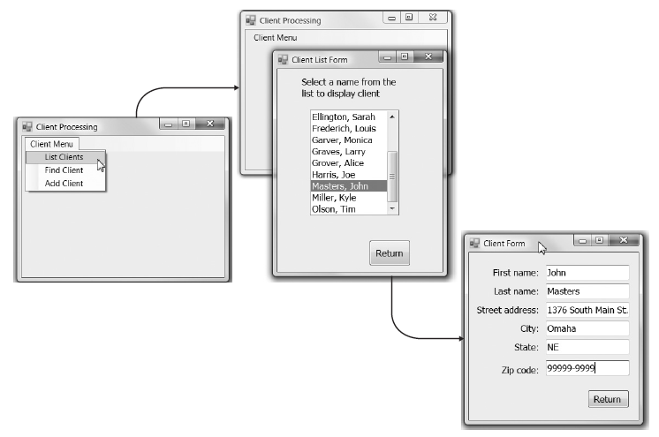
Language Prototype Example

Slide 38
Interface Evaluation Methods
Heuristic evaluation
Compare design to checklist
Walkthrough evaluation
Team simulates movement through components
Interactive evaluation
Users try out the system
Formal usability testing
Expensive
Detailed use of special lab testing

Slide 39
Navigation Design
Providing a seamless interaction

Slide 40
Basic Principles of Navigation Design
Assume users
Have not read the manual
Have not attended training
Do not have external help readily at hand
All controls should be clear and understandable and placed in an intuitive location on the screen.

Slide 41
Basic Principles of Navigation Design
Prevent mistakes
Limit choices
Never display commands that can’t be used (or “gray them out”)
Confirm actions that are difficult or impossible to undo
Simplify recovery from mistakes
Use consistent grammar order (action-object, object-action)

Slide 42
Menu Tips
Menus enable users to select action from an organized display of action categories and options
Broad and shallow design is preferred
Logical categories can be objects (customers; orders) or actions (insert, design)
Common menu formats include menu bars, drop-down menus, popup menus, tab menus, icon tool bars, and image maps.
Menus may become less popular with trend toward touchscreens

Slide 43
Message Tips
Common message types include:
Error message
Confirmation message
Acknowledgment message
Delay message
Help message
Strive for clear, concise, and complete messages
Should be grammatically correct and free of jargon and abbreviations (unless they are the users’)
Avoid negatives and humor (it gets old)

Slide 44
Input Design
entering new data into the system

Slide 45
Basic Principles of Input Design
The goal is to simply and easily capture accurate information for the system
Reflect the nature of the inputs
Find ways to simplify their collection

Slide 46
Online versus Batch Processing
Online processing immediately records the transaction in the appropriate database
Batch processing collects inputs over time, holds them temporarily, and then processes all the transactions at one time in a batch
Batch processing simplifies data communications and other processes; but master files are not updated real time

Slide 47
Capture Data at the Source
Reduces duplicate work
Reduces processing time
Decreases cost
Decreases probability of error

Slide 48
Source Data Automation
Can be obtained by using the following technologies:
bar code readers / scanners
optical character recognition
magnetic stripe readers
smart cards
RFID (Radio Frequency Identification) tags

Slide 49
Minimize Keystrokes
Keyboard entry is slow and error-prone
Never ask for information that can be obtained other ways
Lookups
Dropdown lists
Default values

Slide 50
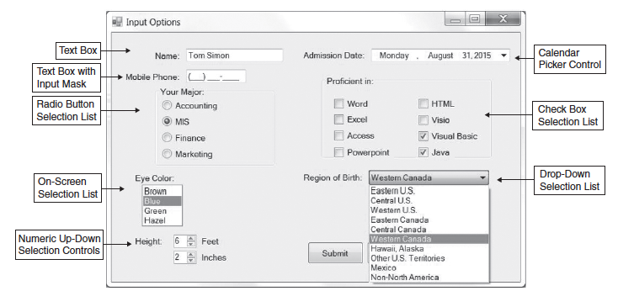
Input Tips
Utilize selection controls whenever possible to minimize keystrokes.

Slide 51
Input Validation
Apply a judicious amount of input validation to ensure accuracy.
Types include:
Completeness check
Format check
Range check
Check digit check
Consistency check
Database checks

Slide 52
Output Design
Conveying the information the user needs

Slide 53
Basic Output Design Principles
Understand report usage
Reference or cover-to-cover?
Frequency?
Real-time or batch reports?
Manage information load
All needed information, no more
Minimize bias
Utilize various report types (detail, summary, exception, graphical) and media to satisfy users’ output requirements.

