Slide 1
Program Design
Systems analysis and design, 6th edition
Dennis, wixom, and roth

Slide 2
Learning Objectives
Be able to revise logical DFDs into physical DFDs.
Be able to create a structure chart.
Be able to write a program specification.
Be able to write instructions using pseudocode.
Become familiar with event-driven programming.

Slide 3
Moving from Logical to Physical Process Models
Making implementation decisions

Slide 4
The Physical Process Model
Show the implementation details and explain how the system will work, including
Actual, specific technology
Format of information
Human interaction with system

Slide 5
The Physical DFD
Contains the same components as the logical DFD
The same rules pertaining to balance and decomposition apply
Contains additional details describing how the system will be built

Slide 6
Steps to Create the Physical DFD
Add implementation references
Draw a human-machine boundary
Add system-related data stores, data flows and processes
Update data elements in the data flows
Update the metadata in the CASE repository

Slide 7
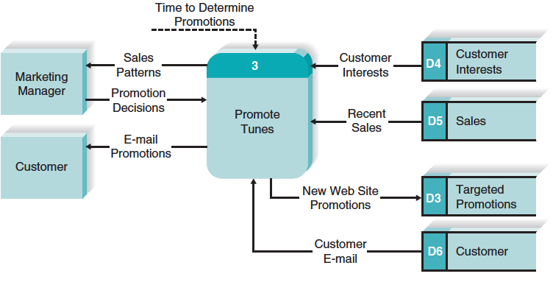
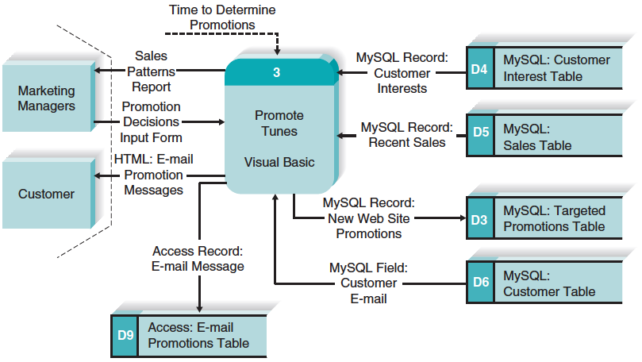
Contrasting a Logical and Physical DFD
Logical DFD
Physical dfd

Slide 8
Designing Programs

Slide 9
Key Definitions
Program design - creating instructions for the programmers
The top-down, modular approach - begin with the “big picture” and gradually add detail
Program design document – all structure charts and specifications needed by programmers to implement the system

Slide 10
The Structure Chart
Important program design technique
Shows all components of code in a hierarchical format
Sequence
Selection
Iteration
Illustrates the organization and interactions of the different program modules

Slide 11
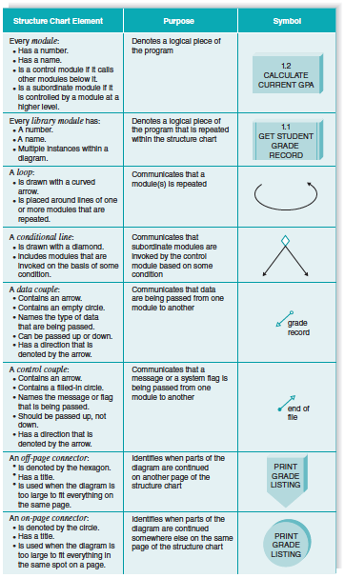
Example Structure Chart

Slide 12
Structure Chart Elements
Module
Conditional Line
Off
Page
1.2
Calculate
Current GPA
Library Module
On
page
Control Couple
1.1
Get Student
Grade Record
Data Couple
Loop

Slide 13
Building the Structure Chart
Processes in the DFD tend to represent one module on the structure chart
Afferent processes – provide inputs to system
Central processes – perform critical system operations
Efferent processes – handle system outputs
The DFD leveling can correspond to the structure chart hierarchy

Slide 14
Types of Structure Charts
Transaction structure – control module calls subordinate modules, each of which handles a particular transaction
Few afferent processes
Many efferent processes
Higher up levels of structure chart
Concerned with coordinating the production of outputs

Slide 15
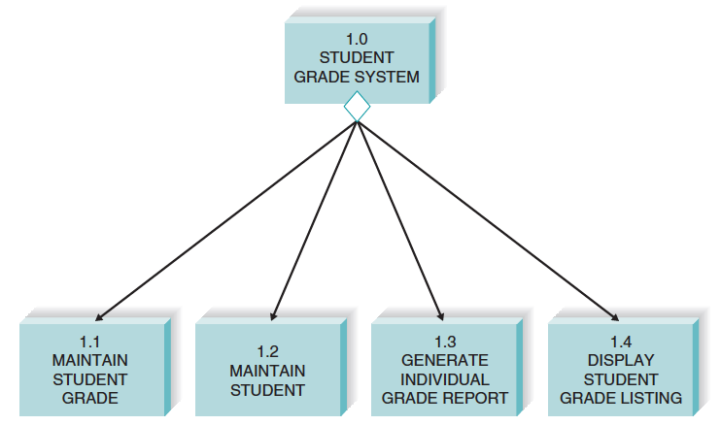
Transaction Structure

Slide 16
Types of Structure Charts, con’t.
Transform structure – control module calls several subordinate modules in sequence
Each subordinate performs a step in a process that transforms an input into an output
Many afferent processes
Few efferent processes
Lower levels of structure chart
Concerned with using inputs to create a new output

Slide 17
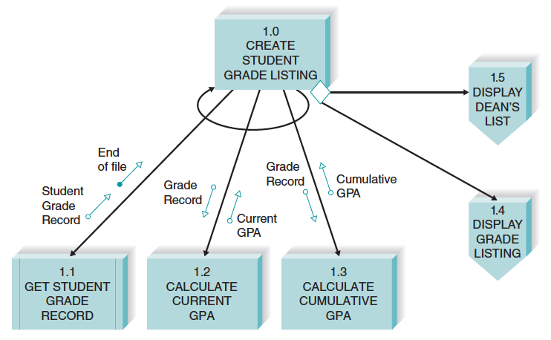
Transform Structure

Slide 18
Steps in Building the Structure Chart
1. Identify top level modules and decompose them into lower levels
2. Add control connections
3. Add couples
4. Review and revise again and again until complete

Slide 19
Design Guidelines
High quality structure charts result in programs that are modular, reusable and easy to implement.
Measures include:
Cohesion
Coupling
Appropriate levels of fan-in and fan-out

Slide 20
Types of Cohesion
Functional
Sequential
Communicational
Procedural
Temporal
Logical
Coincidental
Good
Bad

Slide 21
Factoring
Process of dealing with “low” cohesion
Separates tasks into different modules
Reduces use of control flags

Slide 22
Types of Coupling
Data
Stamp
Control
Common
Content
Good
Bad

Slide 23
Fan-in
High fan-in preferred
Promotes reuse of subordinate modules
1.1
Calculate
Employee
Salary
1.2
Print
Employee
Roster
1.3
Calculate
Benefits
1.1
Calculate
Employee
Salary
1.2
Print
Employee
Roster
1.3
Calculate
Benefits
1.1.2
Read
Employee
Record
1.1.1
Read
Employee
Record
1.2.1
Read
Employee
Record
1.3.1
Read
Employee
Record
Low fan-in not preferred

Slide 24
Quality Checklist
1. Library modules have been created where ever possible
2. The diagram has a high fan-in structure
3. Control modules have no more than 7 subordinates
4. Each module performs only one function (high cohesion)
5. Modules sparingly share information (loose coupling)
6. Data couples that are passed are actually used by the accepting module
7. Control couples are passed from “low to high”
8. Each module has a reasonable amount of code associated with it

Slide 25
Program Specifications
Instructions to the programmer

Slide 26
Program Specification Content
No standard approach
Include program information
Note events that trigger actions
List inputs and outputs
Include pseudocode
Provide additional notes and comments as needed

Slide 27
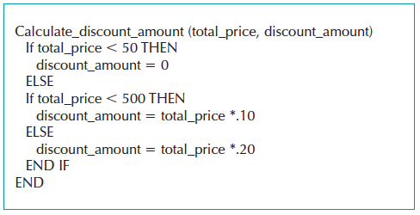
Sample Pseudocode

Slide 28

Sample Program Specification

