Slide 1
Moving into Implementation
Systems analysis and design, 6th edition
Dennis, wixom, and roth

Slide 2
Learning Objectives
Be familiar with the system construction process.
Explain different types of tests and when to use them.
Describe how to develop user documentation.

Slide 3
Key Definitions
Implementation is the development of all parts of the system: the software itself, documentation, and new operating procedures.

Slide 4
Managing the Programming Process
Project management during construction

Slide 5
Project Manager’s Tasks During Programming
Assigning the programmers
Coordinating the activities
Managing the schedule

Slide 6
The Programmer Paradox
More is not always better than less!
After the “right” number of people are assigned to a programming task, adding more people slows down rather than speeds up completion of the project.
Projects requiring a large team should be broken into a series of independent, smaller parts.

Slide 7
Assigning Programmers
Minimize the number of programmers
Two communication
channels
Twelve communication
channels
Match programming tasks with programmer capabilities
When skills are deficient, apply mentoring and training

Slide 8
Coordinating Activities
Weekly (hopefully brief) meetings
Create and follow standards
Organize programmers’ work areas
Development area
Testing area
Production area
Implement change control mechanisms
Use program log to monitor program changes

Slide 9
Managing the Schedule
Use initial time estimates as a baseline
Revise time estimates as construction proceeds
Fight against scope creep
Monitor “minor” slippage
Create risk assessment and track changing risks
Fight the temptation to lower quality to meet unreasonable schedule demands

Slide 10
Avoid Classic Mistakes
Research-oriented development
If you use state-of-the art technology, lengthen planned time
Using “low-cost” personnel
If using a significant number of entry level personnel, lengthen planned time
Lack of code control
Use source code library to keep programmers from changing the same code at the same time
Inadequate testing
Always allocate sufficient time for formal testing

Slide 11
Testing
Ensuring the system fulfills requirements

Slide 12
Testing Philosophy
Testing helps ensure that the system performs as outlined in the specifications.
It is dangerous to test early modules without an overall testing plan
It may be difficult to reproduce sequence of events causing an error
Testing must be done systematically and results documented carefully

Slide 13
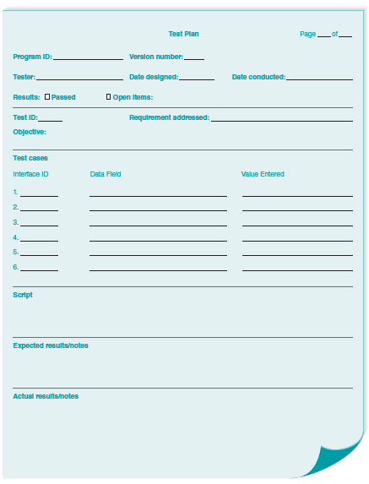
Test Plan

Slide 14
Categories of Testing
Stub testing
Tests control structures before all modules are written
Unit testing
Tests each module – Does it performs its function?
Integration testing
Tests the interaction of modules - do they work together?
System testing
Tests to assure that the software works well as part of the overall system
Acceptance testing
Tests to assure that the system serves organizational needs

Slide 15
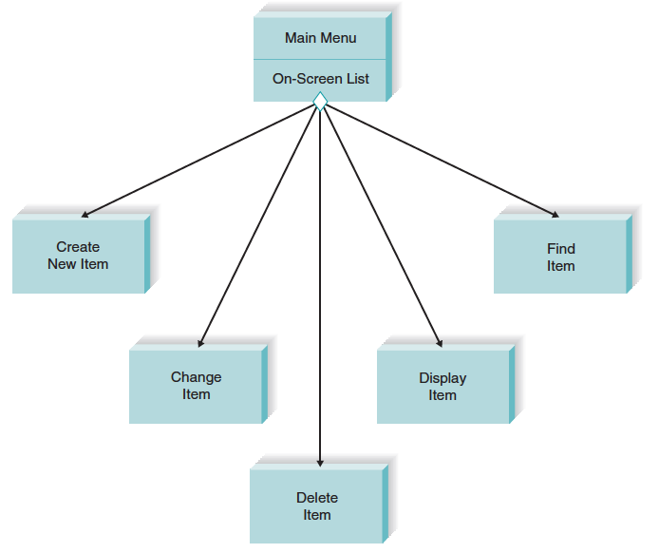
Stub Testing

Slide 16
Unit Testing
Black Box Testing
Focuses on whether the unit meets requirements stated in specification
White-Box Testing
Looks inside the module at actual code

Slide 17
Integration Testing
User interface testing
Tests each interface function
Use-scenario testing
Ensures that each use scenario works correctly
Data flow testing
Tests each process in a step-by-step fashion
System interface testing
Ensures data transfer between systems

Slide 18
System Testing
Requirements Testing
Ensures that integration did not cause new errors
Usability Testing
Tests how easy and error-free the system is in use
Security Testing
Assures that security functions are handled properly
Performance Testing
Assures that the system works under high volumes of activity (e.g., simultaneous users, peak transaction volume)
Documentation Testing
Analysts check the accuracy of documentation

Slide 19
Acceptance Testing
Alpha Testing
Performed by users to assure they accept the system; frequently repeats earlier tests
Beta Testing
Uses real data, not test data. Actual users monitor for errors or needed improvements.
User sign-off following Acceptance Testing indicates the system is ready to be placed into production.

Slide 20
Developing Documentation
Creating good documentation

Slide 21
Types of Documentation
Documentation provides information to make the system easier to use and repair.
System Documentation
Intended to help programmers and analysts understand and maintain the system after it is installed
User Documentation
Intended to help users operate the system

Slide 22
Producing Documentation
High quality documentation takes about 3 hours per page or 2 hours per screen.
The task should not be left to the end of the project.
Time required to develop and test user documentation should be built into project plan.
On-line documentation is predominant today.

Slide 23
Value of Online Documentation
Searching is simplified.
Information can be presented in multiple formats.
New methods of interacting with documentation are possible (e.g., tool tips, animated demos, narrated demos).
Less costly than paper documentation.

Slide 24
Types of User Documentation
Reference documents (perform system functions).
Procedures manuals (perform business tasks – includes manual procedures).
Tutorials (how to use system components).

Slide 25
Sources of Documentation Topics
Users’ business tasks (what they need to do)
The commands and menus in the user interface
Definitions of terms

Slide 26
Guidelines for Crafting Documentation Topics
Don’t omit any step because you “assume” the user knows how to do that step
Use the active voice with direct instructions
Use consistent terms
Use simple, friendly language
Use parallel grammatical structure
Use steps correctly (as actions)
Use short paragraphs

Slide 27
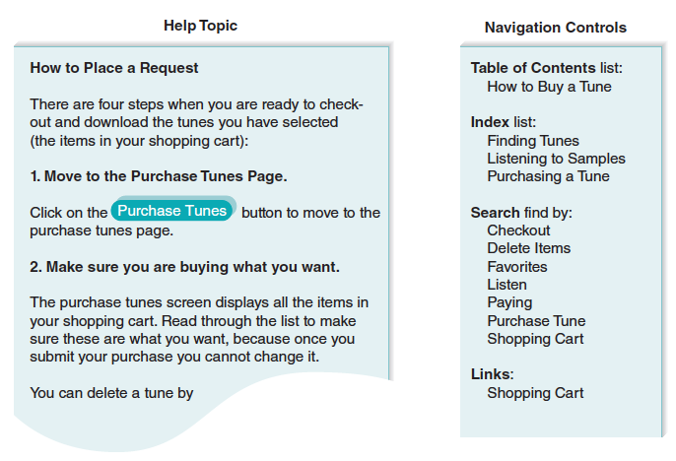
Samples for Tune Source

