Slide 1
The Movement To Objects
Systems analysis and design, 6th edition
Dennis, wixom, and roth

Slide 2
Learning Objectives
Explain the basic concepts of the object approach and UML.
Be able to create a use case diagram.
Be able to create a class diagram.
Be able to create a sequence diagram.
Be able to create a behavioral state machine diagram.

Slide 3
Basic OO Characteristics

Slide 4
What is “object-oriented”?
The object-oriented approach views a system as a collection of self-contained objects, including both data and processes.
Object-oriented systems focus on capturing the structure and behavior of information systems in modules (objects) that encompass both data and processes.

Slide 5
Classes and Objects
Class: the general template used to define and create specific instances, or objects.
An object: an instantiation of a class. An object is a person, place, event, or thing about which we want to capture information.
Each object has attributes that describe information about the object.

Slide 6
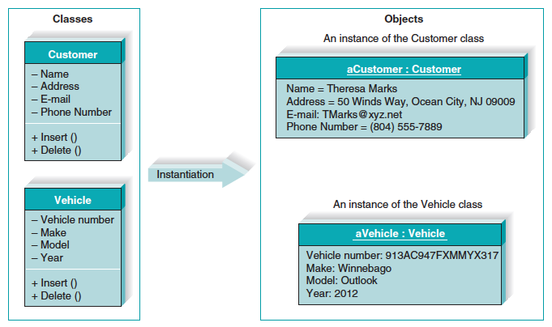
Classes and Objects (cont’d)

Slide 7
Messages and Methods
Methods implement an object’s behavior.
A method is an action that an object can perform.
Messages are information sent to objects to trigger methods.

Slide 8
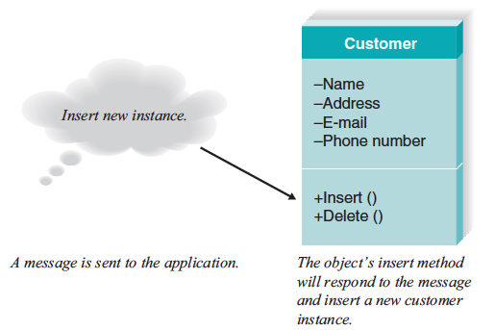
Messages and Methods, con’t.

Slide 9
Encapsulation and Information Hiding
Encapsulation: the combining of process and data into a single entity.
Information hiding: only the information required to use a software module be published to the user of the module.

Slide 10
Inheritance
Inheritance is used to identify higher level, or more general, classes of objects.
Common sets of attributes and methods can be organized into superclasses.
Classes are arranged in a hierarchy whereby the superclasses, or general classes, are at the top, and subclasses, or specific classes, are at the bottom.

Slide 11
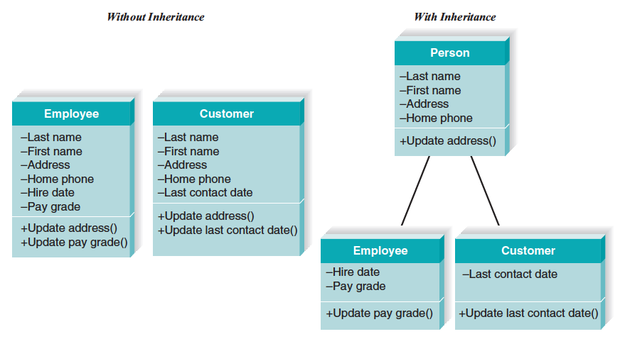
Inheritance

Slide 12
Polymorphism and Dynamic Binding
Polymorphism means that the same message can be interpreted differently by different classes of objects.
Made possible through dynamic binding: a technique that delays identifying the type of object until run-time.
Contrast to static binding in which the type of object would be determined at compile time.

Slide 13
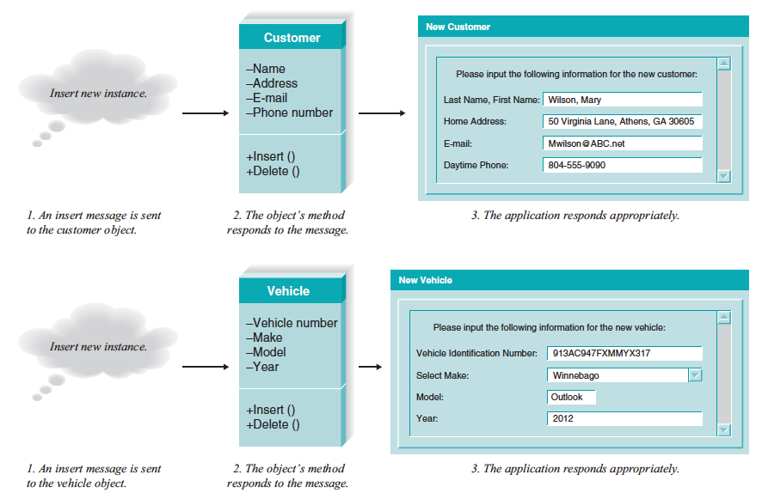
Polymorphism and Encapsulation

Slide 14
OO Systems Analysis and Design
The oo approach

Slide 15
Background
Most object-oriented approaches are associated with an iterative development RAD methodology.
The Unified Modeling Language (UML) is a standard set of diagramming techniques for object-oriented systems analysis and design.

Slide 16
Background, con’t.
Any object-oriented approach to developing information systems must be:
use case driven – use cases are the primary modeling tool;
architecture centric – the underlying architecture of the evolving system drives the specification, construction, and documentation of the system; and
iterative and incremental – the development undergoes continuous testing throughout the life of the project.

Slide 17
Benefits of an Object Approach
Analysts break a complex system into small manageable components
Work on the components individually
Easily piece the components back together to form a system
Modularity makes system development easier to grasp
Modules easier to share among members of a project team
User communication is enhanced
Reusable pieces are created that can be plugged into other systems efforts or used as starting points for other projects
Save time; new projects do not have to start from scratch and learning curves are not as steep
“Object think” is a much more realistic way to think about the real world

Slide 18
UNIFIED MODELING LANGUAGE VERSION 2.0
The objective of the Unified Modeling Language is to provide a common vocabulary of object-oriented terms and diagramming techniques.
The diagrams are broken into two major groupings:
Structure diagrams - for representing data and static relationships;
Behavior diagrams - for representing dynamic relationships among the objects.

Slide 19
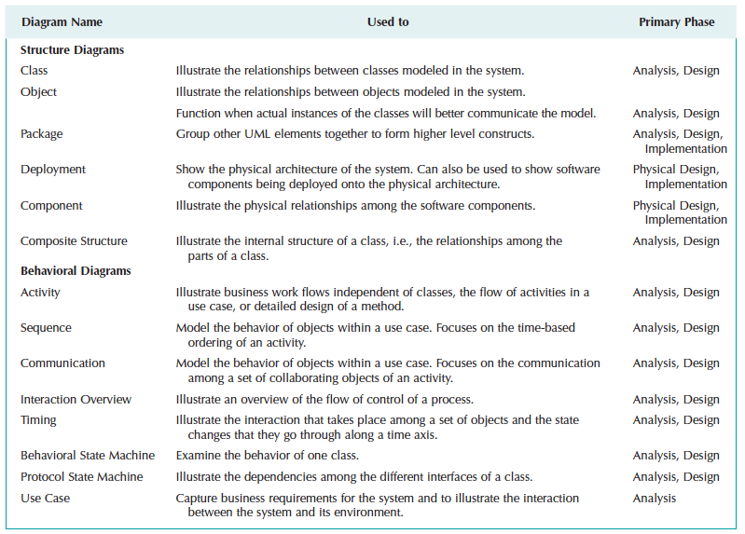
UML v2.0 Diagram Summary

Slide 20
The Rational Unified Process (RUP)
Rational Software Corporation has created a methodology called the Rational Unified Process (RUP) that define how to apply UML.
RUP emphasizes iterative, incremental development, and prototyping.

Slide 21
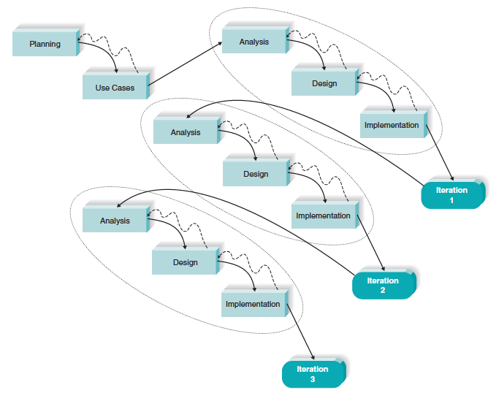
The Rational Unified Phased Develoment Process

Slide 22
Four Fundamental UML Diagrams
Four UML diagramming techniques dominate the object-oriented projects:
Use case diagrams,
Class diagrams,
Sequence diagrams, and
Behavior state machine diagrams.

Slide 23
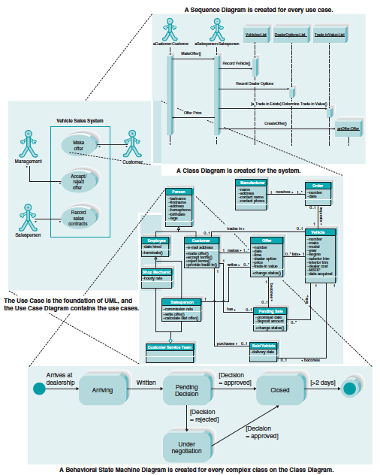
Integration of the Four UML Diagrams

Slide 24
Use Case Diagram
Foundation of UML diagrams

Slide 25
USE CASE DIAGRAM
A use case diagram summarizes all of the use cases (for the part of the system being modeled) together in one picture
use case diagram elements:
Actor
Name
System Boundary
Association Relationship

Slide 26
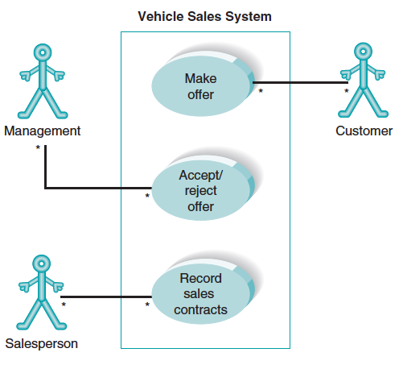
Use Case Diagram

Slide 27
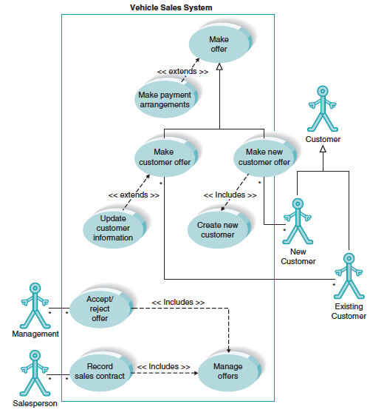
Use Case Diagram with Extends and Includes Associations

Slide 28
Creating a Use Case Diagram
Steps in creating a use case diagram
1. Identify use cases.
2. Draw the system boundary.
3. Place the use cases on the diagram.
4. Identify the actors.
5. Add association relationships.

Slide 29
Class Diagram
A static view of classes

Slide 30
CLASS DIAGRAM
The class diagram is a static model
Shows the classes and the relationships among the classes.
Elements of diagram include:
Classes
Attributes
Methods
Associations
Class is the main building block of a class diagram, which stores and manages information in the system.

Slide 31
(cont’d)
Operations are actions or functions that a class can perform.
There are three kinds of operations: constructor, query, and update.
Associations represent the relationships that classes have with one another.
Associations also have multiplicity, which shows how an instance of an object can be associated with other instances.

Slide 32
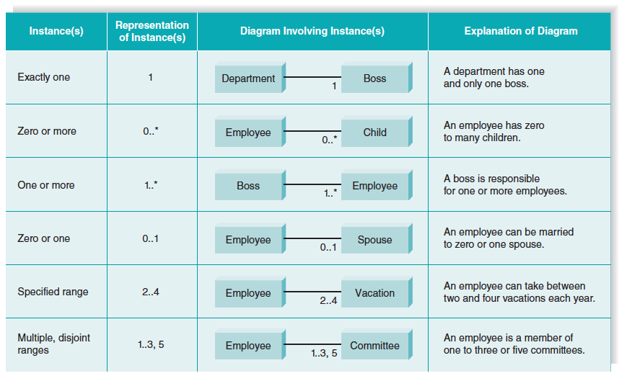
Multiplicity

Slide 33
Generalization and Aggregation
Generalization shows that one class (subclass) inherits from another class (superclass).
Aggregation is used when classes actually comprise other classes.

Slide 34
Simplifying Class Diagram
When the class diagram become very complex, it is sometimes necessary to simplify the diagram by using a view to limit the amount of information displayed.
Another approach to simplifying class diagram is through the use of package (i.e., logical groups of classes).

Slide 35
Creating a Class Diagram
Steps in creating a class diagram:
1. Identify classes.
2. Identify attributes and operations.
3. Draw associations between the classes,

Slide 36
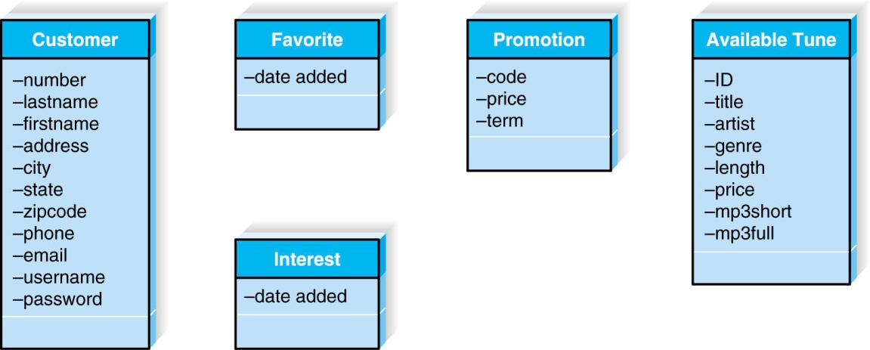
Creating a Class Diagram, con’t.
Example of initial attributes for class diagrams

Slide 37
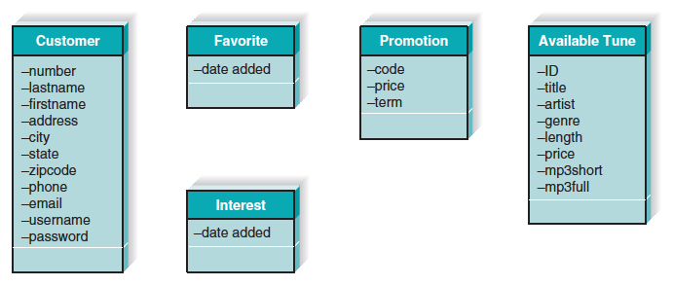
Class Diagram with Revisions

Slide 38
Sequence Diagram
Object message sequences

Slide 39
SEQUENCE DIAGRAM
Illustrates the objects that participate in a use case and the messages that pass between them over time for one use case.
a generic sequence diagram shows all possible scenarios of a use case,
A set of instance sequence diagrams are usually developed, each of which depicts a single scenario within the use case.

Slide 40
Elements of Sequence Diagram
Actor
Object
Lifeline
Focus of control
Message
Object destruction

Slide 41
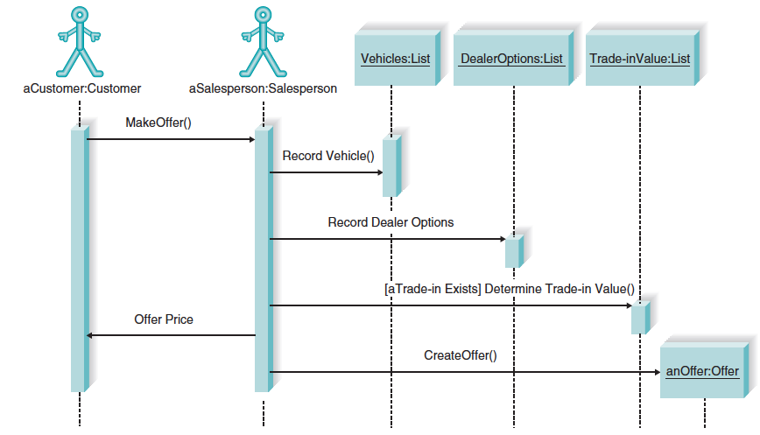
Sequence Diagram

Slide 42
Creating a Sequence Diagram
Steps in creating a sequence diagram
1. Identify objects.
2. Add messages.
3. Place lifeline and execution occurrences.

Slide 43
Behavioral State Machine Diagram
Showing dynamic states of classes

Slide 44
Behavioral State Machine Diagram
A dynamic model showing the different states that a single class passes through during its life in response to events, along with its responses and actions.
Typically, used to further define complex classes to help simplify the design of algorithms for their methods.

Slide 45
Elements of a Behavioral State Machine Diagram
A state
An initial state
A final state
An event
A transition

Slide 46
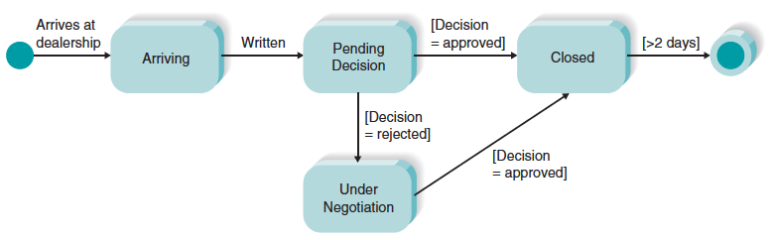
Behavioral State Machine Diagram

Slide 47
Creating a Behavioral State Machine Diagram
Steps in creating a behavioral state machine diagram:
1. Identify the states.
2. Identify the transitions.

