Slide 1
Database 2
Abdifataah Yassen Yousof

Slide 2
What is Database?
- A database is a structured collection of data that is organized and stored in a way that allows for efficient retrieval, management, and manipulation of information.
- Databases are used to store and manage large amounts of data in a secure and organized manner.

Slide 3
History of Databases
Databases have changed significantly over the past several decades.
Early databases were hierarchical or network-based, but these were limited in their flexibility and scalability.
The relational database model, introduced in the 1970s, revolutionized data management and became the dominant approach.

Slide 4
Hierarchical databases
A hierarchical database is a type of database that organizes data in a tree-like structure, with each record or data element being linked to one or more other records or data elements. In a hierarchical database, data is stored in a parent-child relationship, with a parent record being linked to one or more child records.

Slide 5
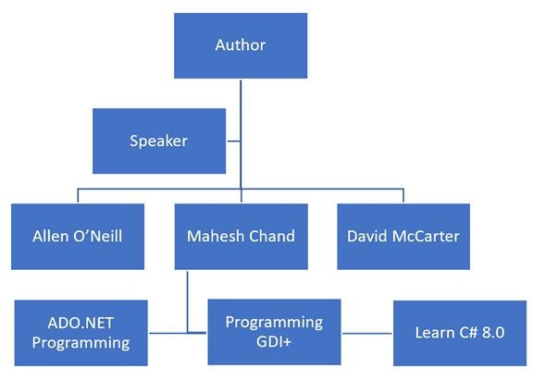
Hierarchical databases

Slide 6
Relational Databases
- Relational databases are the most common type of database.
- In a relational database, data is stored in tables, which are similar to spreadsheets with rows and columns.
- The tables are related to each other through the use of keys, which allow data to be linked and queried across multiple tables.

Slide 7
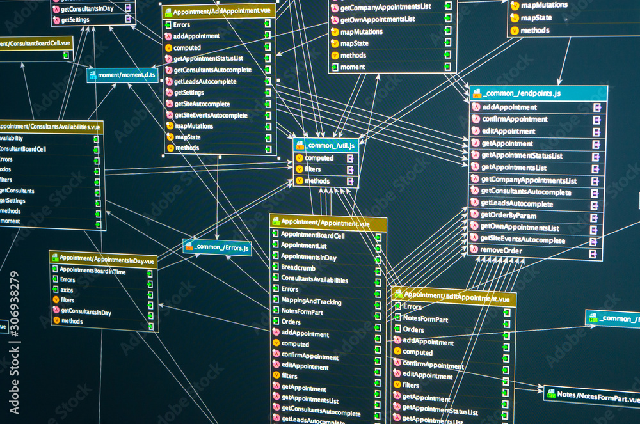
Relational Databases

Slide 8
: SQL (Structured Query Language)
SQL is the standard language used to interact with and manage relational databases.
SQL allows users to create, modify, and delete databases and tables, as well as insert, update, and retrieve data.
SQL is a declarative language, which means you tell the database what you want to do, and the database figures out how to do it.

Slide 9
Database Management Systems (DBMS)
- A DBMS is a software application that allows users to create, manage, and interact with databases.
- Examples of popular DBMS include MySQL, PostgreSQL, Oracle, Microsoft SQL Server, and SQLite.
- DBMS provide features such as data security, transaction management, and backup and recovery.

Slide 10
Why Learn SQL?
- SQL is a fundamental skill for data professionals, including data analysts, data scientists, and database administrators.
- SQL knowledge is in high demand across various industries, as it is the primary language used to interact with and manage relational databases.
- Understanding SQL can open up a wide range of career opportunities and allow you to work with large and complex datasets.

Slide 11
Database Schema
The database schema is the structure of the database, which defines the tables, columns, and relationships between them.
- The schema is created using SQL commands such as `CREATE TABLE` and `ALTER TABLE`.
- A well-designed schema is crucial for the efficient and effective management of data.

Slide 12
Tables
- Tables are the basic building blocks of a relational database.
- Tables are composed of rows (records) and columns (fields).
- Each column has a specific data type, such as `INTEGER`, `VARCHAR`, or `DATE`.

Slide 13
Primary Keys and Foreign Keys
- A primary key is a unique identifier for each row in a table.
- Primary keys ensure that each row in a table is unique and can be easily identified.
- A foreign key is a column or a set of columns in a table that refers to the primary key of another table, establishing a relationship between the two tables.

Slide 14
Queries
- Queries are the commands used to interact with and manipulate data in a database.
- The most common SQL queries include `SELECT`, `INSERT`, `UPDATE`, and `DELETE`.
- Queries can be simple (selecting all data from a table) or complex (joining multiple tables and applying filters).

Slide 15
SELECT Statement
- The `SELECT` statement is used to retrieve data from a database.
- It allows you to specify which columns you want to retrieve, and optionally filter the data using `WHERE`, `ORDER BY`, and other clauses.
- Example: `SELECT name, email FROM users WHERE age > 30;`

Slide 16
INSERT, UPDATE, and DELETE Statements
- The `INSERT` statement is used to add new data to a table.
- The `UPDATE` statement is used to modify existing data in a table.
- The `DELETE` statement is used to remove data from a table.

Slide 17
Joins
- Joins are used to combine rows from two or more tables based on a related column between them.
- Common types of joins include `INNER JOIN`, `LEFT JOIN`, `RIGHT JOIN`, and `FULL JOIN`.
- Joins allow you to retrieve data from multiple tables in a single query.

Slide 18
Aggregation Functions
Aggregation functions are used to perform calculations on multiple rows and return a single value.
- Examples include `SUM`, `AVG`, `COUNT`, `MAX`, and `MIN`.
- Aggregation functions are often used in combination with `GROUP BY` to group data by one or more columns.

Slide 19
Subqueries
- Subqueries are queries that are nested within other queries.
- Subqueries can be used in the `SELECT`, `FROM`, `WHERE`, or `HAVING` clauses of a query.
- Subqueries allow for more complex and powerful database queries.

Slide 20
Indexes
- Indexes are data structures that improve the speed of data retrieval from a database.
- Indexes can be created on one or more columns in a table.
- Indexes can significantly improve the performance of queries, especially for large datasets.

Slide 21
Transactions
- Transactions are a sequence of database operations that must be completed as a single unit.
- Transactions ensure data integrity and consistency by guaranteeing that all operations in the transaction are either completely successful or completely rolled back.
- Transactions are a fundamental feature of ACID-compliant databases.

Slide 22
Database Security
- Database security is essential to protect data from unauthorized access, modification, or deletion.
- Security measures include user authentication, access control, encryption, and backup and recovery procedures.
- Best practices for database security should be implemented to ensure the confidentiality, integrity, and availability of data.

Slide 23
What Students Need to Install
SQL
Visual studio code

Slide 24
Conclusion
- SQL databases are the backbone of many modern applications and have been widely adopted across various industries.
- Understanding the fundamentals of SQL databases, including concepts like tables, queries, joins, and security, is crucial for anyone working with data.
- Continuous learning and staying up-to-date with the latest developments in database technology is important for data professionals.

