Slide 1
Sql joins

Slide 2
What is SQL join?
A JOIN clause is used to combine rows from two or more tables, based on a related column between them.

Slide 3
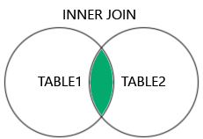
Inner join

Slide 4
This is the most common type of join. It returns only the rows that have matching values in both tables.

Slide 5
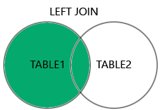
Left join

Slide 6
This returns all rows from the left table, and the matching rows from the right table. If there is no match, the result will contain null values for the right table columns.

Slide 7
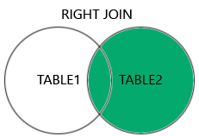
Right join

Slide 8
This returns all rows from the right table, and the matching rows from the left table. If there is no match, the result will contain null values for the left table columns.

Slide 9
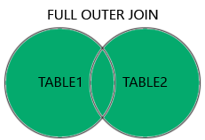
Full outer join

Slide 10
This returns all rows from both tables, whether or not there is a match. If there is no match, the result will contain null values for the missing columns.
You can combine two tables using joins based on a foreign key column. This is a common way to retrieve data from multiple tables and establish relationships between them.

Slide 11
To identify the right and left tables for a join, examine the table structures and relationships. The table with the foreign key is typically the "right" table, while the table with the primary key is the "left" table for a LEFT JOIN.
For a RIGHT JOIN, the table with the foreign key is the "left" table, and the table with the primary key is the "right" table.

