Slide 1
Introduction to Django
Lec: Abdifatah Yasin Yusuf

Slide 2
What is Django?
Django is a high-level, Python-based web framework.
Designed for rapid development and clean design.

Slide 3
Provides many built-in tools (batteries included), such as:
Admin interface
Authentication system
URL routing
ORM (Object Relational Mapper)

Slide 4
What is Framework
A framework is a set of tools and structure that helps you build software faster and more easily. In web development, a framework like Django gives you pre-made parts (like login, database handling, etc.) so you don’t have to start from scratch.

Slide 5
Django vs Flask
Django: All-in-one framework. Great for big websites. Comes with lots of built-in tools (like admin panel, login system). Less flexible but faster to build full apps.
Flask: Lightweight and flexible. Great for small apps or APIs. You build most things yourself by adding extensions

Slide 6
Choose Django if you want everything ready.
Choose Flask if you want more control and simplicity.

Slide 7
“Batteries included” means Django provides these powerful features by default, saving you the effort of building them yourself or installing third-party packages.
Analogy:
Just like a toy that comes with batteries included works right out of the box, Django provides everything you need to build a web application without needing to install extra tools for common tasks

Slide 8
History of Django
1. Origin (2003–2005)
Django was created in 2003 by Adrian Holovaty and Simon Willison.
They were working at a newspaper company called Lawrence Journal-World in Kansas, USA.
They needed a tool to build web applications quickly to publish news online.
Over time, they developed a set of reusable components (e.g. for admin, database, routing).

Slide 9
Open Source Release (2005)
In July 2005, Django was released as open-source software.
It was named after Django Reinhardt, a famous jazz guitarist 🎸.
The release allowed developers around the world to use and improve it.

Slide 10
Rapid Growth (2005–2010)
Django gained popularity because it helped developers build secure and maintainable web applications fast.
The "batteries included-packages" approach meant you didn’t need to install many extra tools.
Used by startups and media companies (like The Washington Post, Instagram later).

Slide 11
4. Django Software Foundation (DSF) – 2008
The Django Software Foundation was created to manage development, support the community, and protect the Django trademark.

Slide 12
Who was djnago?
Django is named after Django Reinhardt, a famous jazz guitarist from the early 20th century. 🎸
The creators of Django (the web framework) were fans of Django Reinhardt's music. They admired his creativity, skill, and the way he developed a unique and efficient style, even with physical limitations (he played guitar with only two fingers on his left hand after an injury).
That spirit of elegance, efficiency, and innovation inspired the framework's name.
So, while Django (the framework) has nothing to do with music directly, it's named in honor of someone who was a master of his craft—just like Django aims to be for web development.

Slide 13
Major Django Milestones
Django 1.0 (2008) – First big release with a stable structure and a growing community of users.
Django 2.0 (2017) – Stopped working with old Python 2; now fully uses modern Python 3.
Django 3.0 (2019) – Let developers build faster, more flexible websites using async (non-blocking) views.
Django 4.0 and 4.2 (LTS) – Brought in new web features, better speed, and long-term support (LTS = supported for a longer time).

Slide 14
Why Django?
Used by major companies: Instagram, Pinterest, Spotify, Mozilla.
Great documentation and community support.
Written in Python, so Python knowledge is a plus

Slide 15
Clean, readable code.
Great admin panel (comes built-in).
Strong security features.
Massive community support.
Reliable for small and large-scale projects.

Slide 16
Prerequisites for Learning Django
1. 🐍 Python (Basics to Intermediate)
Variables, data types, loops, functions
Classes and objects (OOP – Object-Oriented Programming)
List/dict comprehensions, decorators (optional but helpful

Slide 17
2. 🌐 HTML, CSS (Basics)
Structure a web page (HTML)
Style it a little (CSS)

Slide 18
3. 💡 Basic Understanding of Web Concepts
What is a client & server
What is a URL, HTTP request/response
What is a database

Slide 19
4. 🗃️ Basics of Databases & SQL
Know what tables, rows, and columns are
How to write simple SQL queries (SELECT, INSERT)

Slide 20
5. ‍💻 Python Virtual Environments & Package Management
Use pip to install packages
Use venv or virtualenv to create virtual environments

Slide 21

Why Do We Need pip?
pip is Python’s package manager. You use it to install external libraries (tools or code others wrote) so you don't have to build everything from scratch.
Without pip, you'd have to manually download and set up everything — which is messy and slow.

Slide 22
Why Do We Need a Virtual Environment?
A virtual environment is like a clean, isolated box just for your project.
Why it's useful:
✅ Avoid conflicts:
Different projects might need different versions of Django or other libraries.
A virtual environment keeps each project separate.
✅ Keep your system clean:
Instead of installing packages globally (for all of Python), you install them only for one project.
✅ Easy to manage:
You can freeze all the project’s packages into a file (like requirements.txt) for easy sharing

Slide 23
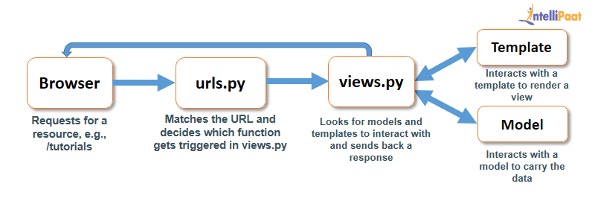
How django works

Slide 24
What is Architecture in Software?
Architecture in software refers to the overall design or structure of how a software application is built.
Think of it like the blueprint for a building – it defines how different parts of the application work together, such as:
How data flows
How components interact
Where the logic lives
How user input is handled

Slide 25
Django Architecture – MVT Pattern
Model: Manages data and database (like tables).
View: Contains the logic to get data and decide what to show.
Template: Displays the data as HTML pages to users.

Slide 26
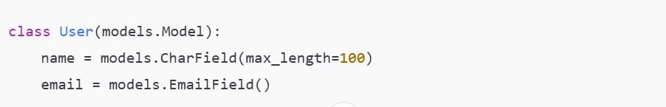
1. Model
What it is: The data layer.
What it does: Handles the database – defines the structure of your data.
Example: A User model with fields like name, email, password.

Slide 27
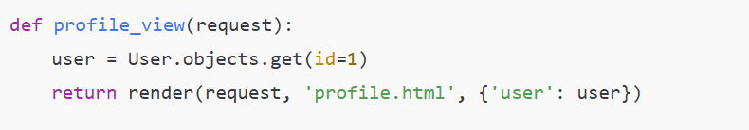
2. View
What it is: The logic layer.
What it does: Controls what data to show, and how to respond to a request.
Example: When someone visits a profile page, the view fetches the user info and sends it to the template.

Slide 28
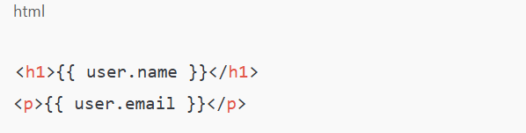
3. Template
What it is: The presentation layer.
What it does: Handles the HTML/UI – what the user actually sees in the browser.
Example: A template might show {{ user.name }} and {{ user.email }} on the.

Slide 29
Flow of Request in Django (MVT):
User request → URL routes to View → View processes → Model fetches data → Template shows the page

Slide 30
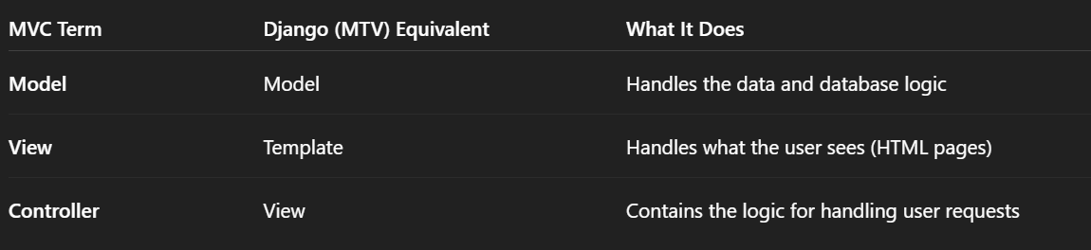
MVC vs MVT

Slide 31
Django uses MTV (Model–Template–View) instead of the more common MVC (Model–View–Controller) pattern, but the concept is basically the same — Django just names the parts a bit differently.

Slide 32
Why Django uses MTV:
Django’s creators wanted to emphasize the role each part plays in a web app, especially how "views" in Django control the logic rather than the user interface.

Slide 33
So:
The "View" in Django is actually the controller (it processes requests and returns responses).
The "Template" is what users see — like the view in MVC.
The Model is the same in both.

Slide 34
Web Framework Overview
Web Frameworks:
Client-Side: React, Angular, Vue
Server-Side: Django (Python), Express (JS), Rails (Ruby), ASP.NET

Slide 35
Benefits of Web Frameworks:
Security
Efficiency
Cost-effective

Slide 36
Why Do We Need a Backend?
Stores and manages data (users, courses, posts, etc.)
Processes user actions (like submitting forms, clicking buttons)
Handles business rules (who can do what, calculations, workflows)
Manages authentication & authorization (login, permissions)
Communicates with databases and other services (emails, payments, APIs)
Sends responses back to the frontend (web pages, JSON data)

Slide 37
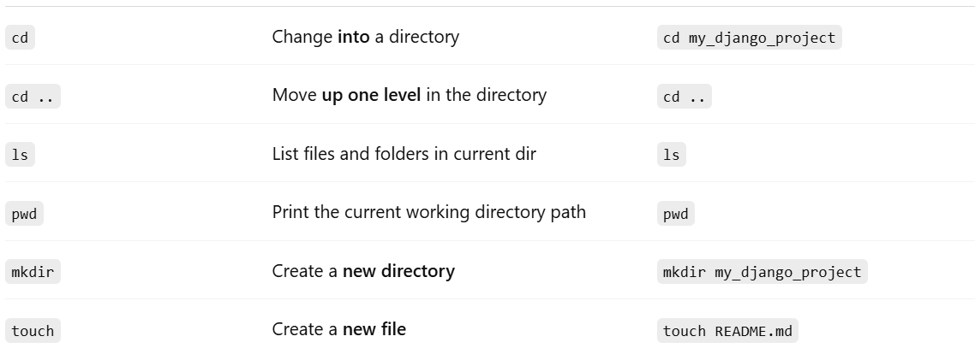
Basic shell commands

Slide 38
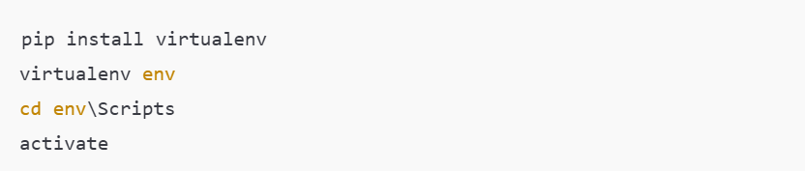
Django Installation (Step-by-Step)
Install Python
Create virtual environment:

Slide 39
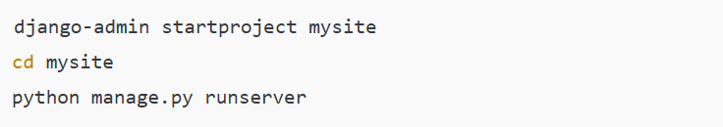
Create Django Project

Slide 40

Django App vs Project
Project: The entire e-learning website.
Apps: Like modules — each one handles a specific feature of the site.

Slide 41
Example Apps for E-Learning:
Courses – Manages course content and lessons.
Users – Handles login, registration, and profiles.
Enrolments – Tracks who joins which courses.
Quizzes – Allows quizzes and tests.
Discussions – Forum or comments for course discussion.
(Optional) Payments, Notifications, etc.

Slide 42
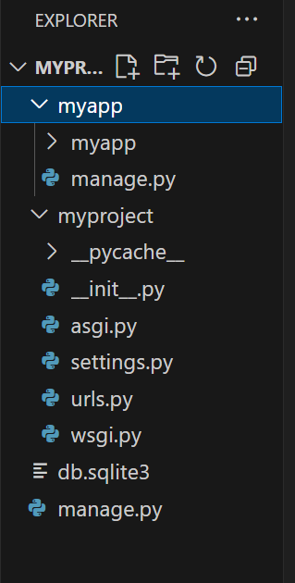
Django Project structure

Slide 43
The main folders
myproject/ → This is your Django project folder. It holds configuration files for the whole site (things like settings, URLs, etc.).
myapp/ → This is a Django app you created inside the project. Apps are like small modules that do one job (e.g., a blog, a shop, a user system).
__pycache__/ → This stores automatically generated Python cache files to make your app run faster. You can ignore it.

Slide 44
2. Important files in myproject/
__init__.py → Marks this folder as a Python package. Without it, Python wouldn’t treat myproject as a module.
asgi.py → Handles ASGI (Asynchronous Server Gateway Interface). This is used for real-time features like WebSockets. You can leave it alone unless you know you need async features.

Slide 45
asgi.py and wsgi.py
These help your project run on a server:
wsgi.py → for normal web servers
asgi.py → for modern servers that can do real-time stuff like chat

Slide 46
settings.py → The heart of your project’s configuration:
Database connection
Installed apps
Middleware(Middleware in Django is a small piece of code that runs on every request and response to add checks, security, or extra features.)
Debug mode
Static files settings

Slide 47
urls.py → Controls which page loads for which URL. Think of it as the map for your website.
wsgi.py → Handles WSGI (Web Server Gateway Interface). This is for traditional request-response websites and is used when deploying to production.

Slide 48
3. Important files in the root folder
db.sqlite3 → Your default SQLite database. It stores your site’s data when you’re in development mode.
manage.py → A command-line tool for running tasks like:
Starting the development server (python manage.py runserver)
Making migrations (python manage.py makemigrations)
Creating superusers, etc.

Slide 49
4. Inside myapp/
This will contain:
models.py → Defines your database tables (in Python class form).
views.py → Contains functions/classes that handle what is shown when someone visits a page.
urls.py (optional) → Handles URLs for this app specifically.

Slide 50
templates/ → HTML templates for pages.
admin.py → Registers models so they appear in Django’s admin panel.

Slide 51
What is URL Mapping
In Django, URL mapping (also called URL routing) is the process of connecting a URL entered in the browser to the appropriate view function (or class-based view) in your Django project.
It defines which function should handle a given request URL.

Slide 52
How it works
When a user enters a URL in the browser, Django checks the URL patterns defined in your project’s urls.py file(s).
It matches the URL against these patterns in order (top to bottom).
When a match is found, Django calls the associated view function.
The view processes the request and returns an HttpResponse (like HTML, JSON, etc.).

Slide 53
Most Commonly Used Django URL Functions
One app → just use path().
Multiple apps → use include() in the main urls.py to connect each app’s own URLs.

Slide 54
http request and response
An HTTP request is sent from your browser to ask a website’s server for something (like a page or image).
The server processes the request and sends back an HTTP response with what you asked for (or an error).
It’s like asking a question (request) and getting an answer (response).

Slide 55
Simple Analogy:
Think of it like ordering food at a restaurant:
You (client) ask the waiter (HTTP request) for a dish (e.g., pizza).
The kitchen (server) prepares it and brings it back (HTTP response) with a message like "Order ready!" (status code 200) or "Out of stock" (status code 404).

Slide 56
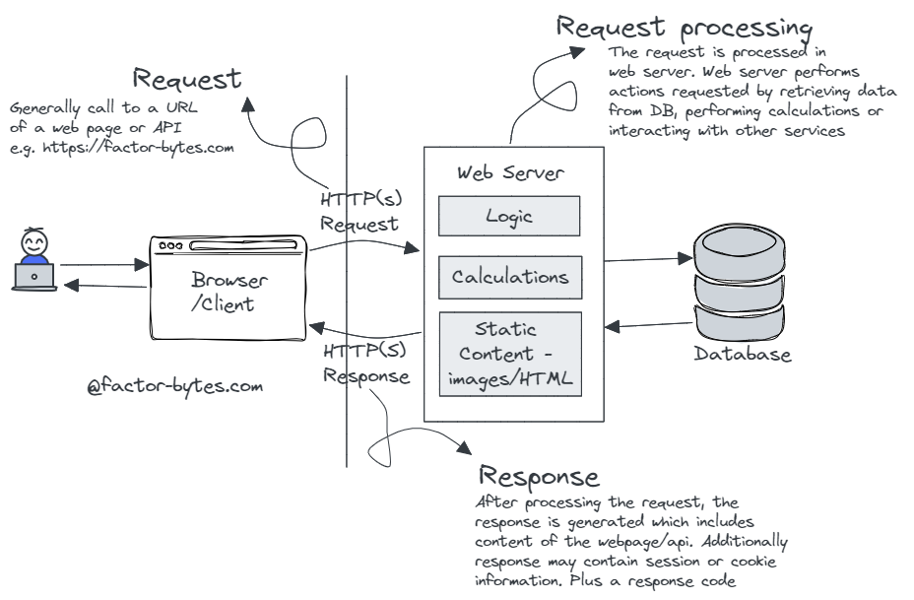

Slide 57
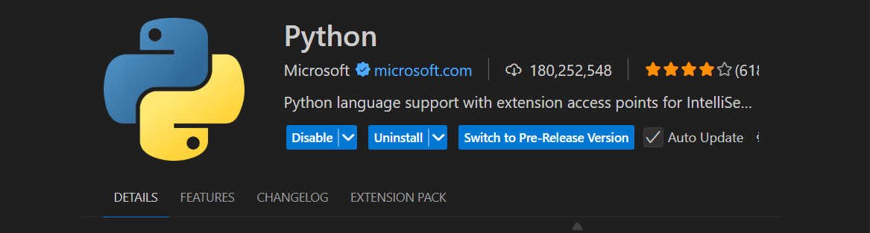
Vs code extension

Slide 58
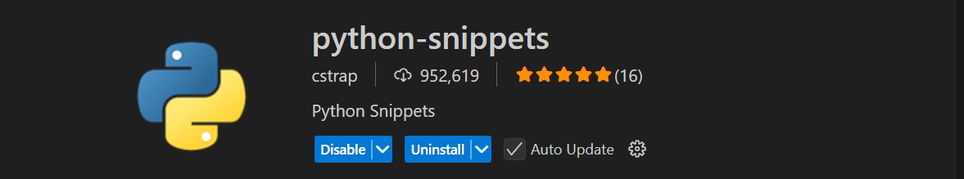

Slide 59
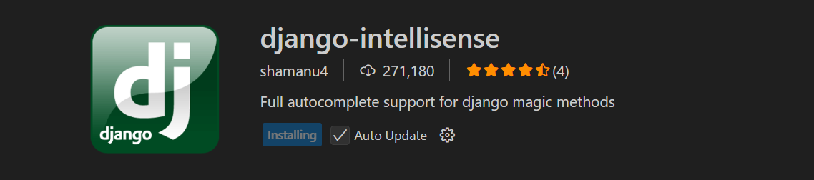

Slide 60
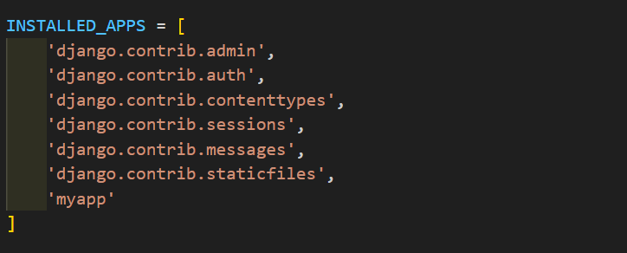
Create Your first App

Slide 61
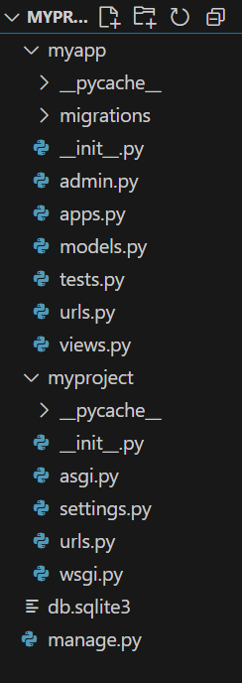
Add urls.py into your app folder

Slide 62
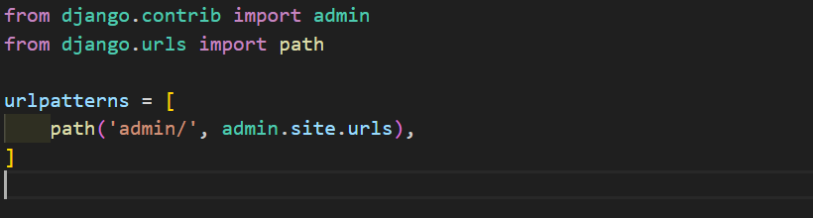
Copy urls.py from your project to your app

Slide 63
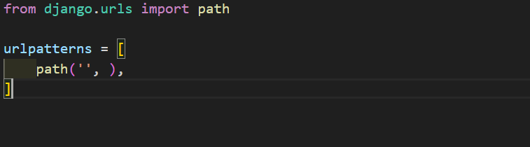
Remove admin part

Slide 64
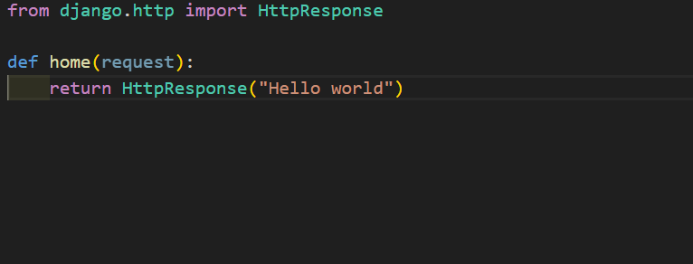
Go your views.py and write this code

Slide 65
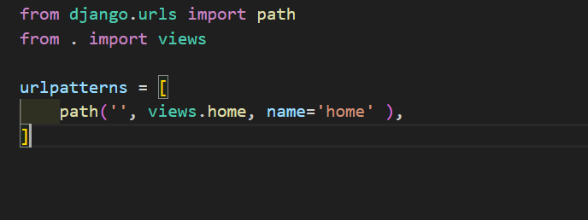
Import the home function from views into your app's urls.py file.

Slide 66
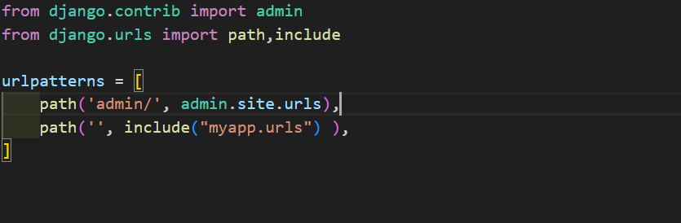
Import include function to your project urls.py

