Slide 1
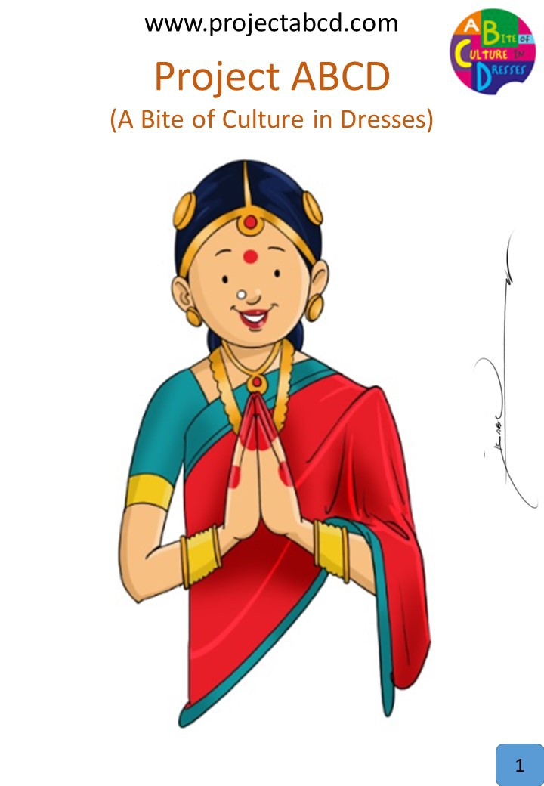
Namasthe
Description:
Namasthe is a customary, non-contact form of Hindu greeting. Namaste is usually spoken with a slight bow and hands pressed together, palms touching and fingers pointing upwards. Namaste is used as a form of greeting, acknowledging, and welcoming a relative, guest, or stranger. In some contexts, it can be used to express gratitude for assistance offered or given and to thank people for their generosity.
Fun Fact:
The gesture of joining both hands has more than a symbolic meaning. It is said to provide a connection between the right and left hemispheres of the brain thus representing unification.

