Slide 1
THESIS DEFENSE
Design and Implementation of a Web-Based
Research Management System for Jamhuriya University
[Your Full Name] | [Student ID]
[Supervisor Name] | JUST | [Date]
Notes:
Assalaamu caleykum. Magacaygu waa [magacaaga]. Maanta waxaan u soo bandhigi doonaa thesis defense-kayga: Jamhuriya Research Management System.

Slide 2
1. INTRODUCTION
Introduction
Universities manage research: proposals, ethics, funding, projects, publications, thesis
Digital transformation improves efficiency, transparency, and accountability
Jamhuriya University (JUST) needs an integrated web platform
This project: Jamhuriya Research Management System (JUST RMS)
Full lifecycle: idea → proposal → ethics → review → project → grant → finance → publication → repository
Jamhuriya RMS — Thesis Defense
Notes:
Hordhac: JUST waxay u baahan tahay nidaam isku xiran oo web ah.

Slide 3
1. INTRODUCTION
System Overview
Web application (browser-based — mobile app out of scope)
MERN stack: MongoDB, Express 5, React 19, Node.js
RBAC + JWT authentication — five roles + Leadership (peer review)
Dual portal: Undergraduate (UG) and Postgraduate (PG)
GitHub: github.com/Abdisalam114/research-management-systems
Jamhuriya RMS — Thesis Defense
Notes:
MERN stack, shan role + Leadership, laba portal UG/PG.

Slide 4
2. PROBLEM STATEMENT
Problem Statement
Paper forms, email attachments, and Excel spreadsheets
No single system from proposal to publication / thesis
Duplicate data entry and lost documents
Slow approval chains: peer → committee → director → finance
Weak financial tracking: grants, budgets, payments disconnected
Poor institutional reporting for leadership and donors
Impact: delays research, reduces transparency, weakens accountability
Jamhuriya RMS — Thesis Defense
Notes:
Dhibaatada: warqado, email, Excel — xog way lumaan, ansixintu way gaabisataa.

Slide 5
3. OBJECTIVES
Objectives (Chapter I)
AIM: Design and develop a web-based RMS that improves efficiency and management of research activities at JUST
O1: Identify challenges of current research management methods
O2: Design a centralized database for secure research information storage
O3: Develop a web-based RMS (proposals, tracking, document management)
O4: Implement reporting and communication for researcher–administrator coordination
O5: Evaluate usability and performance of the proposed system
Jamhuriya RMS — Thesis Defense
Notes:
Shan ujeeddo Chapter One — challenges, database, develop, reporting, evaluation.

Slide 6
4. RESEARCH QUESTIONS
Research Questions
RQ1: What challenges are associated with current research management methods?
RQ2: How can a centralized database improve storage and management of research data?
RQ3: How can a web-based RMS be designed and developed for the institution?
RQ4: How can reporting and communication features improve coordination?
RQ5: How effective is the system in efficiency, usability, and accessibility?
→ Answered in Chapter V using Chapter IV implementation evidence
Jamhuriya RMS — Thesis Defense
Notes:
Shan su'aal cilmi baaris — jawaabtooda Chapter Four iyo Five.

Slide 7
5. RELATED WORK
Related Work
Commercial systems: Pure (Elsevier), Convergence / Symplectic Elements, national CRIS platforms
Literature themes: central repositories reduce duplication; workflow automation speeds approvals
RBAC protects sensitive grant and ethics data
Gap: many regional universities still use manual processes
Few open MERN-stack RMS tailored to JUST workflows (UG/PG + JUREC + thesis)
Jamhuriya RMS — Thesis Defense
Notes:
Related work: Pure, CRIS. Mashruucan wuxuu buuxiyaa farqiga JUST.

Slide 8
5. RELATED WORK
Contribution of This Study
Open-source JUST RMS on GitHub
18 MongoDB collections — full research lifecycle
Multi-stage review: peer, committee, finance, director
Extensions: JUREC ethics certificates, thesis supervision, in-app notifications
Automated project creation (proposal approval) and budget creation (grant award)
Jamhuriya RMS — Thesis Defense
Notes:
Contribution: nidaam furan, 18 collection, workflows automated.

Slide 9
6. METHODOLOGY
Methodology — Agile Development
Requirements: Chapter I problem, objectives, university module specification
System design: ERD (18 collections), REST API, React UI
Implementation: MERN stack — React 19 + Vite, Express 5, Mongoose 9
Testing: functional, integration smoke (verifyAllStakeholders.js), device compatibility
Deployment: local development + cloud-ready (Render / MongoDB Atlas)
Tools: Git/GitHub, JWT/bcrypt, Multer uploads, PDFKit reports
Jamhuriya RMS — Thesis Defense
Notes:
Agile: requirements → design → build → test → deploy.

Slide 10
6. METHODOLOGY
Architecture & Security
Three-tier: Browser (React) ↔ Express REST API ↔ MongoDB
Security: JWT access tokens • bcrypt passwords • RBAC middleware
programTier field isolates Undergraduate vs Postgraduate portal data
Testing (Chapter IV): black-box functional, unit-level rules, integration smoke
Device compatibility: desktop, tablet, mobile viewports
Informal load observation (formal JMeter not completed — limitation)
Jamhuriya RMS — Thesis Defense
Notes:
Architecture saddex heer. JWT + RBAC. Testing functional + device.

Slide 11
7. RESULTS AND DISCUSSION
System Delivered — Modules
1. Proposal Management (+ ethics JUREC, multi-stage review)
2. Project Management (auto-created on Director approval)
3. Grant & Funding Calls (internal/external, finance review)
4. Publications & Outputs (workflow pipeline)
5. Budget & Finance (payments, purchase orders)
6. Institutional Repository (+ OAI-PMH export)
7. Collaboration (research groups + messaging)
8. Analytics & Reporting (KPI, finance, donor, PDF)
Extensions: Thesis Supervision • Research Workflow • Notifications
Jamhuriya RMS — Thesis Defense
Notes:
Siddeed module + extensions. Auto project iyo auto budget.

Slide 12
7. RESULTS AND DISCUSSION
Key Workflows
Proposal: Submit → Peer → Committee → [Grant] Finance → Director → ★ PROJECT auto-created
Grant: Funding call → Apply → Approvals → ★ BUDGET auto-created → Payments/POs
Publication: Researcher submits → Director + Coordinator notified (full details in notification)
Ethics: REC form → Director issues JUREC certificate → Download from notifications
Thesis: Coordinator creates group (UG/PG) → Supervisor → Title → Chapters → Final document
Jamhuriya RMS — Thesis Defense
Notes:
Socodka proposal, grant, publication, ethics, thesis.

Slide 13
7. RESULTS AND DISCUSSION
Objective Achievement
Objective | Evidence | Status
O1 Challenges | Documented in Ch. I; system addresses manual gaps | Fully ✓
O2 Database | 18 MongoDB collections, JWT/RBAC, ER diagram | Fully ✓
O3 Web RMS | React UI + Express API + full lifecycle | Fully ✓
O4 Reporting | Dashboards, PDF, notifications, messaging | Fully ✓
O5 Evaluation | Manual/device tests; no Jest/JMeter formal suite | Partial ◐
Notes:
Afartii ugu horreysay fully achieved; objective 5 partially.

Slide 14
7. RESULTS AND DISCUSSION
Recent Improvements (2026)
Ethics: faculty → department dropdowns
Publish notification: Director + Coordinator receive full output details in-app
Document download in notifications: JUREC certificate + thesis final PDF
Thesis: duplicate email/ID/title blocked; UG/PG fix; supervisor assignment fixed
KPI Dashboard: clickable cards; Finance/Donor total money rows
Repository: fake seed items filtered from catalogue
Jamhuriya RMS — Thesis Defense
Notes:
Updates cusub GitHub commit 276e25c.

Slide 15
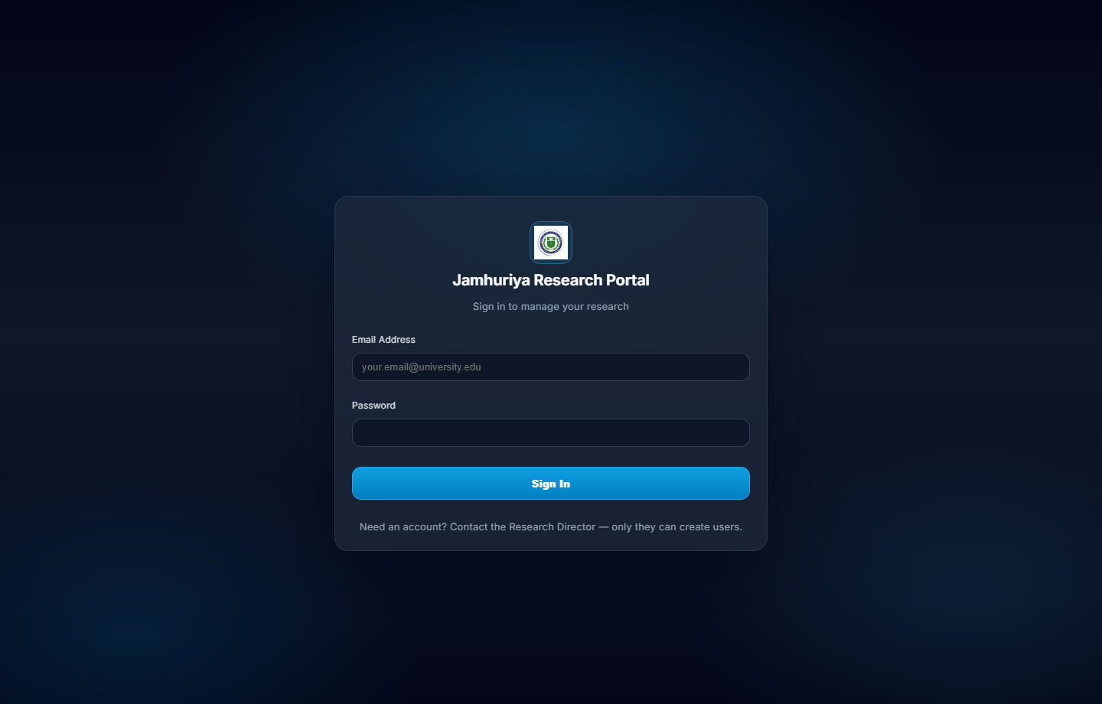
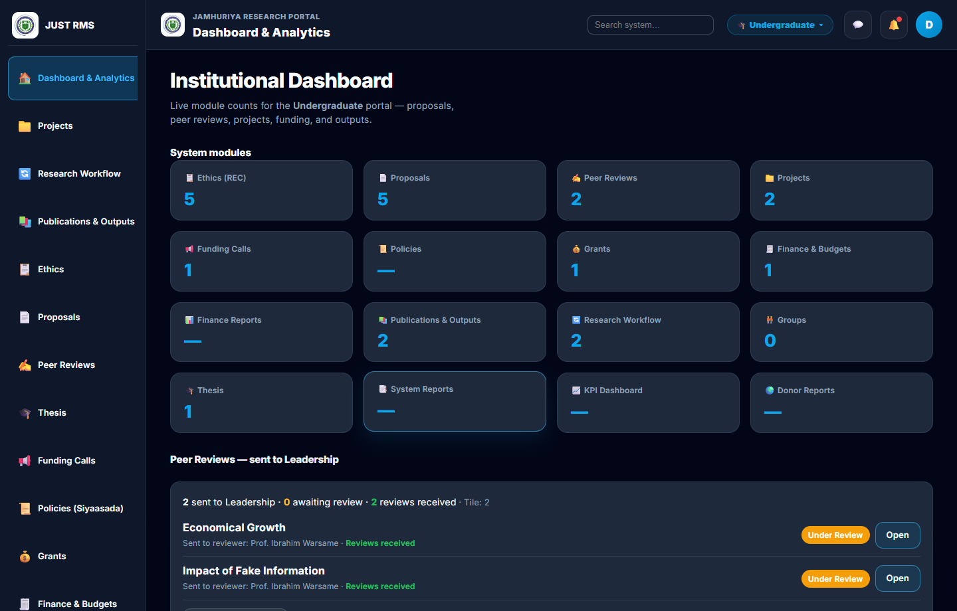
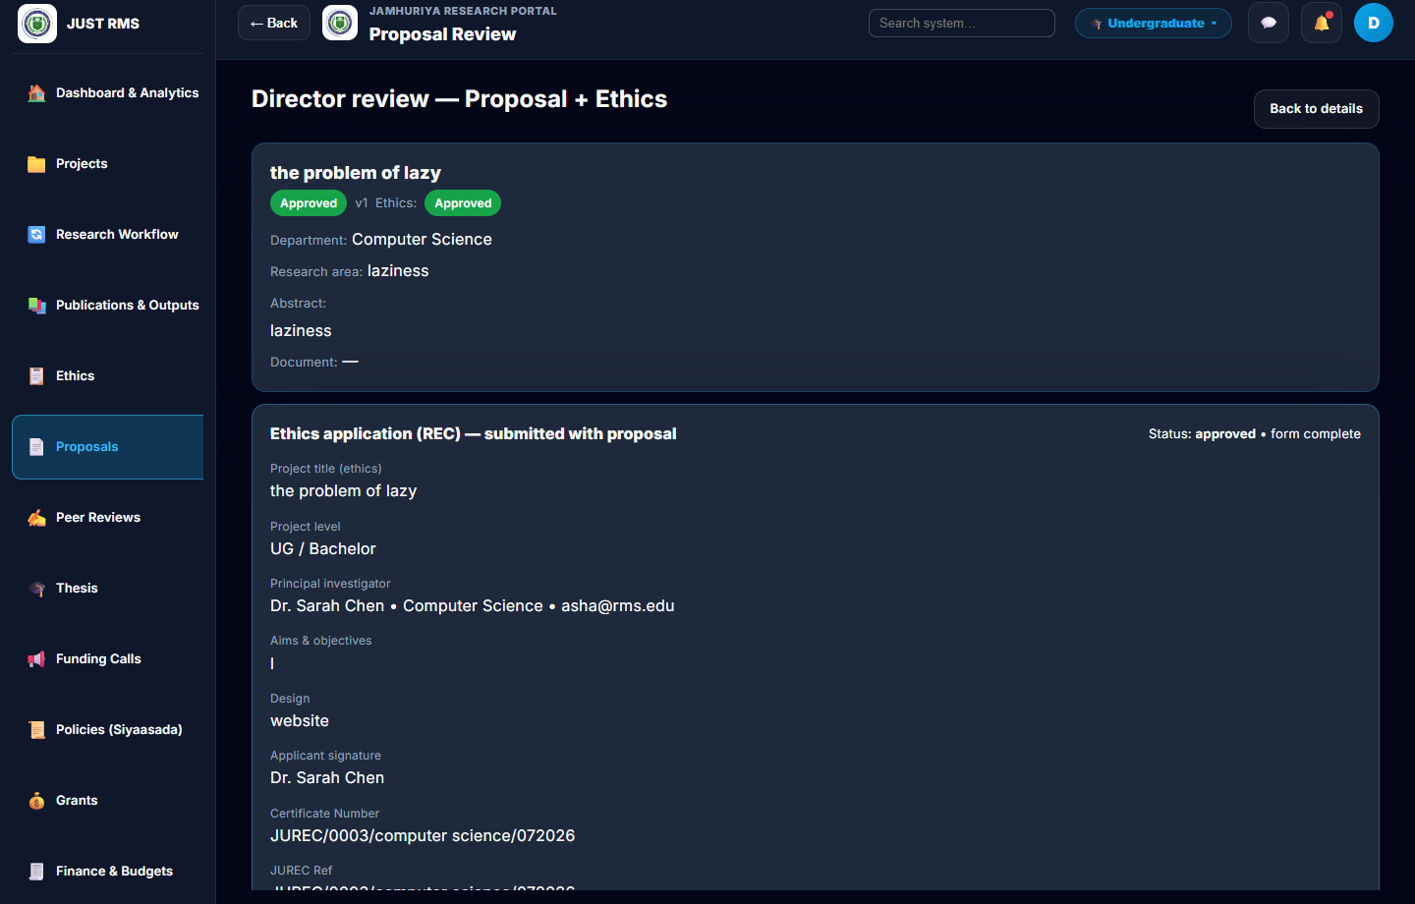
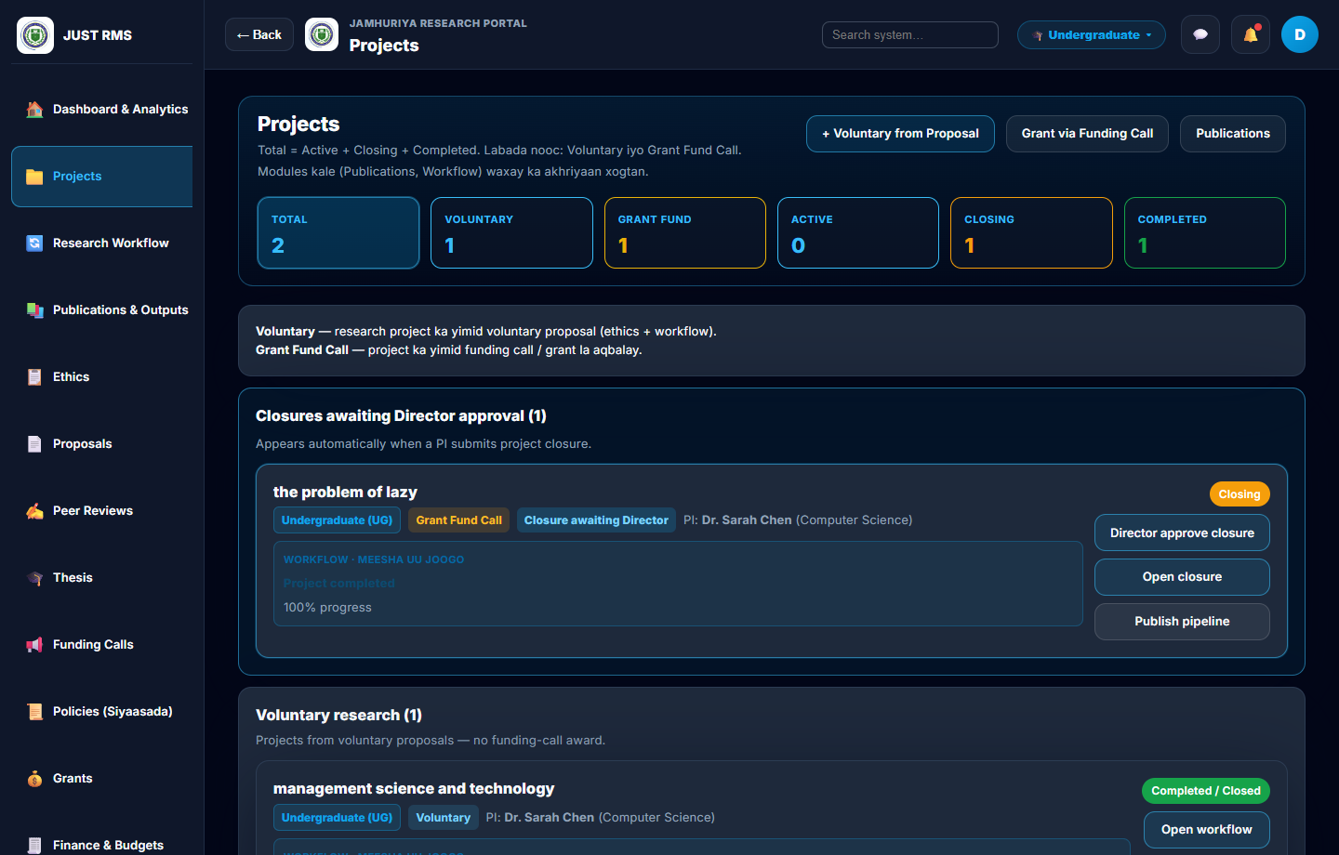
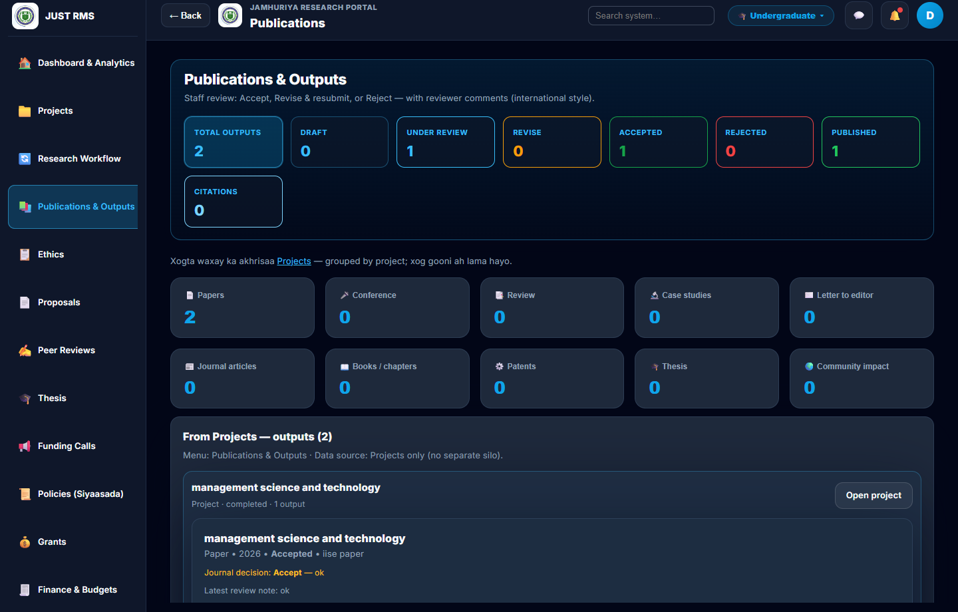
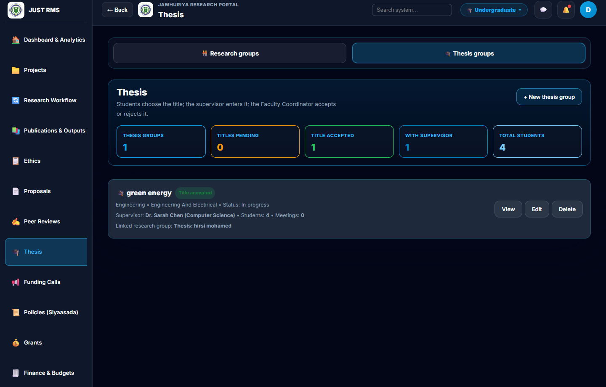
7. RESULTS AND DISCUSSION
Testing & Demo — System Screenshots
Login
Director Dashboard
Proposal Review
Projects
Publications
Thesis Supervision
Functional + integration tests verified ✓ | Demo: director@rms.edu / Director2024! | coordinator@rms.edu / Coordinator2024!
Notes:
Screenshots from Chapter IV (docs/fyp-chapter4-figures). Geli live demo haddii internet jiro.

Slide 16
8. CONCLUSIONS AND RECOMMENDATIONS
Conclusions
Complete web-based RMS successfully developed for JUST using MERN stack
Addresses Chapter I problem: fragmented manual research administration
Objectives 1–4 fully achieved; Objective 5 partially achieved
All five research questions answered with implementation evidence
Automated workflows reduce manual errors and improve transparency
System tested, documented, and ready for institutional pilot
Open source on GitHub for maintenance and extension
Jamhuriya RMS — Thesis Defense
Notes:
Gabagabo: nidaamka waa la dhisay, pilot diyaar.

Slide 17
8. CONCLUSIONS AND RECOMMENDATIONS
Recommendations
Add Jest/Vitest automated tests + formal load testing (JMeter) before production
Configure institutional SMTP for email notifications alongside in-app alerts
Professional penetration testing (OWASP) before public deployment
PWA or native mobile app for offline / push notification needs
Integrate with university student registration / finance systems long-term
Train staff per faculty for pilot rollout
Jamhuriya RMS — Thesis Defense
Notes:
Talooyin: tests, email, security, mobile mustaqbal, training.

Slide 18
THANK YOU
Questions & Discussion
GitHub: github.com/Abdisalam114/research-management-systems
Optional demo: Director login → Approve proposal → Notifications → Ethics → Thesis
Notes:
Mahadsanidiin! Su'aalo? Demo haddii internet jiro.

