Slide 1
JavaScript

Slide 2
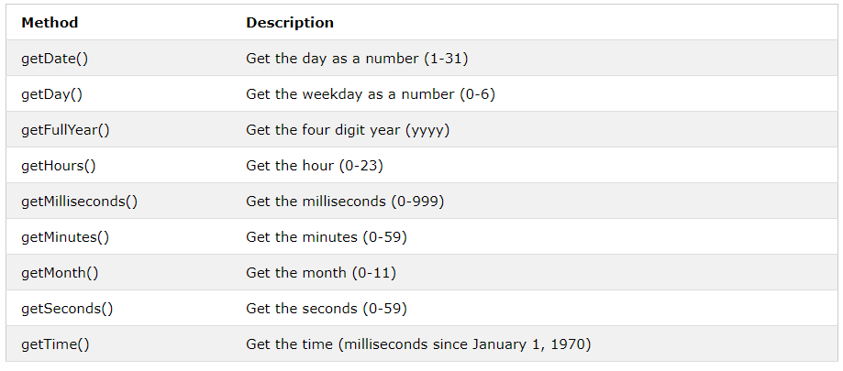
Date object convertions
d = new Date();

Slide 3
Example
<html>
<body>
<p>The internal clock in JavaScript starts at midnight January 1, 1970.</p>
<p>The getTime() function returns the number of milliseconds since then:</p>
<p id="demo"></p>
<script>
var d = new Date();
document.getElementById("demo").innerHTML = d.getDate();
</script>
</body>
</html>

Slide 4
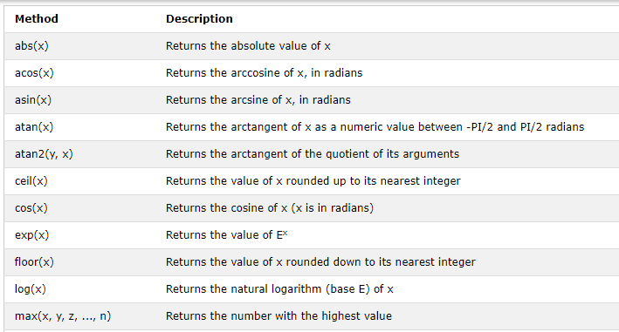
Math

Slide 5
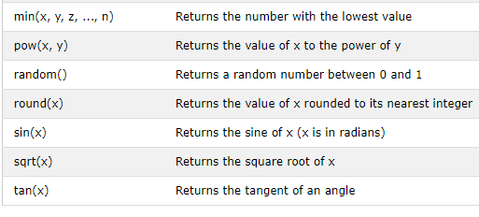
Contd.

Slide 6
Example
<html>
<body>
<h2>JavaScript Math.min()</h2>
<p>Math.min() returns the lowest value in a list of arguments:</p>
<p id="demo"></p>
<script>
document.getElementById("demo").innerHTML =
Math.min(0, 150, 30, 20, -8, -200);
</script>
</body>
</html>

Slide 7
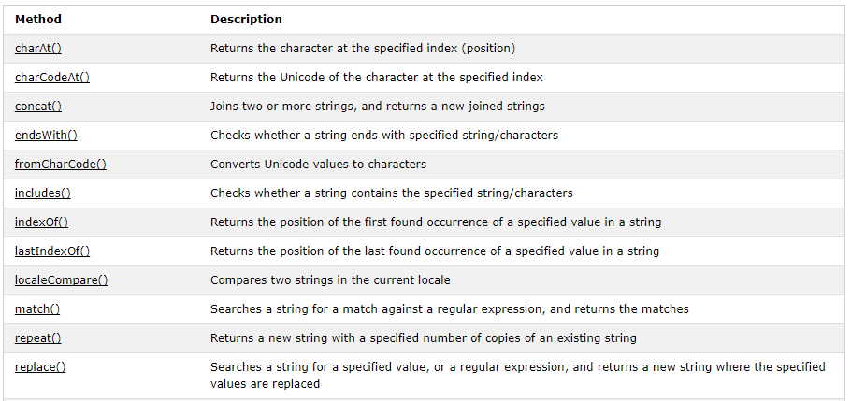
String methods

Slide 8
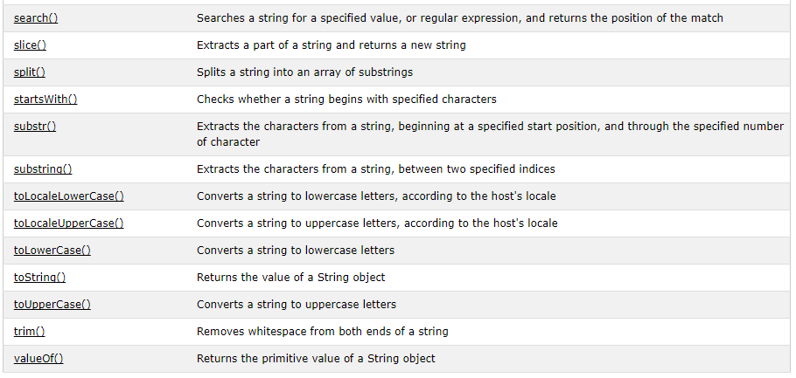
Contd.

Slide 9
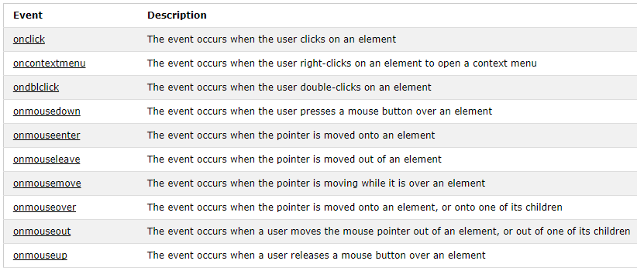
Events: Mouse Events

Slide 10
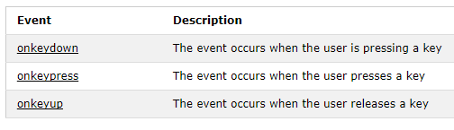
Events: Keyboard Events

Slide 11
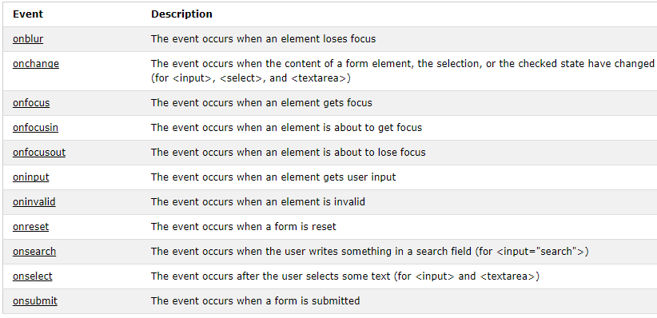
Events: Forms Events

Slide 12
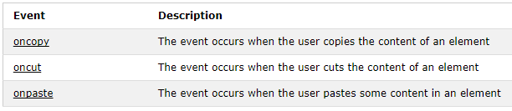
Events: Clipboard Events

Slide 13
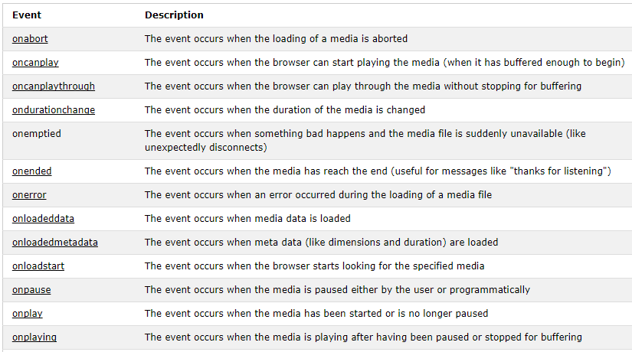
Media Events

Slide 14
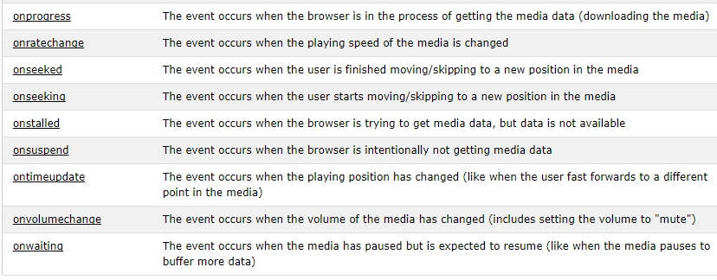
Contd.

Slide 15

Transition Events

Slide 16
The DOM tree

Slide 17
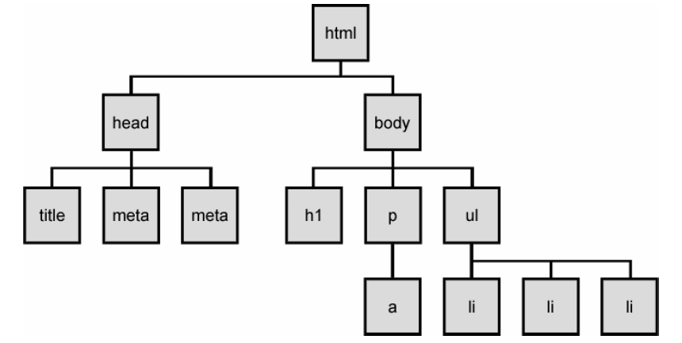
The DOM tree
Notes:
The elements of a page are nested into a tree-like structure of objects
the DOM has properties and methods for traversing this tree

Slide 18



Types of DOM nodes
<p>
This is a paragraph of text with a
<a href="/path/page.html">link in it</a>.
</p> HTML
element nodes (HTML tag)
can have children and/or attributes
text nodes (text in a block element)
attribute nodes (attribute/value pair)
text/attributes are children in an element node
cannot have children or attributes
not usually shown when drawing the DOM tree

Slide 19
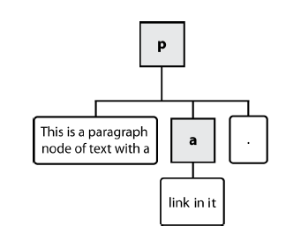
Types of DOM nodes
<p>
This is a paragraph of text with a
<a href="/path/page.html">link in it</a>.
</p> HTML

Slide 20
Traversing the DOM tree
name(s) | description
firstChild, lastChild | start/end of this node's list of children
childNodes | array of all this node's children
nextSibling, previousSibling | neighboring nodes with the same parent
parentNode | the element that contains this node
complete list of DOM node properties
browser incompatiblity information

Slide 21
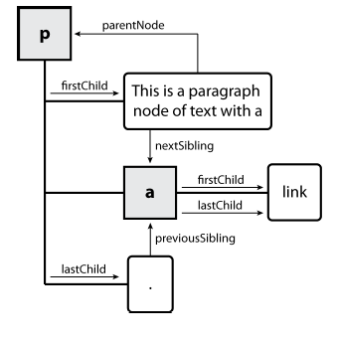
DOM tree traversal example
<p id="foo">This is a paragraph of text with a
<a href="/path/to/another/page.html">link</a>.</p> HTML

Slide 22
Elements vs text nodes
<div>
<p>
This is a paragraph of text with a
<a href="page.html">link</a>.
</p>
</div> HTML
Q: How many children does the div above have?
A: 3
an element node representing the <p>
two text nodes representing "\n\t" (before/after the paragraph)
Q: How many children does the paragraph have? The a tag?

Slide 23
Prototype's DOM element methods
absolutize | addClassName | classNames | cleanWhitespace | clonePosition
cumulativeOffset | cumulativeScrollOffset | empty | extend | firstDescendant
getDimensions | getHeight | getOffsetParent | getStyle | getWidth
hasClassName | hide | identify | insert | inspect
makeClipping | makePositioned | match | positionedOffset | readAttribute
recursivelyCollect | relativize | remove | removeClassName | replace
scrollTo | select | setOpacity | setStyle | show
toggle | toggleClassName | undoClipping | undoPositioned | update
viewportOffset | visible | wrap | writeAttribute
Notes:
categories: CSS classes, DOM tree traversal/manipulation, events, styles

Slide 24
Prototype's DOM tree traversal methods
method(s) | description
ancestors, up | elements above this one
childElements, descendants, down | elements below this one (not text nodes)
siblings, next, nextSiblings, previous, previousSiblings, adjacent | elements with same parent as this one (not text nodes)
Notes:
Prototype strips out the unwanted text nodes
notice that these are methods, so you need ()

Slide 25
Selecting groups of DOM objects
methods in document and other DOM objects for accessing descendants:
name | description
getElementsByTagName | returns array of descendents with the given tag, such as "div"
getElementsByName | returns array of descendants with the given name attribute (mostly useful for accessing form controls)

Slide 26
Getting all elements of a certain type
var allParas = document.getElementsByTagName("p");
for (var i = 0; i < allParas.length; i++) {
allParas[i].style.backgroundColor = "yellow";
} JS
<body>
<p>This is the first paragraph</p>
<p>This is the second paragraph</p>
<p>You get the idea...</p>
</body> HTML

Slide 27
Prototype's methods for selecting elements
var gameButtons = $("game").select("button.control");
for (var i = 0; i < gameButtons.length; i++) {
gameButtons[i].style.color = "yellow";
} JS
Prototype adds methods to the document object
(and all DOM element objects) for selecting groups of elements:
getElementsByClassName | array of elements that use given class attribute
select | array of descendants that match given CSS selector, such as "div#sidebar ul.news > li"

Slide 28
Creating new nodes
name | description
document.createElement("tag") | creates and returns a new empty DOM node representing an element of that type
document.createTextNode("text") | creates and returns a text node containing given text
// create a new <h2> node
var newHeading = document.createElement("h2");
newHeading.innerHTML = "This is a heading";
newHeading.style.color = "green"; JS
merely creating a node does not add it to the page
you must add the new node as a child of an existing element on the page...

Slide 29
Modifying the DOM tree
name | description
appendChild(node) | places given node at end of this node's child list
insertBefore(new, old) | places the given new node in this node's child list just before old child
removeChild(node) | removes given node from this node's child list
replaceChild(new, old) | replaces given child with new node
var p = document.createElement("p");
p.innerHTML = "A paragraph!";
Element.appendChild(p); JS

Slide 30
Removing a node from the page
function slideClick() {
var bullets = document.getElementsByTagName("li");
for (var i = 0; i < bullets.length; i++) {
if (bullets[i].innerHTML.indexOf("children") >= 0) {
bullets[i].remove();
}
}
} JS
each DOM object has a removeChild method to remove its children from the page
Prototype adds a remove method for a node to remove itself

Slide 31
Example: createElements
<html>
<head>
<script src=" https://ajax.googleapis.com/ajax/libs/prototype/1.7.0.0/prototype.js " type="text/javascript"></script>
<script src="paragraph.js " type="text/javascript"></script>
</head>
<body>
<div id="paragrapharea">
<button id="add">Add a paragraph</button>
</div>
</body>
</html>

Slide 32
HTML DOM Table Object
Getting:
Table.rows: Returns an array of all <tr> elements in a table
Table.rows[0].cells : Returns an array of all <td> and <th> elements in a a specific table row
insertRow(n): create a new row (<tr>) at the index n in the table (n starts from 0).
deleteRow(n): remove a row.
insertCell(n): create a new cell (<td>).
deleteCell(n): delete a cell.

Slide 33
Javascript Exercises
Create a webpage with an of Homer Simpson image at the center of the page. Develop a script that prints an alert: “Duh, you are hovering!!” every time the mouse crosses over the image.
Add 5 buttons to your webpage: red, yellow, green, black, and silver. Every time you click on one of these buttons the background should take the corresponding color.

