Slide 1
JavaScript
Building the interactivity

Slide 3
JavaScript
JavaScript is a front-end scripting language developed by Netscape for dynamic content
Lightweight, but with limited capabilities
Can be used as object-oriented language
Client-side technology
Embedded in your HTML page
Interpreted by the Web browser
Simple and flexible
Powerful to manipulate the DOM

Slide 4
What Can JavaScript Do?
Can handle events
Can read and write HTML elements and modify the DOM tree
Can validate form data
Can access / modify browser cookies
Can detect the user’s browser and OS
Can be used as object-oriented language
Can handle exceptions
Can perform asynchronous server calls (AJAX)

Slide 5
Using JavaScript Code
The JavaScript code can be placed in:
<script> tag in the head
<script> tag in the body – not recommended
External files, linked via <script> tag the head
Files usually have .js extension
Highly recommended
The .js files get cached by the browser
<script src="scripts.js">
<!– code placed here will not be executed! -->
</script>

Slide 6
JavaScript – When is Executed?
JavaScript code is executed during the page loading or when the browser fires an event
All statements are executed at page loading
Some statements just define functions that can be called later
Function calls or code can be attached as "event handlers" via tag attributes
Executed when the event is fired by the browser
<img src="logo.gif" onclick="alert('clicked!')" />

Slide 7
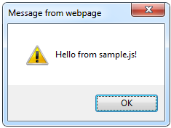
Using External Script Files
Using external script files:
External JavaScript file:
<html>
<head>
<script src="sample.js" type="text/javascript">
</script>
</head>
<body>
<button onclick="sample()" value="Call JavaScript
function from sample.js" />
</body>
</html>
external-JavaScript.html
The <script> tag is always empty.
function sample() {
alert('Hello from sample.js!')
}
sample.js

Slide 8
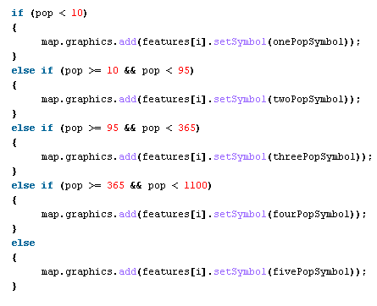

The JavaScript Syntax

Slide 9
JavaScript Syntax
The JavaScript syntax is similar to C# and Java
Operators (+, *, =, !=, &&, ++, …)
Variables (typeless)
Conditional statements (if, else)
Loops (for, while)
Arrays (my_array[]) and associative arrays (my_array['abc'])
Functions (can return value)
Function variables (like the C# delegates)

Slide 10
Debuging in console
To show the output of something in the console.log(var or value)

Slide 11
Data Types
Numbers (integer, floating-point)
Boolean (true / false)
String type – string of characters
Arrays
objects
var myName = "You can use both single or double quotes for strings";
var my_array = [1, 5.3, "aaa"]; // my_array[1]
var my_object = {a:2, b:3, c:"text"}; my_object.b

Slide 12
Multi-dimention array
X={ products: [“apple”,”banana”,”orange”]}
X.products[0]
X={ Ports:
[
{ COM4 : “Sudani modem”},
{COM5 : “Seagate HDD”},
{COM6 : “Aruino Uno”}
]
}
X.Ports[0].COM4

Slide 13
Local and global variables
Local declared with var
Global declared without var (attached to window object)
Local variable can be used just inside the scope where it has been declared
Global variable can be declared anywhere and can be used anywhere
# if you declared a local variable outside any scope it will be truly a global variable

Slide 14
{
var x=5 //local to this scope only
}
console.log(x)

Slide 15
String Operations
charAt(n): retrive one letter
substring(n): retrive all the string starting from n
substring(n,m): retrive from n to m-1
var test = "some string";
alert(test[7]); // shows letter 'r'
alert(test.charAt(5)); // shows letter 's'
alert("test".charAt(1)); //shows letter
alert("test".substring(1,3)); //shows

Slide 16
String Operations
The + operator joins strings
What is "9" + 9?
Converting string to number:
string1 = "fat ";
string2 = "cats";
alert(string1 + string2); // fat cats
alert("9" + 9); // 99
alert(parseInt("9") + 9); // 18
alert(parseFloat("9.5") + 9.5); // 19

Slide 17
Var str=‘hellow’;
alert (str.length); // shows 6

Slide 18
Conditional Statement (if)
unitPrice = 1.30;
if (quantity > 100) {
unitPrice = 1.20;
}
Symbol
Meaning
>
Greater than
<
Less than
>=
Greater than or equal to
<=
Less than or equal to
==
Equal
!=
Not equal

Slide 19
Conditional Statement (if else )
if (quantity > 100) {
unitPrice = 1.20;
}
else{
unitPrice = 1.5;
}

Slide 20
Conditional Statement (else-if )
if (quantity > 100) {
unitPrice = 1.20;
}
else if (quantity > 50) {
unitPrice = 1.3;
}
else{
unitPrice = 1.5;
}

Slide 21
Switch Statement
The switch statement works like in C#:
switch (variable) {
case 1:
// do something
break;
case 'a':
// do something else
break;
case 3.14:
// another code
break;
default:
// something completely different
}
switch-statements.html

Slide 22
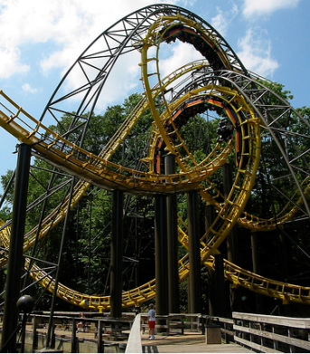

Loops
Like in C
for loop
while loop
do … while loop
var counter;
for (counter=0; counter<4; counter++) {
alert(counter);
}
while (counter < 5) {
alert(++counter);
}
loops.html

Slide 23
Functions
Code structure – splitting code into parts
Data comes in, processed, result returned
Parameters come in here.
function average(a, b, c)
{
var total;
total = a+b+c;
return total/3;
}
Declaring variables is optional..
Value returned here.

Slide 24
JavaScript Can Change HTML Content
One of many JavaScript HTML methods is document.getElementById(‘id’).
HTML
JavaScript
Elements
Variables

Slide 25
Arrays Operations and Properties
Declaring new empty array:
Declaring an array holding few elements:
Appending an element / getting the last element:
Reading the number of elements (array length):
Finding element's index in the array:
var arr = [];
var arr = [1, 2, 3, 4, 5];
arr.push(3);
arr.length;
arr.indexOf(1);

Slide 26
Arrays Operations and Properties
Deleting the last element
Deleting elements in the middle
Adding elements in the middle
arr.pop();
arr.splice(index,number of elements)
arr.splice(index,0,new_element)

Slide 27
Arrays Operations and Properties
Replacing elements in the middle
Copying by value
arr.splice(index,number of elements,new_element)
New_arr=Object.assign([],old_arr);
New_Obj=Object.assign({},old_obj);

Slide 28
Objects Operations and Properties
Get array of keys
Checking the existense of specific key
Looping in object keys
Object.keys(ObjVAR);
ObjVAR.hasOwnProperty(x);
for(key in ObjVAR)

Slide 29
Objects Operations and Properties
Deleting a key
delete ObjVAR[key];

Slide 30
Standard Popup Boxes
Alert box with text and [OK] button
Just a message shown in a dialog box:
Confirmation box
Contains text, [OK] button and [Cancel] button:
Prompt box
Contains text, input field with default value:
alert("Some text here");
confirm("Are you sure?");
prompt ("enter amount", 10);

Slide 31
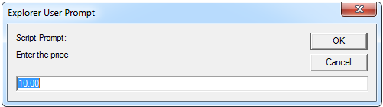
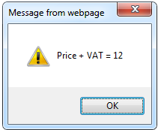
JavaScript Prompt – Example
prompt.html
price = prompt("Enter the price", "10.00");
alert('Price + VAT = ' + price * 1.2);

Slide 32
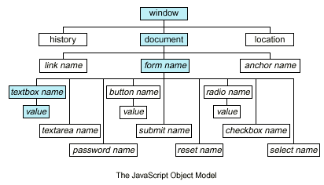
Document Object Model (DOM)

Slide 33
Document Object Model (DOM)
Every HTML element is accessible via the JavaScript DOM API
Most DOM objects can be manipulated by the programmer
The event model lets a document to react when the user does something on the page
Advantages
Create interactive pages
Updates the objects of a page without reloading it

Slide 34
Accessing Elements
Access elements via their ID attribute
Via the name attribute
Via tag name
Returns array of descendant <img> elements of the element "el"
var elem = document.getElementById("some_id")
var arr = document.getElementsByName("some_name")
var imgTags = document.getElementsByTagName("img")

Slide 35
DOM Manipulation
Once we access an element, we can read and write its attributes
DOM-manipulation.html
function change(state) {
var lampImg = document.getElementById("lamp");
lampImg.src = "lamp_" + state + ".png";
var statusDiv =
document.getElementById("statusDiv");
statusDiv.innerHTML = "The lamp is " + state";
}
…
<img src="test_on.gif" onmouseover="change('off')"
onmouseout="change('on')" />

Slide 36
Common Element Properties
Most of the properties are derived from the HTML attributes of the tag
E.g. id, name, href, alt, title, src, etc…
style property – allows modifying the CSS styles of the element
Corresponds to the inline style of the element
Not the properties derived from embedded or external CSS rules
Example: style.width, style.marginTop, style.backgroundImage

Slide 37
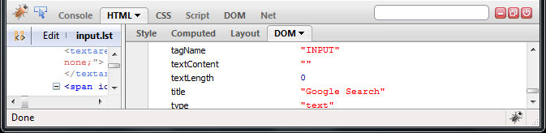
Common Element Properties (2)
className – the class attribute of the tag
innerHTML – holds all the entire HTML code inside the element
Read-only properties with information for the current element and its state
tagName, offsetWidth, offsetHeight, scrollHeight, scrollTop, nodeType, etc…

Slide 38
Accessing Elements through the DOM Tree Structure
We can access elements in the DOM through some tree manipulation properties:
element.childNodes
element.parentNode
element.nextSibling
element.previousSibling
element.firstChild
element.lastChild
Slide has been canceled

Slide 39
Accessing Elements through the DOM Tree – Example
var el = document.getElementById('div_tag');
alert (el.childNodes[0].value);
alert (el.childNodes[1].
getElementsByTagName('span').id);
…
<div id="div_tag">
<input type="text" value="test text" />
<div>
<span id="test">test span</span>
</div>
</div>
accessing-elements-demo.html
Warning: may not return what you expected due to Browser differences

Slide 40
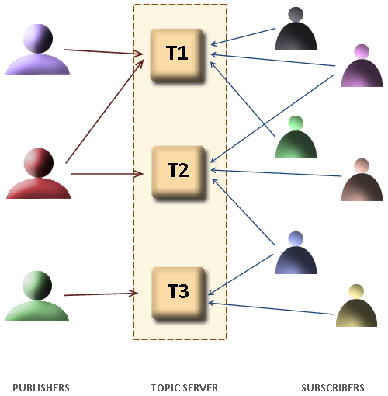
The HTML DOM Event Model

Slide 41
The HTML DOM Event Model
JavaScript can register event handlers
Events are fired by the Browser and are sent to the specified JavaScript event handler function
Can be set with HTML attributes:
Can be accessed through the DOM:
<img src="test.gif" onclick="imageClicked()" />
var img = document.getElementById("myImage");
img.onclick = imageClicked;

Slide 42
The HTML DOM Event Model (2)
All event handlers receive one parameter
It brings information about the event
Contains the type of the event (mouse click, key press, etc.)
Data about the location where the event has been fired (e.g. mouse coordinates)
Holds a reference to the event sender
E.g. the button that was clicked

Slide 43

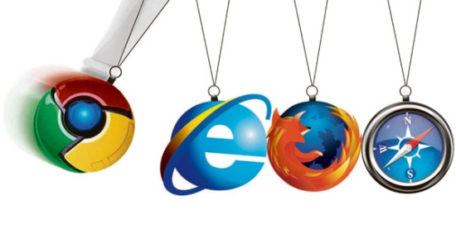
The HTML DOM Event Model (3)
Holds information about the state of [Alt], [Ctrl] and [Shift] keys
Some browsers do not send this object, but place it in the document.event
Some of the names of the event’s object properties are browser-specific

Slide 44
Common DOM Events
Mouse events:
onclick, onmousedown, onmouseup
onmouseover, onmouseout, onmousemove
Key events:
onkeypress, onkeydown, onkeyup
Only for input fields
Interface events:
onblur, onfocus
onscroll

Slide 45
Common DOM Events (2)
Form events
onchange – for input fields
onsubmit
Allows you to cancel a form submission
Useful for form validation
Miscellaneous events
onload, onunload
Allowed only for the <body> element
Fires when all content on the page was loaded / unloaded

Slide 46
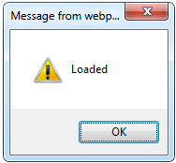
onload Event – Example
onload.html
onload event
<html>
<head>
<script type="text/javascript">
function greet() {
alert("Loaded.");
}
</script>
</head>
<body onload="greet()" >
</body>
</html>

Slide 47
Form Validation – Example
form-validation.html
function checkForm()
{
var valid = true;
if (document.mainForm.firstName.value == "") {
alert("Please type in your first name!");
document.getElementById("firstNameError").
style.display = "inline";
valid = false;
}
return valid;
}
…
<form name="mainForm" onsubmit="return checkForm()">
<input type="text" name="firstName" />
…
</form>

Slide 48
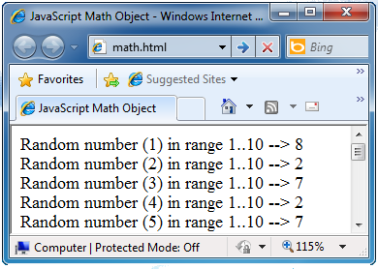
The Math Object
The Math object provides some mathematical functions
math.html
for (i=1; i<=20; i++) {
var x = Math.random();
x = 10*x + 1;
x = Math.floor(x);
document.write(
"Random number (" +
i + ") in range " +
"1..10 --> " + x +
"<br/>");
}

Slide 49
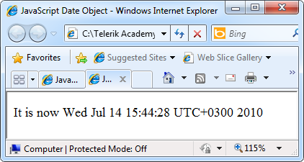
The Date Object
The Date object provides date / calendar functions
dates.html
var now = new Date();
var result = "It is now " + now;
document.getElementById("timeField")
.innerText = result;
...
<p id="timeField"></p>

Slide 50
Timers: setTimeout()
Make something happen (once) after a fixed delay
var timer = setTimeout('bang()', 5000);
5 seconds after this statement executes, this function is called
clearTimeout(timer);
Cancels the timer

Slide 51
Sending data to setTimeout function
var timer = setTimeout('bang(var1,var2…)', 5000,var1,var2,….);

Slide 52
Timers: setInterval()
Make something happen repeatedly at fixed intervals
var timer = setInterval('clock()', 1000);
This function is called continuously per 1 second.
clearInterval(timer);
Stop the timer.

Slide 53
Sending data to setInterval function
var timer = setInterval('bang(var1,var2…)', 5000,var1,var2,….);

Slide 54
Timer – Example
timer-demo.html
<script type="text/javascript">
function timerFunc() {
var now = new Date();
var hour = now.getHours();
var min = now.getMinutes();
var sec = now.getSeconds();
document.getElementById("clock").value =
"" + hour + ":" + min + ":" + sec;
}
setInterval('timerFunc()', 1000);
</script>
<input type="text" id="clock" />

