Slide 1

Lumber Spine Segmentation in MR Images (SPIDER)
Deep Learning Course CIT-654
Spring 2024

Slide 2
Agenda
Introduction
Data Description
Data Inspection
Data Preprocessing
Model Selection
MONAI Framework
Training
Results
Challenges
Other Work
Conclusion
References

Slide 3
Introduction

Slide 4
Spine Segmentation
A crucial process in medical imaging for identifying anatomical structures in MRI or CT scans.
Automating this process with AI reduces manual effort and potential human error, improving workflow efficiency in medical imaging.

Slide 5
Project Objective
Segment three anatomical structures in lumbar spine MRI:
vertebrae
intervertebral discs (IVDs)
spinal canal.

Slide 6
Data Description

Slide 7
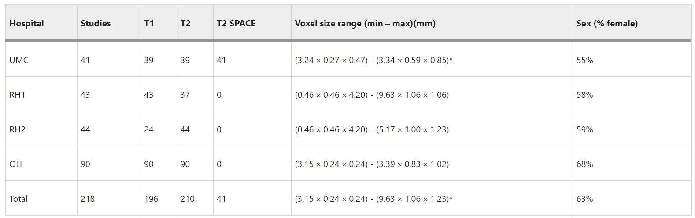
Dataset
447 MRI scans from 257 patients from 4 centers
Types of Scans: sagittal T1 and T2 images
manually segmented

Slide 8
Data Inspection

Slide 9
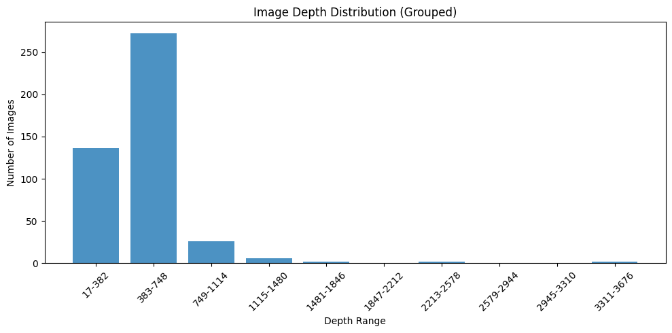
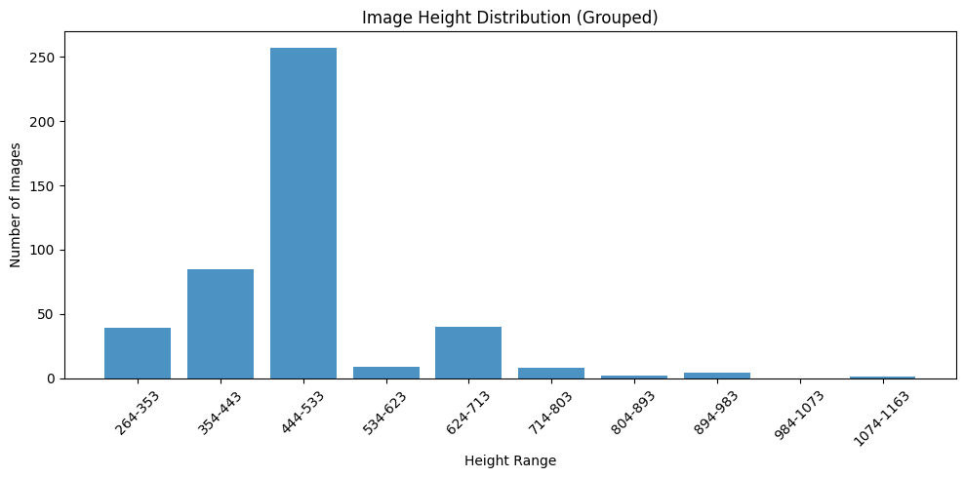
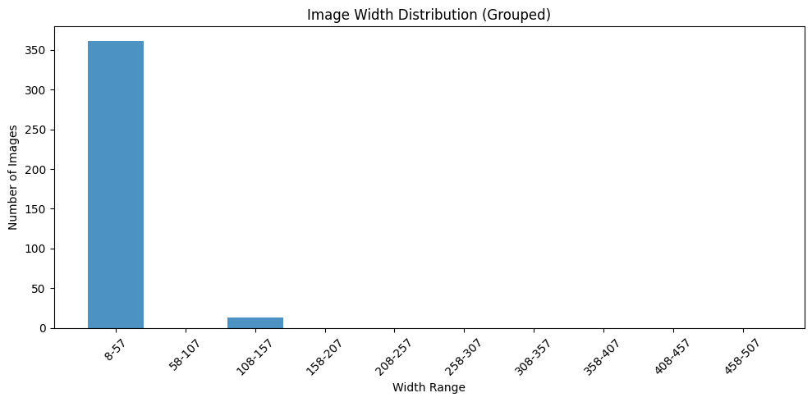
Distribution of H, W, D (grouped)

Slide 10
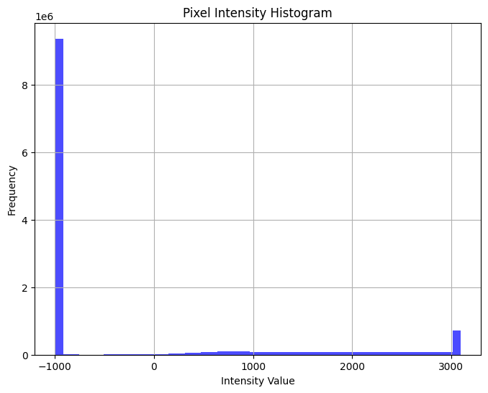

Intensity
1_t1.mha

Slide 11
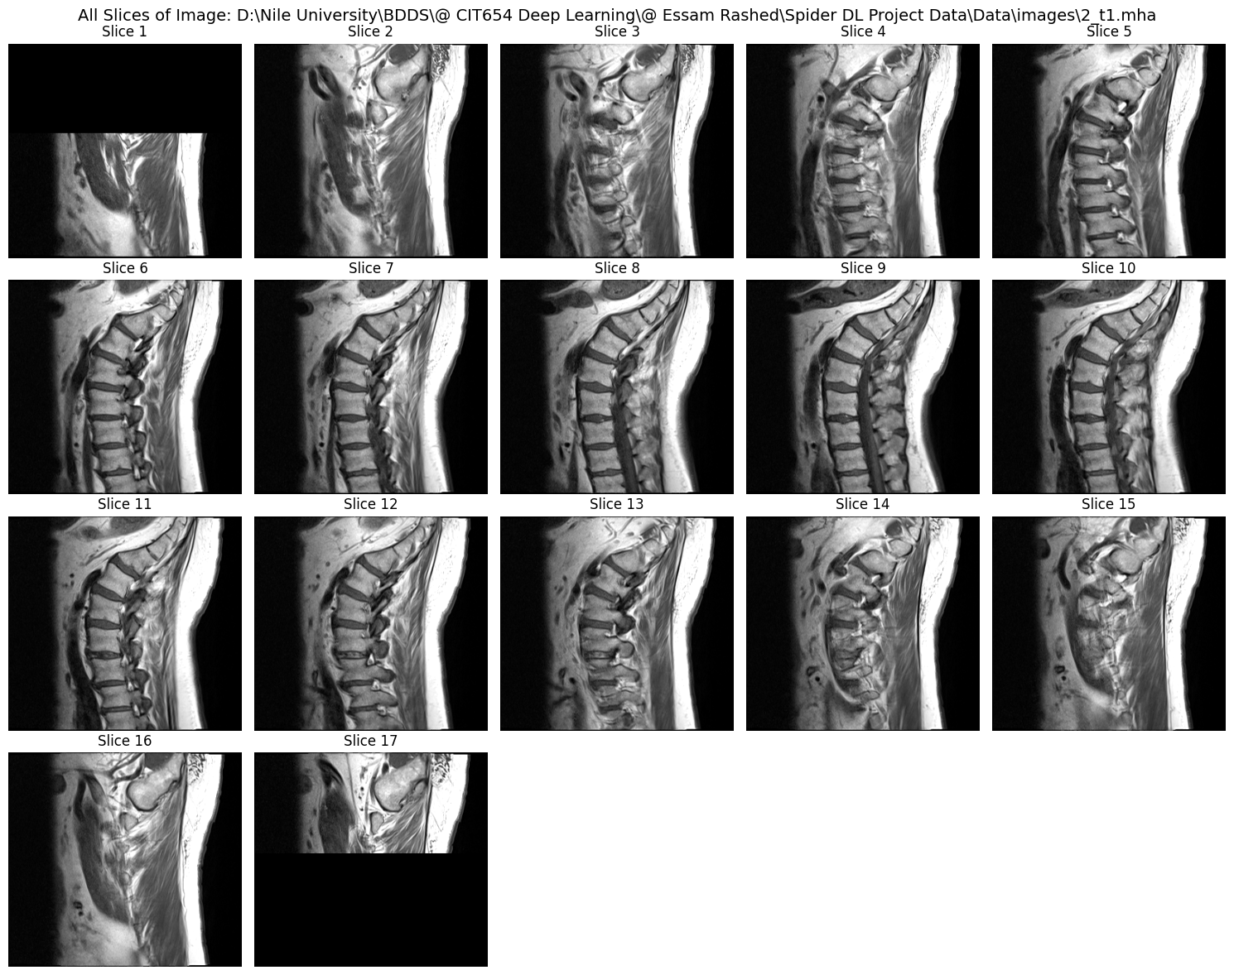
2_t1.mha Display

Slide 12
Data Preprocessing

Slide 13
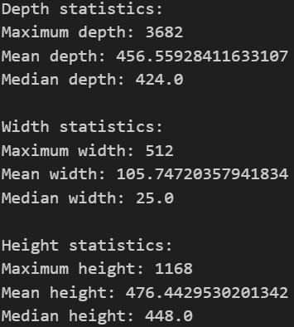
Data Challenges
Class & region imbalance
Inconsistent image sizes and orientations

Slide 14
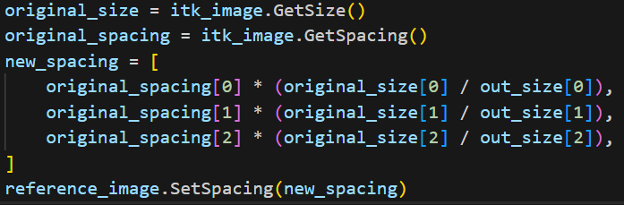

Steps for Resampling
Unified size: (32, 128, 128)
Unify spacing based on the new size
Add interpolators
Set unified orientation
Save new resampled files to directory
Other transformations done later by MONAI

Slide 15
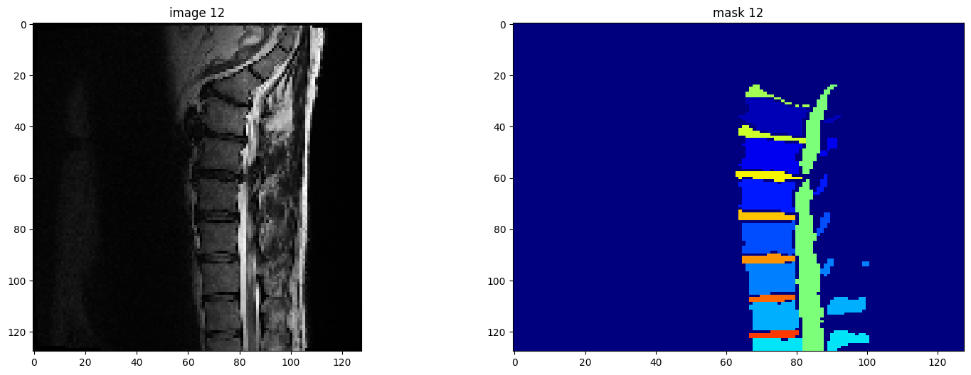
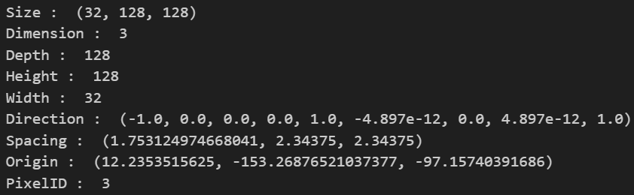
7_t2.mha after processing

Slide 16
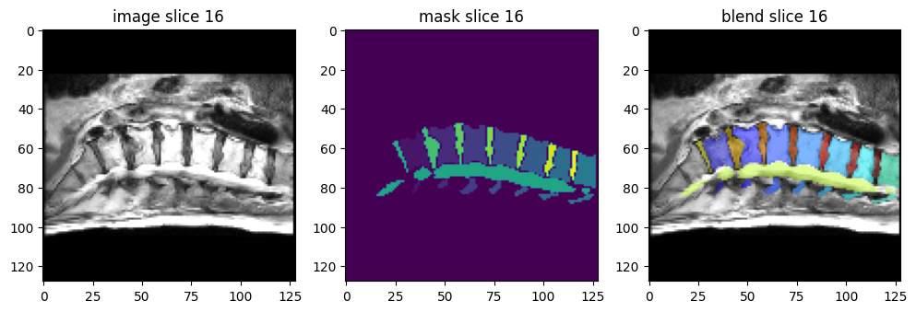
Blended view for image with mask

Slide 17
Model Selection

Slide 18

Architectures Considered:
3D UNet
3D nnUNet
3D MONAI

Slide 19
MONAI Framework

Slide 20
MONAI Framework:
Ease of Use: Simplified coding with MONAI, Many Architecture embedded
Suite of Tools: Integrated data preprocessing, augmentation, model training, evaluation, and deployment
CacheDataset: Efficient data loading and transformation, faster training
Debugging Tools: Identify problems with mask labeling

Slide 21
Architecture

Slide 22
UNETR
Combines UNet and Transformers for effective medical image segmentation.
Components
3D Input Volume
Patching and Linear Projection
Transformer Encoder
Skip Connections
Decoder
Output Layer

Slide 23
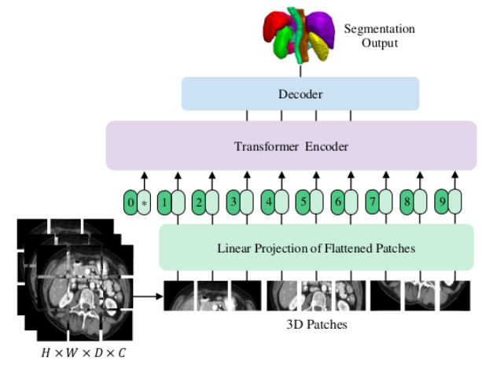
UNETR Components
3D Input Volume:
The input is a 3D medical image with dimensions H×W×D and C channels.
Patching and Linear Projection:
The 3D input volume is divided into smaller, non-overlapping 3D patches.
Each patch is flattened (1D) and then projected into a K-dimensional embedding space using a linear layer.
Positional embeddings (1D) are added to these patch embeddings to retain spatial information.

Slide 24
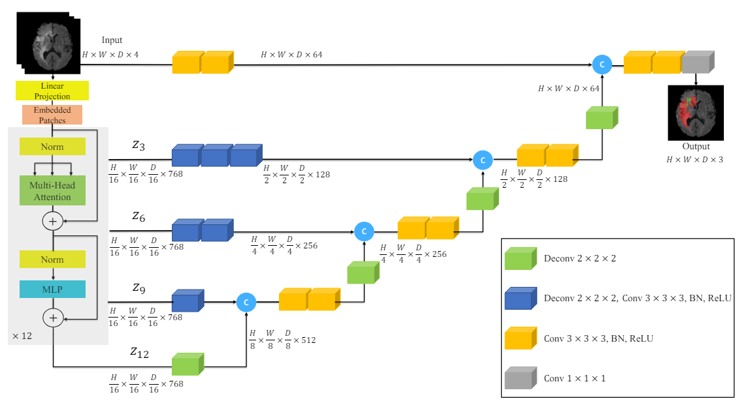
UNETR Components
Transformer Encoder:
The projected patches form a sequence of embeddings.
This sequence is processed by a stack of transformer layers, each consisting of:
Multi-Head Self-Attention (MSA): Allows the model to focus on different parts of the sequence simultaneously.
Multi-Layer Perceptron (MLP): Applies two linear transformations with a GELU activation function in between.
Layer normalization is applied before each MSA and MLP block.

Slide 25
UNETR Components
Skip Connections:
Intermediate representations from the transformer encoder (at specific layers) are extracted.
These representations are reshaped back into 3D tensors and connected to the decoder at corresponding resolutions.
Decoder:
The decoder uses 3×3×3 convolutional layers to process the skip-connected features.
Deconvolution (up-sampling) layers increase the resolution step-by-step, merging features from the encoder to preserve spatial details.
This process is repeated until the output reaches the original input resolution.
Output Layer:
The final output is produced using a 1×1×1 convolutional layer with a softmax activation function to generate voxel-wise semantic predictions.

Slide 26
Training

Slide 27
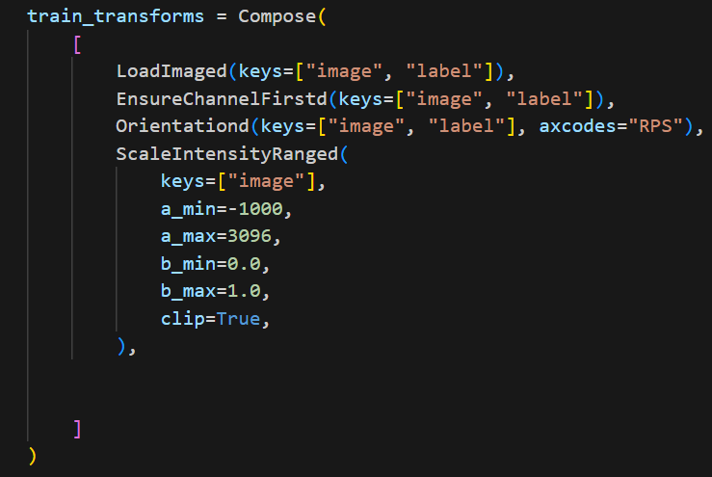
Further data transformation with MONAI

Slide 28

Loss Function & Optimizer
Loss Function: Combination of soft dice loss and cross-entropy loss for robust segmentation in imbalanced datasets.
Optimizer: AdamW

Slide 29
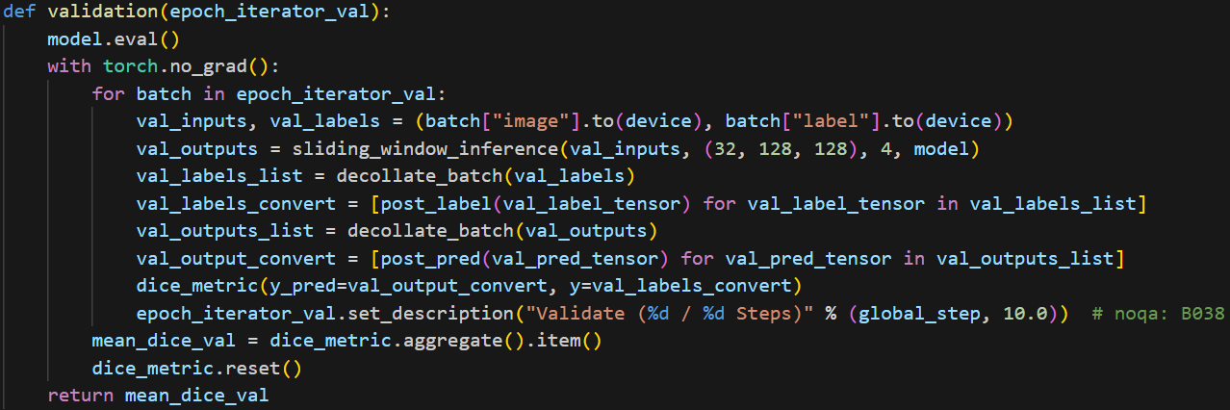
Evaluation Metrics
Mean Dice Score

Slide 30
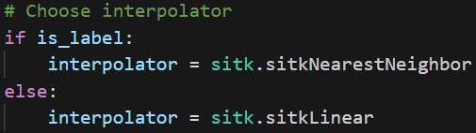

Debugging
Mask labeling? (20 classes by max)
1_t1.mha
Add Interpolators: Using sitkNearestNeighbor for labels and sitkLinear for images.
Clamping

Slide 31
Results

Slide 32
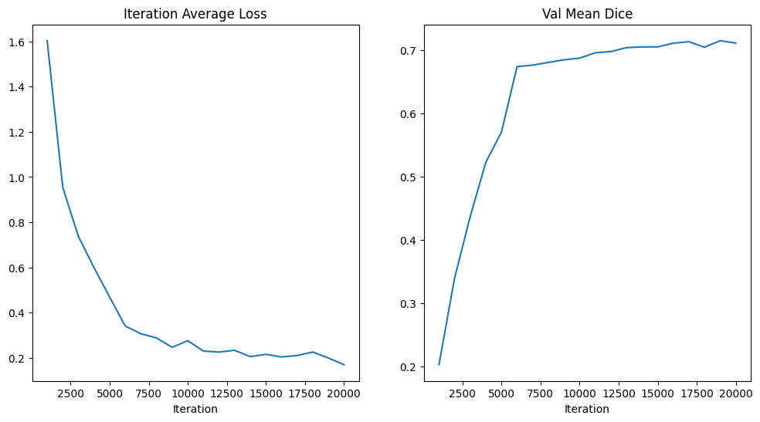
Model Evaluation
Lowest loss: 0.15683
Best metric: 0.7154

Slide 33
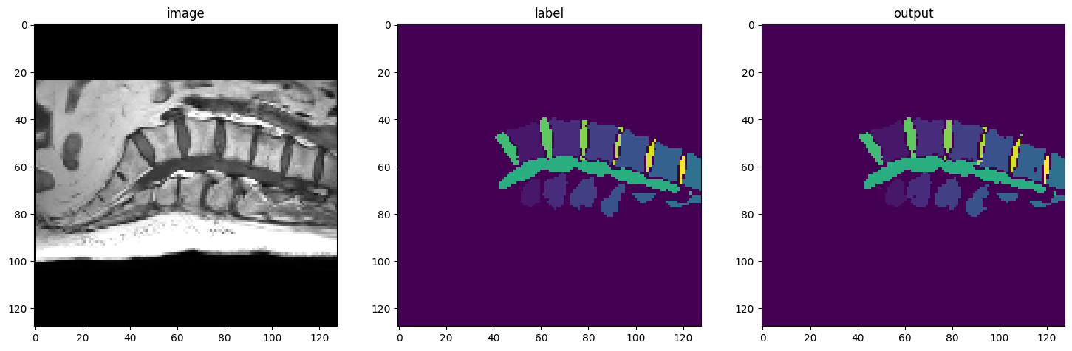
Image & Label & Model Output

Slide 34
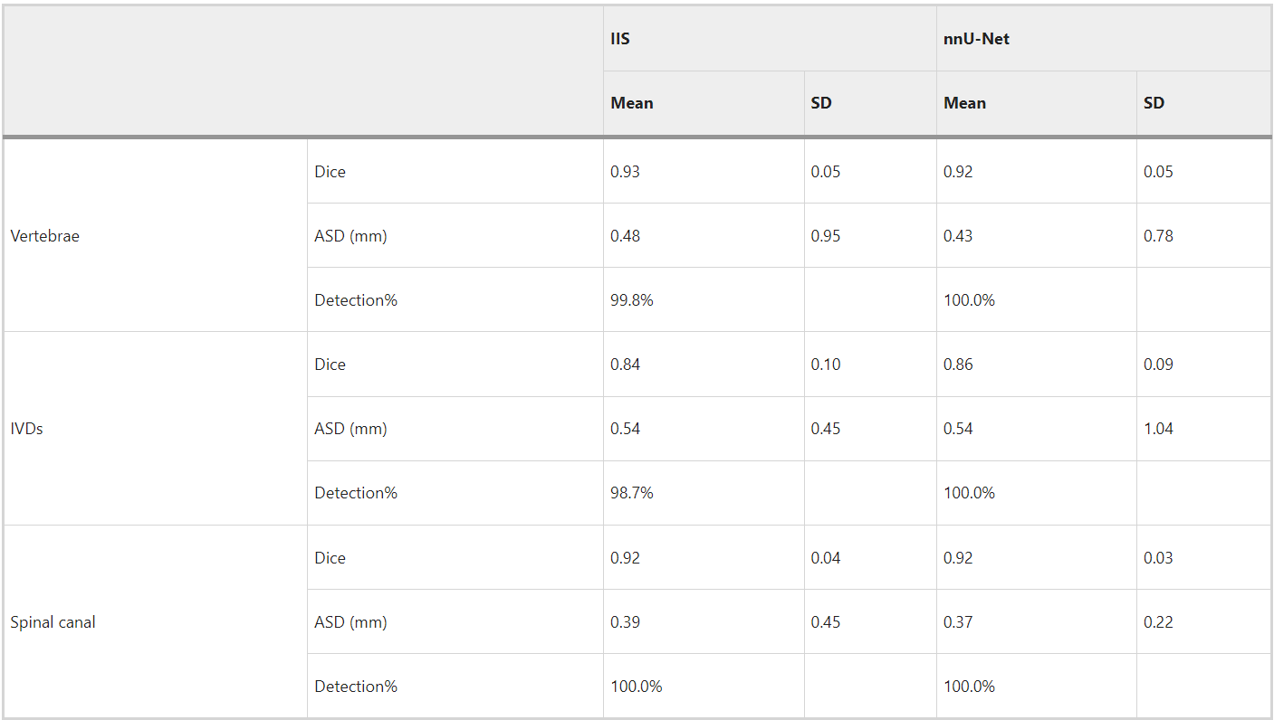
Comparison with Other Works
Results from Challenge site (after 20 times re-annotation)
Q: is 0.72 Mean Dice a good result? (why we don’t achieve 92%)
Bad annotation
Project not good enough
64*192*192
Other reasons!

Slide 35
Other Work

Slide 36
3D UNet, nnUNet
3D UNet taught us the foundational techniques of deep learning.
3D UNet Label visualization after model validation
We'd like to try nnUNet but lack the necessary computational resources.

Slide 37
Conclusion

Slide 38
Conclusion
We successfully developed a spine medical segmentation model with an average Dice Score of 0.72. This model can help healthcare professionals save time and effort while reducing human error.
Using the MONAI framework made the development process smoother and improved performance.
We also gained a good understanding of data processing and handled computational limitations effectively.

Slide 39
References

Slide 40
References
Hatamizadeh, A., Tang, Y., Nath, V., Yang, D., Myronenko, A., Landman, B., Roth, H.R. and Xu, D., 2022. Unetr: Transformers for 3d medical image segmentation. In Proceedings of the IEEE/CVF Winter Conference on Applications of Computer Vision (pp. 574-584).
Ronneberger, O., Fischer, P., & Brox, T. (2015). U-Net: Convolutional Networks for Biomedical Image Segmentation. arXiv preprint arXiv:1505.04597.
van der Graaf, J.W., van Hooff, M.L., Buckens, C.F.M. et al. Lumbar spine segmentation in MR images: a dataset and a public benchmark. Sci Data 11, 264 (2024). https://doi.org/10.1038/s41597-024-03090-w
R. Beare, B. C. Lowekamp, Z. Yaniv, “Image Segmentation, Registration and Characterization in R with SimpleITK”, J Stat Software, 86(8), https://doi.org/10.18637/jss.v086.i08, 2018.
Z. Yaniv, B. C. Lowekamp, H. J. Johnson, R. Beare, “SimpleITK Image-Analysis Notebooks: a Collaborative Environment for Education and Reproducible Research”, J Digit Imaging., https://doi.org/10.1007/s10278-017-0037-8, 31(3): 290-303, 2018.
B. C. Lowekamp, D. T. Chen, L. Ibáñez, D. Blezek, “The Design of SimpleITK”, Front. Neuroinform., 7:45. https://doi.org/10.3389/fninf.2013.00045, 2013.
title: "MONAI: An open-source framework for deep learning in healthcare" , doi: https://doi.org/10.48550/arXiv.2211.02701
Nyothiri Aung, Tahar Kechadi , Liming Chen and Sahraoui Dhelim , “UNet Architecture for 3D Medical Volume Segmentation,” in JOURNAL OF LATEX CLASS FILES, VOL. 14, NO. 8, AUGUST 2015

Slide 41
Q&A
Thank You

