Slide 1
Prediction of Used Car Prices using Regression Models
Data science approach
[Abdulwahid] - [30/10/2022]

Slide 2
Agenda
Problem Definition
CRISP Methodology
Findings and Insights
Recommendations

Slide 3
Problem Definition
Determining the worthiness of cars based on their characteristics
What features impact the price?
What are the best prices for used cars?

Slide 4
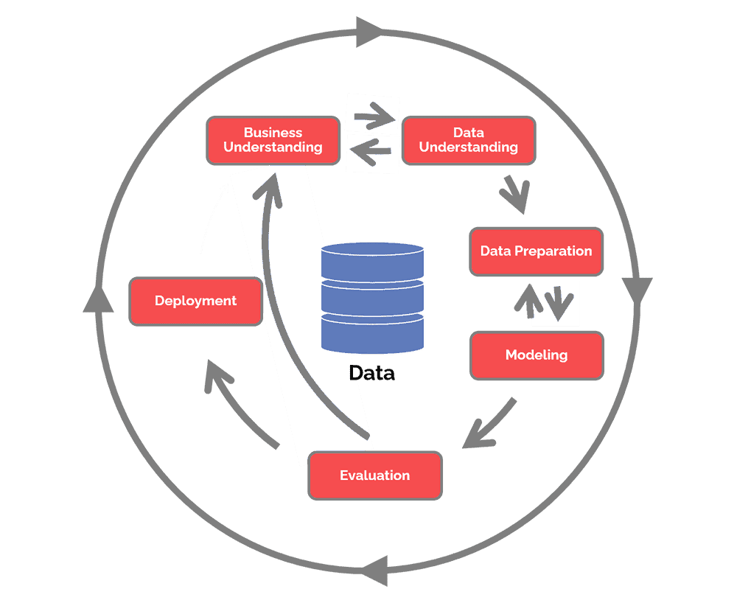
CRISP Methodology
The main stages for a successful data science project
(Data Science Process Alliance, 2022)

Slide 5
Business Understanding
Business Tasks
Improving a company’s advertising approach (used car selling company)
Predicting the best prices to sell their recent used cars

Slide 6
Data Understanding
Data was obtained from GitHub as a part of a data science challenge
The dataset has 16 features with target variable price
Conducted a descriptive and exploratory data analysis
To find trends and insights
To determine the best price predictors

Slide 7
Data Preparation
Data cleaning
Handling missing values for training and testing set
Checking feature data types
Checking for inconsistent data
Data Transformation
Label encoding ( from categorical to numerical)
Feature scaling ( range of 0 to 1)
Dropping unwanted features

Slide 8
Model Development
Training and testing are provided
Split data features from target variable
Models are built by fitting training set
Model testing using testing set

Slide 9
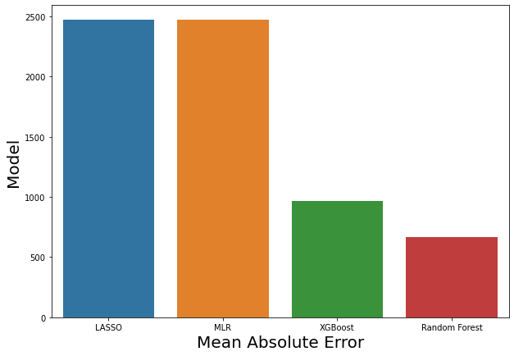
Model Evaluation
Model evaluation matrix (Mean Absolute Error)

Slide 10
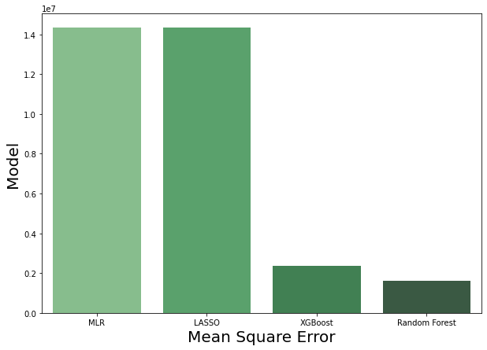
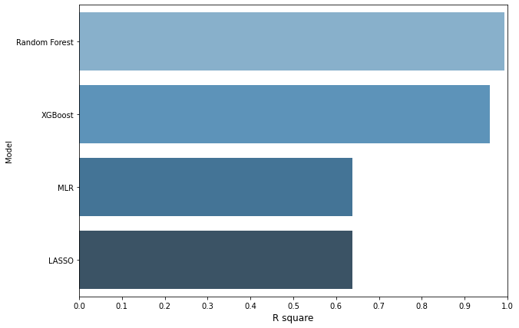
Model Evaluation
Model evaluation matrix (Mean Square Error, R square)

Slide 11
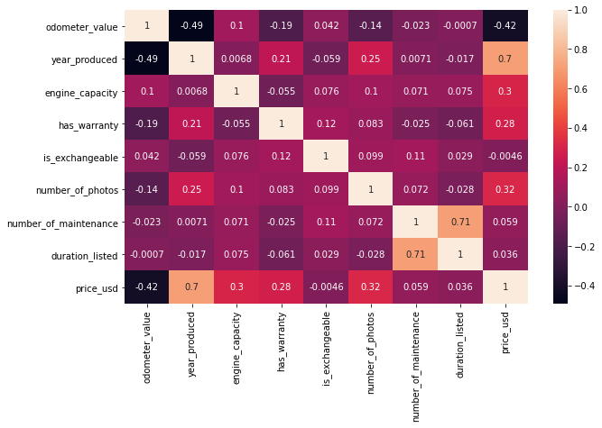
Deployment (Insights and Findings)
Pearson Correlation (Heatmap)
Year produced has the highest correlation with price
Exchangeable has the lowest correlation to the price

Slide 12
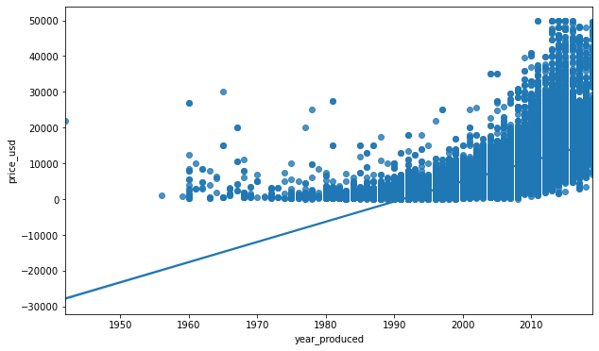
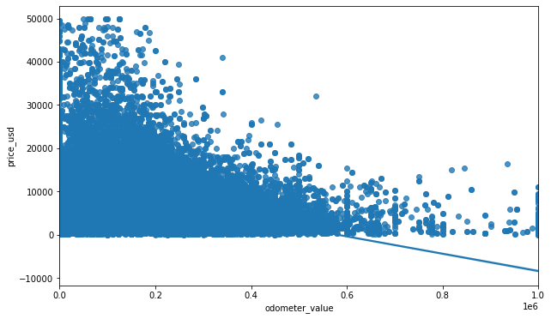
Deployment (Insights and Findings)
Regression Plots
P-value = 0.0
P-value = 0.0

Slide 13
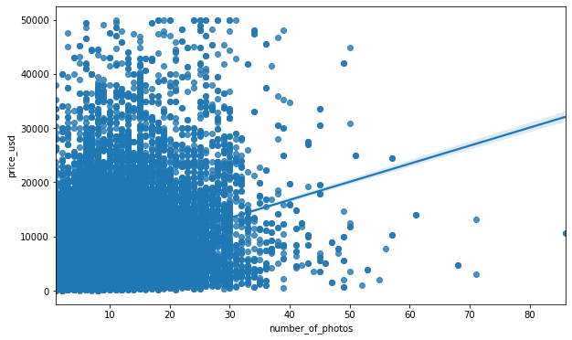
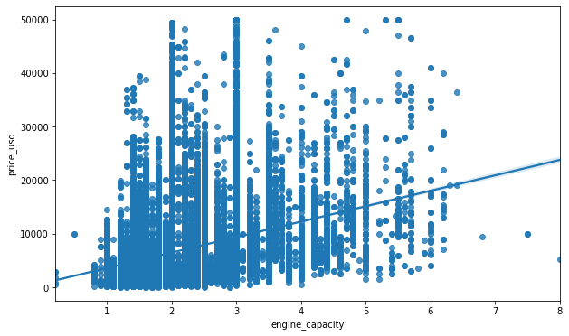
Deployment (Insights and Findings)
Regression Plots
P-value = 0.0
P-value = 0.0

Slide 14
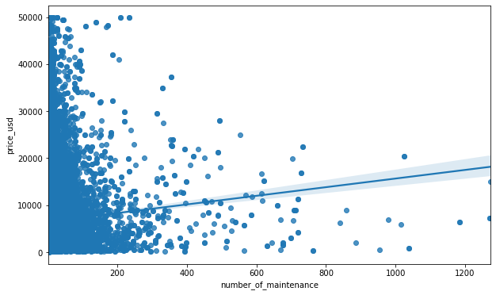
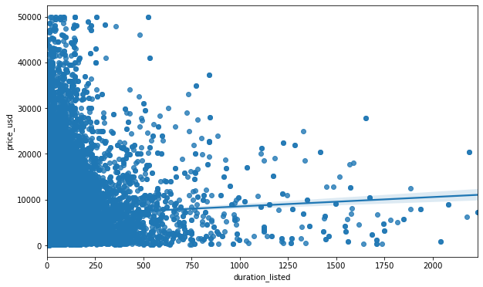
Deployment (Insights and Findings)
Regression Plots
P-value = 1.0242198585534666e-39
P-value = 9.732002080958092e-16

Slide 15
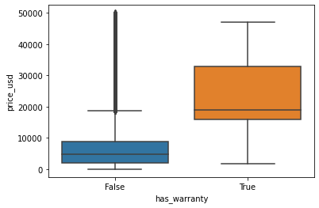
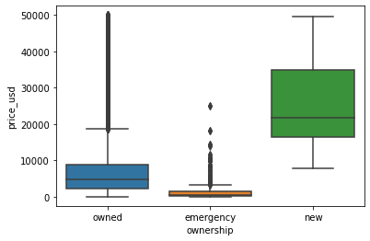
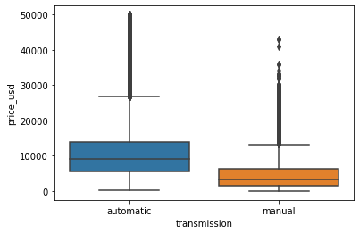
Deployment (Insights and Findings)
Box Plots

Slide 16
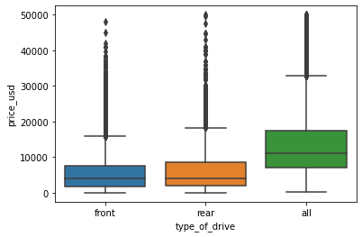
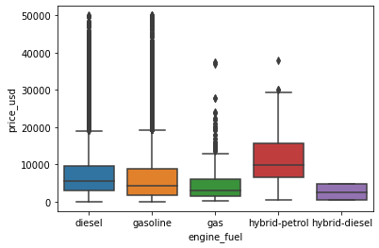
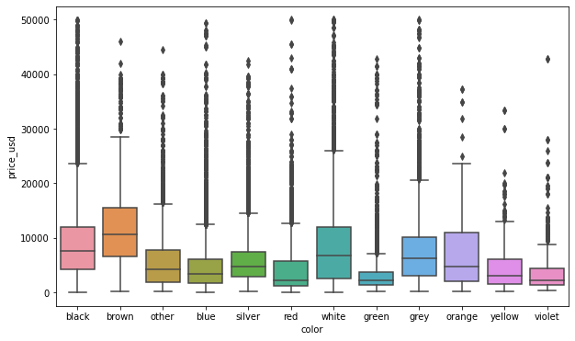
Deployment (Insights and Findings)
Box Plots

Slide 17
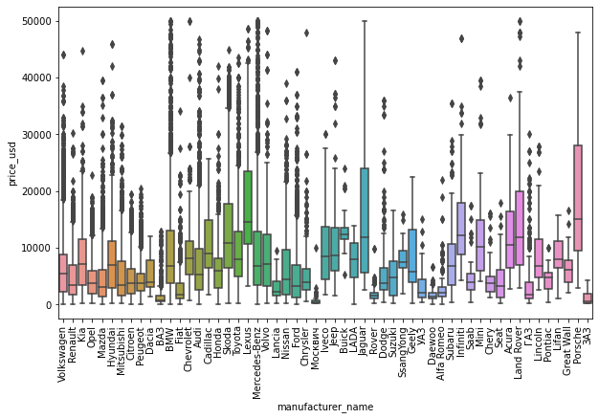
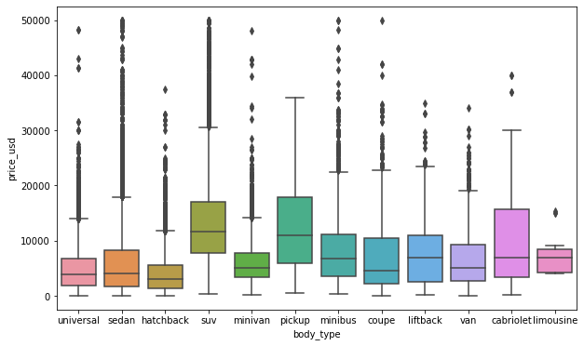
Deployment (Insights and Findings)
Box Plots

Slide 18
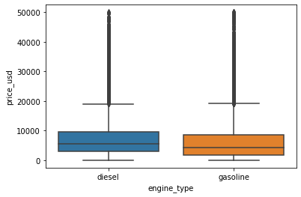
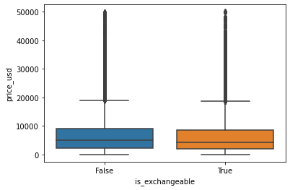
Deployment (Insights and Findings)
Box Plots

Slide 19
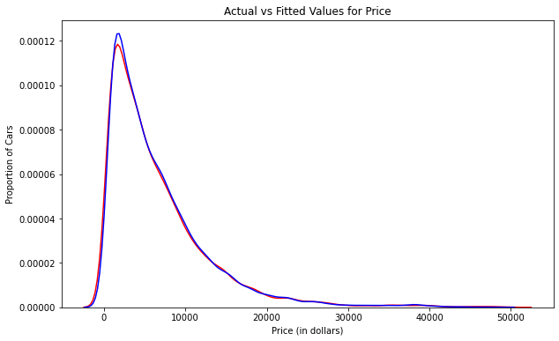
Recommendations
Features that can be utilized to improve the advertising approach.
Manufacturer name
transmission
color
Odometer value
Year produced
Engine fuel
Engine capacity
Body type
Has warranty
ownership
Type of drive
Number of photos
Random Forest’s Plot

Slide 20
Reference
1. CRISP-DM - Data Science Process Alliance. (2022). Data Science Process Alliance. https://www.datascience-pm.com/crisp-dm-2/

Slide 21
Thank You

