Slide 1
Hash function

Slide 2
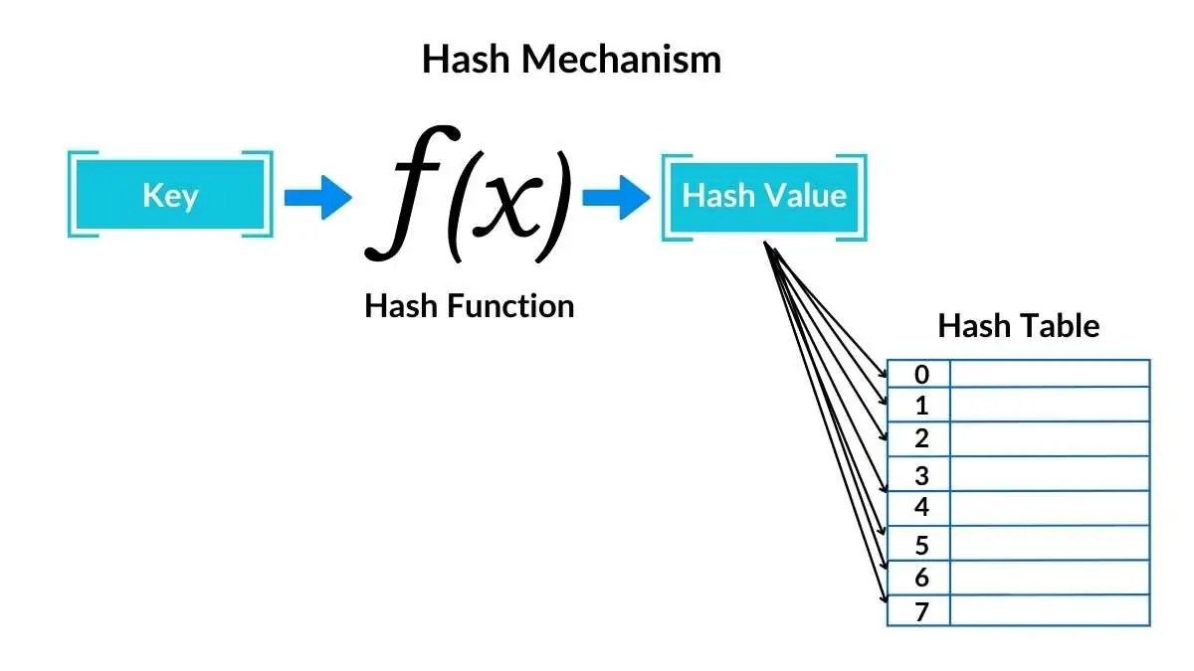
Hash function definition
It is a mathematical function that takes an input (often called a "key") and converts it into a fixed-size string of numbers or characters — this output is called a hash value or hash code.

Slide 3
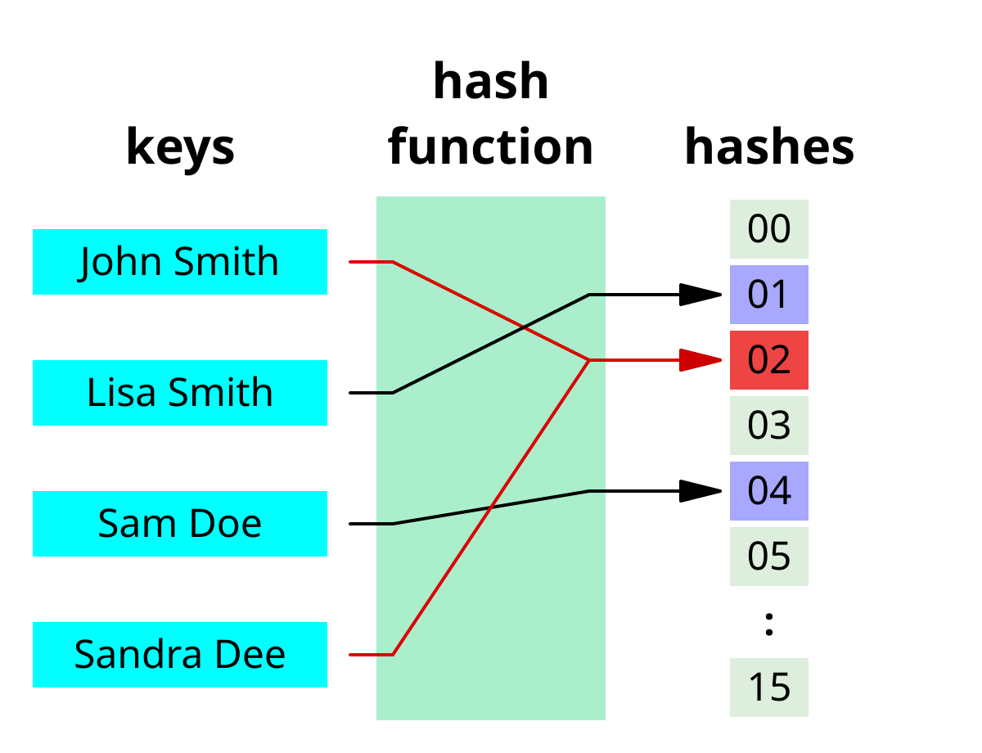
Hash collision
A collision is when a hash function returns the same index value for two different keys.

Slide 4
What are the types of collision?

Slide 5
The types of collision :
Structural Collision
Intentional Collision
Natural Collision

Slide 6
How to solve it ?

Slide 7
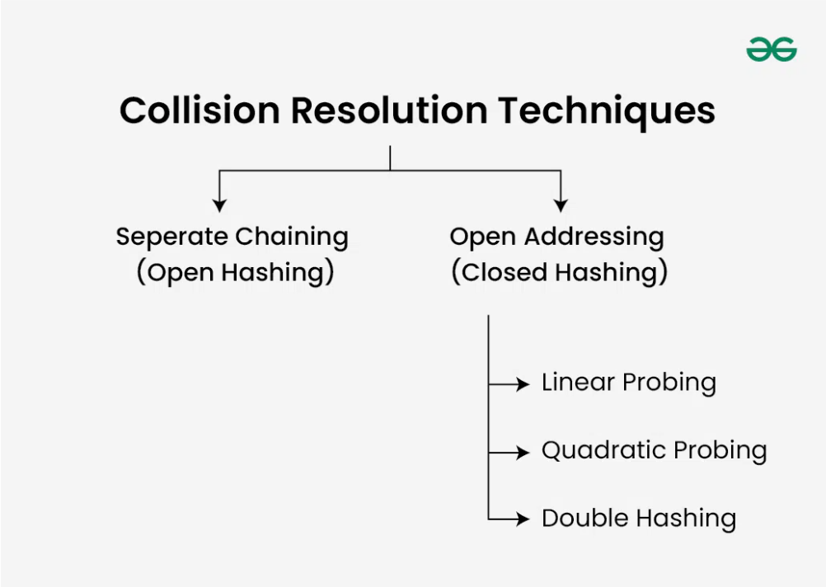
Collision resolution methods :
Separate Chaining
Open address

Slide 8
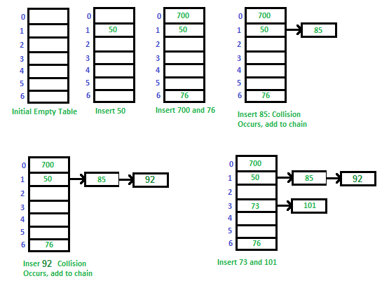
Separate Chaining
Each cell in the table contains a linked list of items that have the same hash value.

Slide 9
PROS and CONS
Advantage
Disadvantage
You can store more than one item in the same cell without any problems.
If the table starts to fill up, you don't need to move or expand it quickly.
There's no need to search for an empty cell.
Slow search if collisions occur frequently.
Memory Overhead
Complexity in implementation compared to simpler methods
Poor performance with poor hash function design
Difficulty improving performance through resizing

Slide 10
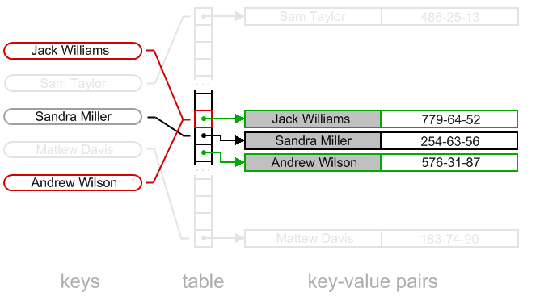
Open Addressing
Linear probing
Quadratic probing
Double Hashing

Slide 11
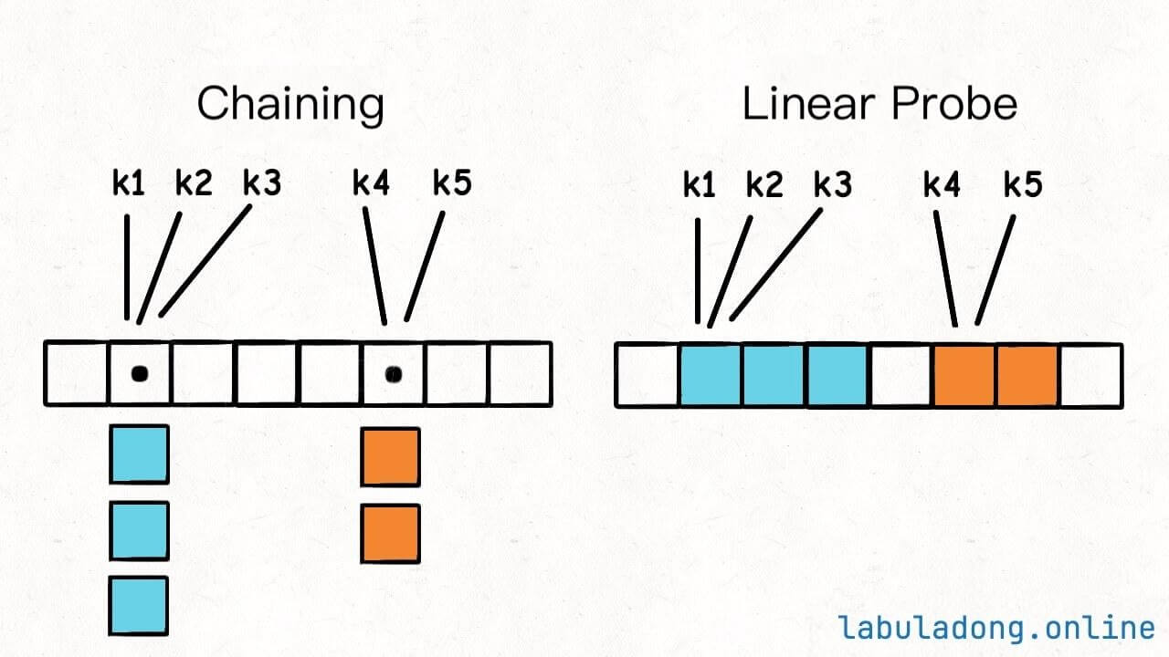
Linear probing
If the field we calculated from the hash function is occupied, we go to the field immediately after it (+1)... and so on until we find an empty field.

Slide 12
PROS and CONS
Advantage
Dis advantage
Very easy to program and understand.
No additional lists or indicators required.
Clustering problem: Elements are clustered together, making the search process longer.
If the table is only partially full, performance deteriorates quickly.

Slide 13
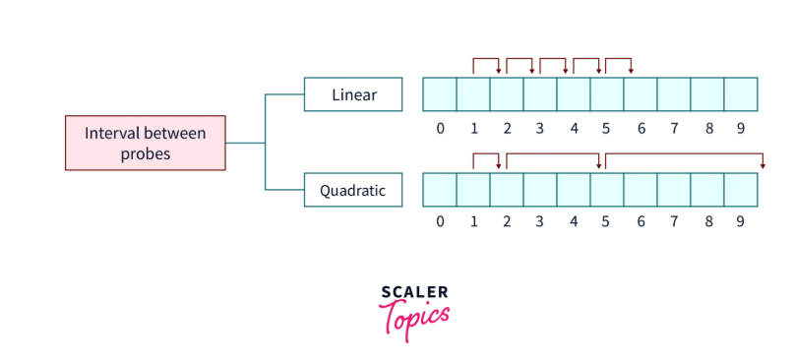
Quadratic Probing
Same idea as linear probing, but instead of moving +1, +2, ... we move in quadratic steps.

Slide 14
PROS and CONS
Advantage
Dis advantage
Reduces the clustering problem that occurs in linear sequences.
The distribution of elements is better on the table.
In some cases, you may not find an empty cell easily if the table size is not suitable.
You must determine the number of attempts intelligently .

Slide 15
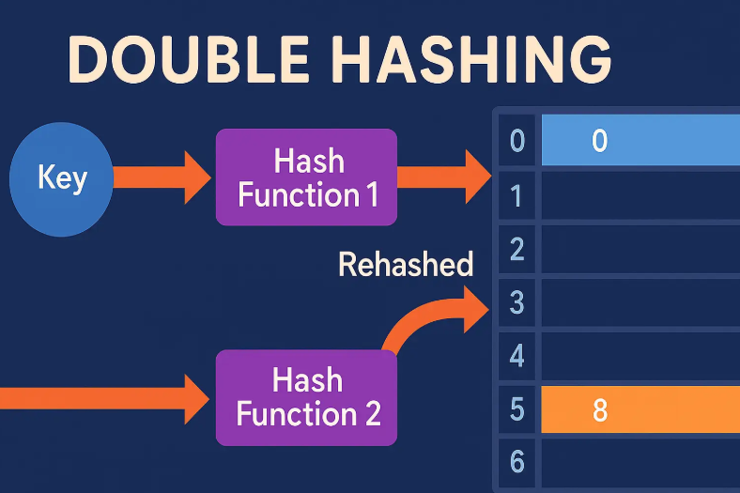
Double Hashing
When a collision occurs, we calculate a new step to move through the table using a second hash function.

Slide 16
PROS and CONS
Advantage
Dis advantage
Significantly reduces clustering
Excellent distribution
High search efficiency
Suitable for large tables
Very complex to implementation
Be careful when choosing second hash.
A suitable table size is required (preferably a prime number).

Slide 17
Thank you

