Slide 1
Diagnosis AI

Slide 2
الاسماء:
1: عبد الرحمن جمال احمد
2:عبدالله احمد مهدى
3:عمر اشرف عمر عجمى
4:عدنان مصطفى فريد فهمى
5:على احمد عبدالحميد

Slide 3

What is Our Project?
We use areas of Artificial intelligence(AI) such as Machine learning(ML) and Deep learning(DL)and use Docker to diagnose diseases through X-rays

Slide 4

Problem & Solve
In the past, when there was any update or change in the project, the developer had to be present to modify and update the project.
Now, with the development of hardware and software, there are daily updates. Instead of the developer's presence, everything is dynamic. With the click of a button, you can add, modify and delete anything you want.
Everything become dynamic.

Slide 5
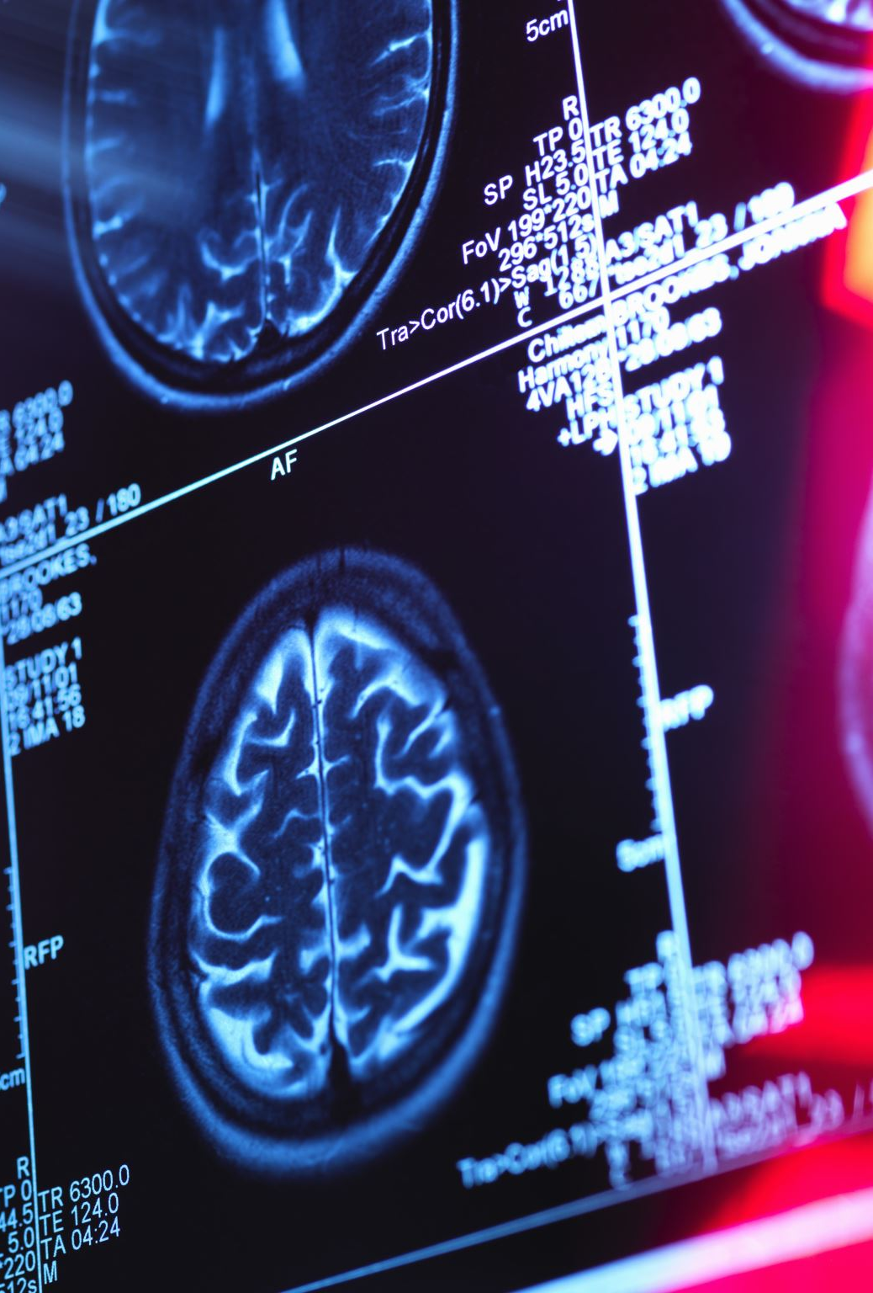
Why Project?
Our project makes it easier for patients and doctors to diagnose and analyze their diseases by uploading an image of an x-ray on the site, and then these x-rays are diagnosed based on the use of a deep learning model in diagnosing the type of disease and giving him the final diagnosis.

Slide 6
Technology & Tools
Deep Learning (DL)
Docker
Falsk
API
.Net
Kubrnates

Slide 7
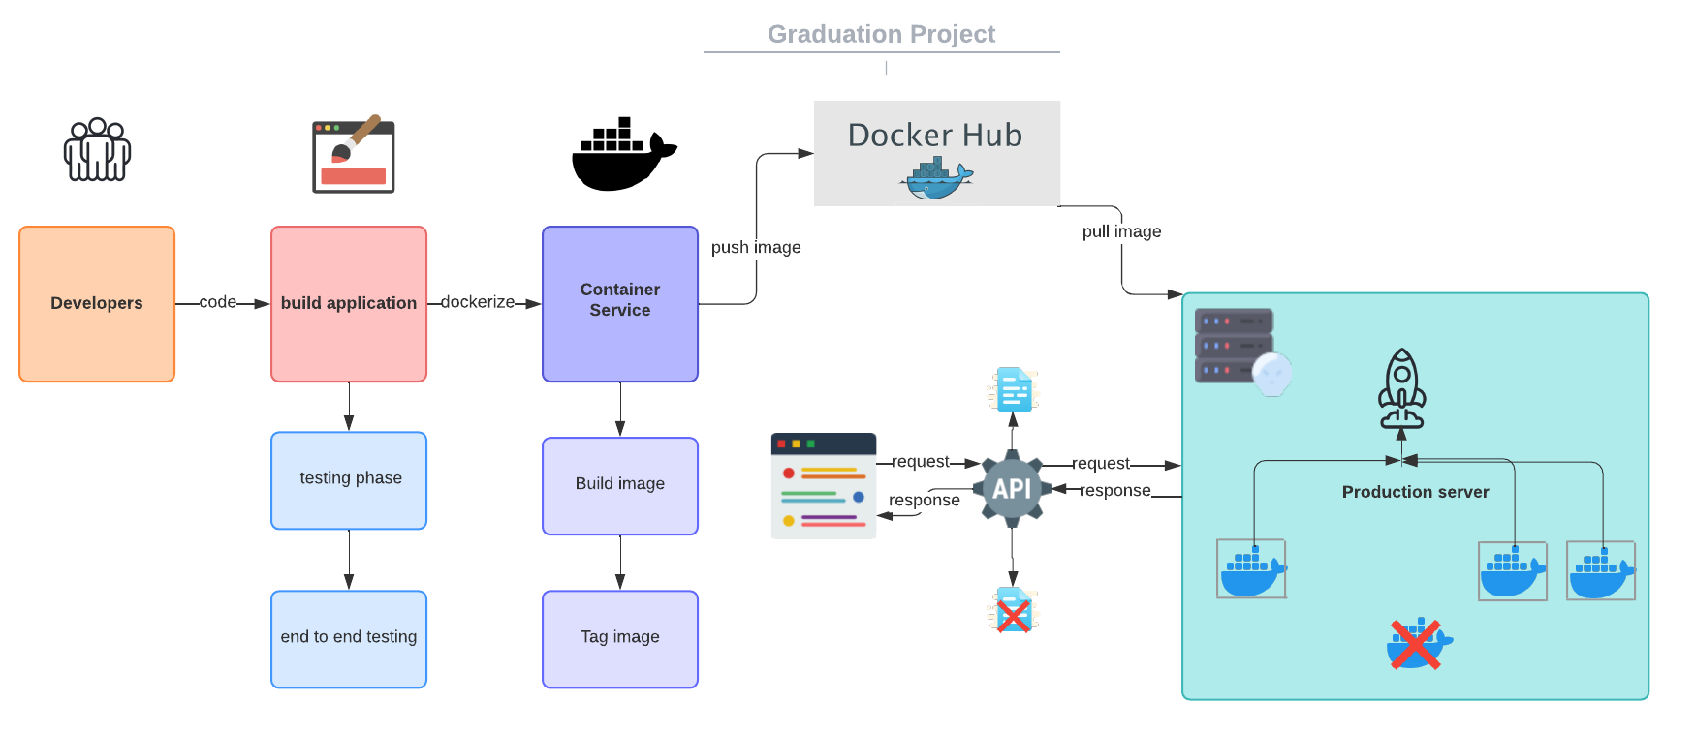

Slide 8
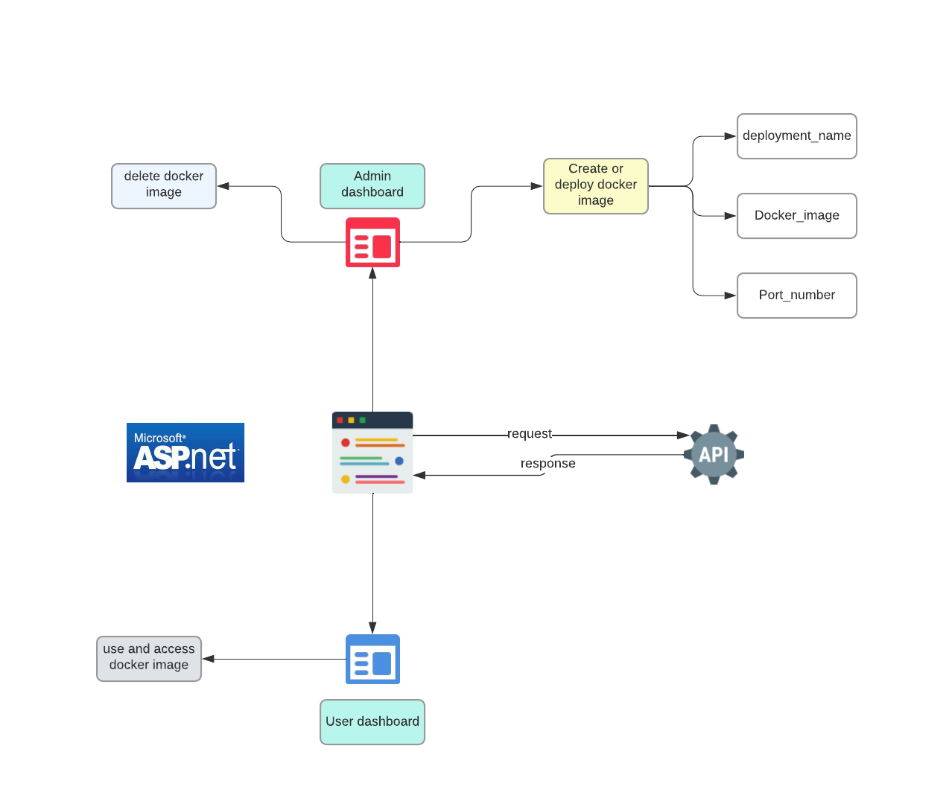

Slide 9
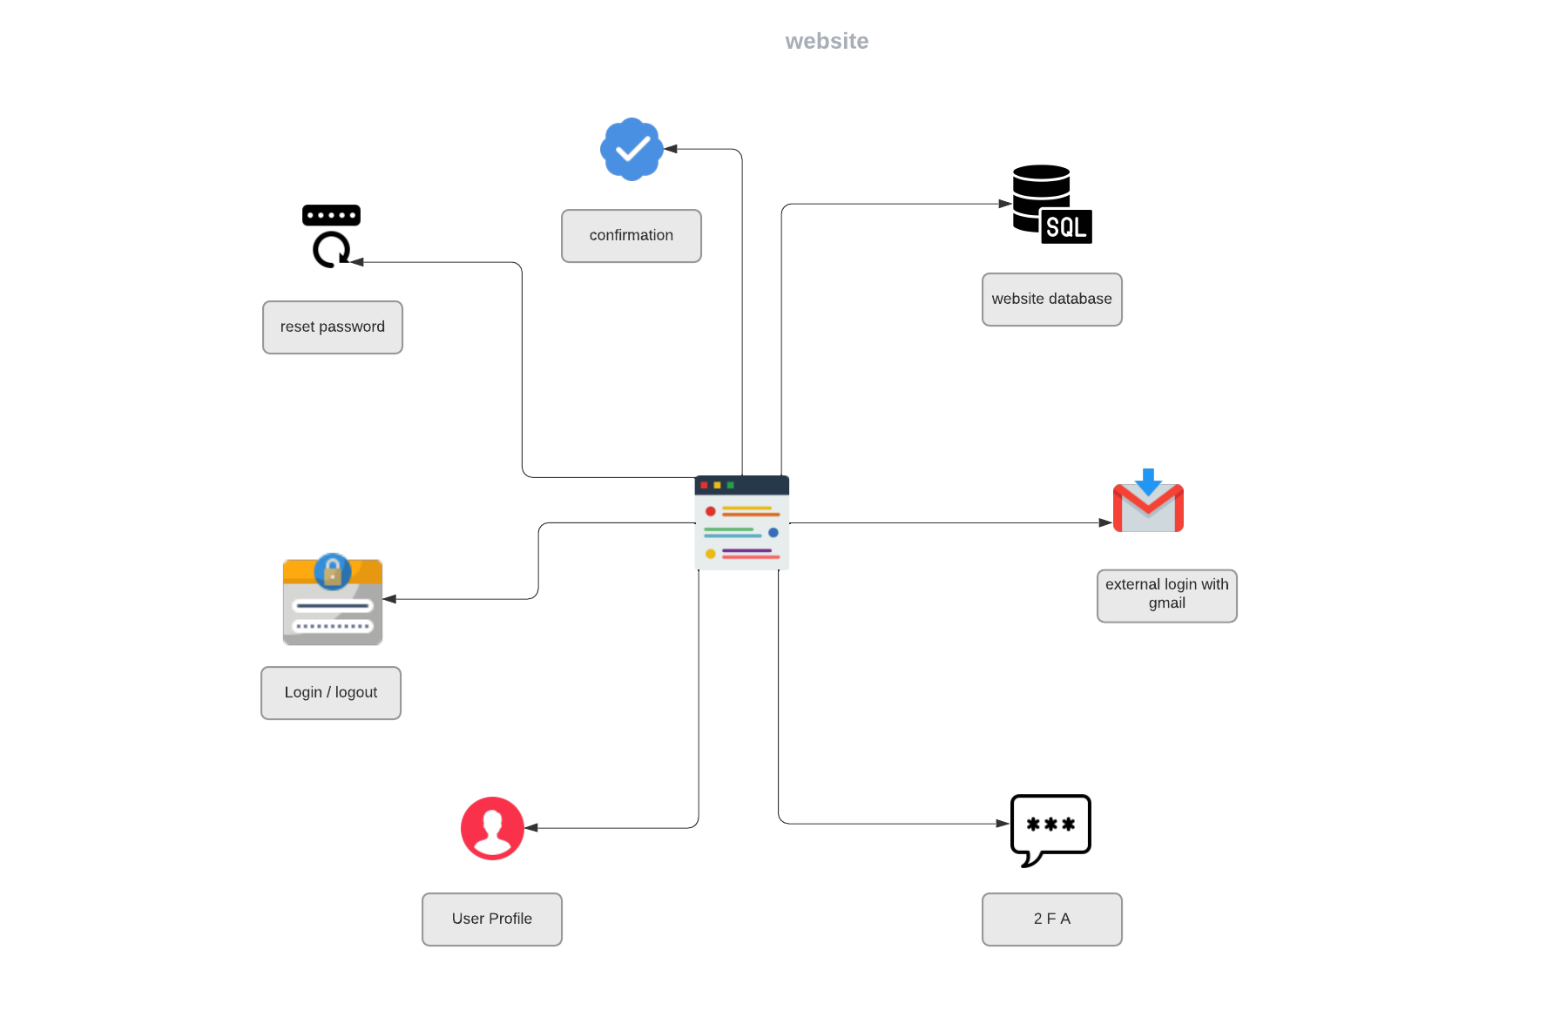

Slide 10
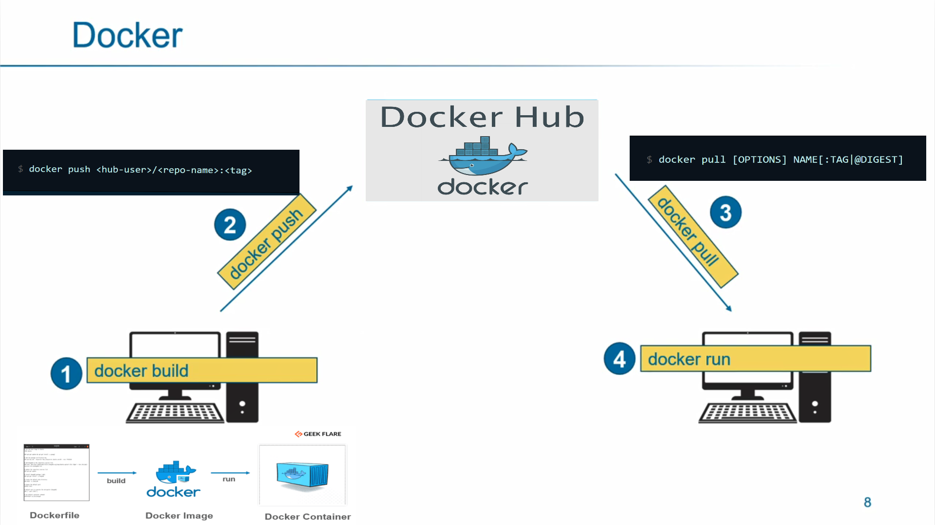
Docker

Slide 11
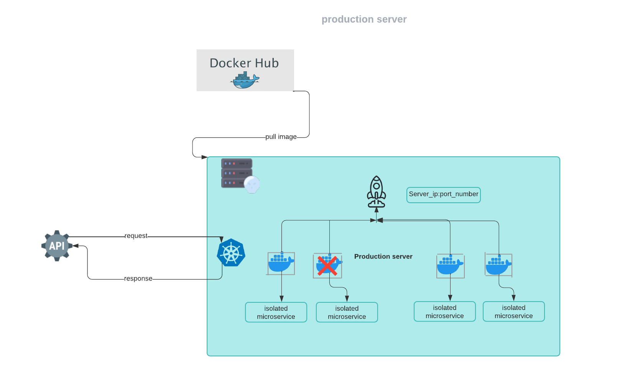

Slide 12
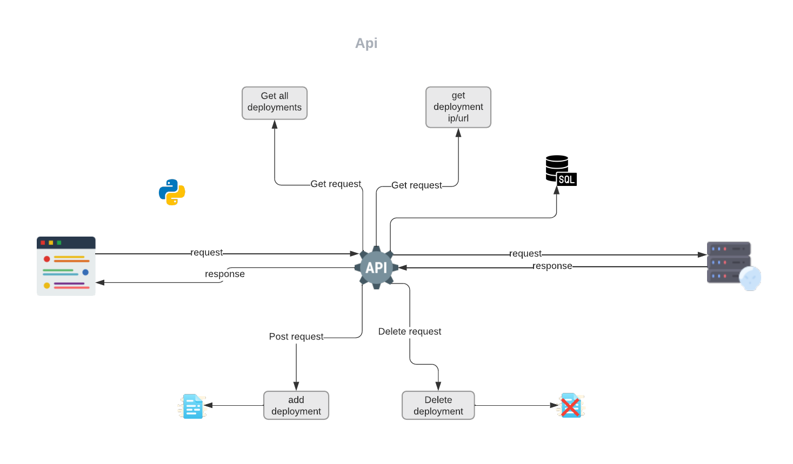

Slide 13
1: Pneumonia Model
Pneumonia: is an infection that inflames the air sacs in one or both lungs, causing cough with phlegm or pus, fever, chills, and difficulty breathing. A variety of organisms, including bacteria, viruses, and fungi, can cause pneumonia.
We use Deep Learning(DL) to detect pneumonia by uploading x-ray images to the model, and the model returns the result, whether it has Pneumonia or Normal.

Slide 14
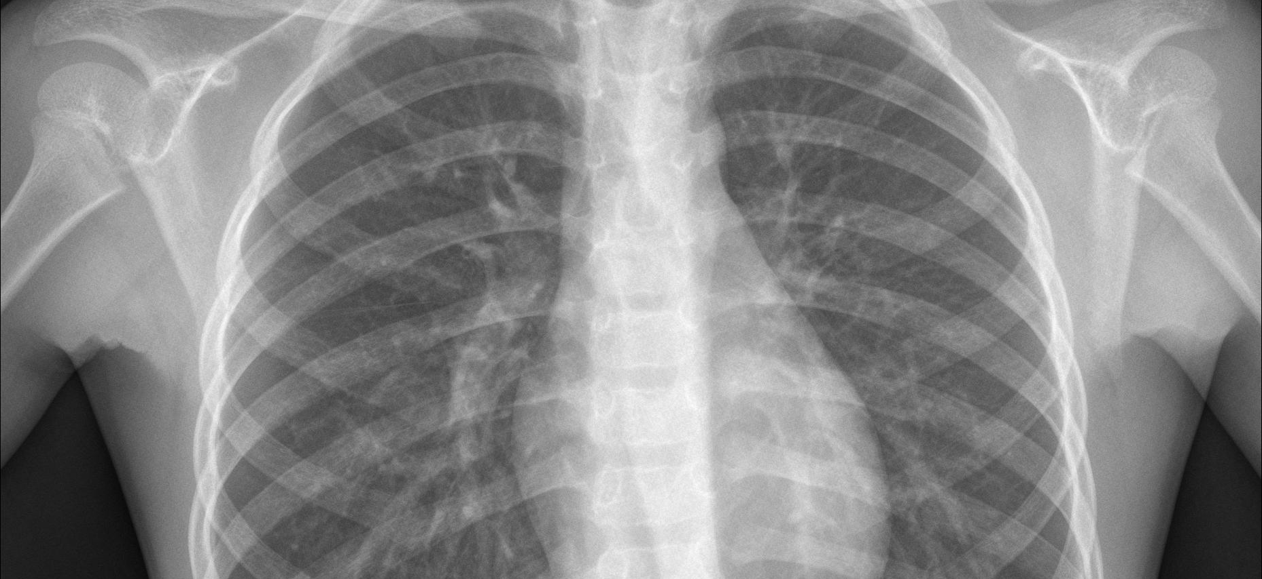
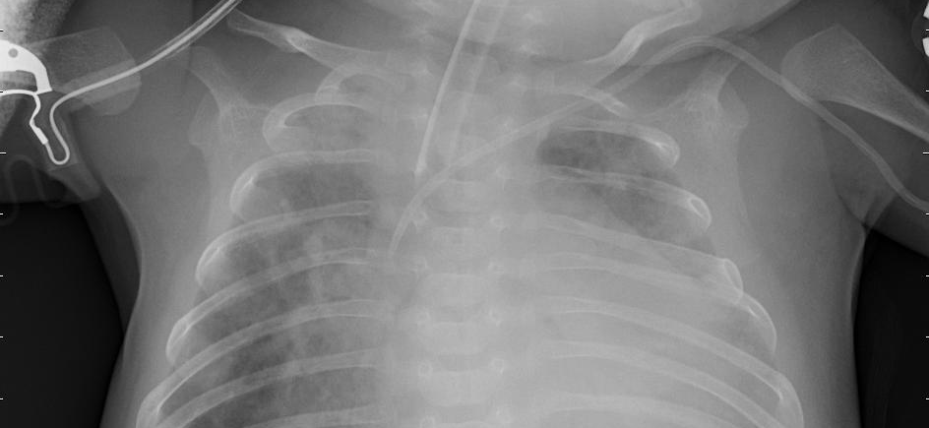
1: Pneumonia Model
Normal image
Pneumonia image

Slide 15
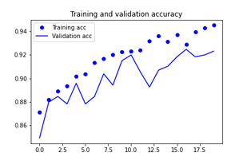
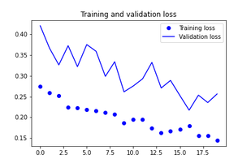

1: Pneumonia Model
Validation Accuracy
Validation Loss

