Slide 1
Problem statement

Slide 6
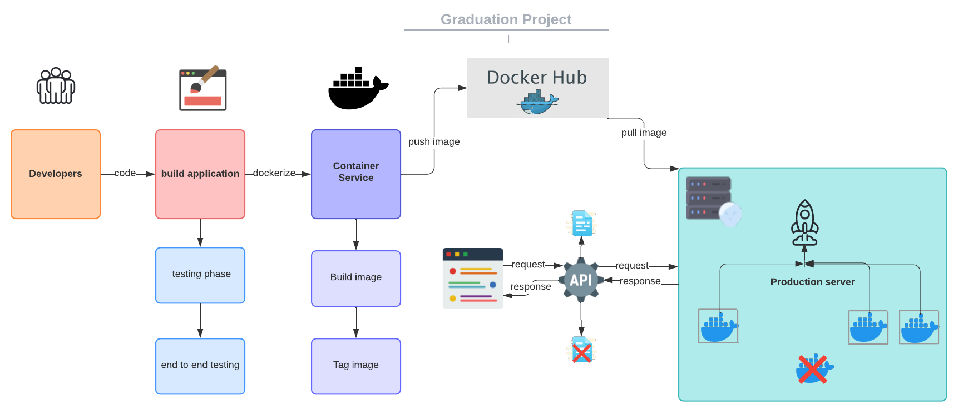

Slide 7
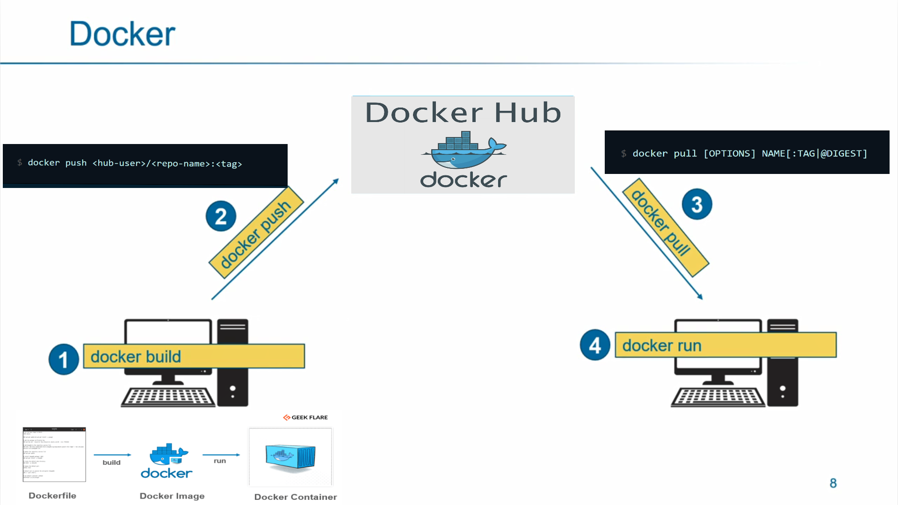

Slide 8
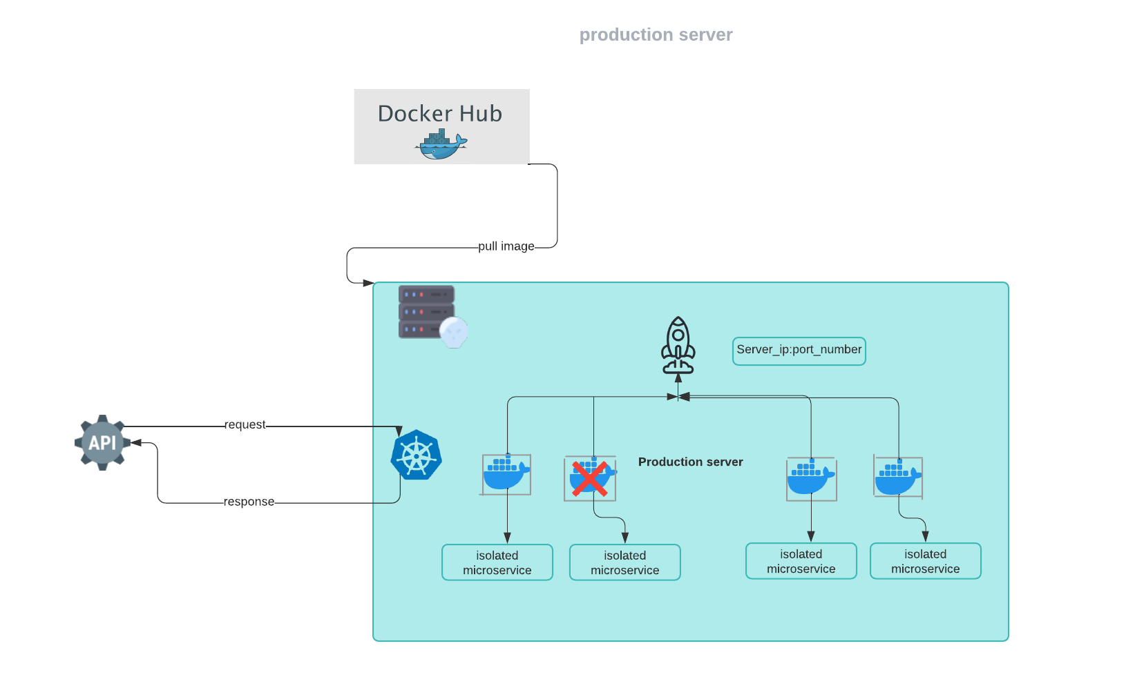

Slide 9
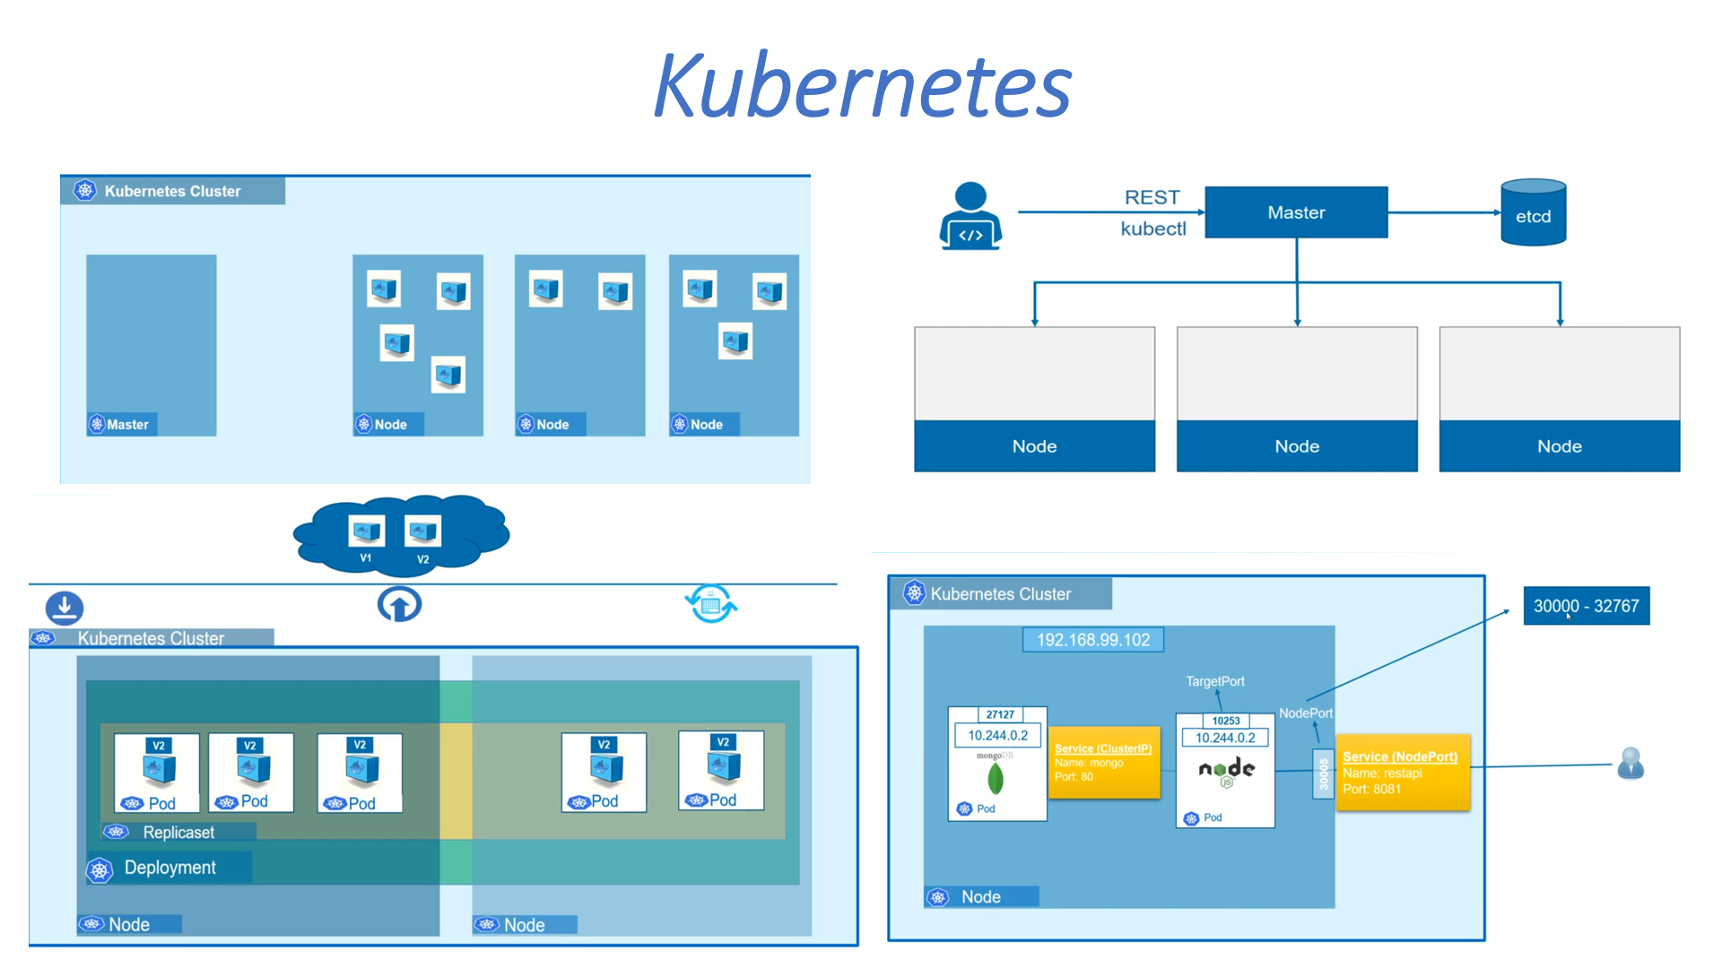

Slide 10
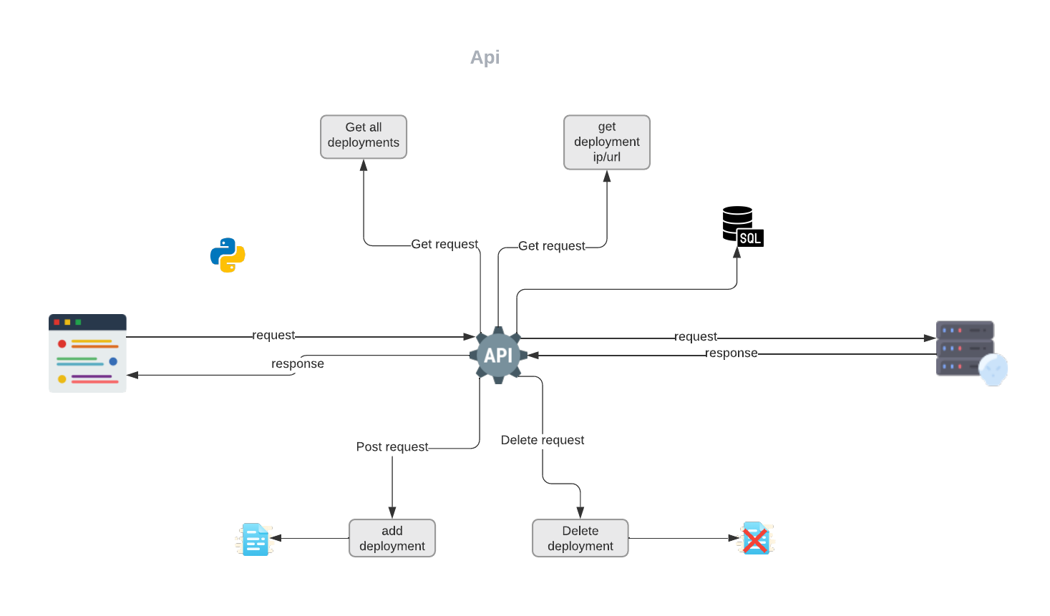

Slide 11
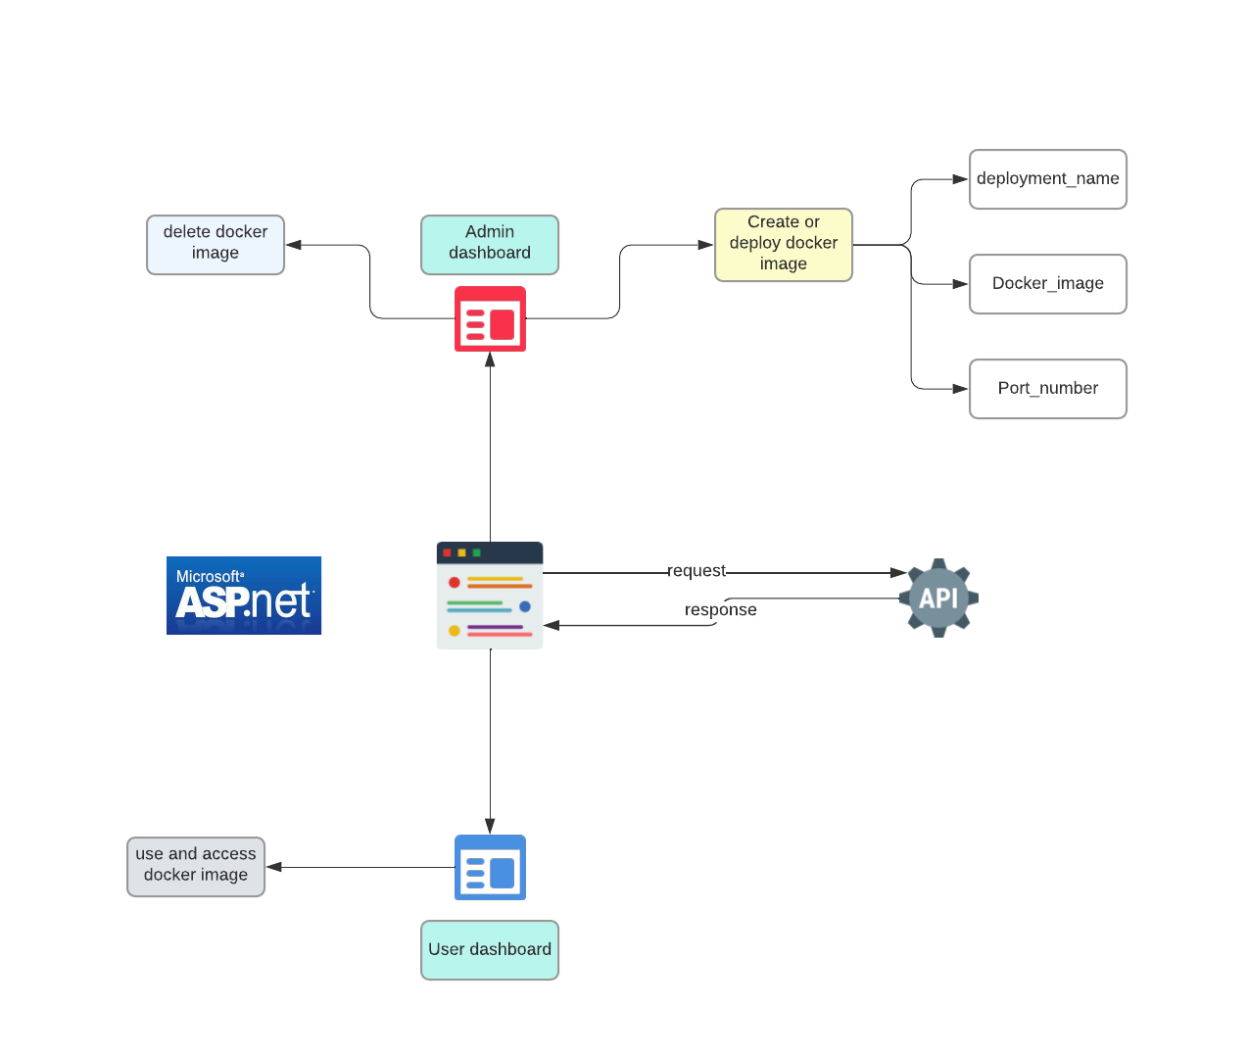

Slide 12
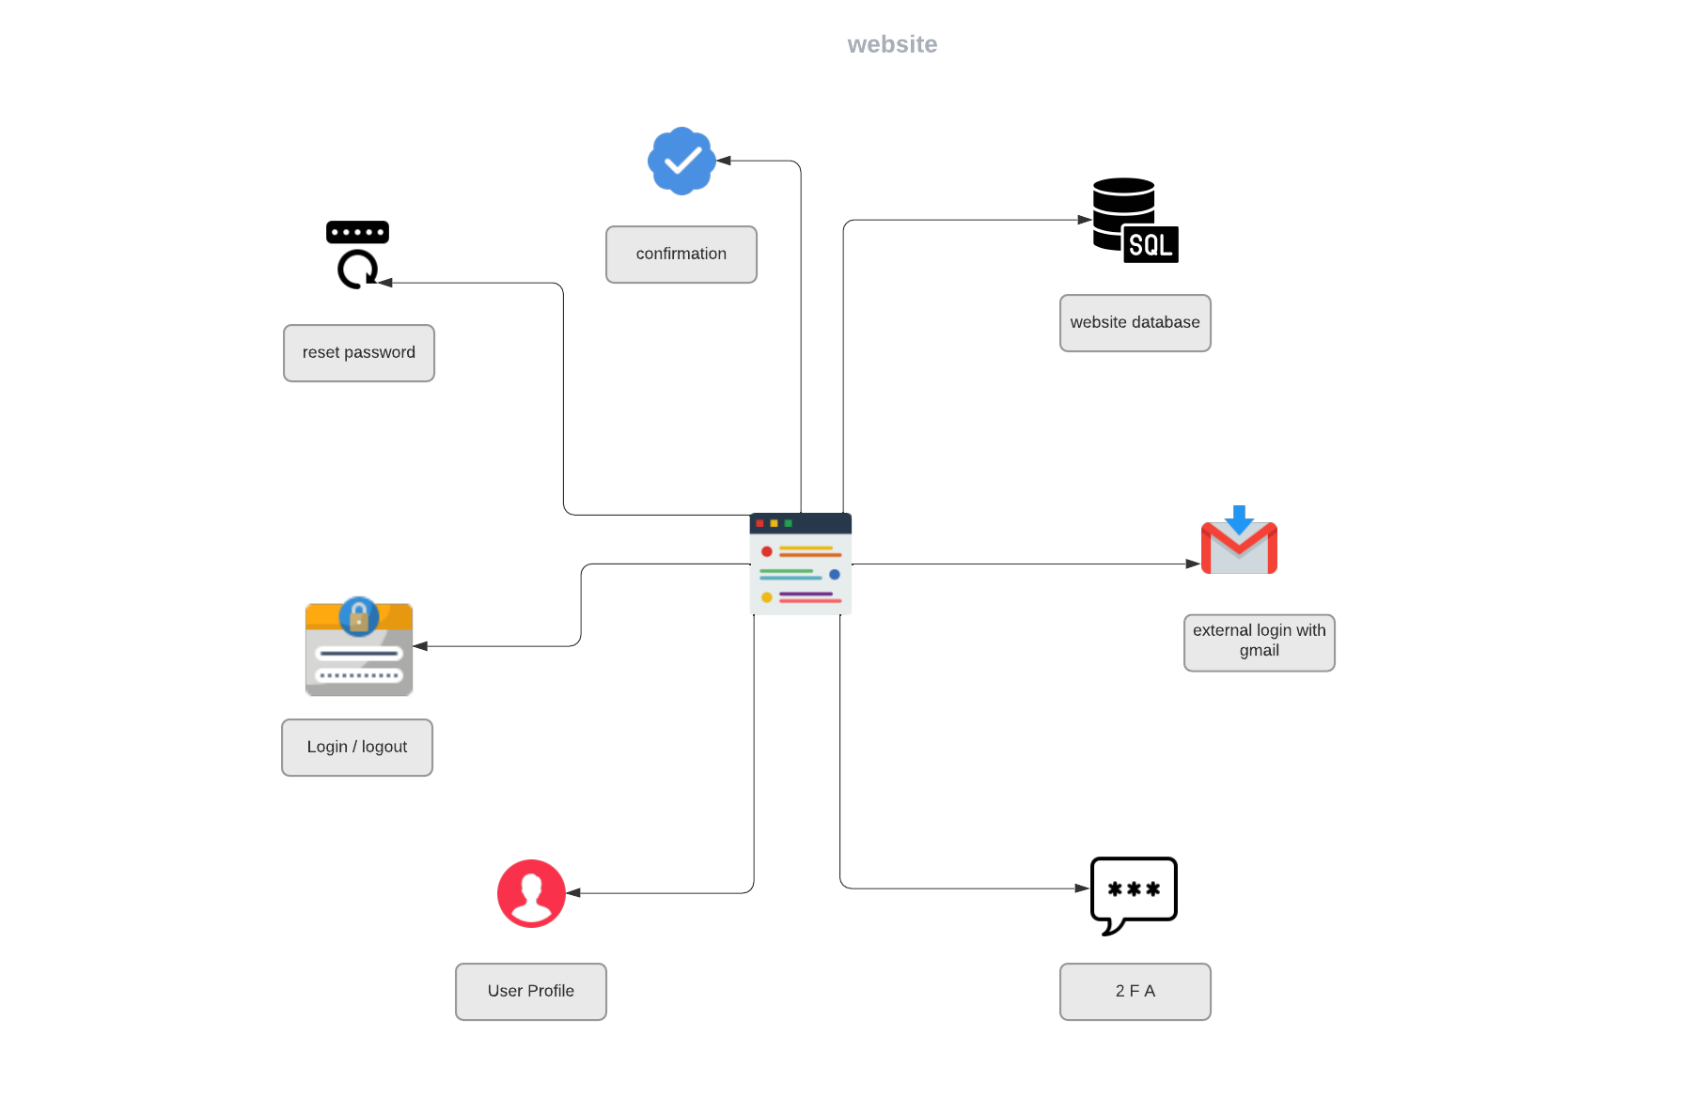

Slide 13
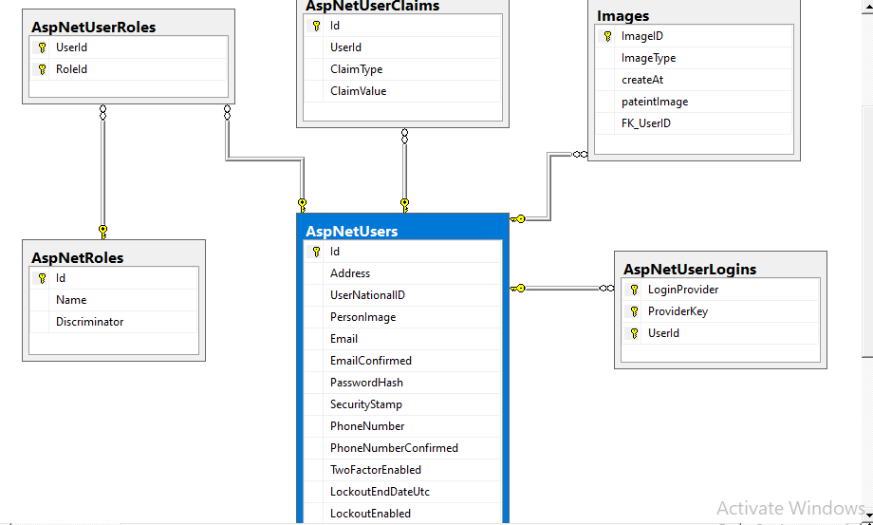

Slide 14
Deep 1

Slide 17
team members
Name | postion
Abdurhman Gamal Ahmed | Backend
mohdy | Doker image
deep learning | Ali Ahmed–adnan –omar ashraf

