Slide 1

Playfair Cipher
Group 04:
Yiyang
Zhongyang
Tan Xiao

Slide 2
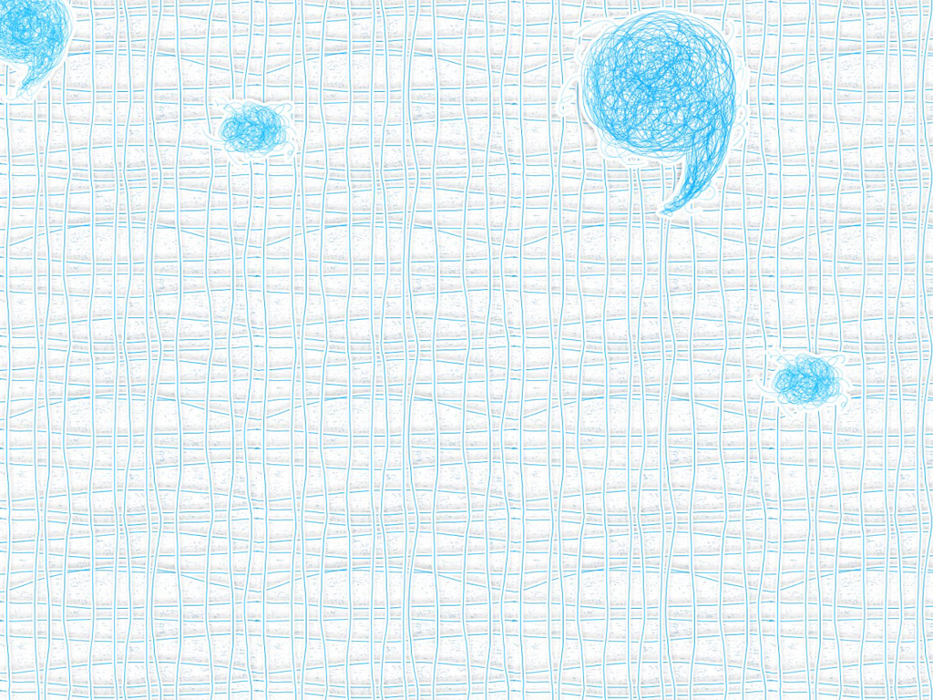
Introduction
simple transposition offering a relatively waek method of encryption
used by many countries during wartime
based around a 5x5 matrix
Notes:
The Playfair Cipher is a simple transposition cipher offering a relatively weak method of encryption. It was used by many countries during wartime and extensively by Britain in World War I, and Germany during World War 2. It is based around a 5x5 matrix, a copy of which is held by both communicating parties, into which 25 of the 26 letters of the alphabet (normally either j and i are represented by the same letter or x is ignored) are placed in a random fashion i.e.

Slide 3
T J A M U
E V G S Q
P Z B W D
I N O F Y
C H L R K
Notes:
The plaintext message is then created, stripped of any spaces or punctuation, any required substitutions take place (i.e. I for J, eliminating X etc.) and it is then grouped into pairs of letters. These letter pairs then undergo the encryption techniques

Slide 4
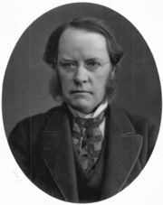
History
invented by Wheatstone on 26 March 1854,but it was promoted by Lord Playfair
Lord Playfair
Notes:
Despite its invention by Wheatstone, it became known as the Playfair cipher after Lord Playfair, who heavily promoted its use.
The first recorded description of the Playfair cipher was in a document signed by Wheatstone on 26 March 1854.

Slide 5
It was rejected by the British Foreign Office when it was developed
It was used for tactical purposes in the Second Boer and World War I by British
for the same purpose by the Australians and Germans during World War II
Notes:
It was rejected by the British Foreign Office when it was developed because of its perceived complexity. When Wheatstone offered to demonstrate that three out of four boys in a nearby school could learn to use it in 15 minutes, the Under Secretary of the Foreign Office responded, "That is very possible, but you could never teach it to attachés."
It was used for tactical purposes by British forces in the Second Boer War and in World War I and for the same purpose by the Australians and Germans during World War II. This was because Playfair is reasonably fast to use and requires no special equipment. A typical scenario for Playfair use would be to protect important but non-critical secrets during actual combat. By the time the enemy cryptanalysts could break the message, the information was useless to them.

Slide 6
Playfair is now regarded as insecure for any purpose because modern hand-held computers could easily break the cipher within seconds
The first published solution of the Playfair cipher was published in 1914
Notes:
Playfair is no longer used by military forces because of the advent of digital encryption devices. Playfair is now regarded as insecure for any purpose because modern hand-held computers could easily break the cipher within seconds.
The first published solution of the Playfair cipher was described in a 19-page pamphlet by Lieutenant Joseph O. Mauborgne, published in 1914.

Slide 7
How to use it?

Slide 8
Preparing the plaintext
Prepare specific information
E.g. Shi Sherry loves Heath Ledger
Choose encryption key
E.g. Sherry

Slide 9
All the letters should be written
in capital letter,
in pairs,
without punctuation,
All Js are replaced with Is.
→SH IS HE RR YL OV ES HE AT HL ED GE R

Slide 10
double letters which occur in a pair must be divided by an X or a Z.
E.g. LI TE RA LL Y→LI TE RA LX LY
→SH IS HE RX RY LO VE SH EA TH LE DG ER

Slide 11
Preparing the Key:
Alphabet Square
present with an alphabet square
5*5
No repeat letter
No Js
KEY: SHERRY→

Slide 12
3 Rules
letters appear on the same row： replace them with the letters to their immediate right respectively
letters appear on the same column： replace them with the letters immediately below respectively

Slide 13
not on the same row or column：
replace them with the letters on the same row respectively but at the other pair of corners of the rectangle defined by the original pair.
The order is important – the first encrypted letter of the pair is the one that lies on the same row as the first plaintext letter.

Slide 14
Plaintext: SH IS HE RX RY LO VE SH EA TH LE DG ER
S H E R Y
A B C D F
G I K L M
N O P Q T
U V W X Z

Slide 15
final ciphertext :
HE GH ER DR YS IQ WH
HE SC OY KR AL RY
HEGHERDRYSIQWHHESCOYKRALRY

Slide 16
Decipher
Shift up and left instead of down and right
Drop extra X
Locate any missing any “I”s that should be “J”s
Back into the original readable message

Slide 17
pros:
simple substitution ciphers do not work with it
it was once extremely popular on the battlefield
it doesn’t contain any complex mathematic or number theory
Frequency analysis can still be undertaken but on the 600 possible digraphs rather than the 26 possible monographs.
Notes:
好处 pros:
1.Simple substitution ciphers do not work with it, so it is harder to crack. In this method, it breaks the usual rules of letters arranging to form a word, like ‘th’, ‘ph’,’ea’ these letters are always together, but by Playfair, these letters are separated to other irrelevant-look letters that are not so easy to observe.
2.The simplicity and reliability of this primitive code-cracking method made it extremely popular on the battlefield.
3.It doesn’t contain any complex mathematic or number theory.
4. Frequency analysis can still be undertaken but on the 600 possible digraphs rather than the 26 possible monographs.

Slide 18
cons:
the frequency analysis of digraphs is still possible.
the Playfair cipher can be easily cracked if there is enough text
Easy to break nowadays
Notes:
坏处 cons:
1.The frequency analysis of digraphs is, anyway, possible.
2.Like most pre-modern era ciphers, the Playfair cipher can be easily cracked if there is enough text.
3.Nowadays, with the proper software, you could use a computer to discover the original text without knowing the cipher key. Some skilled cryptographists and puzzle experts can even break it with nothing more than pen and paper.

Slide 19
Bibliography
http://en.wikipedia.org/wiki/Playfair_cipher
http://simonsingh.net/The_Black_Chamber/playfaircipher.htm
http://www.braingle.com/brainteasers/codes/playfair.php
http://trumpetpower.com/Papers/Crypto/Playfair
http://rumkin.com/tools/cipher/playfair.php

